Slide 1
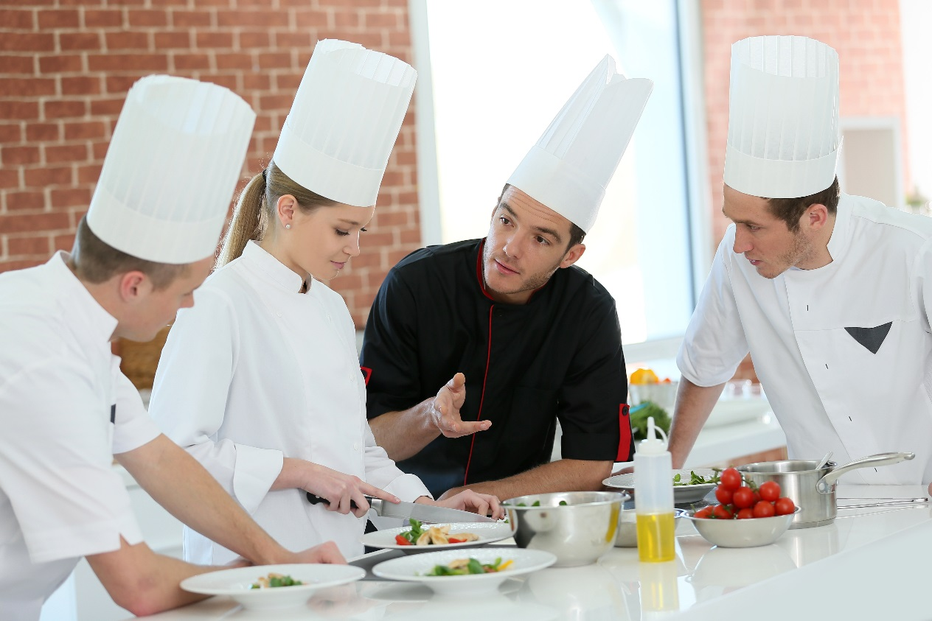
Alberta Food Safety Facts
PUB-0008-201806
CC BY-NC-SA 4.0
Notes:
This is the main PowerPoint file for Alberta Food Safety Facts. Please refer to the teacher resource kit for more information about incorporating games and activities into your lesson. Part 2 of this presentation (except for handwashing and hygiene) can be replaced with the Bingo game.
There are speaker notes throughout the presentation to help guide your lesson. Links to additional information are also provided.
This presentation holds a Creative Commons License: Attribution-NonCommercial-ShareAlike 4.0 International. Please view the next slide for more information.

Slide 2

©2018 Alberta Health Services, Knowledge Management.
This work is licensed under a Creative Commons Attribution-Non-commercial-Share Alike 4.0 International license. You are free to copy, distribute and adapt the work for non-commercial purposes, as long as you attribute the work to Alberta Health services and abide by the other licence terms. If you alter, transform, or build upon this work, you may distribute the resulting work only under the same, similar, or compatible licence. The licence does not apply to content for which the Alberta Health Services is not the copyright owner. To view a copy of this licence, see https://creativecommons.org/licenses/by-nc-sa/4.0/
This material is intended for general information only and is provided on an “as is”, “where is” basis. Although reasonable efforts were made to confirm the accuracy of the information, Alberta Health Services does not make any representation or warranty, express, implied or statutory, as to the accuracy, reliability, completeness, applicability or fitness for a particular purpose of such information. This material is not a substitute for the advice of a qualified health professional. Alberta Health Services expressly disclaims all liability for the use of these materials, and for any claims, actions, demands or suits arising from such use.
Notes:
Copyright and Disclaimer information

Slide 3
Alberta Food Safety Facts
Foodborne Illness
  what it is
  what makes people sick
  potentially hazardous foods
Keeping Food Safe
  controlling temperature
  separating foods
  cleaning and sanitizing
  hand washing and hygiene

Slide 4
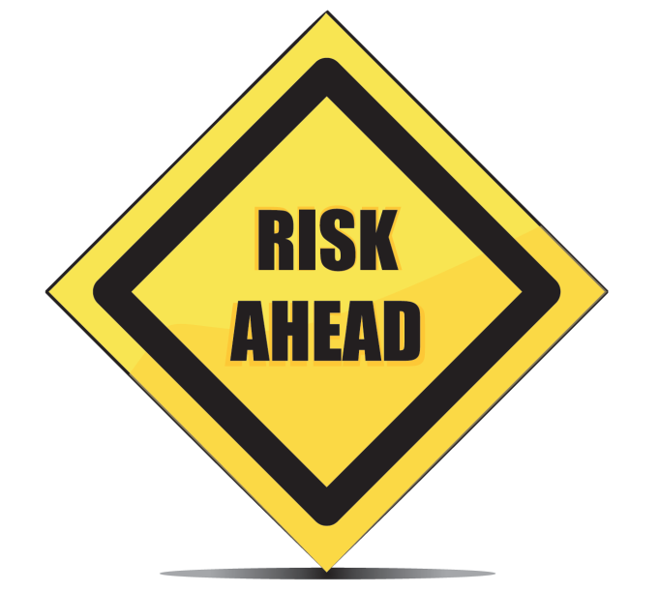
Safe Food Handling
Ultimate goal = make less people sick
Good food safety:
  understand hazards
  recognize risky situations
  know control measures
Notes:
The ultimate goal of safe food handling is to make less people sick with food borne illness, commonly known as food poisoning.
Whenever you work with food it is important to understand the possible dangers that can be associated with food, recognize risking situations and how to implement control measures to keep food safe.
This course will go through how food can become contaminated and how you can keep food safe. A lot of food safety is about creating a good “food safety culture”. When you understand and care about food safety, you can improve your own practices and communicate to others about food safety and ultimately improve food safety culture at home, school and work.
Additional Information:
What is Food Safety Culture? http://www1.agric.gov.ab.ca/$department/newslett.nsf/all/fss21996
Food Safety Culture: 5 simple things you can do everyday: http://www1.agric.gov.ab.ca/$department/newslett.nsf/all/fss24233

Slide 5
Part 1: Foodborne Illness
What it is
What Makes People Sick
Potentially Hazardous Foods

Slide 6
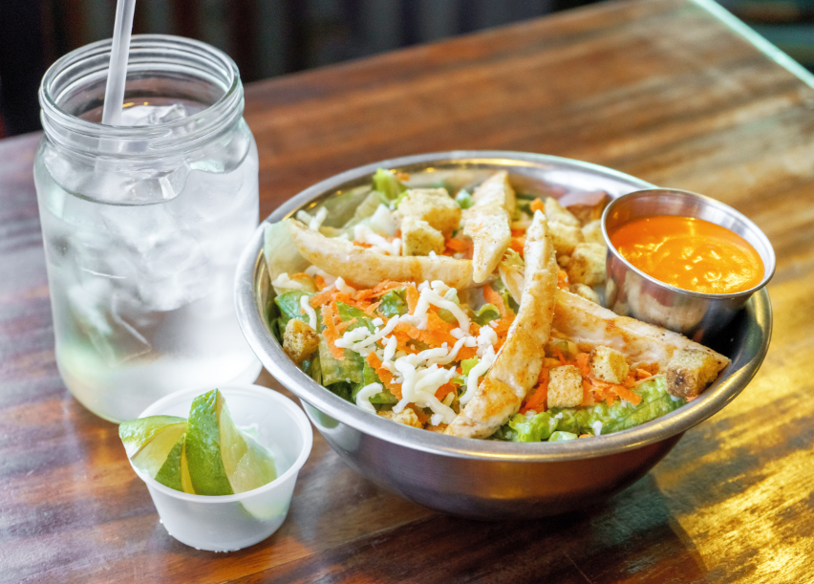
What is Foodborne Illness?
Any illness caused by consuming contaminated food or beverage.
Notes:
6
Foodborne illness is any illness caused by consuming contaminated food or beverage. Another common term for foodborne illness is food poisoning. It may be surprising to know that 46% of food poisoning cases are due to produce (1). The most food poisoning deaths are attributed to meat and poultry.
Additional Information:
Picture is of chicken salad with ice water and lime wedges. This shows that foodborne illness can occur from a variety of sources.
1. https://www.cdc.gov/foodborneburden/attribution-image.html#foodborne-illnesses

Slide 7

Foodborne Illness in Canada
1 in 8 will have a foodborne illness each year.
  over 11,000 hospitalizations
  over 200 deaths
Only 1 out of 350 cases is reported.
Over 4 million cases per year.
Notes:
7
Foodborne illness is more common than people think. It’s estimated that over 4 million Canadians get food poisoning every year and that there are over 200 deaths a year in Canada (1). People who get food poisoning often blame the last place where they ate out; however, people can poison themselves at home as well. The largest outbreaks happen when food is contaminated at the source such as in a farmer’s field or in a processing/manufacturing plant (2). Disease and death are most significant impacts, but there are also costs to Canada’s economy which are estimated at $12 billion per year, damages to a restaurant’s reputation and liability issues.
https://www.canada.ca/en/public-health/services/food-borne-illness-canada/yearly-food-borne-illness-estimates-canada.html
Don’t Blame Consumers: http://www.mygfsi.com/gfsifiles/newsletters/GFSI_Newsletter_April_2010.pdf

Slide 8
Many Factors are Involved
How long does it take to get sick?
How many germs do you have to consume to get sick?
How long are you sick for?
Notes:
It can take as little as one hour to get sick from foodborne illness or as long as 2-3 months. For example: the toxin/poison produced by Staphylococcus aureus can take as little as one hour to make you sick. Hepatitis A can take up to 50 days before you fall ill, and Listeria monocytogenes may take up to 3 months before symptoms occur. (1)
It can take as little as ten E. coli bacteria to cause an infection; where as it takes at least 1 million cells to cause a Clostridium perfringens food poisoning (2).
How long you are sick for and the symptoms you will feel depends on your immune system and the germ (also known as a pathogen) causing the illness. Some mild poisons make you sick for only a few hours whereas something like E coli can result in life-lasting health problems such as kidney disease. Every year, people die from foodborne illness and the associated health problems.
1.https://www.fda.gov/downloads/food/foodsafety/foodborneillness/foodborneillnessfoodbornepathogensnaturaltoxins/badbugbook/ucm297627.pdf
2. Find out more about foodborne illness organisms: http://edis.ifas.ufl.edu/fs127

Slide 9
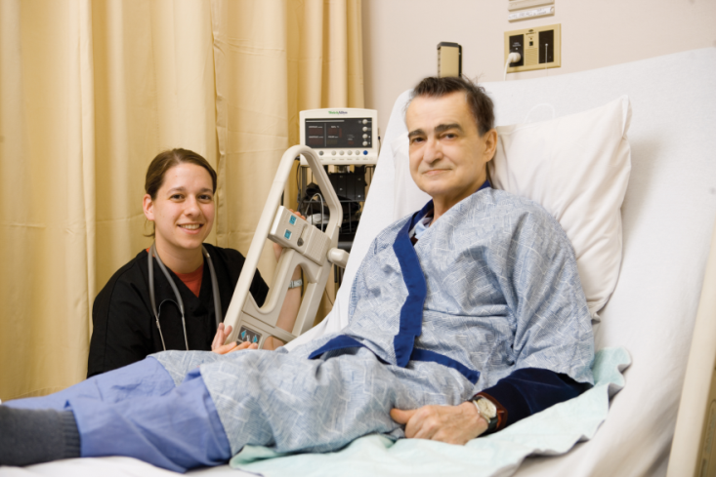
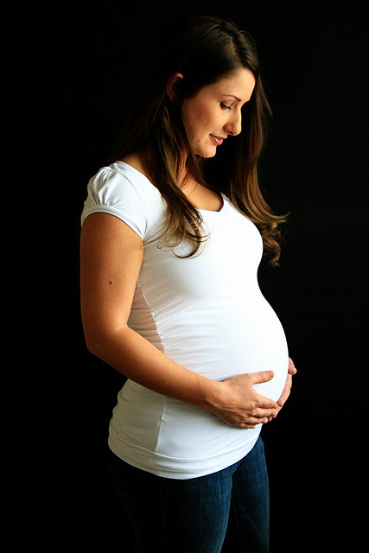

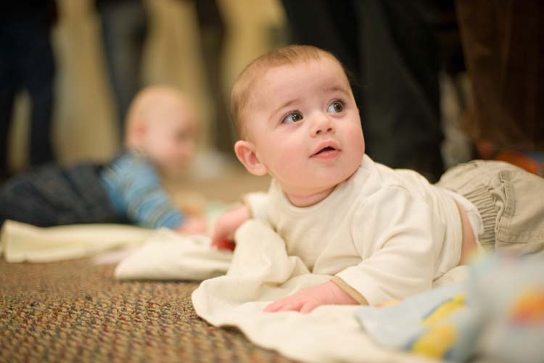
High Risk Populations
Notes:
Pregnant women, elderly, those with an underlying health condition (immunocompromised) and children aged 5 years and younger are more likely to become very sick or die from a foodborne illness. However, even healthy adults can experience severe symptoms and even death from foodborne illness.
Additional Information:
Food safety for vulnerable populations: https://www.canada.ca/en/health-canada/services/food-safety-vulnerable-populations/food-safety-vulnerable-populations.html

Slide 10
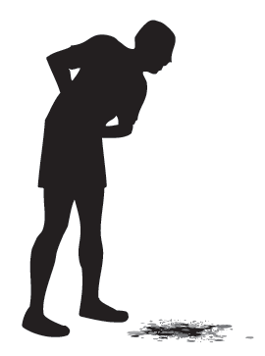
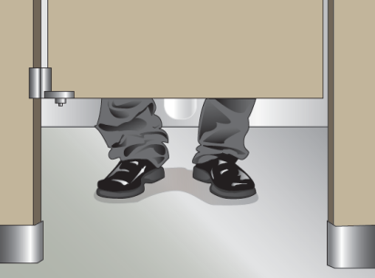
The Symptoms
stomach cramps
diarrhea
vomiting
nausea
fever / headache
body ache
Notes:
The common symptoms of foodborne illness include stomach cramps, diarrhea, vomiting, nausea, fever, headache and body ache. Some complications of foodborne illness are:
paralysis, organ failure and brain damage
septic arthritis
long lasting conditions such as Irritable Bowel Syndrome and Lactose Intolerance
miscarriages or stillborn babies for pregnant women
Additional Information:
Food Safety and You: https://www.canada.ca/en/health-canada/services/general-food-safety-tips/food-safety-you.html

Slide 11
What Makes People Sick

Slide 12
What Makes People Sick?
Chemical contamination
  poisonous substances not normally found in food
Physical contamination
  foreign objects
Biological contamination
  pathogens
Notes:
12
Foods can be contaminated with more than just pathogenic microorganisms. Foodborne illness can be classified into 3 categories based on the type of contaminant:
1. chemical – such as pesticides, cleaning agents, and metals leaching out of containers or surfaces
2. physical – which include foreign objects such as hair or plastic that end up in food
3. biological – pathogens (disease-causing microbes)

Slide 13
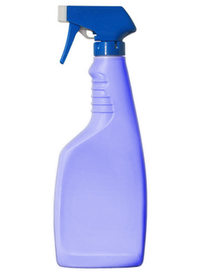
Chemical Contamination
What kind of chemicals are in a kitchen?
What are the common mistakes when using or storing chemicals?
Notes:
13
Question: What kind of chemicals are in a kitchen?
Answer:
dishwashing chemicals
floor cleaners
specific equipment cleaners, such as stainless steel equipment cleaner
dish soap
sanitizers, such as bleach
Question: What are the common mistakes when using or storing chemicals?
Answers:
storing chemicals near food
using incorrectly, such as not rinsing away the chemical with water
improper labelling or no labels (this can make people think that the chemical such as bleach is actually water)
using a chemical container to store food

Slide 14
Physical Contamination
Pieces of surfaces or equipment in kitchen
  glass, metal, plastic, wood
Items coming off of a food handler
  hair, artificial nail, band-aid, jewellery
Miscellaneous items
  thumbtacks, staples, toothpick, bag clip, etc.
Notes:
Physical foodborne illness refers to contamination of food by physical objects, which may cause illness or injury.
Question: What kinds of foreign objects might you find from these sources? (click ahead to show answers)
Answers:
Pieces of surfaces or equipment in the food establishment – glass, metal, plastic, wood.
Items coming off of a food handler – hair, artificial nail, bandage, jewellery.
Items in the kitchen – thumbtacks, staples, toothpick, bag clip, etc.
Reduce the risk of physical contamination of food by identifying and rectifying potential hazards. For example: covering light sources, removing jewellery when handling food and discarding packaging.

Slide 15
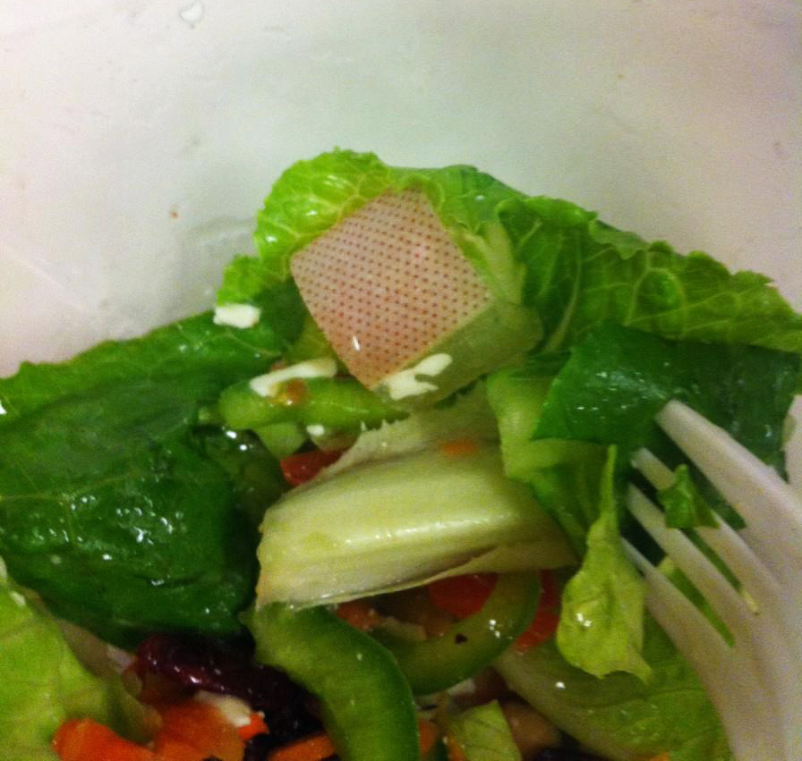
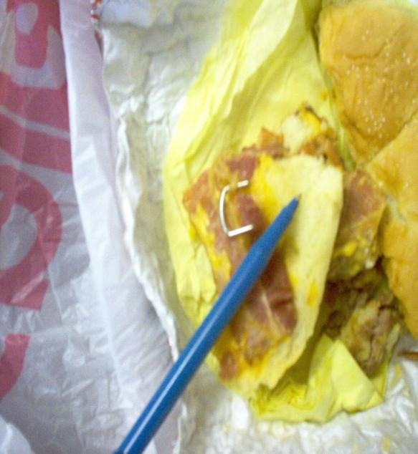

Physical Contamination
Notes:
Question: What physical hazards can you identify in these pictures?
Answers:
Bandage in food. To avoid this from happening, always wear a glove over a bandage when working with food.
Staple in food. To avoid this, make sure you are careful when opening packages, discard packaging immediately and inspect food before serving.
Broken wire mesh. To avoid this, inspect all equipment on a regular basis and discard broken equipment.

Slide 16
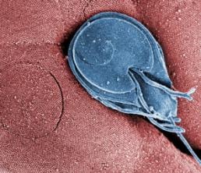
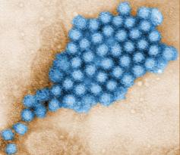
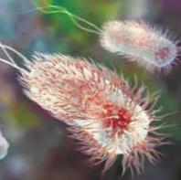
Biological Contamination
Pathogens are disease-causing microbes.
  includes bacteria, viruses, protozoa fungi, parasitic worms
You cannot tell if food is free of pathogens by look, smell or taste.
Notes:
16
The most common cause of foodborne illness is biological contamination. What is interesting to note is that only 1% of known germs are pathogens, meaning they can cause disease. The other 99% are not harmful or are even beneficial to humans, such as probiotic bacteria in yogurt.
There are various types of pathogens such as bacteria, viruses, protozoa, fungi and parasites. These pathogens don’t change the appearance, color or taste of food, so we often don’t realize that it is food that made us sick.

Slide 17
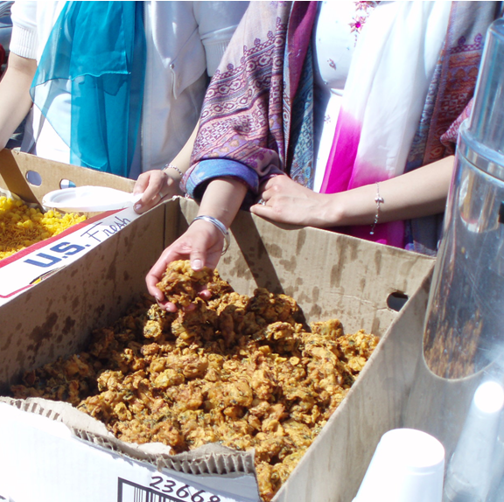
Pathogens Sources
people
raw food
  raw meat, fresh produce
animals & pests
  flies, mice, bugs
environment
  kitchen, garbage, filth
Notes:
Pathogens can enter the kitchen from a variety of sources but people are the most important source of pathogens in a kitchen. People can carry pathogens, such as Salmonella, in their intestinal tract or in their noses, throats or in infected cuts and boils. Other sources of pathogens include raw food, animals and pests, and the environment.

Slide 18
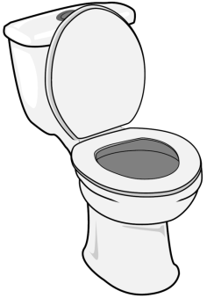

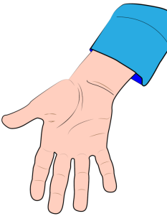

Pathogen Sources: Fecal – Oral Route
Notes:
The fecal-oral route is a common way of transferring pathogens to food and then to customers. This happens when food handlers do not wash their hands properly after using the toilet. Pathogens in feces from the food handler’s hands are transferred to the food and then to the customer.

Slide 19
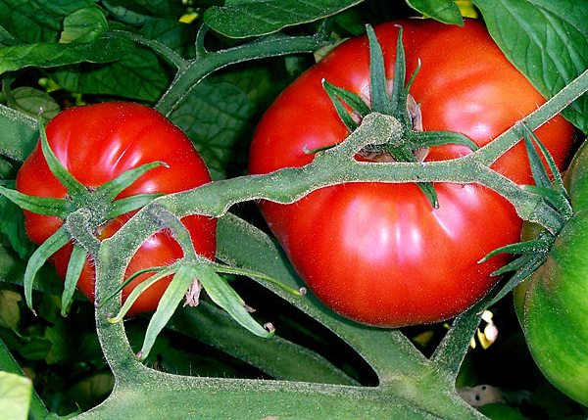
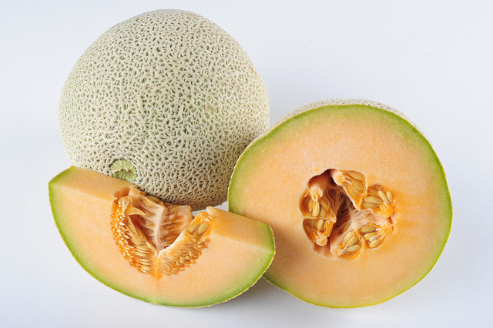
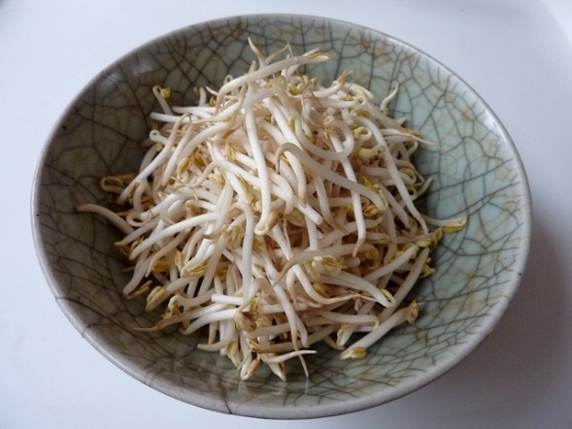
Pathogen Sources: Fruits and Vegetables
leafy greens
tomatoes
cantaloupes
sprouts
cucumbers
strawberries
green onions
Photo: kattebelletjeat@flickr.com
Photo: news21-usa@flickr.com
Notes:
Raw fruits and vegetables have been involved with many food poisoning outbreaks in North America over the years, causing thousands of illnesses and unfortunately some deaths (1). For example: an Hepatitis A outbreak at Chi-Chi’s made over 600 people ill. The outbreak was traced back to green onions (2). Another example is a huge outbreak related to Salmonella in cantaloupes whereby 261 poeple got sick and 3 people died (3).
The inside of fruits and vegetables are relatively safe but pathogens may be found in large numbers on the outside so wash fruits and vegetables before eating. Once fruits and vegetables are cut, keep refrigerated because bacteria can easily grow and multiply on the flesh (4).
https://www.cdc.gov/foodsafety/outbreaks/multistate-outbreaks/outbreaks-list.html
http://www.about-hepatitis.com/hepatitis_outbreaks/view/chi-chis-hepatitis-a-outbreak/#.WQpeAWnyuUk
http://www.about-salmonella.com/salmonella_outbreaks/view/kentucky-salmonella-outbreak-traced-to-cantaloupe/#.WQpfBWnyuUk
https://www.canada.ca/en/health-canada/services/food-safety-fruits-vegetables.html

Slide 20
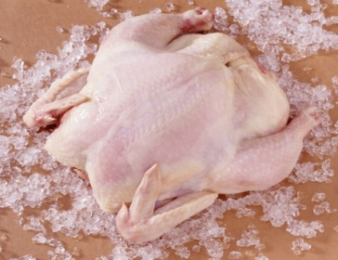
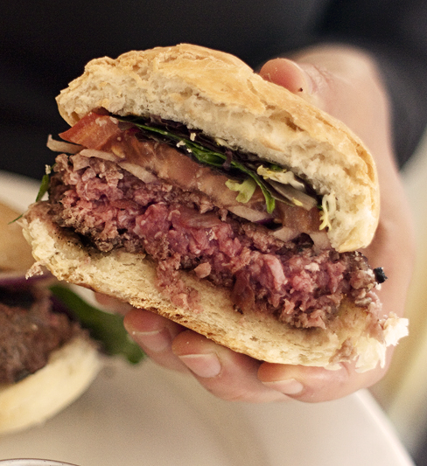
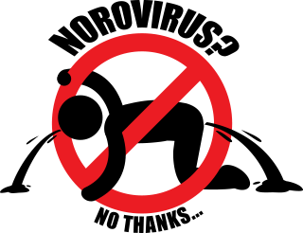
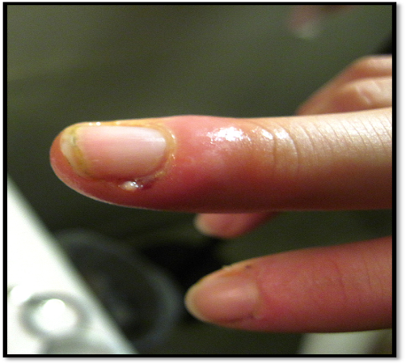
Common Pathogens
Salmonella
E. coli
Norovirus
Staphylococcus
Notes:
There are over 250 known foodborne illness pathogens. Some common pathogens are:
Salmonella, which often enters the kitchen through contaminated poultry.
E coli, which often enters the kitchen through contaminated meat.
Norovirus, which often enters the kitchen through a sick food handler.
Staphylococcus, which often enters the kitchen through a food handler with poor hygiene (such as coughing or sneezing into food) or one that has an infected cut or boil.
Additional Information:
CDC Foodborne Germs and Illnesses: https://www.cdc.gov/foodsafety/foodborne-germs.html

Slide 21
Potentially Hazardous Foods

Slide 22
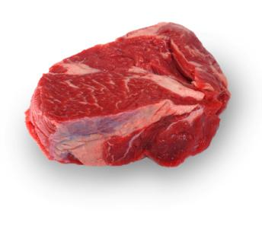
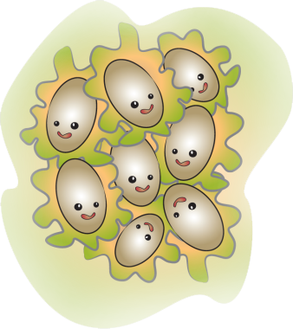
Potentially Hazardous Food
  Food that can support the growth of pathogenic bacteria.
  high in protein/carbs
  lots of moisture
  neutral to slightly acidic pH
Notes:
Potentially hazardous foods can support the growth of pathogens. We must control temperature when handling these types of foods so that bacteria don’t grow. These foods are high in protein or carbohydrates, have lots of moisture and have a neutral or slightly acidic pH.
Additional Information:
pH is a measure of acidity. The pH scale is from 0-14. Very acidic foods have a low pH; an example would be vinegar. Food handlers and processors sometimes adjust the pH of a food to make it less hazardous or shelf-stable; for example, adding enough vinegar to a food to pickle it will then allow the food to be stored safely at room temperature.

Slide 23
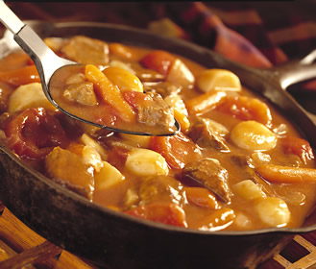
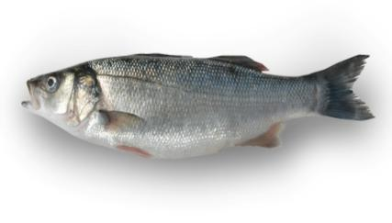
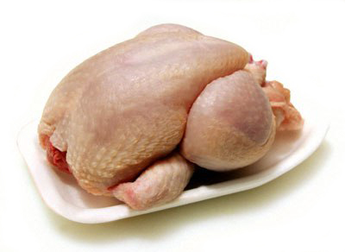
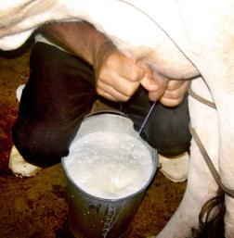
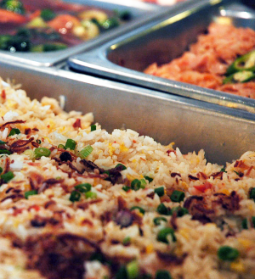

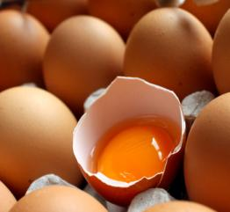
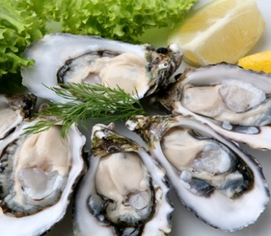
Potentially Hazardous Foods
Notes:
There are many different types of potentially hazardous foods such as meat, eggs, poultry, dairy, fish and shellfish, cream filled pastries, gravies, stews, soups, and even cooked vegetables & grains. When you aren’t sure if a food is potentially hazardous, it is best to always control the temperature of the food so that bacteria don’t grow quickly. This means keep food cold in the fridge at 4°C or colder or hot at 60°C or hotter.
Additional Information:
Cooked cereals (such as rice, pasta, oats) and cooked vegetables are soft, moist, nutrient-rich and easily support the growth of pathogens. Once cooked, these foods must be temperature controlled until served (hot or cold holding).

Slide 24
Part 2: Keeping Food Safe
Controlling Temperature
Separating Foods
Cleaning and Sanitizing
Hand Washing and Hygiene
Notes:
Instructor Note! As an alternative to showing most sections of Part 2 of this presentation, you can play bingo. Please refer to the kit for more information. The sections covered in Bingo are:
Controlling Temperature
Separating Foods
Cleaning and Sanitizing
* Hand Washing and Hygiene is not covered in Bingo

Slide 25
Controlling Temperature
Keep Hot Food HOT
Keep Cold Food COLD
Notes:
The most important point to remember about controlling temperature is to keep hot food hot and cold food cold.

Slide 26
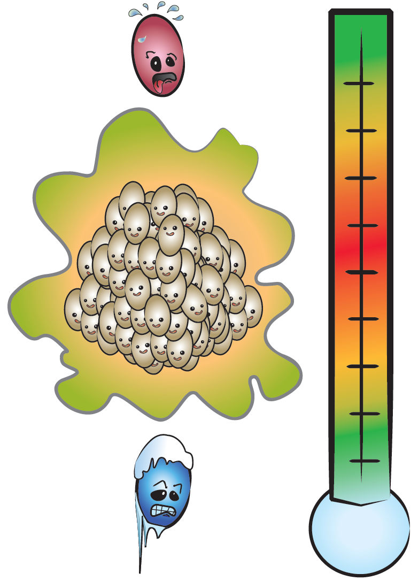

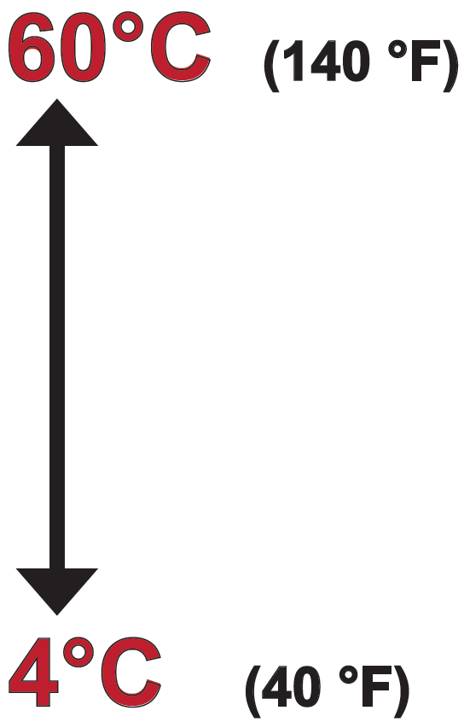
Temperature Danger Zone
Don’t leave potentially hazardous food in Danger Zone for more than 2 hours!
Notes:
When considering that hot food should be kept hot and cold food should be kept cold, it is important to know the Temperature Danger Zone which is the range of temperatures at which bacteria can multiply rapidly to make food unsafe in a short time period. To keep foods hot, keep them at or above 60°C so that bacteria don’t grow and to keep foods cold, keep them at or below 4°C so that bacterial growth is slowed down. The closer the food temperature is to the middle of the danger zone, the faster bacteria can multiply. Ideal temperatures for bacterial growth range from 30 – 45°C. At these temperatures, bacteria can divide into two every 20 minutes. Please note that kitchen temperature often reaches the middle of the danger zone.
Don’t leave potentially hazardous foods in the Danger Zone for more than 2 hours. Leaving food out for too long allows pathogens to multiply to dangerous levels.
Figure © AHS EPH

Slide 27
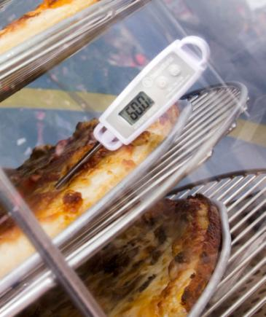
Keep Hot Foods Hot
Hot holding requires temperature ≥ 60°C.
Notes:
Hot holding is needed if cooked foods are not going to be served right away, but within a few hours, or for buffet style service. The food is kept hot on cooking equipment (e.g. stovetop, oven, etc) or foods are placed in hot holding equipment (e.g. steam table, pizza carousel, crock pot, rice warmer, etc). Foods that are being held hot for any period of time must be kept at 60°C (140°F) or hotter. Pathogens will not grow or multiply at this temperature. This means the food can be kept at 60°C for long periods of time but the food texture and taste may be impacted.
Photo: © AHS EPH

Slide 28
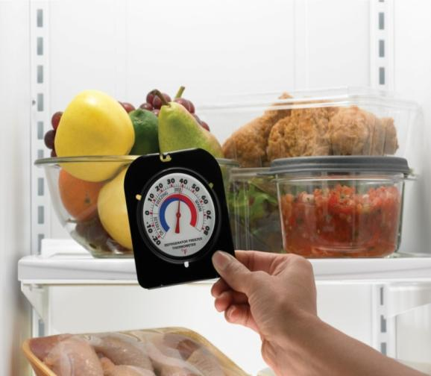
Keep Cold Foods Cold
Cold holding requires temperature ≤ 4°C.
Notes:
Refrigeration or cold holding of potentially hazardous foods will slow the growth of pathogenic bacteria or spoilage organisms that are present. However, cold temperatures do not usually kill microorganisms. This means that refrigerated foods can still spoil or become dangerous, it just takes longer. When using ice or refrigeration equipment for cold holding, the internal temperature of the food must be 4°C (40°F) or colder.
Additional Information:
http://befoodsafe.ca/be-food-safe/4-simple-steps-clean-separate-cook-chill/
http://befoodsafe.ca/wp-content/uploads/2013/08/chill.pdf

Slide 29
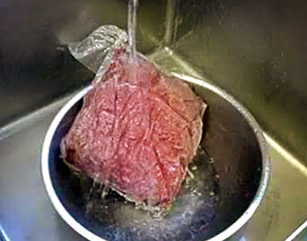
Thawing
Thawing requires temperature control!
refrigerator
cool, running water
cook from frozen
microwave
Notes:
Thawing frozen foods is a process that requires temperature control. Depending on the food size and shape, parts of the food can thaw quickly and be in the Danger Zone for long periods of time before the rest of the food is thawed. Foods should be thawed:
in the refrigerator at 4°C
under cool, running water in a sink
some frozen foods can be cooked from frozen (e.g. frozen hamburger patties, frozen vegetables, soup, etc.)
if a microwave is used to quickly thaw frozen foods, the food should be cooked immediately
Don’t thaw food at room temperature as the food will be in the Danger Zone for more than 2 hours.

Slide 30
Cook foods thoroughly.
Cooking
minimum internal temperature of 74°C for 15 seconds
Notes:
The cooking temperature of foods is important to kill pathogens. An internal cooking temperature of 74°C (165°F) for 15 seconds will kill pathogens in food.
Additional Information:
The above picture shows an undercooked hamburger. Pathogens such as E. coli may be found throughout the hamburger and could cause easily cause illness if eaten.
http://www.healthycanadians.gc.ca/eating-nutrition/healthy-eating-saine-alimentation/safety-salubrite/tips-conseils/cook-temperatures-cuisson-tbl-eng.php
http://befoodsafe.ca/be-food-safe/4-simple-steps-clean-separate-cook-chill/
http://befoodsafe.ca/wp-content/uploads/2013/08/cook.pdf

Slide 31
Color as an Indicator
1 out of 4 hamburger patties turn brown before fully cooked.
  Sometimes patties that are still pink inside may be safely cooked.
  “Juices run clear” and “piping hot” don’t mean the food is safe to eat.
Notes:
We often look at the color and texture of a food to ensure it is safely cooked but color is not a reliable indicator of safety. A large study done on several hundred hamburgers determined that one in four hamburgers turned brown before it was safely cooked to kill pathogens. (1)
Question:
How can we tell when food is done cooking? (Answer on next slide)
https://www.fsis.usda.gov/wps/wcm/connect/fsis-content/internet/main/topics/food-safety-education/get-answers/food-safety-fact-sheets/meat-preparation/color-of-cooked-ground-beef-as-it-relates-to-doneness/ct_index

Slide 32
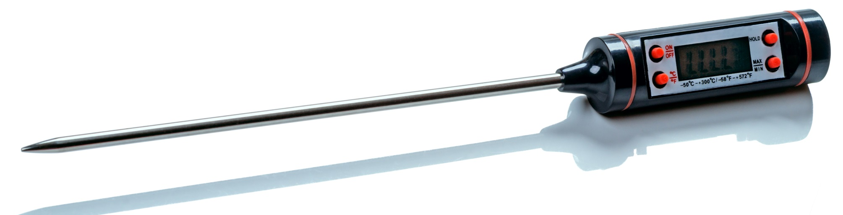
Thermometers
Thermometers are the only sure way to know if a food is safely cooked.
Measure inside the thickest part of the food.
Notes:
Answer (from previous slide):
Using a probe thermometer to measure internal temperatures is the only reliable way to know that a food is safely cooked. When using a probe thermometer, insert the probe into the thickest part of the food. The thickest part of the food will be the last to cook or the last to cool. Avoid parts of the food with large bones as this affects the temperature reading.
Additional Information:
Thermometer calibration: http://www.albertahealthservices.ca/assets/wf/eph/wf-eh-thermometer-calibration.pdf

Slide 33
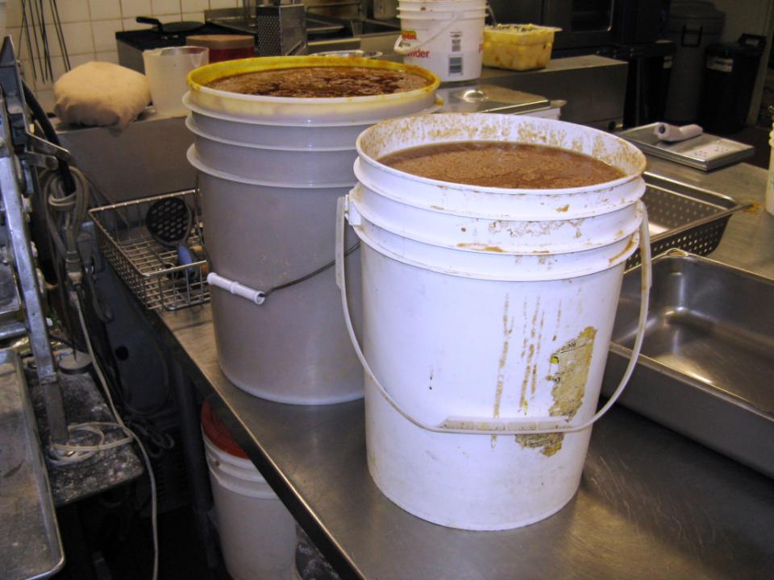
Cool Down Hot Foods Quickly
Improper cooling is a common cause of outbreaks.
Cool hot foods as quickly as possible to 4°C (within 4 – 6 hours).
The larger the volume of hot food, the longer it takes to cool.
Notes:
Not cooling foods properly is a common cause of foodborne illness outbreaks. It is important to cool foods as quickly as possible to limit the growth of pathogens as the food goes through the Danger Zone. The food handler should ensure that the food temperature reaches 4°C within 4 to 6 hours.
When cooling food, the larger the volume of hot food, the longer it takes to cool.

Slide 34
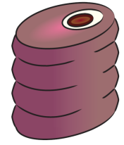
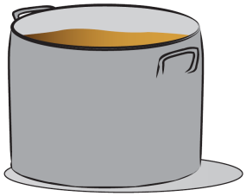



Cooling
Break food down into smaller volumes.
Notes:
To help food cool more quickly, reduce portion size, such as cutting a large roast into smaller pieces. For liquid foods such as stews, sauces or soups, transfer the foods to shallow metal pans and place in the fridge.
Additional Information:
Shallow = more surface area; metal = conducts heat quickly
Figures © AHS EPH

Slide 35
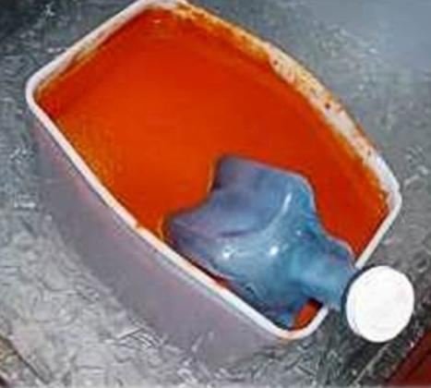
Cooling
use ice
  ice bath
  ice paddle
  ice as an ingredient
keep uncovered
stir
Notes:
Other ways to cool food more quickly are to use ice such as:
1. Fill a sink or large container with ice and water to make an ice bath.
2. Use an ice wand or ice paddle, which is a device that allows you to freeze water in the shape of a stirring tool.
3. Use ice as an ingredient.
Hot foods should not be covered while they are trying to cool as covering the food retains the heat. Any hot food will cool faster when it is stirred often.

Slide 36
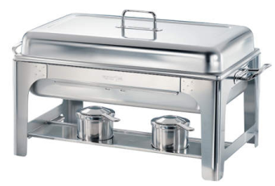
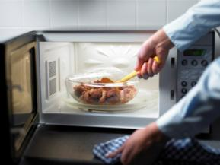
Reheat Cold Foods Quickly
Reheat foods to ≥ 74°C within 2 hours or less.
Do not use hot holding
equipment to reheat.
Only reheat leftovers one time.
Notes:
Left over food should be reheated to at least 74°C within 2 hours. Food should only be reheated one time to maintain food quality and reduce the risk of pathogen growth that can occur from frequent reheating and cooling.
Additional Information:
Top picture = a hot holding pan. This and similar equipment (e.g. steam table) should not be used to reheat food.
Bottom picture = you can use the microwave to quickly reheat cold foods.
http://www.healthycanadians.gc.ca/eating-nutrition/healthy-eating-saine-alimentation/safety-salubrite/tips-conseils/cook-temperatures-cuisson-tbl-eng.php
http://befoodsafe.ca/be-food-safe/4-simple-steps-clean-separate-cook-chill/
http://befoodsafe.ca/wp-content/uploads/2013/08/cook.pdf

Slide 37
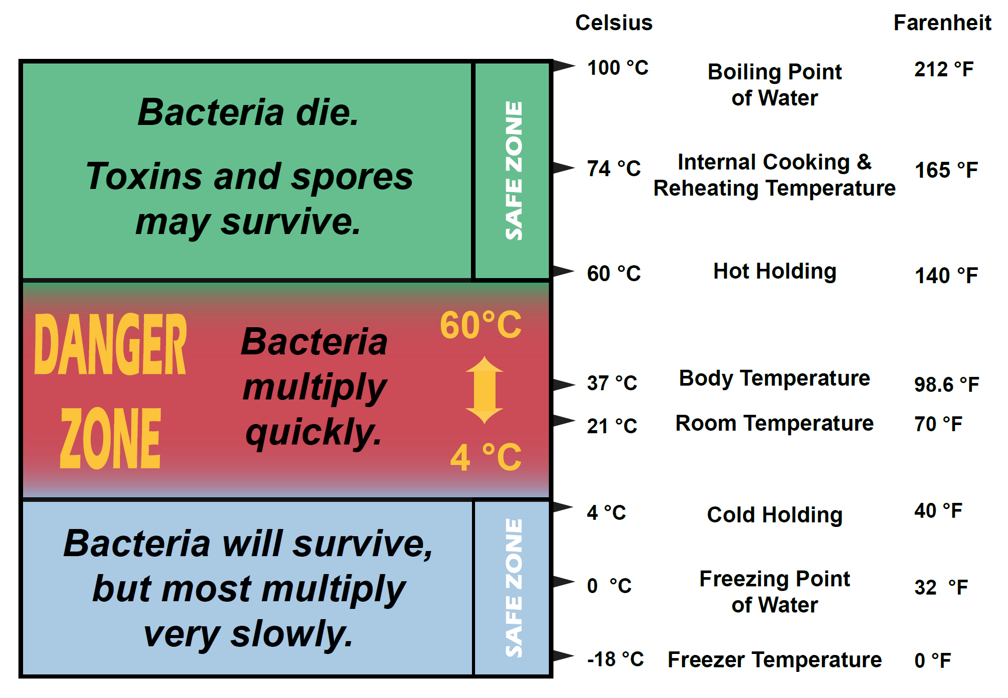
Temperature Summary
Notes:
Review:
Bacteria survive but grow slowly at 4°C or colder. This is a safe cold holding temperature for food.
Bacteria will multiply quickly between 4°C and 60°C, which is known as the Danger Zone. Potentially hazardous food should not be in the Danger Zone for more than 2 hours (cumulative time).
Bacteria stop growly at 60°C. This is a safe hot holding temperature for food.
Bacteria die at 74°C. This is a safe internal cooking temperature and reheating temperature.
Figure © AHS EPH

Slide 38
Separating Foods
Always Separate
Raw and Ready-to-eat Foods
Notes:
Separate raw ingredients from cooked and ready-to-eat foods. This should be done in food preparation and storage areas. Separating tasks in space and time will also help keep raw and ready to eat foods separate.

Slide 39
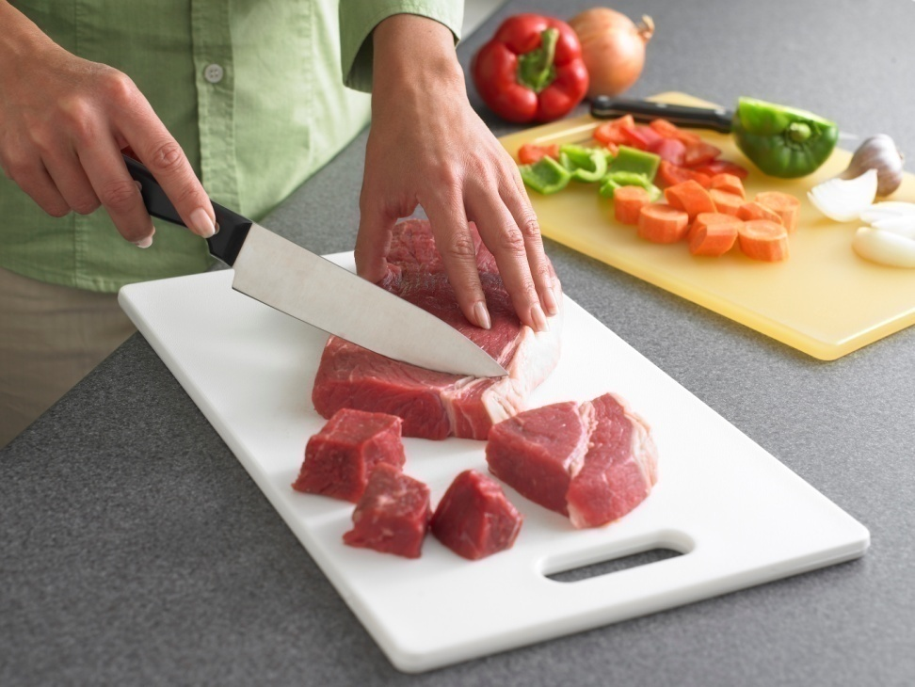
Cross-Contamination
The transfer of harmful substances or pathogens to food by:
hands
food-contact surfaces
raw meats or contaminated foods
cloths and sponges
Notes:
When we talk about properly separating foods we are ultimately trying to avoid cross contamination, which is the transfer of harmful substances or pathogens to food. The most common ways that cross contamination occur are:
by touching food with contaminated hands
not properly cleaning and sanitizing food contact surfaces or using surfaces for raw and cooked foods
by directly contaminating food through improper storage
by improperly using cleaning cloths and sponges
Question: What do you think is the most contaminated or germiest item in your house? (Answer is on the next slide).

Slide 40
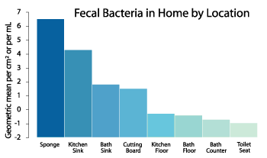
Contamination in the home
Notes:
Answer (to question on previous slide):
The dirty sponge is the germiest thing in your house. This is because sponges contain food, water and are kept warm. These conditions allow bacteria to grow quickly in the sponge. A dirty sponge contains more fecal bacteria than your kitchen sink, cutting board or even your toilet!
As you can see in the graph, the kitchen sink and cutting board also contain high numbers of fecal bacteria. Make sure to keep your sink and cutting board clean and dry.
Additional Information:
See page 9 of this document: http://www.nsf.org/newsroom_pdf/2011_NSF_Household_Germ_Study_exec-summary.pdf
Graph from Dr. Charles Gerba (“Dr. Germ”).
http://www.purebrush.com/UniArizona.php

Slide 41
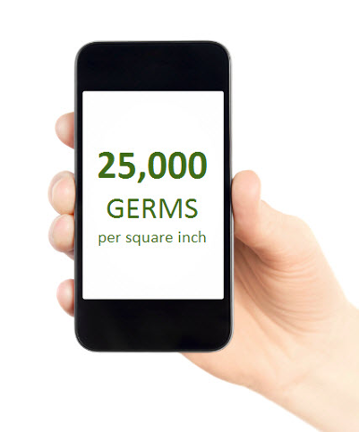
Cell Phones
A phone has 25,000 bacteria per square inch.
more than public toilets, bottoms of shoes, door knobs or kitchen counters
highest count is around “home” button
Source: Deb Canada
Notes:
A common source of contamination is cell phones. A phone has 25,000 bacteria per square inch so make sure to keep your phone away from the kitchen area and if you do check your phone, make sure to wash your hands after.
Additional Information:
Cell phone image from Deb Canada (with permission): http://info.debgroup.com/blog/bid/290652/your-mobile-phone-is-dirtier-than-you-think
25,000 bacteria stat source: Dr. Charles Gerba.

Slide 42
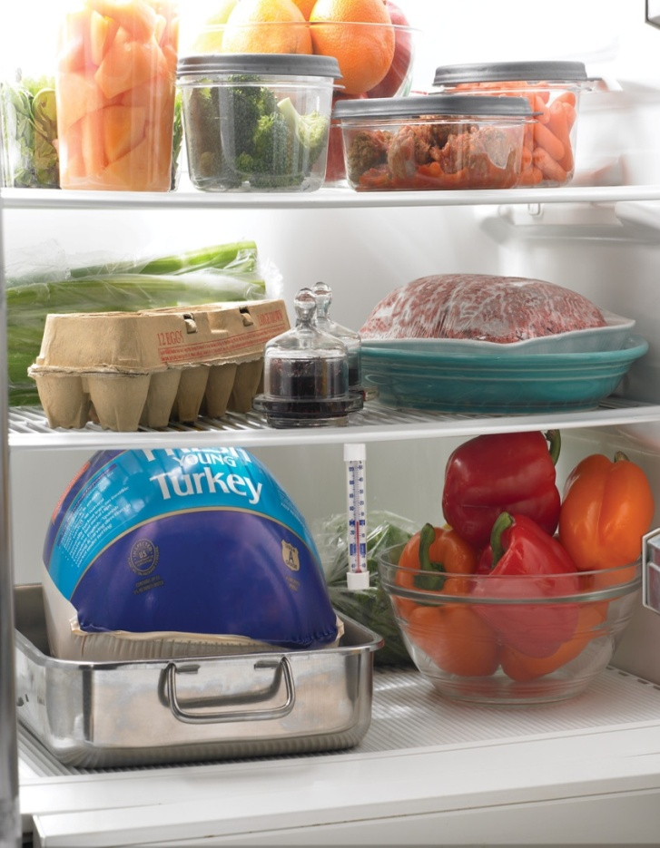
Preventing Cross-Contamination
wash hands
clean surfaces, dishes and equipment
keep cloths/sponges clean & sanitized
store food safely
What is wrong?
Notes:
Question #1: What are some ways we can prevent cross contamination in the kitchen?
Answers (will appear with clicks):
wash hands
clean surfaces, dishes and equipment
keep cloths/sponges clean and sanitized
store food safely with raw meat, poultry and seafood below other foods
Question #2 (will appear will click): What is wrong with the fridge picture?
Answer: raw beef is stored above peppers

Slide 43

Notes:
Now that we have talked about cross contamination, let’s look a few real examples.
This is a picture of cold chicken stored in a walk-in cooler.
Question: What is wrong in the picture and how would you fix it?
Answer: Ready-to-eat chicken is being stored right next to raw chicken. The raw chicken can contaminate the ready-to-eat chicken. To fix this problem: cover all foods and store raw chicken on the bottom shelf away from ready to eat food.
© AHS EPH

Slide 44

Notes:
This is a picture of raw meat stored in a walk-in cooler.
Question: What is wrong in the picture and how would you fix it?
Answer: Raw meat is being stored above the pop cans and in a cardboard box that allows it to easily leak. You could fix this by placing the raw meat in a food grade plastic container with a lid and placing on the bottom shelf, cleaning and sanitizing the entire area and discarding any potentially contaminated products.
© AHS EPH

Slide 45

Notes:
This picture is a close-up of the contamination caused by the leaking meat from the previous picture.
© AHS EPH

Slide 46

Notes:
Question: What is wrong in the picture and how would you fix it?
Answer: the chicken is at the wrong temperature (in the danger zone), is uncovered and easily contaminated. Also food handlers may easily contaminate their hands or clothing if trying to use the washroom and as the raw chicken is blocking the hand sink, they likely won’t wash their hands. To fix this, chicken must be covered and placed in the fridge and the washroom needs to be cleaned and sanitized.
Photo: © AHS EPH

Slide 47
Cleaning and Sanitizing
Always Keep Kitchens Clean and Sanitized

Slide 48

Cleaning and Sanitizing
All food contact surfaces and equipment must be:
  washed with warm, soapy water,
  rinsed,
  sanitized and
  air dried.
Notes:
All food contact surfaces and equipment must be:
1. washed with warm, soapy water
2. rinsed with warm water
3. sanitized, and then
4. air-dried
Question: What is sanitizing?
Answer: using a chemical, like bleach, or heat to reduce the number of pathogens on the surface to an acceptable level.

Slide 49


A Simple Sanitizing Solution
bleach and water
  ½ teaspoon of bleach in 1 L of water
Cloths should be stored in a bucket with sanitizing solution.
Notes:
You can easily make a cheap and effective sanitizer by adding ½ teaspoon of non-concentrated bleach to 1 liter of water. If you are using a reusable cloth to sanitize, it must be stored in a sanitizing solution in order to keep it from being a source of cross-contamination.

Slide 50

Dishwashing by Hand
Water temp = 45°C
Notes:
Dishwashing in a commercial kitchen requires the additional step of sanitizing which is followed up by air drying. There is typically a third sink to easily complete the steps for dishwashing.
Step #1: pre-rinse and pre-scrape to remove large amounts of debris, grease, burnt or baked on food
Step #2: wash in detergent and warm water
Step #3: rinse away soap with clean water
Step #4: sanitize using either a chemical or really hot water (77°C) for at least 2 minutes as the effectiveness of the sanitizer depends on the contact time
Step #5: air dry
Additional Information:
Change water frequently.
When suds disappear in the first compartment, refresh with clean water and soap.
When water in second compartment becomes sudsy, refresh with clean rinse water.
Use test strips to ensure concentration of chemical sanitizer in last compartment remains at minimum concentration (100 ppm for chlorine bleach, 200 ppm for quats).
Figure © AHS EPH

Slide 51

Machine Dishwashing
Sanitize dishes by heat.
Rinse water must reach 82°C for 10 seconds at the manifold or 71°C at the plate level.
Notes:
In a lot of food facilities, commercial dishwashers are used. These dishwashers sanitize dishes, unlike domestic dishwashers that typically just clean dishes. Commercial dishwashers will either use heat or a chemical to sanitize dishes.
The picture shows a high heat sanitizing dishwasher in which the rinse water reaches 82°C at the manifold or at least 71°C at the plate level.

Slide 52

Machine Dishwashing
Sanitize dishes by chemical.
200 ppm quats
100 ppm chlorine
Notes:
If a commercial dishwasher uses chemicals for sanitizing. It will likely use:
1. 200 ppm quats, which stands for quaternary ammonium compound, and is most common chemical in restaurants for surface cleaning, or
2. 100 ppm chlorine, which is the active ingredient in bleach and is what most restaurant dishwashers use to sanitize.
Note:
ppm – parts per million

Slide 53

Test Strips
Notes:
This is a picture of a chlorine test strip that was used to test the concentration of the bleach solution. This shows a concentration of 100 ppm (parts per million) which is the correct concentration.
When testing chemicals:
Be familiar with what each result means.
Ensure you have the correct test strips for the sanitizer you are using.
Know what the correct strength needs to be.
Photos: © AHS EPH

Slide 54
Hand Washing and Hygiene

Slide 55


When to Wash Hands
before preparing food
after handling raw meats, poultry, seafood
after clearing and wiping tables
after handling soiled objects such as money or garbage
after touching skin, a cut/sore, hair or face
after using the toilet
Notes:
There are many times when you need to wash your hands such as:
after using the toilet
before preparing food
after handling raw meats, poultry, seafood
after clearing and wiping tables
after handling soiled objects such as money or garbage
after touching skin, a cut/sore, hair or face
Question: Can you think of other times when you should wash your hands?

Slide 56
Did you Know…
15% of people don’t wash their hands after going to the bathroom.
93% of women do
77% of men do
Notes:
Did you know that 15% of people don’t wash their hands after going to the bathroom (1). This is a big concern when handling food as dirty hands can easily contaminate food.
1. American Society for Microbiology. "Public handwashing: More adults than ever (85 percent) observed washing hands in public restrooms." ScienceDaily. ScienceDaily, 14 September 2010. www.sciencedaily.com/releases/2010/09/100913111121.htm

Slide 57

Correct Handwashing Procedure
wet hands with warm water
use liquid soap
lather for 20 seconds
  use nailbrush
rinse
dry hands with paper towel
This procedure takes a minimum of 20 seconds.
Notes:
To wash your hands:
Wet hands with warm water. Warm water allows the soap to lather.
Apply and lather soap for 20 seconds. Use hand soap. There is no need for antibacterial soap as it is not more effective than regular hand soap.
Rinse away soap with clean warm water.
Use paper towel to dry hands.
Instructor Note:
This is a good opportunity to show a handwashing video and/or complete the Glo-Germ activity. Please consult the Alberta Food Safety Facts – Teacher Resource Kit for options.
Photo: © AHS EPH

Slide 58

Instant Hand Sanitizer
Notes:
Hand sanitizer is very popular and can be a good alternative to warm water and soap in some settings. It does not belong in a kitchen though as it doesn’t work on hands that are dirty, wet or greasy. In order for hand sanitizer to work, your hands must not be visibly soiled and you must apply it properly.
© AHS EPH

Slide 59

Personal Hygiene
Notes:
Hygiene is critical as food handlers are a common source of contamination. When you work with food you should be healthy and clean, and wear clean clothing or a clean apron.

Slide 60



Fingernails
borispumps@flickr.com
Notes:
Keep fingernails short, trimmed and clean.
Do not wear jewellery, nail polish or fake nails.

Slide 61




Hair Control 47
Notes:
Hair must be controlled. At a minimum, long hair should be up in a pony tail. A cap or a hair net can also be used but is not required.
Question: How many hairs do we lose per day from our head?
Answer: 50-100 (1).
1. https://www.aad.org/public/skin-hair-nails/hair-care/hair-loss-vs-hair-shedding

Slide 62

Notes:
Question: What is wrong in this picture?
Answer:
dirty apron (likely from wiping hands on apron)
garbage too close to food and food contact surfaces
cut/boil on arm
dirty food contact surfaces and floor
Photo: © AHS EPH

Slide 63
If you are Vomiting or Have Diarrhea…
Do not prepare or handle food for others for at least 48 hours after your symptoms stop!
Notes:
Part of good personal hygiene is not working with food when you are sick, especially when you are vomiting or have diarrhea. This is because you can easily spread your illness through the fecal-oral route. It is advised that you don’t prepare or serve food for at least 48 hours after your symptoms stop.

Slide 64

Cough or Sneeze into your Sleeve
Staphylococcus
bacteria
Notes:
Even when you are not sick, you can contaminate food with germs that you carry all the time including Staphylococcus bacteria, which is part of some people’s natural flora, so make sure to always cough or sneeze into your sleeve. If you do contaminate your hands, wash them right away.
Note: This is a good opportunity to watch the video: Why don’t we do it in our sleeves. Please see the Alberta Food Safety Facts – Teacher Resource Kit for more information.

Slide 65
Recap – Foodborne Illness
FBI can be caused by biological, physical and chemical contamination.
FBI can cause severe illness and even death.
There are many sources of pathogens including people, raw foods, pests and the environment.
Common ways pathogens are spread are through the fecal oral route and cross contamination.
Notes:
FBI – Foodborne Illness

Slide 66
Recap – Keeping Food Safe
To prevent foodborne illness we should:
keep food out of the Danger Zone
store foods at 4°C or colder, or 60°C or warmer
avoid cross contamination
cool and reheat foods quickly
cook foods thoroughly
clean and sanitize dishes, counters and equipment
wash hands
have good personal hygiene

Slide 67
Contact
Northern Alberta
Northzone.environmentalhealth@ahs.ca
Edmonton and Area
Edmontonzone.environmentalhealth@ahs.ca
Central Alberta
Centralzone.environmentalhealth@ahs.ca
Calgary, Banff and Area
Calgaryzone.environmentalhealth@ahs.ca
Southern Zone
Southzone.environmentalhealth@ahs.ca

Slide 68

www.ahs.ca/eph
Notes:
Environmental Public Health has a website. Here you can find:
restaurant inspection findings
closures, such as a restaurant being closed for a mouse infestation
more resources for safely working with food
additional course information such as courses for becoming certified in food sanitation and hygiene or basic food safety training which provides a certificate that you can print immediately after completing the course online

Slide 69

Restaurant Inspections
Notes:
Here is an example of a restaurant inspection.

Slide 70



Mobile Version
Notes:
The website is mobile friendly – no app required!

