Slide 1
Healthy Eating Environment:
A Call to Action
The Alberta Coalition for PrevenTION and Control of Vascular Disease (ACTION) Network
Adapted from Nutrition Services
Health Eating Environment: Healthy Eating Starts Here Steps to a Healthier You 2014

Slide 2
Objectives
By the end of this presentation, you will be able to:
List / identify how the environment impacts food choices
Identify strategies to improve eating environments to promote health
Describe the importance of advocating for healthy eating environments

Slide 3
Overview
What is eating healthy?
What prevents us from healthy eating?
What is a healthy eating environment?
How does the environment impact healthy eating?
Challenges and solutions to healthy eating
Will advocacy for healthy public policy have an impact?

Slide 4
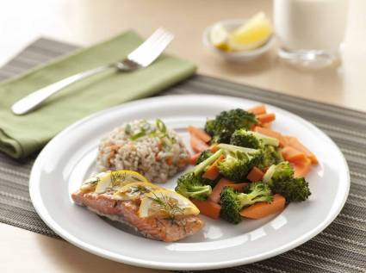
What is Healthy Eating?
Healthy Eating:
A way of eating that
emphasizes
healthy food choices,
variety and portion sizes
consistent with
Canada’s Food Guide.

Slide 5
What prevents us from
healthy eating?
Notes:
5

Slide 6
What Prevents Us From Healthy Eating?
Many people think that individuals are solely responsible for their own eating behaviours.
However, evidence shows that the environment plays a part in what, where, when and how we eat.
“We can only resist the food environment so long before giving into temptation.” (Curitti, 2011)

Slide 7
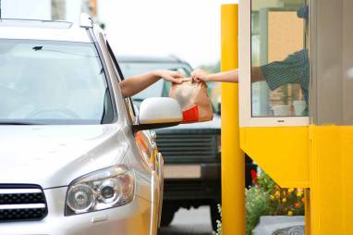
What Prevents Us From Healthy Eating?
Common reasons:
Increasing variety of
food choices
Increasing portion sizes
Subconscious / automatic eating

Slide 8


What Prevents Us From Healthy Eating?
Common reasons:
Food prices
Celebrations and holidays

Slide 9
What is a Healthy Eating Environment?
Healthy Eating Environment
  is a setting which makes choosing healthy eating easy for everyone. This includes:
  Having leadership and organizational values that support healthy eating
  Physical spaces that provide a place to eat, water fountains, food facilities, etc.
  Having healthy food options available at all times

Slide 10
Types of Environments

Slide 11
Types of Environments
Environment influences our choices
We can have control over some factors in our environments

Slide 12
Types of Environments
There are some factors in
our environments that we
have less control over
It is important to be aware of these factors so we
can find ways to manage them

Slide 13
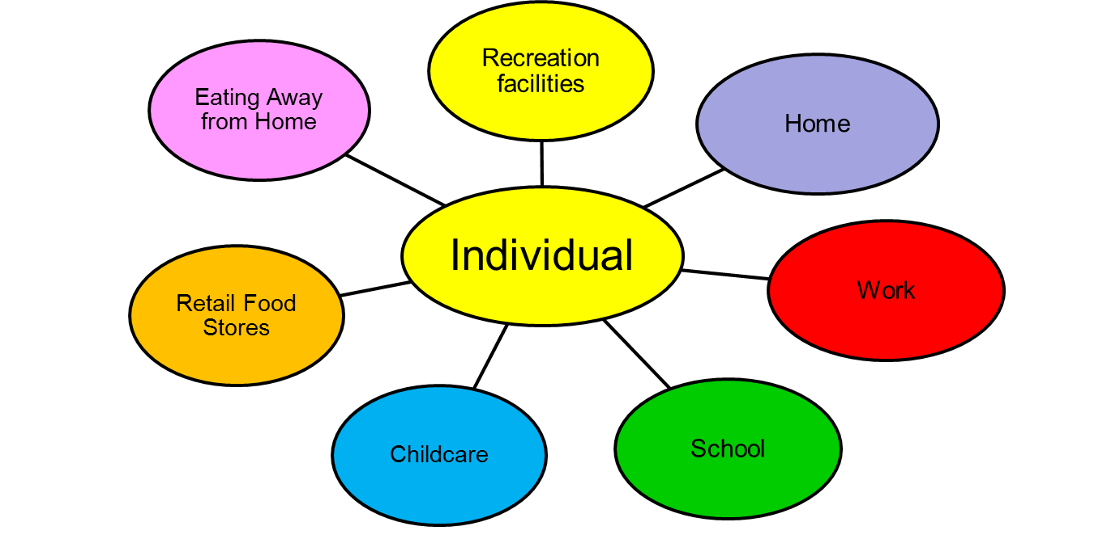
Environments Affecting Food Choices

Slide 14
Healthy Eating at Recreation Facilities
Recreation facilities are often the cornerstone of many communities.
  Activities
  Gatherings/ celebrations
Food is offered in
  Vending machine
  Cafeterias
  Activity programs
  Catering/ special events

Slide 15
Challenges to Healthy Eating at Recreation Facilities
Eating choices are influenced by:
Catering menus for meetings and parties
Food available in vending machines, cafeteria and concession stands
Foods offered for community or promotion events
Food rewards
Food offered for bagged day camp lunches or snacks

Slide 16
Solutions for Healthy Eating at Recreation Facilities
Recreation centres can offer healthy
foods and beverages.
Alberta Nutrition Guidelines for
Children and Youth: A childcare,
school and recreation/community
centre resource manual
http://www.healthyalberta.com/NutritionGuidelines-Sept2012.pdf

Slide 17

Ask venders for healthy food and drink options in healthy portions (vending machines, cafeterias, concession)
Offer non-food rewards or giveaways
Promote healthy eating at programs or events
Offer healthy food choices at community or promotional events
Ask for healthy food and drinks options from caterers
Ask for appliances (fridge, microwave) and an eating area (lunch room) to help support staff with healthy eating
Advocate for a healthy food environment policy at your facility

Slide 18

Challenges to Healthy Eating at Work
Employed Canadians
spend at least 60% of
their waking hours at
work
Eating choices are
influenced by:
Social norms and cues
Food availability
Shift work

Slide 19

Challenges to Healthy Eating at Work
Eating choices are influenced by:
Food based celebrations/rewards
Catered meetings and events
Stressful work environment
Vending machines, convenience stores, cafeterias

Slide 20

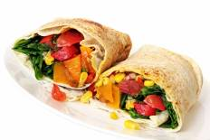
Solutions for Healthy Eating at Work
Decide if food is needed at each meeting / gathering and if so choose healthy options
Ask for healthy options in cafeterias / vending machines
Start a worksite health promotion program
Notes:
20

Slide 21

Solutions for Healthy Eating at Work
Ask for appliances (fridge, microwave) and an eating area (lunch room)
to help support healthy eating
Ask for support from co-workers and
management
Notes:
21

Slide 22
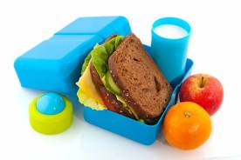

Solutions for Healthy Eating at Work
Bring your own meals
Keep a supply of healthy foods at work
Take meal and rest breaks
Drink water or other healthy drinks
Notes:
22

Slide 23


Challenges to Healthy Eating at School
Amount of time to eat
Available food choices

Slide 24

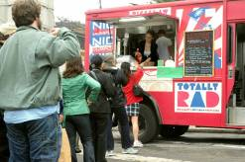
Challenges to Healthy Eating at School
Vending machines
Pricing
Location of convenience stores, fast food restaurants, etc.
Fundraisers / special events

Slide 25
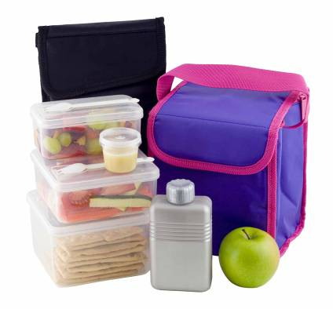
Solutions for Healthy Eating at School
Students can
bring healthy lunches
and snacks from home
Notes:
25

Slide 26

Solutions for Healthy Eating at School
Schools can decide to
offer healthy food and
beverages for special
food days, sports days,
tournaments and
classroom celebrations
Notes:
26

Slide 27
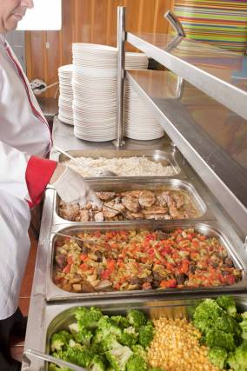
Solutions for Healthy Eating at School
Resources to assist with changing the school
environment are found at
www.healthyeatingstartshere.ca
Notes:
27

Slide 28

Challenges to Healthy Eating at Child Care
Menu variety
Mealtime environment
Role modeling

Slide 29

Challenges to Healthy Eating at Child Care
Fundraisers/ Special events
Unsupportive posters, books, displays

Slide 30
Solutions for Healthy Eating at Child Care
Develop or encourage a healthy eating policy
-See Alberta Nutrition Guidelines for Children and Youth for directions on how to create a policy
Supportive posters, books and visual displays

Slide 31

Solutions for Healthy Eating at Child Care
Include healthy nutrition messages as part of program planning and activities
Follow the division of responsibility (feeding relationship- you decide what and when, the child decides how much)

Slide 32
Advocate for Healthy Eating Environments
Unhealthy eating is the leading cause for premature death and disability in Canada
  Estimated 864,00 years of life lost in 2010
  Inadequate vegetable & fruit in our diets is a significant contributor to risk of chronic disease
Statistics Source: Global Burden of Disease Study 2010 http://www.healthmetricsandevaluation.org/gbd/visualizations/gbd-arrow-diagram
Notes:
32

Slide 33
Advocate for Healthy Eating Environments
Vascular Risk Factor | Years of Life Lost | Years of Disability (Disability Adjusted Life Years) | Risk for Premature Death Ranking | Risk for Disability Ranking
Unhealthy Diet | 864034 | 1047653 | 1st | 1st
Inadequate Fruit & Vegetable Intake | 405946 | 475120 | 1st rank (Sub category) | 1st rank (Sub category)
Tobacco Use | 754083 | 915628 | 2nd | 2nd
Obesity | 480352 | 794956 | 4th | 3rd
Physical Inactivity | 350125 | 443108 | 5th | 5th
Notes:
33

Slide 34
Advocate for Healthy Eating Environments
Policies in Alberta encouraging healthy work places and child/youth settings are voluntary
  This has resulted in sporadic implementation in facilities such as daycares, schools, worksites and recreation facilities.
  If we advocate for these programs, policies may be more comprehensively implemented
Notes:
34

Slide 35
Call to Action
Ensure organizations you belong to have policies to promote healthy eating
An organized strong advocacy approach could result in implementation of comprehensive policies supporting healthy eating environments
Notes:
35

Slide 36
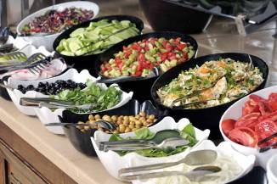
Summary
The environment plays a part in what, where, when and how much we eat.
Healthy eating environments make the healthy choice, the easy choice – for everyone.
You can make a difference and impact healthy eating environments in organizations you belong to
Notes:
36

Slide 37
Resources
Eat Smart Meet Smart- How to Plan and Host Healthy Meetings, Events and Conferences
Eating Well with Canada’s Food Guide
Alberta Nutrition Guidelines for Adults
Alberta Nutrition Guidelines for Children and Youth
AHS Healthy Eating Starts Here: http://www.albertahealthservices.ca/5602.asp
AHS Nutrition Resources for Schools: http://www.albertahealthservices.ca/2925.asp
Healthy Eating Environment in AHS: http://www.albertahealthservices.ca/5234.asp

Slide 38
Questions?
Notes:
38
References:
Alberta Community/Public Health Nutritionists Food Security Subcommittee and Dietitians of Canada, Alberta and the Territories Region. Cost of eating in Alberta, 2008 [Online]. 2008 [cited 2009 Sep 22]. Available from: http://www.calgaryhealthregion.ca/programs/nutrition/pdf/Cost_of_Eating_in_Alberta_2008.pdf.
Alberta Health and Wellness. Alberta nutrition guidelines for children and youth: a childcare, school, and recreation/community centre resource manual [Online]. Government of Alberta; 2008 [cited 2012 Mar 21]. Available from: http://www.healthyalberta.ca/Documents/AB_Nutri_Guidelines_2008%281%29.pdf.
Baumeister RF, Vohs KD, Tice DM. The Strength Model of Self-Control. Psychol Sci. 2007;16(6):351.
Block JP, Chandra A, McManus KD, Willett WC. Point-of-purchase price and education intervention to reduce consumption of sugary soft drinks. Am J Public Health. 2010;100:1427 1433.
Bushnik T. Child care in Canada. Ottawa, ON: Statistics Canada; 2006. 99 p. Report No.: Catalogue no. 89-599-MIE.
Canadian Council of Food and Nutrition (CCFN). Tracking Nutrition Trends VII. Woodbridge, Ontario: CCFN; 2008.
Chandon P, Wansink B. The biasing health halos of fast-food restaurant health claims: Lower calorie estimates and higher side-dish consumption intentions. J Consumer Res. 2007;34:301-314.
Cohen, DA. Neurophysiological pathways to obesity: below awareness and beyond individual control. Diabetes. 2008;57:1768-1773.
Cohen, DA, Farley TA. Eating as an automatic behavior. Prev.Chronic.Dis. 2008 Jan; 5(1):A23.
Cudlow, C. Mindless eating is the easiest way to lost weight: Brian wansink coaching session [Internet] . 2012 [cited 2012 Mar 21)]. Available from: http://curtisludlow.com/easiest-way-to-lose-weight/
Curitti E. Rethinking Healthy Eating in the Workplace. Waterloo: Region of Waterloo Public Health [Internet] 2011 [cited 2011 Nov10]. Available from: http://www.projecthealth.ca/files/upload/Toolkit-Rethinking_Healthy_Eating-Parts_1-2.pdf .

