Slide 1



Vascular Risk Reduction:
Healthy Lifestyle Behaviours
Notes:
Vascular Risk Reduction: Healthy Lifestyle Behaviours
Despite the continuing improvements in treating vascular disease among Canadians, coronary artery disease and stroke remain among the most common causes of premature mortality and disability in adults. Accordingly, the management of modifiable risk factors, such as tobacco use and physical inactivity, to prevent or delay the development of vascular disease remains an essential component of clinical management and public health policy.

Slide 2
Vascular Risk Reduction (VRR)
Welcome!
Presentation & Activities
Focus: Discovering ways to promote healthy lifestyle behaviour strategies within your clinical practice to reduce vascular risk.
Engage, collaborate and have fun!
Notes:
VRR: Welcome and Introduction
The focus of this presentation is on including and promoting healthy lifestyle behaviour strategies within the clinician’s everyday practice.
Cardiovascular disease (CVD) is common in the general population, affecting the majority of adults past the age of 60 years. In 2012, CVD was estimated to result in 17.3 million deaths worldwide on an annual basis . CVD includes four major areas:
●Coronary heart disease (CHD), manifested by myocardial infarction (MI), angina pectoris, heart failure, and coronary death
●Cerebrovascular disease, manifested by stroke and transient ischemic attack
●Peripheral artery disease, manifested by intermittent claudication
●Aortic atherosclerosis and thoracic or abdominal aortic aneurysm
AULaslett LJ, Alagona P Jr, Clark BA 3rd, Drozda JP Jr, Saldivar F, Wilson SR, Poe C, Hart M. The worldwide environment of cardiovascular disease: prevalence, diagnosis, therapy, and policy issues: a report from the American College of Cardiology. SOJ Am Coll Cardiol. 2012;60(25 Suppl):S1.

Slide 3
Vascular Risk Reduction
Objectives:
Discuss the impact of vascular disease in Canada.
Identify non-modifiable and modifiable vascular risk factors.
Implement strategies to promote healthy lifestyle behaviours.
Notes:
Vascular Risk Reduction: Objectives:
Review learning objectives

Slide 4
Impact of Vascular Disease
Vascular Risk Round Up:
Volunteer reads Question card.
The person with the correct Answer card must wave it and read the answer aloud.
If correct, it will be his/her turn to read out the question
on the Question card.
If not correct, everyone must agree on the correct answer, then ask the person with the correct Answer card to read out his/her question.
Play continues until all questions have been read, along with their correct answers.
Notes:
Impact of Vascular Disease:
Group Game: (see instructions). A number of participants should have both a question card and an answer card (A maximum of 15 participants should be dispersed throughout the room). Dispense these cards at the beginning of the session.

Slide 5
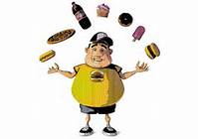


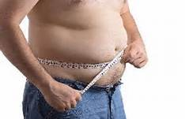

Addressing Vascular Risk Factors
Notes:
Vascular Risk Assessment: Addressing Vascular Risk Factors
Assessment of risk: Assessment of an individual's overall risk status includes determining the degree of overweight (Body Mass Index (BMI)) and the presence of abdominal obesity (waist circumference), cardiovascular risk factors and other comorbidities. The coexistence of several diseases, including established coronary heart disease (CHD), cerebrovascular disease (previous stroke or TIA) other atherosclerotic disease (peripheral vascular disease, vascular dementia, chronic kidney disease) and type 2 diabetes mellitus places patients in a high-risk category for subsequent mortality.

Slide 6
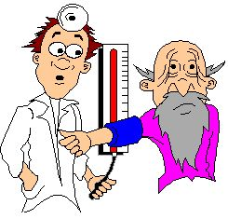
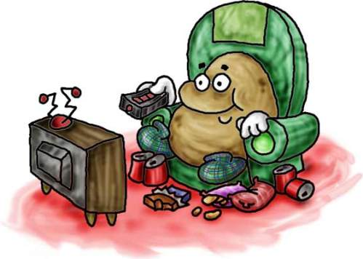
Vascular Disease & Risk Factors
Most vascular disease(s) can be prevented or managed by addressing the risk factors
Why are risk factors such a big deal??
  Over 90% of Canadians have one or more risk factors
  Almost every person you come across can have increased risk for vascular disease
Notes:
Vascular Disease & Risk Factors:
The causes of vascular disease are known and preventable, therefore, identification, control and management are key.
Activity: Group Game – Have everyone stand up and stay standing if their answer is ‘Yes’ to each of the following questions:
Do you get 3 out of 4 food groups at every meal (vegetable and fruit, grain products, milk and alternatives, meat and alternatives)
Are you a non-smoker
Did you get 7-8 hours of uninterrupted sleep last night
Do you get 30 mins of physical activity most days
You do NOT use the salt shaker at the dinner table
Do you use healthy interventions, such as tai chi or yoga to cope with stress

Slide 7
Non-Modifiable Risk Factors
Age
Gender
Family History/Genetics
Ethnicity
Previous Event (Heart Attack, Stroke, etc)
Notes:
Non-Modifiable Risk Factors:
These are things your patient cannot change, but it is important to have an awareness of how these fit into the overall risk.
Even though these risk factors may exist, there are a number of actions which can be taken to positively affect overall health and decrease overall risk.
IN GENERAL
Age: Older age = more risk
Gender: Males generally have more risk, until female reach age 55 (post menopausal) Then equal risk
Family History/Genetics: Risk increased if first degree relative have event (male > 55yo, female >65 yo)
Ethnicity: Higher risk for some African or Asian, Native American or Spanish descent.
Previous Event: Higher risk of another event

Slide 8
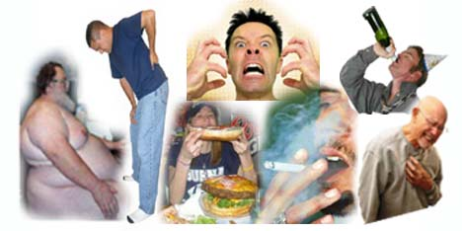
What are some risk factors we can modify?
Notes:
What are some risk factors we can modify?
Activity: Discussion – Question & Answer
Ask group the above question.

Slide 9
Modifiable Risk Factors
May also be called “Healthy Lifestyle Behaviors”
Tobacco Use
Physical Inactivity
Poor Diet
Obesity or Overweight
Excess Alcohol
Unmanaged Stress
Lack of Sleep
Notes:
Modifiable Risk Factors:
Certain unhealthy lifestyle behaviours can increase an individual’s risk of vascular disease. These behaviours can be addressed and modified, or changed, to reduce vascular risk. Identify and discuss these risk factors which are known to have a significant impact. Ask participants if they can think of any others risk factors which can be modified?

Slide 10
Tobacco Use
Smoking may:
    Contribute to the build-up of plaque in the arteries
    Increase the risk of blood clots
    Reduce oxygen in the blood
    Cause the heart to work harder by ↑ heart rate and blood pressure, and constricting blood vessels
    ↑ LDL and ↓ HDL cholesterol
In Alberta, healthcare costs associated with tobacco use are estimated at $470.6 million/year
Notes:
Tobacco Use:
↑ Rate of atherosclerosis - Contributes to the build up of plaque in the arteries
Smoking ↑ the risk of blood clotting
↓ oxygen in the blood
Nicotine : ↑ heart rate & blood pressure, constricts blood vessels
↓ The ‘good’ HDL cholesterol
Smoking also:
Accelerates aging
Constricts cerebral vessels
Tobacco use alone may double the risk of vascular disease
When a smoker quits, within…
20 minutes: BP & pulse drop, body temperature of hands/feet increase to normal
8 hours: CO2 level in blood drops to normal while O2 increases to normal
24 hours: Chance of heart attack decreases
48 hours: Nerve endings start re-growing and ability to smell and taste enhances
1-9 months: cough, sinus congestion, fatigue and shortness of breath decrease
5 years: Stroke risk is reduced to that of a non-smoker
15 years: Risk of coronary heart disease is equal to that of a non-smoker
It may take 7 smoking cessation attempts before success!!
Cigarettes have over 4,000 chemical, 50 of which are cancer causing.
Second Hand Smoke:
Second hand smoke is a CLASS A CARCINOGEN such as asbestos, arsenic, and mustard gas
Second Hand Smoke has up to 4000 chemicals in it and has more tar, nicotine and cancer causing chemicals than mainstream smoke.
5 times more carbon monoxide
2 times more nicotine
2 times more tar than mainstream smoke
(exhaled smoke, side stream smoke from burning cig, cigars, pipes wafting into the air)
85% of the smoke that goes in the air from a burned cigarette is Second Hand Smoke.
CHEWING TOBACCO: High risk for not only oral cancers but cancer of the GI tract, as well as colon cancer because the tobacco is absorbed. Ingredients include a mixture of nicotine, sweeteners, abrasives (sand, grit, glass), salts and >3000 chemicals, including 28 known carcinogens.
10 dips of chew (1 can) has the same amount of nicotine as 40 cigarettes
Cigars contain: up to twice as much tar, 5 times as much carbon monoxide and 7 times as much nicotine as a single cigarette.
In Alberta, healthcare costs associated with tobacco use are estimated at $470.6 million/year.
AHS. (2009). National Release of the Cost of Substance Abuse in Canada, 2002 Study. Alberta Fact Sheet. Taken from: http://www.albertahealthservices.ca/Researchers/if-res-cost-of-sub-abuse-in-can-2002-ab-fact-sheet.pdf [accessed 2014 October 28].

Slide 11
Tobacco Use – Intervention
Assess tobacco use of every individual:
Consider tobacco use as a vital sign in every patient visit.
Support tobacco users in quitting efforts and link to available resources
Research shows that support and advice from a trained
health professional can double a person’s chances of
successfully quitting tobacco use.
Notes:
Tobacco Use – Intervention:
Assess tobacco use of every individual
• Consider tobacco use as a vital sign in every patient visit.
• Support tobacco users in quitting efforts and link to available resources
Tobacco use status of all patients should be updated on a regular basis and health care providers should clearly advise patients to quit smoking. Tobacco cessation resources are available at www.albertaquits.ca and on the Cardiovascular Health and Stroke Strategic Clinical Network website: www.albertahealthservices.ca/10585.asp
Quitting tobacco/cigarette smoking is considered one of the hardest things patients may have to deal with. Encourage them, and let them know they have your support.
Up to 70% of users want to quit but quitting is very difficult.
It is essential that clinicians consistently identify, document and treat every tobacco user.
Brief interventions are effective and should be offered to all tobacco users.
Support and advice from a trained health professional can double a person’s chances of quitting tobacco successfully.
Advice in combination with pharmacotherapy (e.g., varenicline, bupropion, nicotine replacement therapy) should be offered to all smokers with a goal of smoking cessation.
All patients/clients should be asked if they use tobacco and should have their tobacco use status documented on a regular basis. All physicians, nurses and other health care
workers should strongly advise all patients who smoke to quit and provide brief advice.
Stone JA, Arthur HM, Suskin N: Canadian Guidelines for Cardiac Rehabilitation and Cardiovascular Disease. Prevention: Translating Knowledge into Action; Winnipeg, MB, Canadian Association of Cardiac Rehabilitation , 2009.

Slide 12

Tobacco/Smoking Cessation
The 5 A’s
Ask (every individual) about tobacco use
Advise to reduce/quit (personalized)
Assess readiness to quit and interest in support
Assist with providing information and referrals
Arrange for follow up or additional support
Notes:
Tobacco/Smoking Cessation:
AHS and the Canadian Cancer Society recommend using the 5 A’s.
Ask about tobacco use
Advise to reduce/quit
Assess readiness and motivation to change (Would you like some information?)
Assist by providing information and referrals (Alberta Quits)
Arrange for follow up or additional support (next visit – ask how are you doing with tobacco reduction/cessation)
Highlighted / Bold A’s represent Vascular Risk Reduction (VRR) Key priority messages:
1. Ask every single patient about their smoking status
2. Assist with providing information regarding available resources and referral to tobacco cessation programs for long term follow up support

Slide 13
(AHS) Tobacco Cessation Resources
For Providers:
Tobacco Free Future - Online Training (1 hour)
TRAC Program (2 day training)
On Line
  www.albertaquits.ca – Download or order online (free)
    Tobacco Free Future brief intervention laminated card
      The 5 A’s
    Tobacco Cessation Toolkit
    Tobacco Cessation Kits
Notes:
AHS Tobacco Cessation Resources
AHS has training resources for healthcare professionals which are available on line and in person.
Tobacco Free Future - Online Training (1 hour)
Provides participants with the foundational knowledge and tools needed to address tobacco dependence and nicotine addiction in healthcare settings.
TRAC Program (2 day training)
Developed by tobacco reduction experts to provide health professionals with the skills and tools they need to talk effectively with their patients and clients about quitting.
Telephone: 1-780-422-1350 E-mail: tru@albertahealthservices.ca
Tools online: www.albertaquits.ca
Examples of resources:
Double-sided laminated card with the Five A's (Ask, Advise, Assess, Assist, Arrange) of the Tobacco Free Futures Brief Tobacco Intervention on one side and information on nicotine withdrawal symptoms on the other side. Slot in card allows for attachment to lanyard
Tobacco cessation toolkit also located on the Cardiovascular Health and Stroke SCN Website: www.albertahealthservices.ca/10585.asp
Tobacco cessation kits
Tobacco Free Futures Guidelines

Slide 14
Tobacco Cessation Resources
For Patients:
AlbertaQuits – Online quit smoking service from Alberta Lung Association (www.albertaquits.ca )
QuitCore – Free group cessation programs in Alberta
  1-866-710- QUIT (7848)
AADAC – Smokers help line (1-866-332-2322)
Nicotine Anonymous – Non-profit support group
  www.nicotineanonymous.org
What’s available in your community??
Notes:
Tobacco Cessation Resources
There are also numerous provincial resources available to support patients in their quitting efforts.
Many local Primary Care Networks and communities also provide resources and support. It is important to know those resources available in your local area.

Slide 15
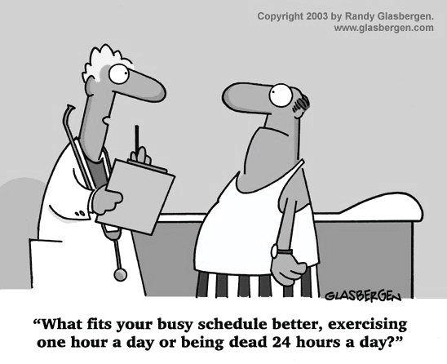
Modifiable RF – Physical Inactivity
Notes:
Modifiable Risk Factors: Physical Inactivity
Harsh, but true. Although is doesn’t have to be an hour everyday, according to the latest recommendations, physical activity is a key component of a healthy lifestyle which can decrease vascular risk and prevent vascular disease.

Slide 16
Benefits of Physical Activity
Physical:
↑ Strength and endurance
↑ Range of motion
Maintain or ↑ bone density
↓ BP; ↑ HDL; ↓ LDL & Trigs
↓ inflammation
↓ Insulin resistance
Improves endothelial function
Mental:
Improves mood
Improves sleep
Improves brain function
↑ Energy
↑ Self esteem & confidence
↓ Stress
Notes:
Benefits of Physical Activity:
Not just physical. Physical activity can affects individuals on cellular, physiological, mental, emotional and cognitive levels.
Tremblay MS, Warburton DE, Janssen I, Paterson DH, Latimer AE, Rhodes RE, Kho ME, Hicks A, LeBlanc AG, Zehr L: New Canadian physical activity guidelines. Applied Physiology, Nutrition, and Metabolism 2011;36:36-46.

Slide 17
Physical Activity Recommendations
To achieve health benefits, adults aged 18-64 years should accumulate at least 150 minutes of moderate- to vigorous-intensity aerobic physical activity per week, in bouts of 10 minutes or more
It is also beneficial to add muscle and bone strengthening activities using major muscles groups, at least 2 days per week
More physical activity provides greater health benefits
Notes:
Physical Activity Recommendations:
From the 2014 update of the Canadian Cardiovascular Harmonized National Guidelines Endeavour (C-CHANGE) which adopted the New Canadian physical activity guidelines.
Tobe SW, Stone JA, Walker KM, et al. Canadian cardiovascular harmonized national guidelines endeavour (C-CHANGE): 2014 update. CMAJ 2014;186(17):E1299-1305.
Tremblay MS, Warburton DE, Janssen I, Paterson DH, Latimer AE, Rhodes RE, Kho ME, Hicks A, LeBlanc AG, Zehr L: New Canadian physical activity guidelines. Applied Physiology, Nutrition, and Metabolism 2011;36:36-46.
Stretching/flexibility exercises and balance activities have also been identified as beneficial.

Slide 18
Physical Activity Intensity (examples)
Moderate Intensity
Vigorous Intensity
Brisk walking
Dancing
Gardening
Housework
Traditional hunting and gathering
Active involvement in games and sports
Running
Walking/climbing briskly up a hill
Fast Cycling
Aerobics
Fast swimming
Competitive sports and games
Heavy shovelling or digging
Notes:
Physical Activity Intensity (examples):
To achieve health benefits, adults aged 18-64 years should accumulate at least 150 minutes of moderate- to vigorous-intensity aerobic physical activity per week, in bouts of 10 minutes or more. Examples of these types of activities are described. Encourage participants to identify those activities they enjoy and would like to incorporate into their lifestyle.

Slide 19
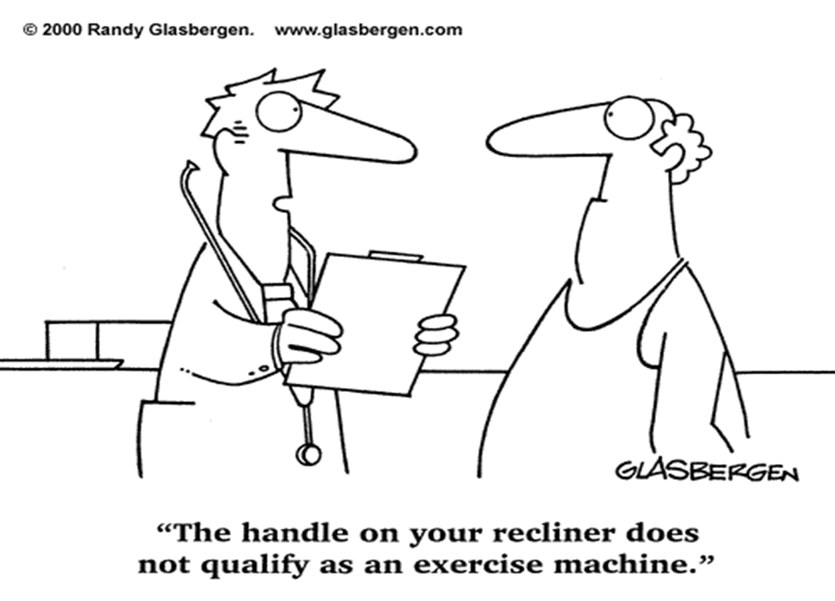

Slide 20
Physical Activity Considerations
Consider physical activity as a “vital sign” in every patient visit – Ask!
Implement “Prescription for Healthy Living”
  Assess current level of activity
  Ask patient’s goals for becoming more active
  Develop a plan (“prescription”) that aligns with guidelines and patient’s goals
    The total duration should be increased gradually to maximize weight loss and other health benefits
Notes:
Physical Activity Considerations:
Start thinking of physical activity as a Vital Sign
Ask every patient what their current activity level is
Talk about the “Prescription for Healthy Living” with patients. Promote use of the prescription within clinical practice.
For those who want to become more physically active, assess, ask goals and develop a plan

Slide 21
Community Resources
Ensure patients are effectively counselled and/or referred to an exercise professional for more guidance.
What is available in your community to support an active lifestyle?
  AHS Alberta Healthy (Living Exercise) Program
  Walking/Running programs and groups
  Mall Walking programs
  Community fitness facilities
Notes:
Community Resources
All those considering initiating a vigorous exercise program are encouraged to consult their physician or health care team professionals.
Tobe SW, Stone JA, Walker KM, et al. Canadian cardiovascular harmonized national guidelines endeavour (C-CHANGE): 2014 update. CMAJ 2014;186(17):E1299-1305.
Lau DC, Douketis JD, Morrison KM, Hramiak IM, Sharma AM, Ur E: 2006 Canadian clinical practice guidelines on the management and prevention of obesity in adults and children [summary]. CMAJ 2007;176:S1-13.
Become aware of programs within your local community which support active living (Prescription to Get Active, Grande Prairie Get Active, UWALK, etc.)

Slide 22

Poor Dietary Intake
An unhealthy diet is the leading risk for death and disability in Canada and can lead to:
Increased weight
Type 2 diabetes
High blood pressure
High cholesterol
Heart disease & stroke
Some cancers
Osteoporosis
Depression
Notes:
Poor Dietary Intake
A poor or inadequate diet can lead to many health problems.
In contrast, a healthy and balanced diet can prevent, manage or control most vascular diseases.
All individuals should be encouraged to adopt healthy eating habits to lower their risk of cardiovascular disease:
moderate energy (caloric) intake to achieve and maintain a healthy body weight;
emphasize a diet rich in vegetables, fruit, whole-grain cereals and polyunsaturated and monounsaturated oils, including omega-3 fatty acids particularly from fish;
avoid trans fats, limit saturated and total fats to < 7% and < 30% of daily total energy (caloric) intake, respectively;
4) increase daily fibre intake to > 30 g;
5) limit cholesterol intake to 200 mg daily for individuals with dyslipidemia or at increased risk of cardiovascular disease.
Anderson TJ, Gregoire J, Hegele RA, Couture P, Mancini GB, McPherson R, Francis GA, Poirier P, Lau DC, Grover S, Genest J, Jr., Carpentier AC, Dufour R, Gupta M, Ward R, Leiter LA, Lonn E, Ng DS, Pearson GJ, Yates GM, Stone JA, Ur E: 2012 update of the Canadian Cardiovascular Society guidelines for the diagnosis and treatment of dyslipidemia for the prevention of cardiovascular disease in the adult. Can J Cardiol 2013;29:151-167.

Slide 23
Healthy Eating - Recommendations
Have a good variety of healthy foods from the four food groups each day
Increase daily intake of vegetables and fruit to 7 or more servings
Drink fresh, clean water instead of sugary drinks
Plan your meals ahead and shop for healthy ingredients
Eat less packaged and restaurant food
An optimal dietary plan for health issues may need guidance from a qualified health care professional (registered dietician)
Notes:
Healthy Eating Recommendations
Key Healthy Eating Tips:
Buy fresh or frozen vegetables instead of canned or packaged with added sauces.
Choose low-sodium vegetable juices and soups.
Choose at least 3 higher fibre whole grain foods each day.
When buying breads, crackers, cereals, bakery products, desserts and snacks, choose products with higher fibre, lower fat and lower sodium.
Choose skim or 1% milk and yogurt more often than cheese.
Limit processed cheese slices and processed cheese spreads.
Have smaller portions of meats, fish (avoid fish high in mercury or deep-fried), and poultry.
Eat a small handful of unsalted nuts and seeds several times a week.
Limit processed, cured, smoked or deli meats.
Check food labels and choose sweets and snack foods with the lowest amount of sodium and saturated or trans fat.
DASH Diet: The DASH (Dietary Approach to Stop Hypertension) Diet is similar to Canada’s Food Guide and has been shown to improve blood pressure. The DASH Diet emphasizes eating plenty of vegetables and fruit, low-fat milk products, whole grains, lean meats, fish, legumes (dried beans) and nuts and limits sodium to 1500 - 2300mg each day.
An optimal dietary plan for achieving healthy body weight and dietary counseling for adults should be developed with a qualified and experienced health professional (preferably
a registered dietitian) together with the individual and family to meet their needs.
Lau DC, Douketis JD, Morrison KM, Hramiak IM, Sharma AM, Ur E: 2006 Canadian clinical practice guidelines on the management and prevention of obesity in adults and children [summary]. CMAJ 2007;176:S1-13.
Tobe SW, Stone JA, Walker KM, et al. Canadian cardiovascular harmonized national guidelines endeavour (C-CHANGE): 2014 update. CMAJ 2014;186(17):E1299-1305.

Slide 24

Canada’s Food Guide
All adults should maintain a healthy balanced diet that is high in vegetables, fresh fruits, low-fat dairy products, dietary and soluble fibre, whole grains and protein from plant sources, and low in saturated and trans fat, cholesterol and sodium, in accordance with Canada’s Food Guide to Healthy Eating
Resources available online and
print materials to order
Notes:
Canada’s Food Guide
The eating pattern (amount and type of food) recommended in Canada's Food Guide was carefully developed to meet nutrient needs and contribute to reduced risk of chronic disease development. The Dietary Reference Intakes nutrient standards and assessment methods were used in the development of the eating pattern. A review of two major reports (2004 WHO/FAO Joint Report on Diet, Nutrition and the Prevention of Chronic Diseases and the 2005 Dietary Guidelines Advisory Committee Report) summarizing the evidence on the relationships between select foods and their potential effect on health and prevention of chronic disease also supported the development of the recommendations.
All individuals should be encouraged to adopt healthy eating habits to lower their risk of cardiovascular disease:
1) moderate energy (caloric) intake to achieve and maintain a healthy body weight;
2) emphasize a diet rich in vegetables, fruit, whole-grain cereals and polyunsaturated and monounsaturated oils, including omega-3 fatty acids particularly from fish;
3) avoid trans fats, limit saturated and total fats to < 7% and < 30% of daily total energy (caloric) intake, respectively;
4) increase daily fibre intake to > 30 g;
5) limit cholesterol intake to 200 mg daily for individuals with dyslipidemia or at increased risk of cardiovascular disease.
Anderson TJ, Gregoire J, Hegele RA, Couture P, Mancini GB, McPherson R, Francis GA, Poirier P, Lau DC, Grover S, Genest J, Jr., Carpentier AC, Dufour R, Gupta M, Ward R, Leiter LA, Lonn E, Ng DS, Pearson GJ, Yates GM, Stone JA, Ur E: 2012 update of the Canadian Cardiovascular Society guidelines for the diagnosis and treatment of dyslipidemia for the prevention of cardiovascular disease in the adult. Can J Cardiol 2013;29:151-167.

Slide 25
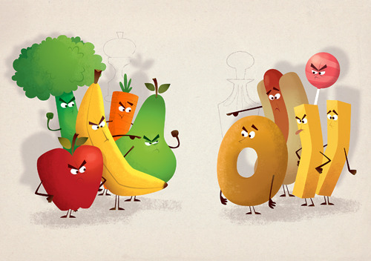
Increase Vegetable and Fruit Intake
Recommend 7 - 10 servings a day
What are some ways to increase intake?
Have 2 or more servings at each meal and snack
Fill half your plate with vegetables and fruit
Add fruit to breakfast
Pack vegetables and fruit to eat
with lunch
Write down what you eat and drink
Visit Healthy Eating Starts Here: www.albertahealthservices.ca/5621.asp
Notes:
Increase Vegetable and Fruit Intake
Health Canada recommends that adults have 7 to 10 servings of vegetables and fruits per day (Canada Food Guide). More than 60% of Albertans eat less than the minimum recommendation.
Statistics Canada. Health indicator profile, two year period estimates, by age group and sex, Canada, provinces, territories, health regions (2012 boundaries) and peer groups. CANSIM 2012. Retrieved August 10, 2014 from: http://www5.statcan.gc.ca/cansim/a26?lang=eng&retrLang=eng&id=1050502&tabMode=dataTable&srchLan=-1&p1=-1&p2=9
Why Vegetables and Fruit Are Important To Your Health
Vegetables and fruits have protective substances in them, such as vitamins, minerals, fibre, and plant compounds called phytochemicals. These protective substances can:
Reduce the risk of strokes - Vegetables and fruits can lower blood pressure and reduce other cardiovascular risk factors. A meta-analysis found that the risk of stroke goes down by as much as 32% for every two servings of vegetables and fruits eaten.
Reduce blood cholesterol and protect against cardiovascular disease - We know that 31% of ischemic heart disease is due to a low intake of vegetables and fruit.
Reduce risk of certain cancers - There is convincing evidence that eating fibre can reduce the risk of colorectal cancer. Vegetable and fruit intake could possibly lower the risk of cancers of the mouth, pharynx, larynx, esophagus, and stomach.
Promote a healthy weight - Vegetables and fruits are naturally low in calories and high in fiber. This means 2 things; 1) you will take in fewer calories and 2) you will feel fuller. It’s easier to lose weight and stay at a healthy weight when you eat vegetables and fruits prepared with little or no added fat and eat less meat, grains, and dairy products.
What are some ways to increase vegetable and fruit intake? Have 2 or more servings at each meal and snack
Fill half your plate with vegetables and fruit
Add fruit to breakfast
Pack vegetables and fruit to eat with lunch
Write down what you eat and drink.
Activity: Discussion – Question and Answer
Can you think of any other ways to add more color to your daily intake?
HEALTHY EATING: Visit Healthy Eating Starts Here www.albertahealthservices.ca/5621.asp
One serving of vegetable and fruit is:
Item size Amount Food Number of servings
Baseball 1 cup ( 250 mL) Salad 1 serving
Fresh, frozen or canned vegetables or fruit 2 servings
Tennis ball ¾ cup (175 mL) Whole vegetable or fruit, medium size 1 serving
Hockey puck ½ cup ( 125 mL) Fresh, frozen or canned vegetables and fruit 1 serving
Tips
Choose whole vegetables and fruits instead of juice
Choose fresh, frozen and canned vegetables and fruits without added salt, sugar, and higher calorie sauces or syrups
What You Can Do as a Health Provider
Encourage your patients to eat more vegetables and fruits by pointing out the health benefits of reducing their risk of heart disease, cancer, and stroke.
Highlight why these foods are healthy and how much they should eat each day.
Use the Healthy Living Prescription to help your patients set goals on how to add more vegetables and fruits into their diet.
Hyson, D. The health benefits of fruits and vegetables: a scientific overview for health professionals. Wilmington, DE: Produce for Better Health Foundation 2002.
World Cancer Research Fund /American Institute for Cancer Research. Food, nutrition, physical activity, and the prevention of cancer: a global perspective [document on internet]. 2007 [cited 2009 Mar 23]; Available from: http://www.cpma.ca/Archived%20Documents/Marketing/Second_Expert_Report_2007.pdf
Yao LH, Jiang YM, Tomás-Barberán FA, Datta N, Singanusong R, Chen SS. Flavonoids in food and their health benefits. Plant Foods for Human Nutr 2004; 59(3):113-22.
Hu, D., Huang, J., Wang, Y., Zhang, D., & Qu, Y. Fruits and Vegetables Consumption and Risk of Stroke A Meta-Analysis of Prospective Cohort Studies. Stroke 2014; 45(6), 1613-1619.
Report of a Joint FAO/WHO Expert Consultation. Diet, nutrition and the prevention of chronic diseases; World Health Organization 2003; Geneva.
Norat, T., Aune, D., Chan, D., Romaquera, D. Fruits and vegetables: updating the epidemiologic evidence for the WCRF/AICR lifestyle recommendations for cancer prevention. Cancer Treatment Research 2014;159:35-50. http://www.ncbi.nlm.nih.gov/pubmed/24114473
Kaiser, K. A., Brown, A. W., Brown, M. M. B., Shikany, J. M., Mattes, R. D., & Allison, D. B. Increased fruit and vegetable intake has no discernible effect on weight loss: a systematic review and meta-analysis. The American Journal of Clinical Nutrition 2014;100(2): 567-576.

Slide 26
Special Considerations
Hypertension: Consider the DASH diet (high in V/F, whole grains, fish, poultry, nuts and low fat dairy). Has been shown to reduce systolic and diastolic blood pressure.
Diabetes: No more than 7% of total daily intake from saturated fats and limit trans fatty acids to a minimum. Develop an optimal diet plan for achieving healthy body weight.
Chronic Kidney Disease: Maintain adequate fluid intake as fluid restriction is not required for most patients. Monitor protein intake and refer to a CKD dietician when possible.
**Consult or refer patient to an experienced health care provider (preferably a registered dietician) for more guidance and information
Notes:
Special Considerations
Hypertension: Consider the DASH diet (high in V/F, whole grains, fish, poultry, nuts and low fat dairy). Has been shown to reduce systolic and diastolic blood pressure.
Diabetes: No more than 7% of total daily intake from saturated fats and limit trans fatty acids to a minimum. Develop an optimal diet plan for achieving healthy body weight.
Chronic Kidney Disease: Maintain adequate fluid intake as fluid restriction is not required for most patients. Monitor protein intake as insufficient may lead to loss of body mass and malnutrition, and excess may lead to accumulation of uremic toxins.
**Consult or refer patient to an experienced health care provider (preferably a registered dietician) for more guidance and information.
These recommendations are general guidelines. Some conditions require special considerations due to pathology or required medications, etc. If a patient requires additional dietary advice, please refer them to a registered dietician for more information.

Slide 27
Weight Management
Maintenance of a healthy body weight and waist circumference can reduce vascular risk.
Body Mass Index (BMI)
  Normal BMI 18.5-24.9 kg/m²
  BMI> 27 is linked with HTN, DM, Dyslipidemia
Waist Circumference
  < 102 cm for men and < 88 cm for women
Initial weight loss goal in obese individuals (BMI >30) should be 5-10% of baseline body weight
Notes:
Weight Management
Maintenance of a healthy body weight (body mass index 18.5 to 24.9 kg/m2, and waist circumference less than 102 cm for men and less than 88 cm for women) is recommended for non-hypertensive individuals to prevent hypertension and for hypertensive patients to reduce blood pressure. All overweight hypertensive individuals should be
advised to lose weight.
Body Mass Index (BMI) is a method to assess how much an individual's body weight departs from the normal or desired weight of a person with the same height (wt / ht x2)
History and a general physical examination should be completed to exclude secondary (endocrine or syndrome-related) causes of overweight/obesity and overweight/obesity related health risks and complications. Additional investigations, such as liver enzyme tests, urinalysis and sleep studies (when appropriate), should be completed to screen for and exclude other common overweight/obesity-related health problems.
The initial weight loss goal in obese individuals should be 5% to 10% of baseline body weight.
Lau DC, Douketis JD, Morrison KM, Hramiak IM, Sharma AM, Ur E: 2006 Canadian clinical practice guidelines on the management and prevention of obesity in adults and children [summary]. CMAJ 2007;176:S1-13.
Dasgupta K, Quinn RR, Zarnke KB, et al. The 2014 Canadian Hypertension Education Program Recommendations for Blood Pressure Measurement, Diagnosis, Assessment of Risk, Prevention, and Treatment of Hypertension. Can J Cardiol 2014;30:485-501.
Currently 7 million obese adults (BMI ≥ 30) and 600,000 obese school aged children (WHO BMI growth standards)
In 2006, obesity accounted for $3.9 billion in direct healthcare cost and 3.2 billion in indirect cost. ( Ian Janssen, April 2013, Can J Diabetes 37, 90-96)

Slide 28

Weight Management – Cont’d
A comprehensive healthy lifestyle intervention is recommended for overweight and obese people
It is vital to create a non-judgemental atmosphere when discussing weight management
Consider the specific individual barriers patients may have regarding obesity and its management and what potential solutions might be feasible.
Are there any resources you can think of in your community for weight management??
Notes:
Weight Management
A comprehensive healthy lifestyle intervention is recommended for overweight and obese people.
An optimal dietary plan for achieving healthy body weight and dietary counseling for adults should be developed with a qualified and experienced health professional (preferably a registered dietitian) together with the individual and family to meet their needs.
Primary care health professionals are encouraged to create a nonjudgmental atmosphere when discussing weight management.
Health care professionals are encouraged to consider the barriers people might have concerning overweight/obesity and its management.
All those considering initiating a vigorous exercise program are encouraged to consult their physician or health care team professionals.
Long-term, regular physical activity is suggested, which is associated with maintenance of body weight or a modest reduction in body weight for all overweight and obese people.
Physical activity and exercise should be sustainable and tailored to the individual. The total duration should be increased gradually to maximize the weight-loss benefits.
Tobe SW, Stone JA, Walker KM, et al. Canadian cardiovascular harmonized national guidelines endeavour (C-CHANGE): 2014 update. CMAJ 2014;186(17):E1299-1305.
Lau DC, Douketis JD, Morrison KM, Hramiak IM, Sharma AM, Ur E: 2006 Canadian clinical practice guidelines on the management and prevention of obesity in adults and children [summary]. CMAJ 2007;176:S1-13.
Resources:
Living Well Classes
Food and Mood
Lifestyles Nutrition & Exercise classes
Alberta Health Link for AHS weight management programs: 1-866-408-5465
Weight Management programs in the community such as Weight Watchers and others.
Heart and Stroke: Healthy Weight Action Plan
Obesity Network: www.obesitynetwork.ca (free membership, BMI calculator, food Diaries, download resources)

Slide 29
Alcohol Consumption
Drinking too much of any type of alcohol can increase blood pressure and contribute to heart disease and stroke
Best to follow low risk drinking guidelines and encourage those who chose to drink to limit to:
  2 or fewer standard drinks per day;
  fewer than 14 drinks per week for men;
  and fewer than 9 for women.
Notes:
Alcohol Consumption
Too much alcohol may cause an increase in blood pressure and contribute to the occurrence of vascular disease (heart disease, stroke/TIA, vascular dementia, peripheral vascular disease, chronic kidney disease, etc) among other health conditions. Light drinking has some association with positive health outcomes but this may not be a cause and effect relationship. There is no data, though, to support zero drinking is better than light drinking.
Patients should be encouraged to limit their alcohol consumption.
Reducing alcohol consumption can reduce blood pressure.
Consuming no more than maximum 2 drinks per day, can potentially drop SBP by 3.9 mmHg and DBP by 2.4 mmHg.
It is recommended alcohol consumption should be limited to: Two or fewer standard drinks per day; fewer than 14 drinks per week for men; fewer than 9 drinks per week for women.
Tobe SW, Stone JA, Walker KM, et al. Canadian cardiovascular harmonized national guidelines endeavour (C-CHANGE): 2014 update. CMAJ 2014;186(17):E1299-1305.
Dasgupta K, Quinn RR, Zarnke KB, et al. The 2014 Canadian Hypertension Education Program Recommendations for Blood Pressure Measurement, Diagnosis, Assessment of Risk, Prevention, and Treatment of Hypertension. Can J Cardiol 2014;30:485-501.

Slide 30

Stress
Chronic Stress
Long-term or work-related stress can predict the occurrence of coronary heart disease (CHD)
Isolated individuals have an increased risk for a cardiac event
Acute Stress
Can act as a trigger of cardiac events
Notes:
Stress
Definitions of Stress:
The cognitive, affective, behavioural and hormonal response to threat, challenge or loss.
The response to a negative or positive condition that can impact an organism’s mental and physical well-being.
A sympathetic nervous system response which results in the Fight-or-Flight response.
Physiological - HPA axis activation
Eustress – positive, Distress – negative
Although the relationship between stress and vascular disease is not clear, some people with high levels of stress or prolonged stress may have higher blood cholesterol, increased blood pressure or be more prone to developing atherosclerosis.
If life is stressful, it can be difficult to lead a healthy lifestyle. Instead of being physically active to relieve stress, patients may respond by overeating, eating unhealthy foods, consuming too much alcohol or smoking. Reactions that can increase the risk of developing heart disease and stroke.

Slide 31
Stress and Vascular Risk
Notes:
Stress and Vascular Risk
Stress increases LDL, decreases HDL and increases clotting enzymes.
Acute Stress Response: Results in - ↑ blood glucose, ↑ blood pressure, modulation of immune response, vigilance and arousal.
Persistent Stress: May cause Type 2 diabetes, hypertension, cardiovascular disease, vulnerability to inflammatory disease, anxiety and depression.

Slide 32
Symptoms of Stress
Stress can lead to unhealthy coping habits:
Smoking/drugs
Too much alcohol
Over eating, choosing less healthy foods
Not continuing physical activity
Notes:
Symptoms of Stress
Persistent stress may also contribute to neuropsychological deficits including difficulty learning and retaining information. Symptoms of anxiety and depression may need to be addressed in order to facilitate learning. This is important to remember when asking for behaviour change.

Slide 33
Symptoms of Stress
Headache
Fatigue
Stomach complaints
Symptoms that mimic illness
Anxiety
Depression
What are some ways to deal with stress?
Notes:
Symptoms of Stress
Tips for dealing with stress
Refer or suggest psychological counselling if needed
Don't worry about things you can't control, such as the weather.
Solve the little problems. This can help you gain a feeling of control.
Prepare to the best of your ability for events you know may be stressful, such as a job interview.
Try to look at change as a positive challenge, not as a threat.
Work to resolve conflicts with other people.
Talk with a trusted friend, family member or counselor.
Set realistic goals at home and at work. Avoid over scheduling.
Exercise on a regular basis.
Eat regular, well-balanced meals and get enough sleep.
Meditate. Tai Chi. Yoga.
Participate in something you don't find stressful, such as sports, social events or hobbies.

Slide 34
Stress Management
Change how we react/perceive things
Breathing exercises
Progressive Relaxation
Meditation
Make time for laughter
Daily physical activity
Coping by learning- books, films, courses
Counselling and support
Notes:
Stress Management
Aim for Stress Free Living
The CMHA (Canadian Mental Health Association) states that much of our stress comes from within us in the form of negative self-talk. The goal of managing stress is to cue the “relaxation response” which is a calming process our body goes through when we perceive that the stressful event has passed. 7 CMHA tips for triggering the relaxation response:
1. Learn relaxation techniques
Practicing meditation or breathing awareness every day can relieve chronic stress and realign your outlook in a more positive way.
2. Set realistic goals
Learning to say no is essential for some people. Assess your schedule and identify tasks or activities that you can or should let go.
3. Exercise
Regular, moderate exercise helps ease tension, improves sleep and self-esteem.
4. Enjoy yourself
Taking the time for a favourite hobby is a great way of connecting with and nurturing your creative self.
5. Visualization
Athletes achieve results by picturing themselves crossing the finish line first. Use the same technique to practice “seeing” yourself succeed in whatever situation is uppermost in your mind.
6. Maintain a healthy lifestyle
A good diet is often the first thing to go when we’re feeling stressed. Making a meal instead of buying one ready-made will be better for you.
7. Talk about it
Sharing your troubles with a friend may help you to put things in perspective and to feel that you’re not alone.

Slide 35
Sleep
Most adults need 7-8 hours of uninterrupted sleep each night
Chronic sleep deprivation can lead to fatigue, anxiety, depression and weight gain
It also disrupts the normal restoration and regeneration process and affects hormones
Long term sleep loss can lead to vascular problems
Don’t underestimate the importance of a good night’s sleep!
Notes:
Sleep
Adults need 7 – 8 hours of uninterrupted sleep each day to maintain vascular health. (Teenager 9-10 hours; Child > 10 hours)
Sleep has the following positive effects:
Restores and regenerates the body and the mind
Decreases the bodies inflammatory response.
Allows the body to heal itself
Suppresses the appetite hormone which helps to decrease or prevent abdominal obesity
Reduces the hormone cortisol released (stress) which in turn decrease blood pressure and weight gain around the abdomen
Reduces Vascular Damage!!
Lack of sleep has the following negative effects:
Risk for disease starts to kick in when we get <6 or 7 hrs of sleep on avg/night.
Sleep loss contributes to chronic fatigue, persistent anxiety, depression and weight gain.
Sleep deprived people have 25% higher levels of vascular inflammation which causes chronic disease.
If we get on average less than 6 hours of sleep per night, increased risk for obesity due to the influence sleep has on hunger hormones grehlin and leptin
Those between ages of 32 & 49 who sleep < 7 hrs a night are at an increased risk for obesity.
Lack of sleep influences Melatonin production, believed to protect against cancer by affecting levels of other hormones, such as estrogen. Melatonin can prevent tumor cells from growing (cancer protective).
A Harvard run Nurses Health Study found insufficient or irregular sleep increases risk for colon cancer, breast cancer, heart disease & Diabetes.
Good Sleep Hygiene:
Avoid heavy meals before bedtime
Not exercising to close to bedtime
Thoroughly dark room (light shifts our biological clock, increases pulse, temp, and brain activity; and suppresses melatonin production)
Shut down electronic devices – blue light
Shun caffeine after 3 pm
Morning light exposure important
Designate a clear your head time
Bedroom for only sleep and intimacy
Keep a schedule – meal and wake/sleep times the same even on weekends.

Slide 36
Addressing Vascular Risk
Key Messages:
Assess tobacco use of every individual:
  Consider tobacco use a vital sign in every patient visit.
Support tobacco users in quitting efforts
  link to available resources
Support healthy eating and physical activity to promote health
  Increase vegetable and fruit intake
  Promote 150 minutes of aerobic activity per week
Notes:
VRR: Key Messages
Summary slide – Highlight the key messages discussed in this presentation.

Slide 37
Questions?

Slide 38

A Special Thanks to:
The Calgary & Lethbridge Vascular Risk Reduction
Programs and the CvHS SCN - VRR RxEACH Project,
for their support and collaboration.

Slide 39
References:
AHS Smoking Cessation Guidelines:
http://www.tobaccofreefutures.ca
Canadian Cardiovascular Society:
http://www.ccs.ca/index.php/en/
Canadian Society for Exercise Physiology:
http://csep.ca
C-CHANGE Clinical Resource Centre:
http://www.c-changecrc.ca/

Slide 40
References:
Harmonization of guidelines for the prevention and treatment of cardiovascular disease: the C-CHANGE Initiative – www.cmaj.ca (November 18, 2014)
Heart and Stroke Foundation of Canada: http://heartandstroke.com
Hypertension Canada (CHEP recommendations): http://hypertension.ca
Vascular Risk Reduction Resource:
http://www.albertahealthservices.ca/10585.asp

