Slide 1

Vascular Risk Reduction:
Why is it Important?
The Alberta Coalition for PrevenTION and Control of Vascular Disease (ACTION) Network
June 5, 2015
Notes:
Vascular Risk Reduction: Why is it Important?
To maximize the benefits of preventive therapy, lipid and hypertension guidelines increasingly recommend that high-risk individuals be targeted for treatment. An individual's risk of developing vascular disease depends on many risk factors, such as age, sex, blood pressure, blood lipid levels, body weight, physical fitness, smoking habits and familial predisposition. Multivariable statistical models have therefore been developed to better estimate the global risk of future coronary events and stroke.
Despite the continuing improvements in treating vascular disease among Canadians, coronary artery disease and stroke remain among the most common causes of premature mortality and disability in adults. Accordingly, the treatment of manageable risk factors, such as hypertension and dyslipidemia, to prevent or delay the development of vascular disease remains an essential component of medical therapy and public health policy.
The clinical benefits of risk factor modification to prevent cardiovascular events have been clearly demonstrated in randomized clinical trials. Nonetheless, these benefits may be associated with important treatment complications, minor side effects and the substantial, direct health care costs of lifelong therapy. To maximize the net benefits of preventive therapy, evolving treatment guidelines increasingly recommend that health care professionals target high-risk individuals for therapy. In this way, the potential risks of therapy are offset by a substantial reduction in the risk of cardiovascular disease. Targeting high-risk individuals also maximizes the cost-effectiveness of treatment.
Padwal R, Straus SE, McAlister FA. Evidence based management of hypertension. Cardiovascular risk factors and their effects on the decision to treat hypertension: Evidence based review. BMJ. 2001;322:977–80.

Slide 2
Vascular Risk Reduction (VRR)
Welcome!
Presentation & Activities
Focus: Why reducing vascular risk is of primary importance.
Engage, collaborate and have fun!
Notes:
VRR: Welcome and Introduction
The focus of this presentation is on understanding the effects of increased Vascular Risk and importance of Vascular Risk Reduction (VRR) strategies within Alberta.
Cardiovascular disease (CVD) is common in the general population, affecting the majority of adults past the age of 60 years. In 2012, CVD was estimated to result in 17.3 million deaths worldwide on an annual basis . CVD includes four major areas:
●Coronary heart disease (CHD), manifested by myocardial infarction (MI), angina pectoris, heart failure, and coronary death
●Cerebrovascular disease, manifested by stroke and transient ischemic attack
●Peripheral artery disease, manifested by intermittent claudication
●Aortic atherosclerosis and thoracic or abdominal aortic aneurysm
AULaslett LJ, Alagona P Jr, Clark BA 3rd, Drozda JP Jr, Saldivar F, Wilson SR, Poe C, Hart M. The worldwide environment of cardiovascular disease: prevalence, diagnosis, therapy, and policy issues: a report from the American College of Cardiology. SOJ Am Coll Cardiol. 2012;60(25 Suppl):S1.

Slide 3
Vascular Risk Reduction
Objectives:
Discuss the impact of vascular disease in Canada
Identify the prevalence of vascular risk
Discuss the collaboration and rationale for C-CHANGE guideline development
Describe the process of vascular disease development
Notes:
Vascular Risk Reduction: Objectives:
Review learning objectives

Slide 4
Impact of Vascular Disease
Vascular Risk Round Up:
Volunteer reads Question card.
The person with the correct Answer card must wave it and read the answer aloud.
If correct, it will be his/her turn to read out the question
on the Question card.
If not correct, everyone must agree on the correct answer, then ask the person with the correct Answer card to read out his/her question.
Play continues until all questions have been read, along with their correct answers.
Notes:
Impact of Vascular Disease:
Group Game: (see instructions). A number of participants should have both a question card and an answer card (A maximum of 15 participants should be dispersed throughout the room). Dispense these cards at the beginning of the session.

Slide 5
Impact of Vascular Disease
Major cause of death and disability
  Affects more than 300,000 Albertans
Every 7 min in Canada someone dies of heart disease or stroke
Costs Canadians $7.4 billion/yr (hosp, Dr & drug), plus $12.8 billion/yr in lost productivity
Costs Albertans $373 million/yr (heart disease & stroke)
Notes:
Impact of Vascular Disease:
Following game activity, review the significant impact of vascular disease
Non-communicable disease (NCD), and in particular vascular NCDs, (which include heart disease, stroke, diabetes, kidney and peripheral vascular disease) are the major cause of death and disability in Alberta and in Canada. In fact, the WHO indicates 89% of deaths in Canada are caused by NCDs and over 90% of Canadians have one or more common vascular risk factor such as high blood pressure, high cholesterol, detrimental nutrition or alcohol intake, physical inactivity, obesity or tobacco use.
References:
-Public Health Agency of Canada. (2009). Tracking Heart Disease and Stroke in Canada.
-WHO Department of Health Statistics and Information Systems, Disease and injury country mortality estimates, 2000–2012. Available at
http://www.who.int/healthinfo/global_burden_disease/estimates/en/index1.html
-Based on CRG data 2009-10 from DIMR, includes all CRGs that encompass coronary artery disease, CHF, cerebrovascular disease, diabetes, dyslipidemia and kidney disease (not including hypertension as single disease).
Lifetime risk of overall cardiovascular disease (CVD) approaches 50 percent for persons aged 30 years without known CVD. Coronary heart disease (CHD) accounts for approximately one-third to one-half of the total cases of CVD. The lifetime risk of CHD was illustrated in a study of 7733 participants, age 40 to 94, in the Framingham Heart Study who were initially free of CHD. The lifetime risk for individuals at age 40 was 49 percent in men and 32 percent in women. Even those who were free from CHD at age 70 had a non-trivial lifetime risk of developing CHD (35 and 24 percent in men and women, respectively). Similar findings have been reported in a meta-analysis of 18 cohorts involving over 250,000 men and women.
Rapsomaniki E, Timmis A, George J, et al. Blood pressure and incidence of twelve cardiovascular diseases: lifetime risks, healthy life-years lost, and age-specific associations in 1·25 million people. Lancet 2014; 383:1899.
Lloyd-Jones DM, Larson MG, Beiser A, Levy D. Lifetime risk of developing coronary heart disease. Lancet 1999; 353:89.
Berry JD, Dyer A, Cai X, et al. Lifetime risks of cardiovascular disease. N Engl J Med 2012; 366:321.

Slide 6
Vascular Disease
Causes are known and preventable
Over 90% of Canadians have at least 1 common vascular risk factor (VRF)
VRF are largely uncontrolled
VRF identification, control and management are key to the prevention of vascular disease!
Notes:
Vascular Disease
Highlight the importance of VRR identification, control and management
Reference:
Public Health Agency of Canada. (2009).
Over 90 percent of Canadians have one or more risk factors for vascular disease. On the other hand, the absence of major risk factors predicts a much lower risk of CHD.
The frequency and predictive value of five major risk factors (blood pressure, low-density lipoprotein [LDL] and high-density lipoprotein [HDL] cholesterol, glucose intolerance, and smoking) was evaluated in 35- to 74-year-old white non-Hispanic individuals without CHD in the Framingham Heart Study and the Third National Health and Nutrition Examination Survey (NHANES III). The frequency of "borderline" risk factors (defined as systolic pressure 120 to 139 mmHg, diastolic pressure 80 to 89 mmHg, LDL-cholesterol 100 to 159 mg/dL [2.6 to 4.1 mmol/L], HDL-cholesterol 40 to 59 mg/dL [1.0 to 1.5 mmol/L], impaired fasting glucose without overt diabetes, and a past history of smoking) was also assessed in the same cohorts. The following estimates were noted:
●More than 90 percent of CHD events occurred in individuals with at least one risk factor, and approximately 8 percent occurred in individuals who had only borderline levels of multiple risk factors. Few events occurred in patients with no elevated or borderline risk factors
●In NHANES III, approximately 60 percent of men and 50 percent of women had one to two elevated risk factors, and 26 percent of men and 41 percent of women had at least one borderline risk factor. The complete absence of any elevated or borderline risk factor was rare (0 to 0.4 percent) except for women between the ages of 35 to 44 (8.9 percent) or 45 to 54 (3.7 percent).
Yusuf S, Hawken S, Ounpuu S, et al. Effect of potentially modifiable risk factors associated with myocardial infarction in 52 countries (the INTERHEART study): case-control study. Lancet 2004; 364:937.
Vasan RS, Sullivan LM, Wilson PW, et al. Relative importance of borderline and elevated levels of coronary heart disease risk factors. Ann Intern Med 2005; 142:393.
Stamler J, Stamler R, Neaton JD, et al. Low risk-factor profile and long-term cardiovascular and noncardiovascular mortality and life expectancy: findings for 5 large cohorts of young adult and middle-aged men and women. JAMA 1999; 282:2012.

Slide 7
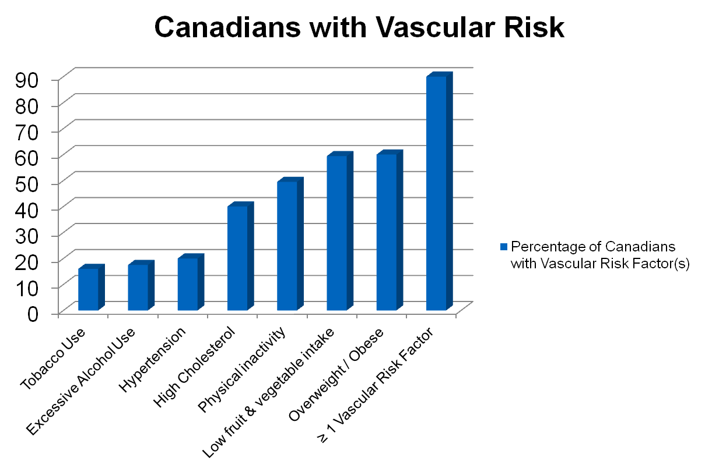
Prevalence of Vascular Risk
Notes:
Vascular Risk Tobacco Use / Excessive Alcohol Use / Hypertension / High Cholesterol / Physical inactivity / Overweight-Obese / low Fruit and Vegetable intake
Percentage of Canadians
with Vascular Risk Factor(s) 16 17.5 20 40 49.5 60 59.40
Percentage of Albertans
with Vascular Risk 14.3 ? 17 18.9 45.08 53.6 ?
≥ 1 Vascular Risk Factor 90%
References:
-Health Canada. (2013). Canadian Tobacco Use Monitoring Survey. Summary of Annual Results for 2012.
-Public Health Agency of Canada. (2009). Tracking Heart Disease and Stroke in Canada.
-Statistics Canada. (2011b). Heavy drinking, 2010.
-Statistics Canada. (2012, December). Canada Health Measures Survey – Cholesterol levels of Canadians, 2009-2011.
-Statistics Canada. (2012b, December). Canada Health Measures Survey – Body composition of Canadian adults, 2009-2011.
-Wilkins, K., Campbell, N.R.C., Joffres, M.R., McAlister, F.A., Nichol, M., Quach, S., Johansen H.L., & Tremblay M.S. Blood pressure in Canadian adults. Health Reports 2010;20(1):1-10.
Additional data from United States:
An exact estimate of the prevalence of CVD risk factors remains elusive, but the prevalence of identified risk factors has changed over time with increased awareness and changes in diet and lifestyle. A comparison of results from sequential reports from the National Health and Nutrition Examination Survey (NHANES) has shown that the prevalence of obesity (body mass index ≥30 kg/m2) increased dramatically in the United States between 1960 and 2000 (15 to 30 percent) [36]. Not surprisingly, there was an associated increase in diagnosed diabetes (1.8 to 5.0 percent) that was most prominent in obese subjects (2.9 to 10.1 percent).
In contrast, a number of other major cardiovascular risk factors declined substantially between 1960 and 2000:
●Serum total cholesterol ≥240 mg/dL (6.2 mmol/L) – 34 to 17 percent
●Hypertension (blood pressure ≥140/≥90 mmHg) – 31 to 15 percent
●Smoking – 39 to 26 percent
These changes occurred in all weight groups, including obese individuals, and were associated with increases in the use of lipid-lowering drugs and antihypertensive medications.
The presence of established risk factors is associated with CHD, and the achievement and maintenance of good health is being emphasized in programs that promote seven ideal cardiovascular health metrics, including:
●Not smoking
●Being physically active
●Having a normal blood pressure
●Having a normal blood glucose level
●Having a normal total cholesterol level
●Being normal weight
●Eating a healthy diet
Gregg EW, Cheng YJ, Cadwell BL, et al. Secular trends in cardiovascular disease risk factors according to body mass index in US adults. JAMA 2005; 293:1868.
Lloyd-Jones DM, Hong Y, Labarthe D, et al. Defining and setting national goals for cardiovascular health promotion and disease reduction: the American Heart Association's strategic Impact Goal through 2020 and beyond. Circulation 2010; 121:586.

Slide 8

Vascular Risk:
38 y/o male
Smoker
Diabetes
Hypertension
Hypercholesterolemia
Slightly reduced renal function (CKD)
Recent TIA
How should he be managed?
Notes:
Vascular Risk:
Clinicians often know what to do in terms of preventing vascular disease yet it is still the number-one killer of Canadians! Still over 90% of Canadians possess at least one vascular risk factor!
As seen in this case study, many patients present with more than 1 vascular risk. Tom is a 38 year old obese diabetic who smokes, has raised blood pressure, high cholesterol, some renal disease and recently experienced a Transient Ischemic Attack (TIA). What if this patient came to see you in your clinic?
Activity: Discussion : Question & Answer
Ask participants: How should this patient be managed? (tests? medications? Lifestyle behaviors?)
- want participants to identify known clinical management of this vascular patient. Not intended to be comprehensive management but to discuss and identify some management actions. Prompt by asking tests (ie BP, Lipid profile, fasting glucose, carotid Doppler, ), medications (ie. Insulin, antihyperglycemic agents, anatihypertensives, antiplatelet, statin, diuretic), lifestyle behaviors (ie. Healthy eating, limited sodium intake, physical activity).
How do you know what should be done?
- discuss how you can be sure that the tests, medications and lifestyle management are optimal and evidence-supported. Direct participants to the use of best practice guidelines, clinical resources.

Slide 9

What Should You Do?
Clinical Practice Guidelines (CPG):
Canadian Action Network for the Advancement, Dissemination and Adoption of Practice-Informed Tobacco Treatment
Canadian Association of Cardiac Rehabilitation
Canadian Cardiovascular Society Lipid Guidelines
Canadian Diabetes Association
Canadian Hypertension Education Program
Canadian Society for Exercise Physiology
Canadian Stroke Network
Obesity Canada
Notes:
What Should You Do?
Can refer to Clinical Practice Guidelines (CPG):
Activity: Discussion : Question & Answer
Ask participants: Can you name a few CPG that you could refer to?
- want participants to identify as many CPGs they can think of . Perhaps identify those they may commonly refer to.
If you want to make sure that the tests you are ordering or the drugs you are recommending are optimal and evidence-supported, you have the option of referring to any or all of the following guidelines:
1. Canadian Action Network for the Advancement, Dissemination
and Adoption of Practice-Informed Tobacco Treatment
2. Canadian Association of Cardiac Rehabilitation
3. Canadian Cardiovascular Society Lipid Guidelines
4. Canadian Diabetes Association
5. Canadian Hypertension Education Program
6. Canadian Society for Exercise Physiology
7. Canadian Stroke Network
8. Obesity Canada
This can be overwhelming! Like putting your mouth to a fire hose. There is too much information to absorb!
There are several hundred clinical recommendations—some even contradictory—that could apply to this patient. As a result, clinicians are uncertain, or even confusion, and likely end up relying on their clinical judgment with little regard to guidelines.

Slide 10
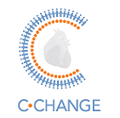
Harmonized Guidelines
Canadian Cardiovascular HArmonization of National Guidelines Endeavour
Mission:
Harmonize CPGs for vascular disease prevention & treatment
National strategy for prevention & treatment of vascular disease
  Reps from the 8 guideline groups and 3 GPs
  Reduced 400 recommendations to 89
Notes:
Harmonized Guidelines
Having so many problem-specific guidelines can be counter-productive to the practical demands of clinical practice. That is why C-CHANGE (Canadian Cardiovascular HArmonization of National Guidelines Endeavour) was developed. The C-CHANGE initiative was established to harmonize clinical practice recommendations for vascular disease prevention and treatment.
The mission of the C-CHANGE initiative is twofold:
To establish one authoritative set of harmonized guidelines for the prevention and treatment of chronic atherosclerotic disease in Canada
To develop, disseminate, implement and evaluate a nationally coordinated, harmonized and integrated strategy for the prevention and treatment of vascular disease (cardiovascular, cerebrovascular, peripheral vascular) to help understand vascular risk, treatment targets and treatments to achieve these targets.
The C-CHANGE Guideline Panel, composed of representatives from the 8 previously identified guideline groups, along with three GPs, employed a rigorous selection process to reduce the total number of clinical recommendations from over 400 to 89. This represents a unique gathering of key guideline groups working together towards creating a clinically useful set of overall recommendations. The C-Change initiative produced Canada’s first harmonized clinical practice guidelines. C-CHANGE provides authoritative, harmonized information and validated clinical tools to assist in key areas of cardiovascular health.
C-CHANGE was first published in 2011 with an update later published in November of 2014.

Slide 11

C-CHANGE
Resources:
National website: C-CHANGE Clinical Resources Center: www.c-changecrc.ca
Patient / Public Resource:
www.c-changeinme.com
Notes:
C-CHANGE (Canadian Cardiovascular HArmonization of National Guidelines Endeavour):
All vascular risk reduction education and vascular care recommendations, resources and tools are grounded in the C-CHANGE recommendations. The 89 recommendations serve as a focus point for vascular care and can be located on the national C-CHANGE website.
National Website: There is a national C-CHANGE website which explains the initiative and provides additional information.
Clinical Resource Centre: The purpose of the C-CHANGE Clinical Resource Centre (CRC) is to facilitate the use of the C-CHANGE guidelines in practice. All information is concordant with the most recent C-CHANGE clinical practice guidelines published in the Canadian Medical Association Journal. This CRC is intended to provide evidence-informed support to all health care practitioners to better manage the prevention and treatment of cardiovascular disease. It will also assist in the care of patients that present with more than one CVD risk factor. The C-CHANGE Clinical Resource Centre includes a harmonized guideline search feature, supplemental resources and clinical tools, along with a process for providing feedback for quality improvement. There is also a C-CHANGE Clinical Primer available.
Supplementary resources from partner organizations enhance the C-CHANGE guidelines recommendations throughout the site. Vascular risk calculators, screening algorithms, and other decision-making support tools are designed to assist health care professionals in managing patients with multiple comorbidities related to CVD.
Patient / Public Education Site: C-CHANGEinme is a patient information site dedicated to prevention and management of cardiovascular disease risk. All information contained is concordant with the C-CHANGE recommendations.

Slide 12
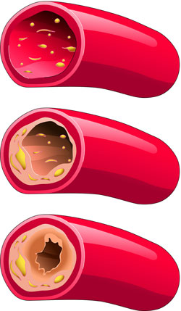
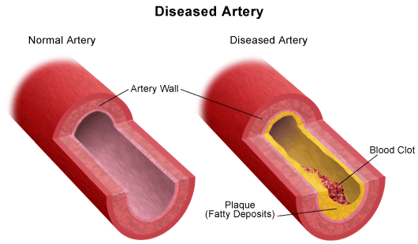
Vascular Disease-Atherosclerosis
Plaque
Notes:
Vascular Disease - Atherosclerosis
Damaged endothelium, traps lipids, calcium, cellular debris and the artery is narrowed by atherosclerotic plaque.
Review process with participants.
Atherosclerosis is a process in which plaques develop within the inner walls of arteries. The plaque develops slowly over many years and causes thickening and hardening of the arterial wall with fatty deposits.
Plaque formation is thought to occur as a result of a protective response following damage to the endothelium of the arterial wall. The damage is caused by: elevated levels of cholesterol or glucose, hypertension, atherogenic diet, or toxins from cigarette smoke
Atherosclerosis is responsible for almost all cases of coronary heart disease (CHD). This insidious process begins with fatty streaks that are first seen in adolescence; these lesions progress into plaques in early adulthood, and culminate in thrombotic occlusions and coronary events in middle age and later life.
A variety of factors, often acting in concert, are associated with an increased risk for atherosclerotic plaques in coronary arteries and other arterial beds Risk factor assessment is useful in adults to guide therapy for dyslipidemia, hypertension, and diabetes, and multivariate formulations can be used to help estimate risk for coronary disease events.
Wilson PW. Established risk factors and coronary artery disease: the Framingham Study. Am J Hypertens 1994; 7:7S.
Wilson PW, D'Agostino RB, Levy D, et al. Prediction of coronary heart disease using risk factor categories. Circulation 1998; 97:1837.
Ridker PM. Evaluating novel cardiovascular risk factors: can we better predict heart attacks? Ann Intern Med 1999; 130:933.

Slide 13
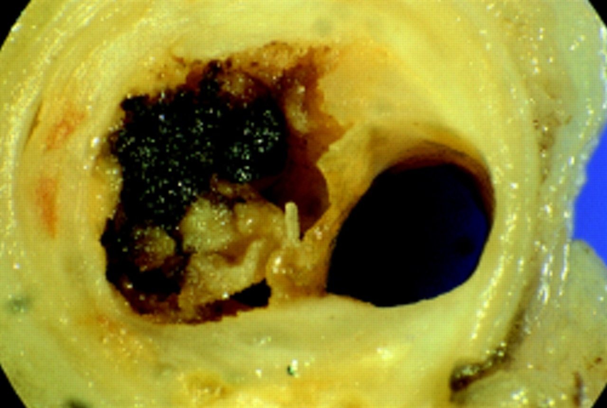
Athero-thrombosis is characterized by a sudden atherosclerotic plaque disruption leading to platelet activation and thrombus formation
Vascular Disease-Athero-thrombosis
Notes:
Vascular Disease – Athero-thrombosis
Rupture or erosion of the plaque may occur. Small parts of the plaque may break off, forming emboli, which circulate in the vascular system. The embolus will become lodged in an artery and may lead to a vascular event
Rupture also provides an ideal site for blood clot or thrombus formation which may occlude the artery leading to a vascular event
Plaques may become calcified, leading to reduced elasticity of the artery and a weakening of the vessel wall. A thinner and weaker vessel wall can lead to an aneurysm and possible haemorrhage.

Slide 14
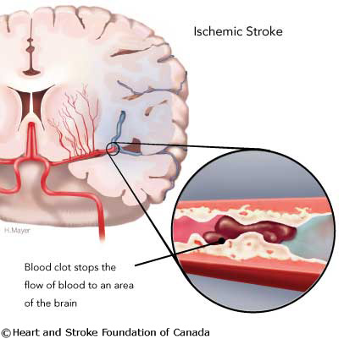
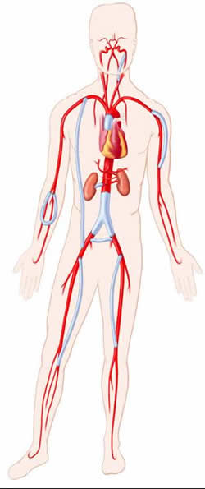
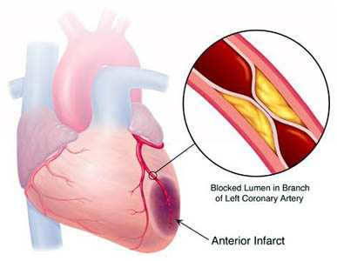
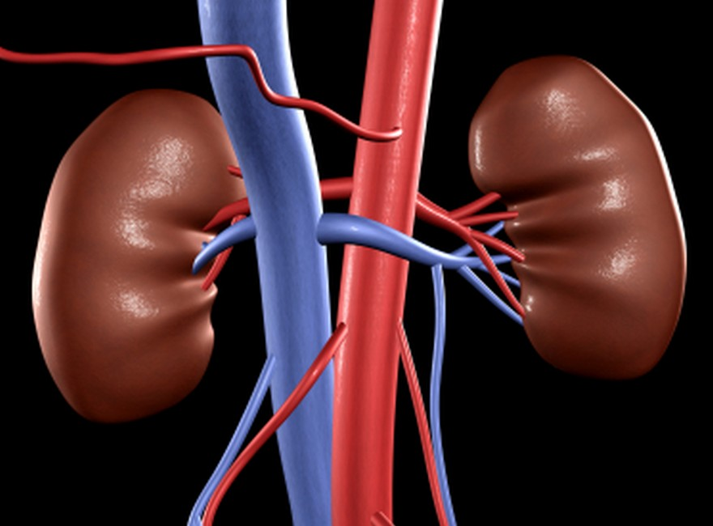
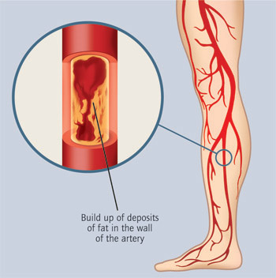
Vascular Disease
Stroke / TIA
Coronary Heart Disease
Plaque
Chronic Kidney Disease (CKD)
Peripheral Vascular Disease
Notes:
Vascular Disease:
(Interesting info – if all blood vessels were placed end to end, it is reported that they would have a total length of 100,000km (long enough to encompass the earth 2.5 times!)
Narrowing or blockage of arteries causes ischemia which can lead to cell death. Dead cells lead to tissues/organs not working well and/or causes death.
Activity:
Discussion Question: Imagine if this atherosclerosis is happening throughout the entire body, what vascular problems could there be?
Discuss with participants the different kind of vascular disease and manifestations of pathology. Slide will show each disease individually after discussion.

Slide 15
Vascular Disease
Athero-thrombosis: a progressive process
Plaque
rupture/
fissure &
thrombosis
Athero-
sclerotic
plaque
Fatty
streak
Fibrous
plaque
Normal
Myocardial
infarction
Ischaemic
stroke
Critical leg ischaemia
Clinically silent
Angina
Transient ischaemic attack
Claudication/PAD
Clinically Critical
Kidney Disease
Increasing age
Notes:
Vascular Disease – Athero-thrombosis
It is a dynamic process and progressive over time. Gets worse as we get older. Vascular risk factors such as smoking, lipids, BP, diabetes, hypertension may enhance this process.
Heart attack and Stroke are well known and thought about when discussing atherosclerosis. However, peripheral vascular disease and kidney disease are also important to think about.
These are the end games of this lethal process. Is it about time that we start talking about these end games collectively because after all their so much overlap.
Prevention and management is about caring for the entire arterial system!

Slide 16
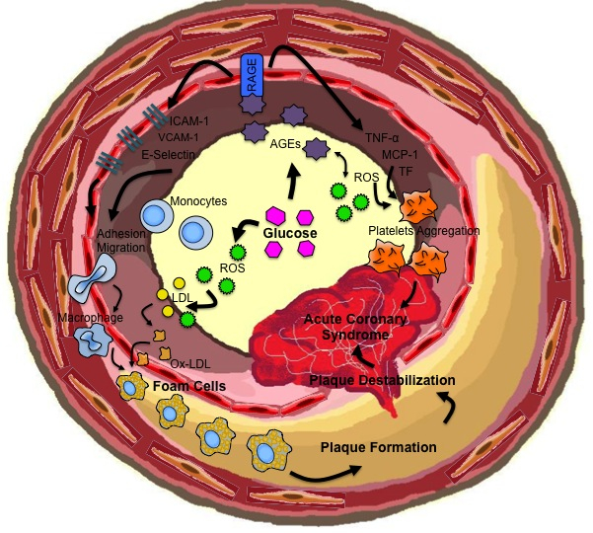
Vascular Disease and Diabetes
Normal endothelium produces nitrous oxide (NO)
  Relaxes vessel wall
  Prevents cells sticking
Diabetes
Disrupts NO production
  gluc & lipids → sticky walls → local tissue reaction → plaque
Increases vessel constriction
  Vessels hyperactive
Affect platelets and clotting factors
  Cells are stickier
  ↓ effect of factors that inhibit clot formation
Plaque
Notes:
Vascular Disease (Atherosclerosis) and Diabetes
Normal blood vessels have an inner lining, called endothelium, that keeps blood flowing smoothly by producing local Nitrous oxide (NO). NO serves to relax the smooth muscles in the walls of the vessels and prevent cells from sticking to the walls. A disruption of this mechanism is thought to be at the heart of the increased formation of plaques in diabetes. High blood sugar, elevated fatty acids and triglycerides leads to stickier walls, encouraging the attachment of cells that produce local tissue reaction. The local tissue reaction further traps floating particles and different blood cells, heaping up and hardening the vessel walls.
Insulin stimulates the production of NO by the cells lining the blood vessels. In diabetics who are resistant to the actions of insulin, this stimulatory effect is lost, resulting in increased tendencies towards plaque formation.
In the presence of raised blood sugar and resistance to insulin, the lining cells of the blood vessels not only reduce production of NO, they also increase the production of substances that constrict the blood vessel, further encouraging plaque formation. The smooth muscles of the blood vessels are also hyperactive in diabetes.
Platelets and clotting factors are also affected by the high blood sugar, fatty acids and free radicals in diabetes. The blood cells are much stickier and the factors that inhibit clots do not work well under the peculiar circumstances of diabetes.
To reduce the excessive vascular risk associated with diabetes, all risk factors must be addressed and treated aggressively. Adequate treatment of diabetes with lifestyle modifications has a highly positive impact, restoring normal function and reducing plaque formation.
Review: Clinical Cardiology: New Frontiers
Diabetes and Vascular Disease Pathophysiology, Clinical Consequences, and Medical Therapy: Part II. Thomas F. Lüscher, MD, FRCP; Mark A. Creager, MD; Joshua A. Beckman, prepared with the assistance of, MD; Francesco Cosentino, MD, PhD

Slide 17
Vascular Risk Reduction (VRR)
Key Messages:
Vascular disease is the major cause of death and disability in Alberta and in Canada
Causes of vascular disease are known and preventable
Over 90% of Canadians have at least 1 common vascular risk factor (VRF)
National harmonized CPGs exist for vascular disease prevention & treatment (C-CHANGE)
Notes:
VRR: Key Messages
Summary slide – Highlight the key messages discussed in this presentation.

Slide 18
Questions?

