Slide 1



Vascular Risk Reduction:
Identifying Vascular Risk
Notes:
Vascular Risk Reduction: Identifying Vascular Risk
To maximize the benefits of preventive therapy, lipid and hypertension guidelines increasingly recommend that high-risk individuals be targeted for treatment. An individual's risk of developing vascular disease depends on many risk factors, such as age, sex, blood pressure, blood lipid levels, body weight, physical fitness, smoking habits and familial predisposition. Multivariable statistical models have therefore been developed to better estimate the global risk of future coronary events and stroke.
Despite the continuing improvements in treating vascular disease among Canadians, coronary artery disease and stroke remain among the most common causes of premature mortality and disability in adults. Accordingly, the treatment of manageable risk factors, such as hypertension and dyslipidemia, to prevent or delay the development of vascular disease remains an essential component of medical therapy and public health policy.
The clinical benefits of risk factor modification to prevent cardiovascular events have been clearly demonstrated in randomized clinical trials. Nonetheless, these benefits may be associated with important treatment complications, minor side effects and the substantial, direct health care costs of lifelong therapy. To maximize the net benefits of preventive therapy, evolving treatment guidelines increasingly recommend that health care professionals target high-risk individuals for therapy. In this way, the potential risks of therapy are offset by a substantial reduction in the risk of cardiovascular disease. Targeting high-risk individuals also maximizes the cost-effectiveness of treatment.
Padwal R, Straus SE, McAlister FA. Evidence based management of hypertension. Cardiovascular risk factors and their effects on the decision to treat hypertension: Evidence based review. BMJ. 2001;322:977–80.

Slide 2
Vascular Risk Reduction (VRR)
Welcome!
Presentation & Activities
Focus: Work together to discover ways to best implement vascular risk identification into your practice
Engage, collaborate and have fun!
Notes:
VRR: Welcome and Introduction
The focus of this presentation is on identifying and assessing Vascular Risks within the clinician’s everyday practice
Cardiovascular disease (CVD) is common in the general population, affecting the majority of adults past the age of 60 years. In 2012, CVD was estimated to result in 17.3 million deaths worldwide on an annual basis . CVD includes four major areas:
●Coronary heart disease (CHD), manifested by myocardial infarction (MI), angina pectoris, heart failure, and coronary death
●Cerebrovascular disease, manifested by stroke and transient ischemic attack
●Peripheral artery disease, manifested by intermittent claudication
●Aortic atherosclerosis and thoracic or abdominal aortic aneurysm
AULaslett LJ, Alagona P Jr, Clark BA 3rd, Drozda JP Jr, Saldivar F, Wilson SR, Poe C, Hart M. The worldwide environment of cardiovascular disease: prevalence, diagnosis, therapy, and policy issues: a report from the American College of Cardiology. SOJ Am Coll Cardiol. 2012;60(25 Suppl):S1.

Slide 3
Vascular Risk Reduction
Objectives:
Describe which clinical assessments may indicate vascular risk.
Identify who to screen for cardiovascular risk assessment.
Implement vascular risk assessments into clinical practice.
Notes:
Vascular Risk Reduction: Objectives:
Review learning objectives

Slide 4
Impact of Vascular Disease
Vascular Risk Round Up:
Volunteer reads Question card.
The person with the correct Answer card must wave it and read the answer aloud.
If correct, it will be his/her turn to read out the question
on the Question card.
If not correct, everyone must agree on the correct answer, then ask the person with the correct Answer card to read out his/her question.
Play continues until all questions have been read, along with their correct answers.
Notes:
Impact of Vascular Disease:
Group Game: (see instructions). A number of participants should have both a question card and an answer card (A maximum of 15 participants should be dispersed throughout the room). Dispense these cards at the beginning of the session.

Slide 5

Identifying Vascular Risk-
Who Has BAD FAT?
Assess the following:
Blood pressure
Alcohol use
Diabetes (yes/no)
Fruits and vegetables
Activity
Tobacco use
Every Patient visit!
Waist
Height
Obesity
Notes:
Identifying Vascular Risk- Who Has BAD FAT?
The presence of BAD FAT can result in vascular disease. Clinicians should assess adult patients for those indicators identified in the acronym “WHO has BAD FAT?”. These quick assessments can assist in identifying who is at risk. They can be obtained through interview and non-invasive clinical assessments (no blood tests are required).
Activity: Discussion : Question & Answer
Ask participants: How do we know who has bad fat or is at vascular risk? Who do we ask?
Assess the following on every adult, no matter what age they are. Make sure you have this information available at each visit.
If you have a recent Waist, Height and Obesity (weight – body mass index) assessment then these need not be repeated.
Discussion : Question & Answer
Ask participants: How can you fit these assessments into your routine patient evaluation? Who could gather the information?
BAD FAT is placed first as Blood Pressure is an important assessment for vascular risk and should be completed in a quiet environment, often first, before walking to scale for height and weight etc.

Slide 6
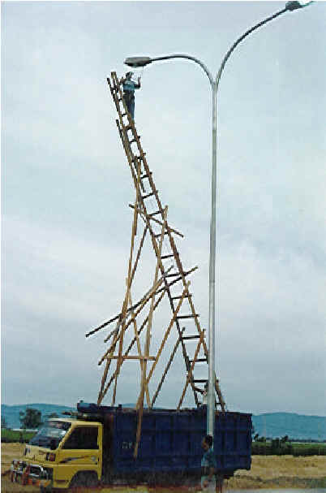
Identifying Vascular Risk-
Who Has HIGH RISK?
Diabetes
  40 years or older
  15 year duration and at least 30 y/o with MVD
Abdominal Aortic Aneurysm
Clinical evidence of atherosclerosis
  MI, coronary revascularization, stroke/TIA, PVD
Chronic Kidney Disease (CKD)
Hypertension (high risk): with 3 VRF
  Male, >55 y/o, smoker, LVH, family history of CVD, abnormal ECG, TC/HDL ratio >6, microalbuminuria
Notes:
Identifying Vascular Risk- Who Has HIGH RISK?
Individuals possessing the following conditions are automatically considered to be at HIGH RISK for a vascular event:
Clinical evidence of atherosclerosis:
previous MI, coronary revascularization
coronary artery bypass graft (CABG) surgery or other revascularization procedures
cerebrovascular disease including transient ischemic attack (TIA)
peripheral arterial disease
Abdominal aortic aneurysm (AAA)
Diabetes and 40 years of age or older
Diabetes of 15 yrs duration and at least 30 years of age with microvascular disease
Chronic Kidney Disease (CKD) with either:
Glomerular filtration rate (GFR) of 45 mL/min/1.73m2 or less OR albumin-to-creatinine ratio of 30 mg/mmol or greater (300 mg/day or greater)
GFR of 60 mL/min/1.73m2 or less AND an albumin-to-creatinine ratio (ACR) of 3 mg/mmol or greater
Hypertension plus three of the following risk factors:
male left ventricular hypertrophy (LVH)
age greater than 55 years family history of premature CVD
smoking electrocardiogram (ECG) abnormalities
total cholesterol/HDL-C ratio greater than 6 micoalbuminuria
Certain individuals with established cardiovascular disease (CVD) or CVD risk equivalents are known to be at high risk of recurrent cardiovascular events and should be treated with appropriate secondary prevention measures.
Diabetes: Patients with diabetes have a greater burden of atherogenic risk factors than nondiabetics, including hypertension, obesity, lipid abnormalities, and elevated plasma fibrinogen. The CHD risk in patients with diabetes varies widely with the intensity of these risk factors. The evidence is strongest for hypertension, elevated low density lipoprotein, smoking, the metabolic syndrome, hyperglycemia, and microalbuminuria.
Hammoud T, Tanguay JF, Bourassa MG. Management of coronary artery disease: therapeutic options in patients with diabetes. J Am Coll Cardiol 2000; 36:355.
Taegtmeyer H, McNulty P, Young ME. Adaptation and maladaptation of the heart in diabetes: Part I: general concepts. Circulation 2002; 105:1727.
Haffner SM, Mykkänen L, Festa A, et al. Insulin-resistant prediabetic subjects have more atherogenic risk factors than insulin-sensitive prediabetic subjects: implications for preventing coronary heart disease during the prediabetic state. Circulation 2000; 101:975.
Cardiovascular risk factors promote CVD in either gender at all ages but with different relative importance.
●Diabetes and a low high-density lipoprotein (HDL)-cholesterol/total cholesterol ratio operate with greater power in women
●The incidence of a myocardial infarction is increased sixfold in women and threefold in men who smoke at least 20 cigarettes per day compared to subjects who never smoked.
●Systolic blood pressure and isolated systolic hypertension are major CHD risk factors at all ages and in both genders. The Framingham study found that the relative importance of systolic, diastolic, and pulse pressure (the difference between the systolic and diastolic blood pressures) changes with age. In patients <50 years of age, diastolic blood pressure was the strongest predictor of CHD risk; in those 50 to 59 years of age, all three blood pressure indices were comparable predictors of CHD risk, while in those ≥60 years of age, pulse pressure was the strongest predictor.
●Some risk factors, such as dyslipidemia, impaired glucose tolerance, and elevated fibrinogen have a diminished impact with advancing age, but a lower relative risk is offset by the high absolute risk in older adults. Thus, all of the major risk factors continue to be relevant in older persons.
●Obesity or weight gain promotes or aggravates all the atherogenic risk factors and physical inactivity worsens some of them, predisposing subjects of all ages to CHD events. (Age alone also appears to contribute to the development of CVD. In a cohort of more than 3.6 million individuals age 40 years or older who underwent self-referred screening for cardiovascular disease (ankle brachial index, carotid duplex ultrasound, and abdominal ultrasound), the prevalence of any vascular disease increased significantly with each decade of life:
●2 percent in 40 to 50 year olds
●3.5 percent in 51 to 60 year olds
●7.1 percent in 61 to 70 year olds
●13 percent in 71 to 80 year olds
●22.3 percent in 81 to 90 year olds
●32.5 percent in 91 to 100 year olds
After adjusting for traditional risk factors, each additional decade of life was associated with an approximate doubling of the risk of vascular disease (odds ratios per decade of life were 2.14, 1.80, and 2.33 for peripheral arterial disease, carotid stenosis, and abdominal aortic aneurysm, respectively).
Age and Gender: Male gender alone may contribute to the risk of CHD, although the potential mechanisms for such risk are not well understood. Several population studies have identified male gender as a risk factor for higher rates of CHD and CHD-related mortality . Among 31,000 patients from the ONTARGET and TRANSCEND study populations (9378 females, 22,168 males) who were followed for an average of 56 months, females had approximately 20 percent lower risk than males for all major cardiovascular endpoints including cardiovascular death (adjusted RR 0.83, 95% CI 0.75-0.92), myocardial infarction (MI) (adjusted RR 0.78, 95% CI 0.68-0.89), and a combined endpoint of death, MI, stroke, and heart failure hospitalization (adjusted RR 0.81, 95% CI 0.76-0.87).
Savji N, Rockman CB, Skolnick AH, et al. Association between advanced age and vascular disease in different arterial territories: a population database of over 3.6 million subjects. J Am Coll Cardiol 2013; 61:1736.
Tunstall-Pedoe H, Kuulasmaa K, Mähönen M, et al. Contribution of trends in survival and coronary-event rates to changes in coronary heart disease mortality: 10-year results from 37 WHO MONICA project populations. Monitoring trends and determinants in cardiovascular disease. Lancet 1999; 353:1547.
D'Agostino RB Sr, Vasan RS, Pencina MJ, et al. General cardiovascular risk profile for use in primary care: the Framingham Heart Study. Circulation 2008; 117:743.
Kappert K, Böhm M, Schmieder R, et al. Impact of sex on cardiovascular outcome in patients at high cardiovascular risk: analysis of the Telmisartan Randomized Assessment Study in ACE-Intolerant Subjects With Cardiovascular Disease (TRANSCEND) and the Ongoing Telmisartan Alone and in Combination With Ramipril Global End Point Trial (ONTARGET). Circulation 2012; 126:934.
Hypertension — Hypertension is a major risk factor for the development of atherosclerosis, particularly in the coronary and cerebral circulations. It can increase arterial wall tension, potentially leading to disturbed repair processes and aneurysm formation.
Smoking — Cigarette smoking is another major risk factor and it impacts all phases of atherosclerosis from endothelial dysfunction to acute clinical events, the latter being largely thrombotic. The following observations have been made:
●In humans, cigarette smoke exposure impairs endothelium-dependent vasodilation, perhaps through decreased nitric oxide (NO) availability .
●Cigarette smoking is associated with an increased level of multiple inflammatory markers, including C-reactive protein, interleukin-6, and tumor necrosis factor alpha in both male and female smokers .
Yusuf S, Hawken S, Ounpuu S, et al. Effect of potentially modifiable risk factors associated with myocardial infarction in 52 countries (the INTERHEART study): case-control study. Lancet 2004; 364:937.
Frohlich J, Al-Sarraf A. Cardiovascular risk and atherosclerosis prevention. Cardiovasc Pathol 2013; 22:16.
Ambrose JA, Barua RS. The pathophysiology of cigarette smoking and cardiovascular disease: an update. J Am Coll Cardiol 2004; 43:1731.
Chronic kidney disease — The increased CHD risk in patients with end-stage renal disease has been well described, but there is now clear evidence that mild to moderate renal dysfunction is also associated with a substantial increase in CHD risk.
Gansevoort RT, Correa-Rotter R, Hemmelgarn BR, et al. Chronic kidney disease and cardiovascular risk: epidemiology, mechanisms, and prevention. Lancet 2013; 382:339.

Slide 7
Identifying Vascular Risk
Who needs additional screening for vascular risk?
Labs?
Notes:
Identifying Vascular Risk:
Although every adult should be assessed to see ‘WHO has BAD FAT’, additional assessment is required to determine the individual cardiovascular risk. This includes obtaining lipid lab values.

Slide 8

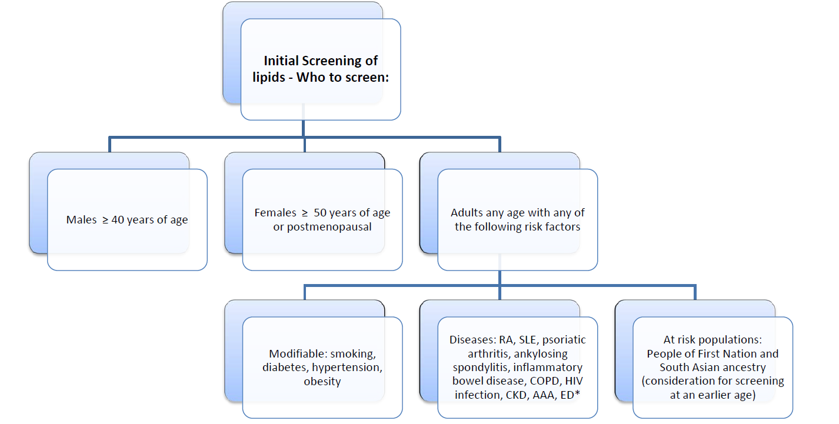
Vascular Risk Assessment – Who to Screen
Who to Screen
Notes:
Vascular Risk Assessment: Who to Screen
While a general estimate of the relative risk for CVD can be approximated by counting the number of traditional risk factors present in a patient, a more precise estimation of the absolute risk for a first CVD event is desirable when making treatment recommendations for a specific individual.
Patients aged 20 years or older without established CVD should also undergo periodic cardiovascular risk assessment every three to five years. Periodic risk assessment offers the opportunity to identify CVD risk factors and offer guidance on the appropriate management of specific risk factors (eg, dietary modifications for hypertension or dyslipidemia, etc) and overall CVD risk (eg, maintaining a healthy diet, regular exercise, etc). It is unknown at what age periodic risk assessment should no longer be performed, but many of the validated risk models have only included patients up to 79 years of age or less. Decisions regarding the discontinuation of periodic risk assessment should be made in collaboration with each individual patient based on the patient’s overall functional status, life expectancy, and values and preferences for risk factor modification.
Goff DC Jr, Lloyd-Jones DM, Bennett G, et al. 2013 ACC/AHA guideline on the assessment of cardiovascular risk: a report of the American College of Cardiology/American Heart Association Task Force on Practice Guidelines. Circulation 2014; 129:S49

Slide 9
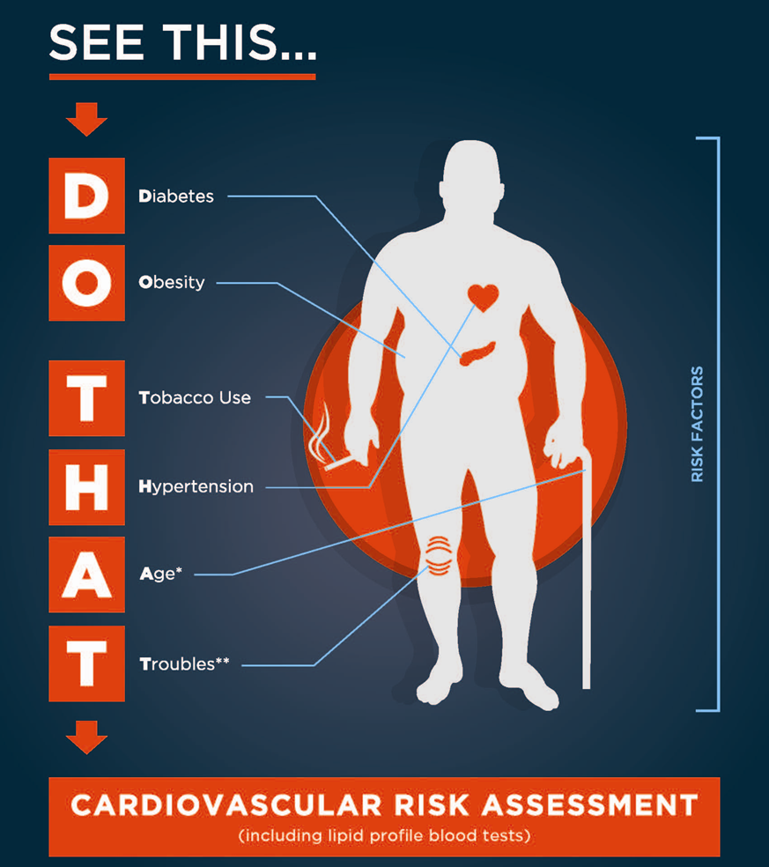
Cardiovascular Risk Assessment:
Who to Screen
Notes:
See this…DO THAT Cardiovascular Risk Assessment
The Alberta Coalition for PrevenTION and control of vascular disease (ACTION) Network has developed the enclosed resource to assist you in identifying who should be assessed for cardiovascular risk.
Research shows 23.8 per cent of Canadians have moderate to high cardiovascular risk (Framingham Risk Score ≥ 10 per cent) but only 22-48 per cent of physicians regularly assess this risk. Those at risk of vascular disease are often unaware, untreated, or not treated optimally. It is important, therefore, for clinicians to identify who requires assessment of cardiovascular risk and ensure risk assessments are completed when indicated. As vascular risk is known, actions can be taken to manage risk factors and prevent the devastating effects of vascular diseases such as heart disease, stroke, dementia, diabetes, kidney and peripheral vascular disease.
When an individual possesses any one of the conditions mentioned in the ‘DO THAT’ acronym (Diabetes, Obesity, Tobacco use, Hypertension, Age*, Troubles*), a Cardiovascular Risk Assessment should be completed, including a lipid profile blood test, utilizing an approved CV Risk Assessment tool.
*Age refers to men 40 years and older, women 50 years and older or postmenopausal, and adults of any age if other risk factors exist.
*Troubles refer to troubling diseases such as Rheumatoid Arthritis, Systemic Lupus Erythematosus, Psoriatic Arthritis, Ankylosing Spondylitits, Inﬂammatory Bowel Disease, Chronic Obstructive Pulmonary Disease, Chronic Kidney Disease, Erectile Dysfunction, Abdominal Aortic Aneurysm, HIV infection
This graphic memory aid is available in both poster (11”x 17”) and card (3”x4”) format for use in clinical practice.
Order Information (No Charge): To order, please email Priyanka at Priyanka.Manocha@albertahealthservices.ca and indicate: Type of Resource (Poster or Laminated Card), #Amount and Mailing Address.

Slide 10
Vascular Risk Assessment – How to Screen
How to screen for
vascular risk?
Notes:
Vascular Risk Assessment: How to Screen

Slide 11
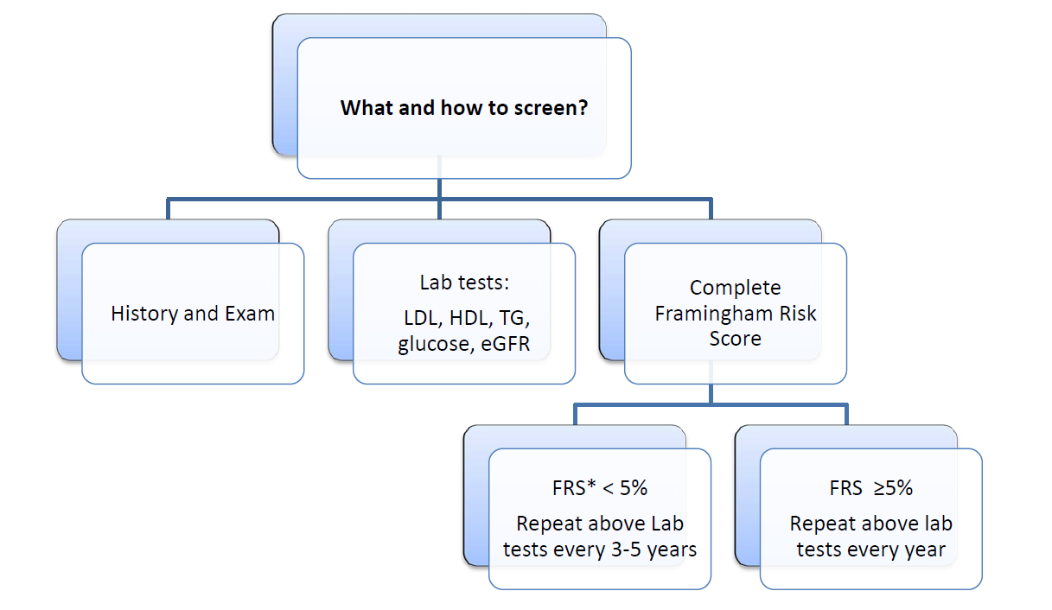
Vascular Risk Assessment – How to Screen
Notes:
Vascular Risk Assessment – How to Screen
Additional Screening tests – Labs (Lipid Profile-LDL, HDL, TG, total cholesterol, fasting glucose, eGFR)
A number of multivariate risk models have been developed for estimating the risk of cardiovascular events in apparently healthy, asymptomatic individuals based upon assessment of multiple variables. While all of the risk models have advantages and disadvantages, no single risk model will be appropriate for all patients. The choice a specific risk model for cardiovascular disease (CVD) risk assessment should be individualized based on patient-specific characteristics (eg, age, gender, ethnicity). Most experts feel that the use of risk models that predict hard CVD events (ie, death, myocardial infarction [MI], stroke) are preferred over those which include other endpoints (ie, revascularization).
An important component of these models is that many of the risk factors (eg, age, hypertension, serum LDL-cholesterol) are recognized as producing a graded increase in risk. These models estimate risk of an individual over the next 10 years.
Several studies have suggested that the Framingham criteria either overestimate or underestimate the risk of initial coronary heart disease (CHD) events in other populations such as Japanese American and Hispanic men, Native American women, European and Asian populations, and African-American men and women, as well as patients older than age 85 years. These differences are partly explained by the research methods used, adjudication procedures, time intervals studied, and calendar year of the baseline evaluations. Multiple models, including SCORE and QRISK2, have been developed in an attempt to provide better predictive accuracy for European patients.
Framingham risk score (1998) — The original Framingham risk score (1998), published in 1998, was derived from a largely Caucasian population of European descent. Subsequent studies have suggested that the Framingham risk score performs well for prediction of CHD events in black and white women and men.
●Parameters incorporated in Framingham General CVD risk score (2008)
●Age
●Gender
●Total cholesterol (mg/dL)
●HDL cholesterol (mg/dL)
●Systolic blood pressure (mmHg)
●Blood pressure treatment (yes or no)
●Diabetes mellitus (yes or no)
●Current smoking (yes or no)
D'Agostino RB Sr, Grundy S, Sullivan LM, et al. Validation of the Framingham coronary heart disease prediction scores: results of a multiple ethnic groups investigation. JAMA 2001; 286:180.

Slide 12
Framingham Risk Score (FRS) Estimation of 10-year
Cardiovascular Disease (CVD) Risk
Step 1
Step 2
Step 1 In the “points” column enter the appropriate value according to the patient’s age, HDL-C, total cholesterol, systolic blood pressure and if they smoke or have diabetes. Calculate the total points.
Risk factor |  | Risk points |  |  |  | Points
 |  | Men |  | Women
Age
30-34 35-39 40-44 45-49 50-54 55-59 60-64 65-69 70-74 75+ |  | 0 2 5 6 8 10 11 12 14 15 |  | 0 2 4 5 7 8 9 10 11 12
HDL-C (mmol/L)
>1.6 1.3-1.6 1.2-1.3 0.9-1.2 <0.9 |  | -2 -1 0 1 2 |  | -2 -1 0 1 2
Total cholesterol
<4.1 4.1-5.2 5.2-6.2 6.2-7.2 >7.2 |  | 0 1 2 3 4 |  | 0 1 3 4 5
Systolic blood pressure (mmHg) |  | Not treated | Treated | Not treated | Treated
<120 120-129 130-139 140-149 150-159 160+ |  | -2 0 1 2 2 3 | 0 2 3 4 4 5 | -3 0 1 2 4 5 | -1 2 3 5 6 7
Diabetes | Yes No | 3 0 |  | 4 0
Smoker | Yes No | 4 0 |  | 3 0
Total Points
Total points | 10-year CVD Risk (%)
 | Men | Women
-3 or less -2 -1 0 1 2 3 4 5 6 7 8 9 10 11 12 13 14 15 16 17 18 19 20 21+ | <1 1.1 1.4 1.6 1.9 2.3 2.8 3.3 3.9 4.7 5.6 6.7 7.9 9.4 11.2 13.3 15.6 18.4 21.6 25.3 29.4 >30 >30 >30 >30 | <1 <1 1.0 1.2 1/5 1.7 2.0 2.4 2.8 3.3 3.9 4.5 5.3 6.3 7.3 8.6 10.0 11.7 13.7 15.9 18.51 21.5 24.8 27.5 >30
Step 2 Using the total points from Step 1, determine the 10-year CVD risk %.
Step 3 For subjects between 30 and 59 years – double cardiovascular disease risk percentage if cardiovascular disease is present in a first degree relative before 55 years of age for men and 65 years of age for women
Can be calculated concurrently with adjusted Cardiovascular Age at: www.chiprehab.com
For mobile device applications from the CCS, please visit: www.ccsguidelineprograms.ca
or www.ccs.ca
HDL-C: high-density lipoprotein cholesterol.
Notes:
Framingham Risk Score (FRS):
Gather information from your assessments and use it to complete the FRS.
An individual’s risk of developing cardiovascular disease depends on many risk factors, such as age, sex, blood pressure, blood lipid levels, body weight, physical fitness, smoking habits and familial predisposition. Multivariable statistical models, based on prospective cohort data, have therefore been developed to better estimate the global risk of future coronary events and stroke. A Canadian model is not currently available for calculating the risk of cardiovascular disease among Canadian men and women. Therefore, global risk assessment among Canadians can only be completed using statistical tools based on adults followed in the United States or Europe.
A paper based Framingham risk assessment worksheet is available and recommended.
Practical tip:
Be aware of the importance of Step #3: Double cardiovascular disease risk percentage (for subjects between 30 and 59 years) if cardiovascular disease is present in a first degree relative before 55 years of age for men and 65 years of age for women.
For patients >75 years of age, the FRS is not well validated
Clinical judgement is required in consultation with the patient to determine the value of pharmacotherapy
One approach is extrapolation of modified FRS – this identifies most subjects as intermediate to high-risk, based on age
Anderson TJ, Gregoire J, Hegele RA, Couture P, Mancini GB, McPherson R, Francis GA, Poirier P, Lau DC, Grover S, Genest J, Jr., Carpentier AC, Dufour R, Gupta M, Ward R, Leiter LA, Lonn E, Ng DS, Pearson GJ, Yates GM, Stone JA, Ur E: 2012 update of the Canadian Cardiovascular Society guidelines for the diagnosis and treatment of dyslipidemia for the prevention of cardiovascular disease in the adult. Can J Cardiol 2013;29:151-167.

Slide 13

Vascular Risk Assessment - FRS
  >> Cardiac Resynchronization Therapy (CRT)
Apps
Additional Topics
CCS Website
On-line: The University of Edinburgh: Cardiovascular Risk Calculator
http://cvrisk.mvm.ed.ac.uk/calculator/calc.asp
Mobile App:
CCS – Lipid Guidelines
Notes:
Vascular Risk Assessment Tools:
The Cardiovascular Health and Stroke Strategic Clinical Network (Vascular Risk Reduction Initiative) recommends healthcare professionals use the CV risk engine within your electronic medical record (EMR) if readily available and/or easy to use. If not, the following easy to use on-line risk calculator is recommended:
The University of Edinburgh: Cardiovascular Risk Calculator
http://cvrisk.mvm.ed.ac.uk/calculator/calc.asp
These additional supported risk calculator tools provide other format options:
Paper based - Updated Framingham Risk Score worksheet
Mobile App - CV risk calculator within the Canadian Cardiovascular Society Lipid Guidelines.

Slide 14
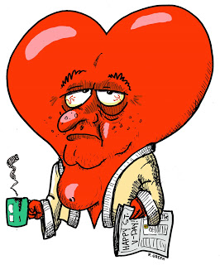

Vascular Risk Assessment – Cardiovascular Age
CV Age motivates people to achieve risk factor targets
Notes:
Vascular Risk Assessment – Cardiovascular Age
Cardiovascular Age= Patient’s Age – (Estimated Remaining Life Expectancy* – Canadian† Average Remaining Life Expectancy)
To calculate cardiovascular age the following is required: patient age, blood pressure, status of smoker (no-smoker or current smoker) and presence of Diabetes.
The website is an excellent resource which calculates FRS as well as cardiovascular age.
If a history of vascular disease is “Yes” – then the on-line calculator will only identify the risk of CV disease in the next 10 years. If a history of vascular disease is “No” - then the on-line calculator will also identify patient’s cardiovascular are. A 10-year risk does not fully account for risk in younger individuals.
Activity: Do a sample Vascular risk assessment on line
Cardiovascular age
Calculation of Cardiovascular Age has been shown to motivate subjects to achieve risk factor targets. Calculating and discussing a patient’s Cardiovascular Age may improve the likelihood they will reach lipid targets and treat poorly controlled hypertension. (Strong Recommendation, High-quality Evidence).

Slide 15
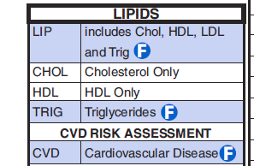

Vascular Risk Assessment: Enhanced Lipid Reporting
A laboratory-based solution for determination and reporting of CV risk
Information required at point of ordering lipid profile to calculate CV risk (FRS):
FRS (10 year CVD risk) reported back with lipid results; recommendations to consider therapy based on 2012 guidelines
Objective:
↑ appropriate use of meds for dyslipidemia
↓ inappropriate use of lipid panels
Use provincially to ↓ vascular morbidity
Smoker Y N
Systolic BP____ / Treated Y N
Diabetes Y N
# years having diabetes ___
Chronic Kidney Disease Y N
Atherosclerosis Y N
Family history of CVD in first degree
relative before age 60 Y N
Demonstration project underway in Lethbridge
Notes:
Vascular Risk Assessment – Enhanced Lipid Reporting
A laboratory based solution for determination and reporting of cardiovascular risk is being trialed in the Lethbridge Chinook PCN for possible provincial implementation. A specific description of this demonstration project is described below:
Context: Research shows 23.8% of Canadians have moderate to high cardiovascular risk (Framingham Risk Score ≥ 10%). Statins have shown to lower risk of cardiovascular events in this population but unfortunately only 20% of those at moderate risk and 49% at high risk are presently on these medications. Perhaps the result of only 22-48% of physicians using risk assessment tools regularly.
Objectives: Enhanced Lipid Profile Reporting seeks to provide a laboratory based solution for the determination of cardiovascular risk, lipid profile and treatment recommendations. Primary care groups will assess the utility of a lab based approach to: a) increase appropriate use of pharmacological therapy for dyslipidemia; b) decrease use of inappropriate laboratory utilization of lipid panels; and c) use provincially to decrease vascular morbidity.
Target Audience: Subjects who require cardiovascular risk determination (men over 40, women over 50 and those with evidence of increased vascular risk) will be included. The demonstration project will include 2 or 3 interested primary care practices. If results are positive, the intent is to roll this out provincially.
Description: Laboratory Services (LS) will adapt the laboratory requisition, with input from primary care providers, to capture all elements required for the laboratory to determine the Framingham Risk Score (FRS). LS will then generate and report FRS with the lipid profile and alert the ordering clinician to current 2012 Canadian Cardiovascular Society Dyslipidemia guidelines. Those patients at risk suitable for treatment with statins will be identified. The work of calculating FRS is done upfront for the care provider.
Evaluation: Surveillance will be undertaken with data provided by DIMR and LS. The following will be assessed: percent of completed lipid panels ordered with accompanying information to determine FRS, FRS categories, change in statin therapy use, change in use of laboratory lipid testing, satisfaction and time required of primary care staff for ordering labs and time commitment of laboratory services staff.
Conclusion: In the early stages of implementation, this laboratory based assessment tool of vascular risk will have downstream beneficial effects for patients and health care providers.

Slide 16
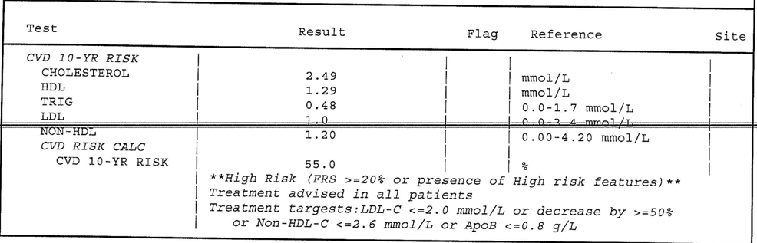
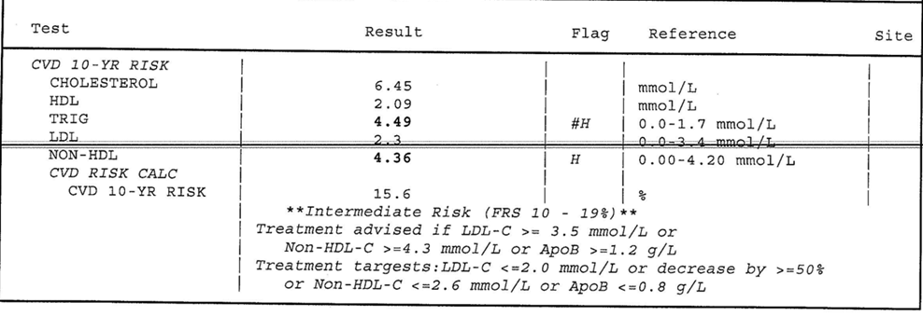
Vascular Risk Assessment: Enhanced Lipid Reporting
Lab report identifies risk and recommended guidelines
If risk suitable for Statin it will be identified
Notes:
Vascular Risk Assessment – Enhanced Lipid Reporting
Sample lab reports.

Slide 17
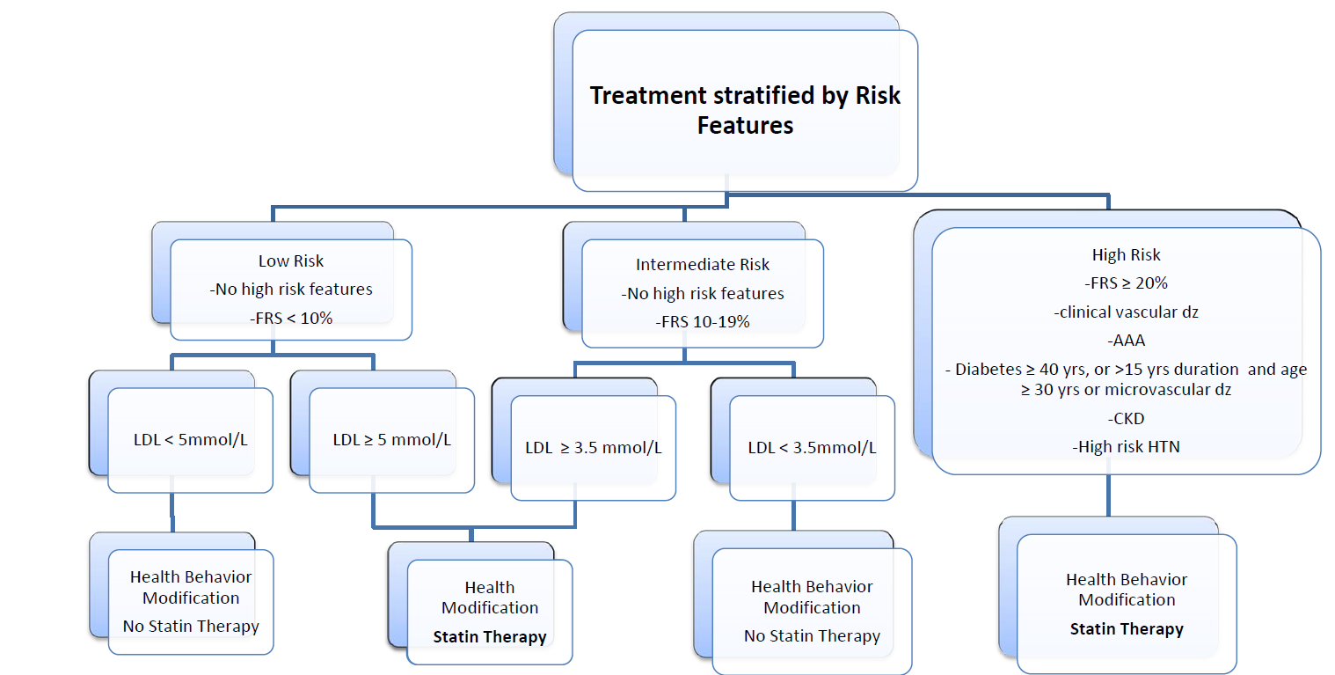
Vascular Risk – What to do
Notes:
Vascular Risk – What to do:
The Canadian Cardiovascular Society (CCS) guidelines are very much aligned with the ACC/AHA and European recommendations that statins are the cornerstone of pharmacotherapy in addition to lifestyle intervention. The evidence supporting their use in appropriate populations is undeniable and this remains an essential message to convey to prescribing clinicians and patients alike. The CCS guidelines also address safety concerns for statin use and provide practical information on dealing with possible side effects.
Anderson, T.J., Gregoire, J., Hegele, R.A. et al. Are the ACC/AHA Guidelines on the Treatment of Blood Cholesterol a Game Changer? A Perspective From the Canadian Cardiovascular Society Dyslipidemia Panel. Can J Cardiol. 2014; 30: 377–380.
Resources to assist clinicians and patients in addressing ‘Myths’ surrounding statin use are available at http://www.albertahealthservices.ca/10585.asp
Clearing Up Myths About Statin Resources:
Handouts:
Clearing Up Myths About Statins Medication (patient resource)
Clearing Up Myths About Statins For Healthcare Providers
Video Resource:
Statins: Overcoming Barriers to Taking Them (Video)
All those with vascular risk should be encouraged to implement Healthy Living behaviors such as eating well (eat more vegetables and fruit), being active (recommend 150 minutes aerobic activity a week) and becoming tobacco-free.
All those at High vascular risk should be treated with statin therapy.
All those with known Vascular Disease should be treated with statin therapy.
Treat Those for Whom There Is the Strongest Evidence:
There is strong concordance between the ACC/AHA and CCS Guidelines to use statin-based therapy in subjects most likely to derive cardiovascular benefit, that is: (1) those with established atherosclerosis (so called secondary prevention); (2) most subjects with diabetes mellitus; and (3) those with LDL-C > 5 mmol/L. These are not new recommendations and are well recognized. Considering the greater risk of these subjects and the fact that up to a third of eligible patients in this category are not currently receiving statin therapy, both guidelines strongly support the need for therapy in this population and the large opportunity to improve cardiovascular health by advocating around this message. In addition, based on evidence from randomized controlled trials, the CCS guidelines also endorse statin-based therapy in subjects with significant chronic kidney disease and high-risk hypertension.
Anderson, T.J., Gregoire, J., Hegele, R.A. et al. Are the ACC/AHA Guidelines on the Treatment of Blood Cholesterol a Game Changer? A Perspective From the Canadian Cardiovascular Society Dyslipidemia Panel. Can J Cardiol. 2014; 30: 377–380.
Baigent, C., Landray, M.J., Reith, C. et al. The effects of lowering LDL cholesterol with simvastatin plus ezetimibe in patients with chronic kidney disease (study of heart and renal protection): a randomised placebo-controlled trial. Lancet. 2011; 377: 2181–2192.
The ACC/AHA guidelines also extended the range of people to be treated by recommending statin therapy for most “intermediate” risk subjects (using a new pooled cohort equations risk > 7.5%).
Goff, D.C. Jr, Lloyd-Jones, D.M., Bennett, G. et al. 2013 ACC/AHA guideline on the assessment of cardiovascular risk: a report of the American College of Cardiology/American Heart Association task force on practice guidelines [epub ahead of print]. J Am Coll Cardiol. 2013; (http://dx.doi.org/10.1016/j.jacc.2013.11.005. Accessed November 07, 2013.)
The CCS did not advocate treating all subjects within an intermediate Framingham risk score but instead included those with an LDL-C ≥ 3.5 mmol/L, or exceeding threshold values of non–high-density lipoprotein cholesterol (non–high-density lipoprotein cholesterol = total cholesterol minus high-density lipoprotein cholesterol) or apolipoprotein B. The 2 approaches would treat different numbers of at-risk subjects, with the ideal approach not clear. The CCS primary panel continues to believe that the evidence-derived approach, based on a level of atherogenic lipoprotein particles, provides a conservative number needed to treat. Decisions about treating additional subjects in the intermediate risk category in a primary prevention setting should be undertaken after risk-benefit discussions with individual patients including the use of the Cardiovascular Age. Cardiovascular Age was added to the CCS guidelines as a tool to improve adherence to lipid-lowering therapy.
D'Agostino, R.B. Sr., Vasan, R.S., Pencina, M.J. et al. General cardiovascular risk profile for use in primary care: the Framingham heart study. Circulation. 2008; 117: 743–753
* Highlight the importance that those with HIGH RISK should be taking a statin.
* Make note of the conditions listed which are identified as indicators of high risk. FRS calculation does not need to be completed on these individuals.
Who is at High Vascular Risk?
- Clinical evidence of atherosclerosis:
previous MI, coronary revascularization
coronary artery bypass graft (CABG) surgery or other revascularization procedures
cerebrovascular disease including transient ischemic attack (TIA)
peripheral arterial disease
- Abdominal aortic anaurysm (AAA)
- Diabetes and 40 years of age or older
- Diabetes of 15 yrs duration and at least 30 years of age with microvascular disease
- Chronic Kidney Disease (CKD) with either:
Glomerular filtration rate (GFR) of 45 mL/min/1.73m2 or less OR albumin-to-creatinine ratio of 30 mg/mmol or greater (300 mg/day or greater)
GFR of 60 mL/min/1.73m2 or less AND an albumin-to-creatinine ratio (ACR) of 3 mg/mmol or greater
- Hypertension plus three of the following risk factors:
male left ventricular hypertrophy (LVH)
age greater than 55 years family history of premature CVD
smoking electrocardiogram (ECG) abnormalities
total cholesterol/HDL-C ratio greater than 6 micoalbuminuria

Slide 18
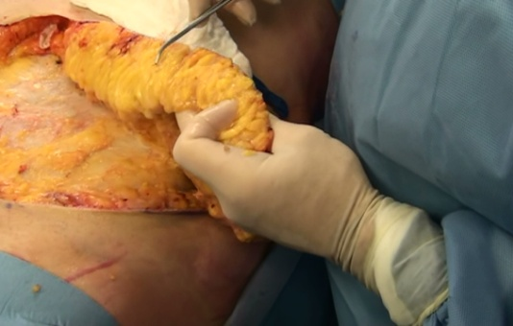
Vascular Risk Assessment – Enhanced Lipid Reporting
Blood pressure
Alcohol use
Diabetes
Fruits and vegetables
Activity
Tobacco use
B
A
D
F
A
T
Waist Height Obesity ?
Labs?
Notes:
Vascular Risk Assessment – Enhanced Lipid Reporting
Review assessment for ‘BAD FAT’ and indications for vascular risk assessment.

Slide 19

BP Measurement Technique
Notes:
Vascular Risk Assessment (VRA) – BP Measurement Technique
Most information required to complete a vascular risk assessment can be obtained through patient interview. Some items, though, require additional clinical assessment and those procedures will be addressed in the following sections.
Blood pressure of all adults should be measured by a trained healthcare professional at all appropriate visits.
For example:
new patient visits
periodic health exams
urgent office visits for neurological or cardiovascular related issues
medication renewal visits
Blood pressure of adults with high normal blood pressure (130-139/80-89 mmHg) should be assessed annually
2014 Canadian Hypertension Education Program (CHEP) Recommendations

Slide 20
VRA – How to Assess BP
Only clinicians specifically trained to measure BP accurately should assess BP.*
  Use standard measurement technique
    Proper technique is critical!
  Recommended to use automated BP devices (OBPM)
Measure BP on both arms at least once (same position) to confirm similar readings
  If different readings, always use arm with higher reading for BP measurement
Notes:
Vascular Risk Assessment (VRA) – How to Assess BP
Health care professionals who have been specifically trained to measure blood pressure (BP) accurately should assess BP in all adult patients at all appropriate visits to determine cardiovascular risk and monitor antihypertensive treatment.
Use of standardized measurement techniques is recommended when assessing blood pressure.
Automated office blood pressure measurements can be used in the assessment of office blood pressure.
When used under proper conditions, automated office SBP of 135 mmHg or higher or DBP values of 85 mmHg or higher should be considered analogous to mean awake ambulatory SBP of 135 mmHg or higher and DBP of 85 mmHg or higher, respectively.
Recommended Technique for Measuring Blood Pressure:
Measurements should be taken with a sphygmomanometer known to be accurate. A recently calibrated aneroid or a validated and recently calibrated electronic device can be used. Aneroid devices or mercury columns need to be clearly visible at eye level.
1. Choose a cuff with an appropriate bladder size matched to the size of the arm. For measurements taken by auscultation, bladder width should be close to 40% of arm circumference and bladder length should cover 80 - 100% of arm circumference. When using an automated device, select the cuff size as recommended by its manufacturer.
2. Place the cuff so that the lower edge is 3 cm above the elbow crease and the bladder is centered over the brachial artery. The patient should be resting comfortably for 5 minutes in the seated position with back support. The arm should be bare and supported with the BP cuff at heart level, as a lower position will result in an erroneously higher SBP and DBP. There should be no talking, and patients' legs should not be crossed.
3. At least three measurements should be taken in the same arm with the patient in the same position. The first reading should be discarded and the latter two averaged. Blood pressure also should be assessed after 2 minutes standing (with arm supported) and at times when patients report symptoms suggestive of postural hypotension. Supine BP measurements may also be helpful in the assessment of elderly and diabetic patients.
When using automated office oscillometric devices such as the BpTRU (VSM MedTech Ltd, Vancouver, Canada), the patient should be seated in a quiet room (no specified period of rest). With the device set to take measures at 1- or 2- minute intervals, the first measurement is taken by a health professional to verify cuff position and validity of the measurement. The patient is left alone after the first measurement while the device automatically takes subsequent readings. The BpTRU automatically discards the first measure and averages the next 5 measures.
Steps 4 to 7 are specific to auscultation
4. Increase the pressure rapidly to 30 mmHg above the level at which the radial pulse is extinguished (to exclude the possibility of a systolic auscultatory gap).
Place the bell or diaphragm of the stethoscope gently and steadily over the brachial artery.
5. Open the control valve so that the rate of deflation of the cuff is approximately 2 mmHg per heart beat. A cuff deflation rate of 2 mmHg per beat is necessary for accurate systolic and diastolic estimation.
6. Read the systolic level - the first appearance of a clear tapping sound (phase I Korotkoff) - and the diastolic level (*the point at which the sounds disappear (phase V Korotkoff)). If Korotkoff sounds persist as the level approaches 0 mmHg, then the point of muffling of the sound is used (phase IV) to indicate the diastolic pressure. Leaving the cuff partially inflated for too long will fill the venous system and make the sounds difficult to hear. To avoid venous congestion, it is recommended that at least one minute should elapse between readings.
7. Record the blood pressure to the closest 2 mmHg on the manometer (or 1 mmHg on electronic devices) as well as the arm used and whether the patient was supine, sitting or standing. Avoid digit preference by not rounding up or down. Record the heart rate.
Unless specifically mentioned, steps apply to measurement by auscultation and oscillometry using an upper arm cuff.
Re-printed with permission of CHEP. 2014 Canadian Hypertension Education Program (CHEP) Recommendations

Slide 21
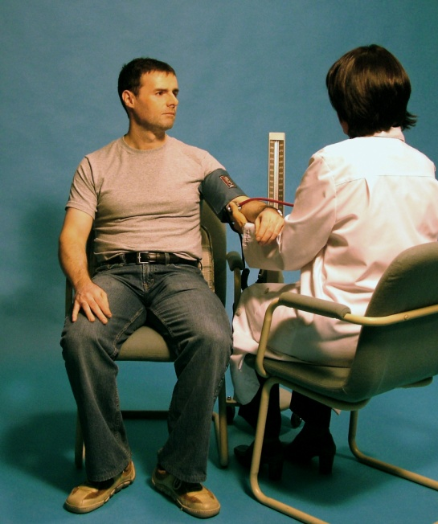
Blood Pressure Assessment:
Patient preparation and posture
Standardized Preparation:
Patient
No acute anxiety, stress or pain.
No caffeine, smoking or nicotine in the preceding 30 minutes.
No use of substances containing adrenergic stimulants such as phenylephrine or pseudoephedrine (may be present in nasal decongestants or ophthalmic drops).
Bladder and bowel comfortable.
No tight clothing on arm or forearm.
Quiet room with comfortable temperature
Rest for at least 5 minutes before measurement
Patient should stay silent prior and during the procedure.
Notes:
Blood Pressure Assessment: Patient preparation and posture
2014 CHEP Recommendations
21

Slide 22

Blood Pressure Assessment:
Patient preparation and posture
Standardized technique:
Posture
The patient should be calmly seated with his or her back well supported and arm supported at the level of the heart.
His or her feet should touch the floor and legs should not be crossed.
Notes:
Blood Pressure Assessment: Patient preparation and posture
2014 CHEP Recommendations
22

Slide 23
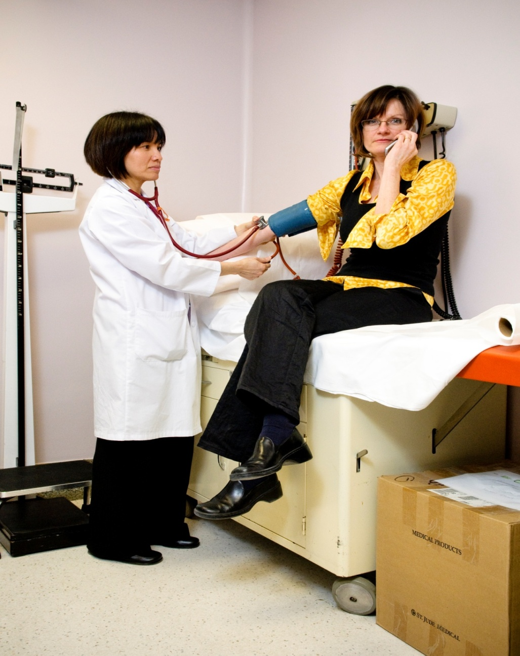
What’s wrong with this picture?
Notes:
What’s wrong with this picture?
Activity: Discussion : Question & Answer
Ask participants: What’s wrong with this picture?
Manual Office Blood Pressure Measurement (OBPM) is inaccurate.
In the real world the accuracy of manual OBPM can be adversely affected by healthcare professional patient and device factors such as:
conversation during BP readings
recording of only a single BP reading
no antecedent period of rest before BPM
rapid deflation of the cuff
digit preference with rounding off of readings to 0 or 5
patient’s anxiety
mercury sphygmomanometer being phased out
Up to 20 studies in the past 4 decades have studied the errors observed in routine office auscultatory measurement, both in nurses and physicians, due to issues concerning the:
observer
preparation of the patient
technique and the device used
This leads to misclassification of the BP.
Armstrong RS, et al. Int J Nursing Practice 2002;8:118-26
Gillespie A and Curzio J. Nursing Standard 1998;12:35-7
Gleichmann SI, et al. J Hypertens 1989;7(S3):S99-S102
Villegas I, et al. Hypertension 1995;26:1204-6
Dreveniiorn E, et al. J Clinical Nursing 2001;10:189-94
McKay DW, et al. Medical Education 1992;26:208-12
McKay DW, et al. J Hum Hypertens 1990;4:639-45
Kemp F, et al. Professional Nurse 1994;9:521-4
Campbell NC, et al. AJH 2005;18:1522-7

Slide 24

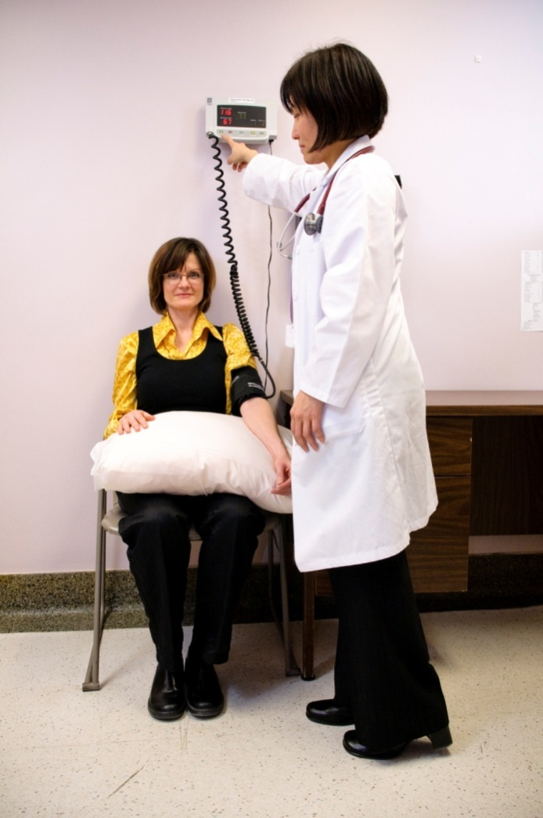
Blood Pressure Assessment:
Patient position
X
Notes:
Blood Pressure Assessment: Patient position
Proper position is demonstrated in the slide.
24

Slide 25
What should we consider when taking an accurate BP?
Appropriate cuff size | No strenuous exercise 2 hour prior
Rest for five minutes | Keep BP arm at heart level
Calm, comfortable environment | Cuff edge is 3 cm above elbow crease
No tight clothing on arm or forearm | Initial: 3 readings on both arms; f/u on arm with highest BP. If unable to get initial 3 readings use non-dominant arm
No crossing of legs
No talking during measurement | F/U-3 BP readings every 1-2 minutes; leave room after first successful reading
Ensure bladder/bowel is empty
No smoking/nicotine/caffeine/light activity 30min prior
Notes:
What should we consider when taking an accurate BP?
Blood pressure should be taken in both arms on at least one visit and if one arm has a consistently higher pressure, that arm should be subsequently used for blood pressure measurement and interpretation. Protocol suggests taking 3 readings on each arm and in future use arm that had the highest BP. If there is no time to assess 3-6 readings always take pressure on non dominant arm.
When using automated office oscillometric devices such as the BpTRU (VSM MedTech Ltd, Vancouver, Canada), the patient should be seated in a quiet room (no specified period of rest). With the device set to take measures at 1- or 2- minute intervals, the first measurement is taken by a health professional to verify cuff position and validity of the measurement. The patient is left alone after the first measurement while the device automatically takes subsequent readings. The BpTRU automatically discards the first measure and averages the next 5 measures.
The seated blood pressure is used to determine and monitor treatment decisions. The standing blood pressure is used to examine for postural hypotension, if present, which may modify the treatment.
In the case of arrhythmia, additional readings with auscultation may be required to estimate the average systolic and diastolic pressure. Isolated extra beats should be ignored. Note the rhythm and pulse rate.
Manual reading may be required in the presence of:
Cone shaped arms
Arrythmias
Deep arteries
Dasgupta K, Quinn RR, Zarnke KB, et al. The 2014 Canadian Hypertension Education Program Recommendations for Blood Pressure Measurement, Diagnosis, Assessment of Risk, Prevention, and Treatment of Hypertension. Can J Cardiol 2014;30:485-501.

Slide 26
Arm Circumference
Arm Circumference (cm) | Size of Cuff (cm)
From 18 – 26 cm | 9 X 18 (child/small adult)
From 26 – 33 cm | 12 X 23 (regular adult)
From 33 – 41 cm | 15 X 33 (large adult)
> 41 cm | 18 X 36 (extra large adult)
BP cuff too large = a low BP reading
BP cuff too small = a high BP reading
Notes:
Arm Circumference:
The BP cuff should never be too small or too large as this can skew the reading. Most cuffs are marked so it is easy to assess the correct cuff size. Otherwise use the measurement table on this slide.
Some people are difficult to monitor due to conical arm shape.
Dasgupta K, Quinn RR, Zarnke KB, et al. The 2014 Canadian Hypertension Education Program Recommendations for Blood Pressure Measurement, Diagnosis, Assessment of Risk, Prevention, and Treatment of Hypertension. Can J Cardiol 2014;30:485-501.

Slide 27
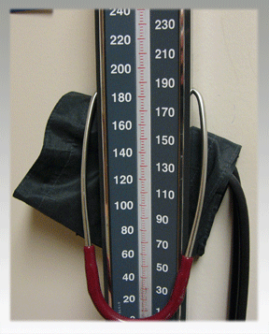
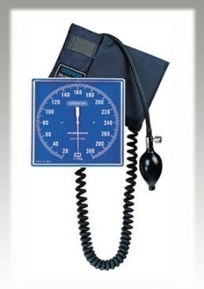
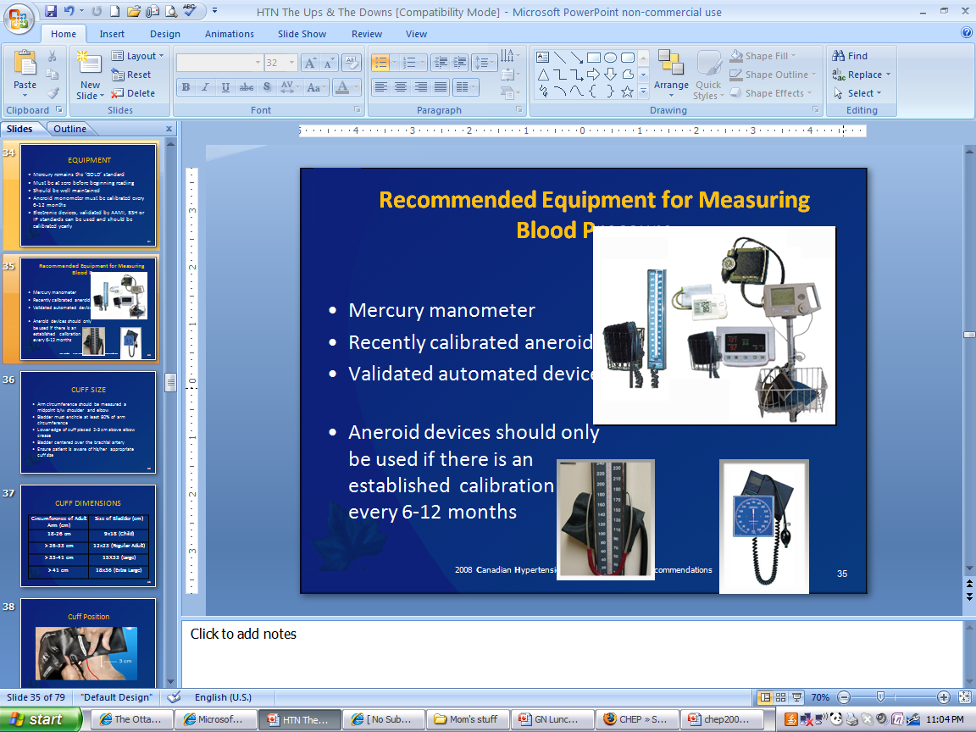
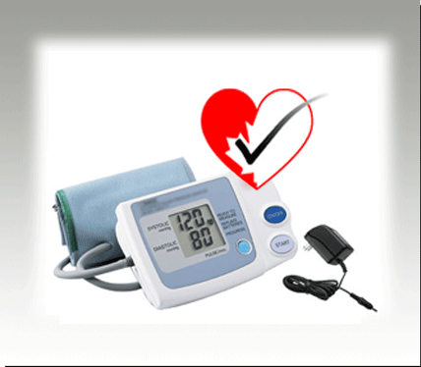
Calibrated/Validated Equipment
Notes:
Calibrated / Validated Equipment
Office Blood Pressure Measurement (OBPM)
Auscultatory (mercury, aneroid)
Oscillometric
Automated Office Blood Pressure (AOBP)
Oscillometric
Ambulatory Blood Pressure Measurement (ABPM)
Home Blood Pressure Measurement (HBPM)
http://www.dableducational.org/sphygmomanometers.html
http://www.bhsoc.org/bp-monitors/bp-monitors/
Devices used to measure blood pressure at home can be purchased from most pharmacies and from other stores that sell health-care equipment. This statement should appear on the box and/or in material supplied with the device: Recommended by Hypertension Canada.
Blood pressure measuring devices that have a memory or printout for storing readings are recommended as this allows your doctor to see all readings that have been taken. Recommend patients ask their doctor or pharmacist to check the monitor to make sure it measures blood pressure accurately.
IMPORTANT NOTE: Automated blood pressure recording devices may not work properly in all individuals such as persons with an irregular heart rhythm. Some models may perform better than others when an irregular heartbeat is present. If your patient has this condition, encourage him/her to mention it to the sales staff and make certain the device takes proper readings before making a purchase.
Assessing the calibration of an aneroid device:
Attach the aneroid device and cuff to a mercury manometer using tubing and if necessary a ‘Y’ or ‘T’ connection (see diagram). Consider putting cotton wool in the T tube to prevent the mercury from oxidizing and becoming contaminated.
Pump the cuff up and assess the pressure of the aneroid at 20 mmHg intervals from 300 mmHg to 60 mmHg.
The aneroid is out of calibration if the readings are 4 or more mmHg different from the mercury device.
Do not use the aneroid device if it reads 4 or more mmHg different from the mercury device at pressures where diagnosis or therapeutic decisions are made.

Slide 28
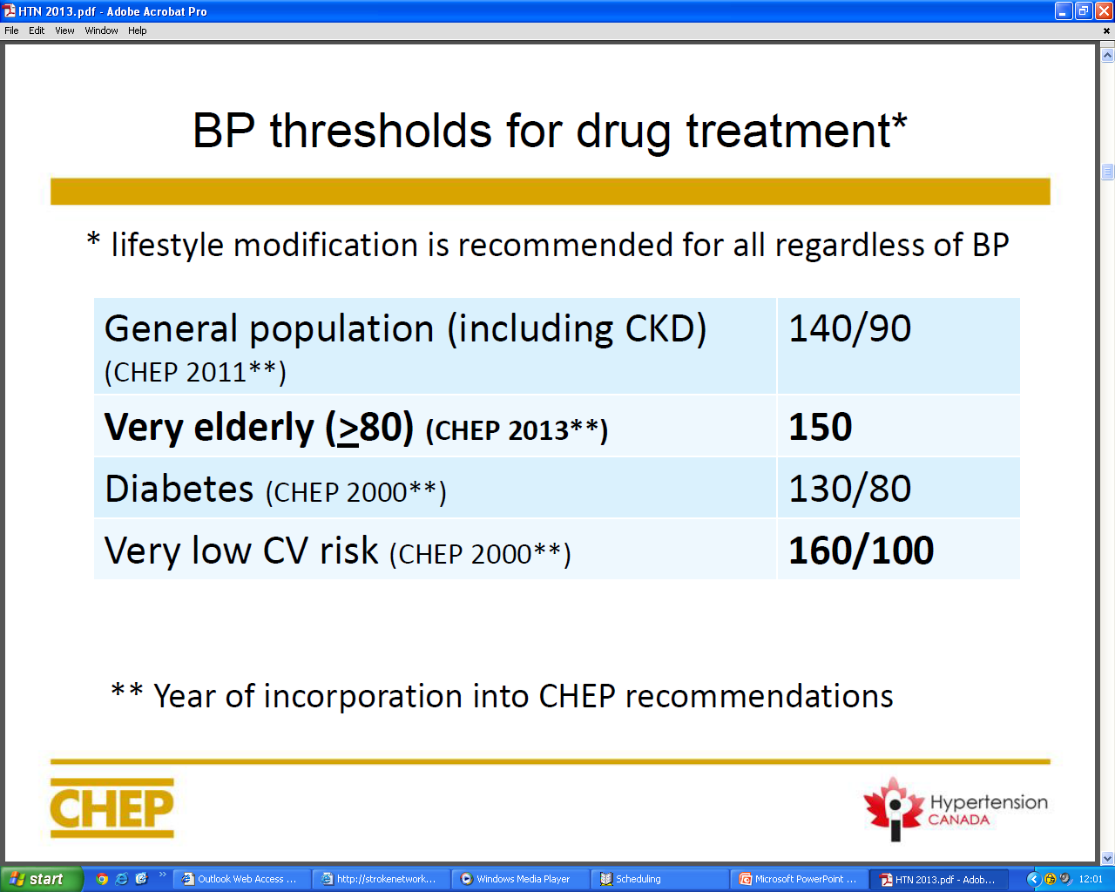
Notes:
BP Thresholds for drug treatment
2014 Canadian Hypertension Education Program Recommendations

Slide 29
Office or Home Automated BP
Recommend use of office devices that measure without a healthcare professional present or home automated blood pressure measurements
When preformed with the correct procedure, the office automated BP that is ≥ 135/85 should be considered out of target.
Notes:
Office or Home Automated BP
2014 CHEP Recommendations
If systolic BP (SBP) is ≥140 mmHg and/or diastolic BP (DBP) is ≥90 mmHg, a specific visit should be scheduled for the assessment of hypertension. If BP is high-normal (SBP 130 – 139 mmHg and/or DBP 85 – 89 mmHg), annual follow-up is recommended.
At the initial visit for the assessment of hypertension, if SBP is >140 mmHg and/or DBP is >90 mmHg, at least two more readings should be taken during the same visit using a validated device and according to the recommended procedure for accurate BP determination. The first reading should be discarded and the latter two averaged. A history and physical examination should be performed and, if clinically indicated, diagnostic tests to search for target organ damage and associated CV risk factors should be arranged within two visits. Exogenous factors that can induce or aggravate hypertension should be assessed and removed if possible. Schedule visit two within one month .
At visit 2 for the assessment of hypertension, patients with macrovascular target organ damage, diabetes mellitus, or chronic kidney disease (CKD; GFR < 60 ml/min/1.73m² ) can be diagnosed as hypertensive if SBP is ≥140 mmHg and/or DBP is ≥90 mmHg.
At visit 2 for the assessment of hypertension, patients without macrovascular target organ damage, diabetes mellitus, and/or chronic kidney disease can be diagnosed as hypertensive if the SBP is ≥180 mmHg or greater and/or the DBP is ≥110 mmHg. Patients without macrovascular target organ damage, diabetes mellitus, or CKD but with lower BP levels should undergo further evaluation using any of the three approaches outlined below:
Office manual BPs:
Using office manual BP measurements, patients can be diagnosed as hypertensive if the SBP is ≥160 mmHg or the DBP is ≥100 mmHg averaged across the first 3 visits, or if the SBP averages ≥140 mmHg or the DBP averages ≥90 mmHg averaged across 5 visits.
Ambulatory BP monitoring (ABPM):
Using ABPM, patients can be diagnosed as hypertensive if the mean awake SBP is ≥135 mm Hg or greater or the DBP is ≥85 mm Hg, or if the mean 24 hour SBP is ≥130 mm Hg or greater or the DBP is ≥80 mm Hg.
Office or Home Automated BP Measurement:
Using office or home automated BP measurements, patients can be diagnosed as hypertensive if the average SBP is ≥135 mmHg or the DBP is ≥ 85 mmHg. If the average home BP is < 135/85 mmHg, it is advisable to either repeat home monitoring to confirm the home BP is < 135/85 mmHg or perform 24-hour ABPM to confirm that the mean 24-hour ABPM is <130/80 mmHg and the mean awake ABPM is <135/85 mmHg before diagnosing white coat hypertension.
Investigations for secondary causes of hypertension should be initiated in patients with suggestive clinical and/or laboratory features.
If at the last diagnostic visit the patient is not diagnosed to be hypertensive, and has no evidence of macrovascular target organ damage, the patient’s BP should be assessed at yearly intervals.
Hypertensive patients receiving lifestyle modification advice alone (nonpharmacological treatment) should be followed up at three to six month intervals. Shorter intervals (every one or two months) are needed for patients with higher BPs.
Patients on antihypertensive drug treatment should be seen monthly or every two months, depending on the level of BP, until readings on two consecutive visits are below their target. Shorter intervals between visits will be needed for symptomatic patients and those with severe hypertension, intolerance to antihypertensive drugs or target organ damage. Once the target BP has been reached, patients should be seen at three-to six-month intervals.
Dasgupta K, Quinn RR, Zarnke KB, et al. The 2014 Canadian Hypertension Education Program Recommendations for Blood Pressure Measurement, Diagnosis, Assessment of Risk, Prevention, and Treatment of Hypertension. Can J Cardiol 2014;30:485-501.

Slide 30
Only Relying on Office Pressures misses out on White Coat and Masked Hypertension
140
Masked HTN
True hypertensive
Home or Daytime ABPM
SBP mmHg
135
135
True
Normotensive
White Coat HTN
140
Office SBP mmHg
Derived from Pickering et al. Hypertension 2002:40:795-796
Notes:
30
White Coat and Masked Hypertension:
WHITE COAT HYPERTENSION — Many patients are anxious when visiting the clinician, leading to an office blood pressure (BP) that may be substantially higher than BP during normal daily activities. The diagnosis of white coat hypertension (also called isolated clinic or office hypertension) is applied to patients with office readings that average more than 140/90 mmHg and reliable out-of-office readings that average less than 140/90 mmHg. Having the BP in the office taken by a nurse or technician, rather than the clinician, may minimize the white coat effect.
Sequential studies have shown that, in patients diagnosed as being hypertensive on a first visit to a new clinician, there is a mean 15 and 7 mmHg fall in the systolic and diastolic BP, respectively, by the third visit, with some patients not reaching a stable value until the sixth visit . Thus, it has been recommended that a patient with mild to moderate elevation in BP should not be diagnosed with hypertension unless the BP remains elevated after three to six visits, unless there is evidence of ongoing end-organ damage.
In cross-sectional studies, the prevalence of white coat hypertension ranges from 10 to more than 20 percent, and appears to be higher in children and the elderly. White coat hypertension can also be seen in patients with apparently resistant hypertension. The likelihood of normal ambulatory pressures is low (less than 5 percent) in patients with office diastolic pressures ≥105 mmHg , but such patients may still have a white coat effect that underestimates the efficacy of therapy
MASKED HYPERTENSION — As many as 10 to 40 percent of patients who are normotensive by conventional clinic measurement are hypertensive by ABPM. This phenomenon is called masked hypertension or isolated ambulatory hypertension. It has only been identified by screening clinical studies since patients who are normotensive by office readings do not typically undergo ambulatory monitoring.
Mancia G, Parati G, Pomidossi G, et al. Alerting reaction and rise in blood pressure during measurement by physician and nurse. Hypertension 1987; 9:209.
Watson RD, Lumb R, Young MA, et al. Variation in cuff blood pressure in untreated outpatients with mild hypertension--implications for initiating antihypertensive treatment. J Hypertens 1987; 5:207.
Pickering TG, James GD, Boddie C, et al. How common is white coat hypertension? JAMA 1988; 259:225.
Niiranen TJ, Jula AM, Kantola IM, Reunanen A. Prevalence and determinants of isolated clinic hypertension in the Finnish population: the Finn-HOME study. J Hypertens 2006; 24:463.
Mancia G, Bombelli M, Brambilla G, et al. Long-term prognostic value of white coat hypertension: an insight from diagnostic use of both ambulatory and home blood pressure measurements. Hypertension 2013; 62:168.

Slide 31
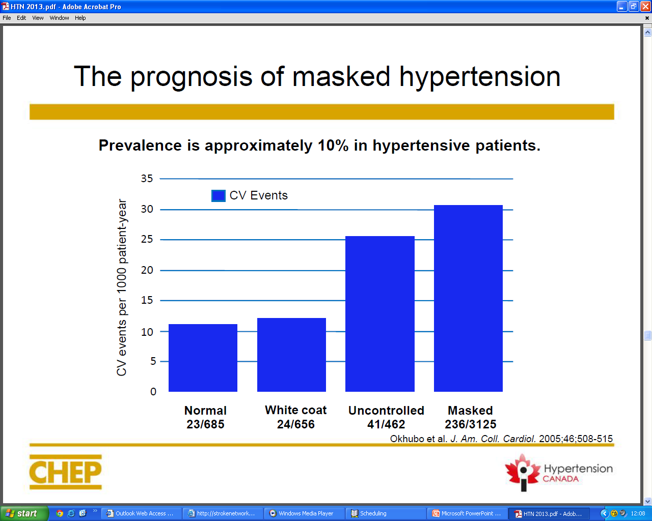
Notes:
The prognosis of masked hypertension:
Masked hypertension — As many as 10 to 40 percent of patients who are normotensive by conventional clinic measurement are hypertensive by Ambulatory BP Measurement. This phenomenon is called masked hypertension or isolated ambulatory hypertension. It has only been identified by screening clinical studies since patients who are normotensive by office readings do not typically undergo ambulatory monitoring.
Masked hypertension has been associated with an increased long-term risk of sustained hypertension and cardiovascular morbidity. Because of the risk associated with masked hypertension, ABPM should be considered in patients referred for possible hypertension (for a variety of reasons, such as left ventricular hypertrophy) despite repeatedly normal BP when measured in the clinic
Pickering TG, Davidson K, Gerin W, Schwartz JE. Masked hypertension. Hypertension 2002; 40:795.
Mallion JM, Clerson P, Bobrie G, et al. Predictive factors for masked hypertension within a population of controlled hypertensives. J Hypertens 2006; 24:2365.
Pierdomenico SD, Cuccurullo F. Prognostic value of white-coat and masked hypertension diagnosed by ambulatory monitoring in initially untreated subjects: an updated meta analysis. Am J Hypertens 2011; 24:52.
Hänninen MR, Niiranen TJ, Puukka PJ, et al. Target organ damage and masked hypertension in the general population: the Finn-Home study. J Hypertens 2013; 31:1136.
Fagard RH, Cornelissen VA. Incidence of cardiovascular events in white-coat, masked and sustained hypertension versus true normotension: a meta-analysis. J Hypertens 2007; 25:2193.
Björklund K, Lind L, Zethelius B, et al. Isolated ambulatory hypertension predicts cardiovascular morbidity in elderly men. Circulation 2003; 107:1297.
Bobrie G, Chatellier G, Genes N, et al. Cardiovascular prognosis of "masked hypertension" detected by blood pressure self-measurement in elderly treated hypertensive patients. JAMA 2004; 291:1342.
Ohkubo T, Kikuya M, Metoki H, et al. Prognosis of "masked" hypertension and "white-coat" hypertension detected by 24-h ambulatory blood pressure monitoring 10-year follow-up from the Ohasama study. J Am Coll Cardiol 2005; 46:508

Slide 32
Home measurement of blood pressure
Enables diagnosis of white coat and masked hypertension
Assists early diagnosis of hypertension
Improves prediction of cardiovascular prognosis
Improves adherence to drug therapy
Enables better blood pressure control
Notes:
Home Measurement of Blood Pressure (HBPM)
Can provide:
Diagnosis of white coat and masked hypertension – which will reduce unnecessary medication prescriptions /use
Rapid confirmation of the diagnosis of hypertension
Better prediction of cardiovascular prognosis
Improved adherence to drug therapy
Better blood pressure control
Located on-line at Hypertension Canada (www.Hypertension.ca)
Healthcare Provider Educational Resources
High Blood Pressure Patient Education Animated slide deck (webcast)
High Blood Pressure Patient Education (PPT)
Hypertension Action Tools (PDF)
Patient Resources
Understanding and Managing your Blood Pressure (PDF)
Managing your Blood Pressure (PDF)
Measure Blood Pressure at Home (PDF)
My Home Blood Pressure Log (PDF)
Home Blood Pressure - Get the Facts (PDF)
Home Blood Pressure - Postcard (PDF)
Blood Pressure Measurement & Medication Log (PDF)
32

Slide 33
Home blood pressure measurement
Home BP measurement is encouraged to increase patient involvement in care
Which patients?
  suspected diagnosis of hypertension
  Suspected non adherence
  Diabetes mellitus
  Chronic kidney disease
  White coat hypertension or effect
  Masked hypertension
Average BP equal to or over 135/85 mmHg should be considered elevated
Notes:
33
Home blood pressure measurement (HBPM): 2014 CHEP Recommendations
HBPM can be used in the diagnosis of hypertension.
The use of home BP monitoring on a regular basis should be considered for patients with hypertension, particularly those with:
diabetes mellitus
chronic kidney disease
suspected nonadherence
demonstrated white coat effect
BP controlled in the office but not at home (masked hypertension)
When white coat hypertension is suggested by HBPM, its presence should be confirmed by repeat HBPM or Ambulatory BP Monitoring before treatment decisions are made.
Patients should be advised to purchase and use only home BP monitoring devices that are appropriate for the individual and have met standards of the Association for the Advancement of Medical Instrumentation, the most recent requirements of the British Hypertension Society protocol, or the International Protocol for validation of automated BP measuring devices. Patients should be encouraged to use devices with data recording capabilities or automatic data transmission to increase the reliability of reported home BP values.
Please refer to http://www.hypertension.ca/devices-endorsed-by-hypertension-canada-dp1 for a complete list of device endorsed by Hypertension Canada.
Home SBP values ≥135 mmHg or DBP values ≥ 85 mmHg should be considered elevated and associated with an increased overall mortality risk analogous to office SBP readings of ≥140 mmHg or DBP ≥90 mmHg.
Health care professionals should ensure that patients who measure their BP at home have adequate training, and, if necessary, repeat training in measuring their BP. Patients should be observed to determine that they measure BP correctly and they should be given adequate information about interpreting these readings.
The accuracy of all individual patients’ validated devices (including electronic devices) must be regularly checked against a device of known calibration.
Home BP values for assessing white coat hypertension or sustained hypertension should be based on duplicate measures, morning and evening, for an initial seven-day period. First day home BP values should not be considered.
Dasgupta K, Quinn RR, Zarnke KB, et al. The 2014 Canadian Hypertension Education Program Recommendations for Blood Pressure Measurement, Diagnosis, Assessment
of Risk, Prevention, and Treatment of Hypertension. Can J Cardiol 2014;30:485-501.

Slide 34
Some patients are not suitable for home monitoring due to:
Anxiety
Physical or mental disability
Arm not suited to blood pressure cuff
Irregular pulse or arrhythmias
Lack of interest
Notes:
Some patients are not suitable for home monitoring due to:
Undue anxiety in response to high blood pressure readings
Physical or mental disability prevents accurate technique or recording
Arm not suited to blood pressure cuff (e.g. conical shaped arm)
Irregular pulse or arrhythmias prevent accurate readings (there are certified BP monitors that are specifically for irregular heart beat)
Lack of interest-not willing to spend the money
Most patients can be taught to measure blood pressure. Periodic reassessment of technique and retraining is desirable.
IMPORTANT RESOURCES FOR HOME MEASUREMENT OF BLOOD PRESSURE
An internet-based tool kit for home blood pressure measurement including recording and tracking of blood pressure can be found at www.heartandstroke.ca/bp
Patient information on selecting an approved device, and how to measure and track home blood pressure can be found at www.hypertension.ca/bpc
A video on Home BP monitoring can be watched or downloaded at http://hypertension.ca/video/
A website to assist patients to monitor and track home blood pressure and support self management including healthy lifestyle change is available at: www.heartandstroke.ca/BP
34

Slide 35
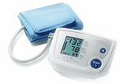
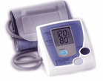
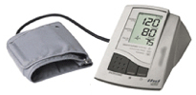



Recommended home blood pressure monitors
Monitors that have been validated as accurate and available in Canada are listed at www.hypertension.ca/chs in the ‘device endorsements’ section
  The boxes containing the device are also marked with
Monitors A&D® or LifeSource® Models: 705, 767, 767PAC, 767Plus, 774, 774AC, 779, 787, 787AC
Monitors Omron® Models: HEM-705 PC, HEM-711, HEM-741CINT
Monitors Microlife® or Thermor® (also sold under different brand names)
Models: BP 3BTO-A, BP 3AC1-1, BP 3AC1-1 PC, BP 3AC1-2, BP 3AG1, BP 3BTO-1,BP 3BTO-A (2), BP 3BTO-AP, RM 100, BP A100 Plus, BP A 100
Notes:
35
Recommended home blood pressure monitors:
Encourage hypertensive patients to use an approved blood pressure measuring device that is appropriate for them, and use proper technique to assess blood pressure at home.
Please check the web site www.hypertension.ca/chs as this list is updated regularly with models that have the heart check symbol.
The Life Source model number 767 plus main feature is reading arrythmias
ENSURE Adequate training for the patient regarding measuring their BP and how to interpret blood pressure readings. We should regularily verify patients are measuring BP properly and ensure to discuss yearly calibration.
Recommended Models:
A&D® or LifeSource® Models: 705, 767, 767PAC, 767Plus, 774, 774AC, 779, 787EJ, 787AC, 787W, 631, 853, 854, 855, UA 1020CN (UA 1030CN)
Atico International and Le Groupe Jean Coutu Models: KD-556, KD-5031, KD-5963, A58H0401
Beurer North America LP Models: Beurer BM35, Beurer BM44, Beurer BM60
HoMedics® Models:
BPA-040-0CA (BP-A04-00CA)
BPA-060-0CA (BP-A06-00CA)
BPA-110-2CA (BP-A11-02CA)
iHealth Models: Blood Pressure DOCK-BP 3, iHealth BP5
Microlife® or BIOS® Models (also sold as 'private label brands'): BP 3BTO-A, BP 3AC1-1, BP 3AC1-1 PC, BP 3AC1-2, BP 3AG1, BP 3BTO-1, BP 3BTO-A (2), BP 3BTO-AP, RM 100, BP A100 Plus, BP A 100, BP 3AL1 – 3E, BP 3MX1-1, 3AN1-3X, 3MS1-4K
Omron® Models: HEM-705CPCAN, HEM-741CAN, HEM-711DLXCAN, HEM-773ACCAN, HEM-775CAN, HEM-790ITCAN, BP742CAN, BP760CAN, BP762CAN, BP785CAN, BP710CANN, BP742CANN, BP765CAN, BP761CAN, BP786CAN
Physio Logic Model: HL868BA, 106-910, 106-915
Thermor: BIOS Diagnostics BD215, BD209 (BD204), A6PC
Tremblay Harrison Inc Models : ABP-C1, ABP-C2 and ABP-C3
Dasgupta K, Quinn RR, Zarnke KB, et al. The 2014 Canadian Hypertension Education Program Recommendations for Blood Pressure Measurement, Diagnosis, Assessment of Risk, Prevention, and Treatment of Hypertension. Can J Cardiol 2014;30:485-501.

Slide 36

Vascular Risk Assessment – Diagnosis of Hypertension
OBPM | ABPM | HBPM
Hypertensive Emergency SBP>200 or DBP>130 | Mean awake BP ≥135 / 85 | Average BP ≥ 135 / 85
If no macrovascular target organ damage (TOD) BP > 180/110 | Mean 24 hour BP ≥ 130 / 80
If macrovascular TOD BP ≥140 / 90
BP > SBP 160 /100 over 3 visits
BP > 140 / 90 over 4-5 visits
Notes:
Vascular Risk Assessment – Diagnosis of Hypertension:
OBPM – Office Blood Pressure Monitoring
ABPM – Ambulatory Blood Pressure Monitoring
HBPM – Home Blood Pressure Monitoring
Measurement protocol
For the results to be valid, blood pressure measurement must be done under the right conditions, with a validated device, following specific rules. It has been shown that even with a quick briefing, most patients are able to take adequate blood pressure readings. A series of measurements must be taken to obtain values that can be used to measure cardiovascular risk.
HBPM protocol
• Take measurements for seven consecutive days
• Measure twice in the morning and twice in the evening
• Average the values for the last six days
Dasgupta K, Quinn RR, Zarnke KB, et al. The 2014 Canadian Hypertension Education Program Recommendations for Blood Pressure Measurement, Diagnosis, Assessment of Risk, Prevention, and Treatment of Hypertension. Can J Cardiol 2014;30:485-501.

Slide 37
Criteria for the Diagnosis of Hypertension and Recommendations for Follow-up
BP: 140-179 / 90-109
Clinic BPM
ABPM (If available)
Home BPM
Hypertension visit 3
>160 SBP or >100 DBP
Diagnosis
of HTN
Awake BP
<135/85
and
24-hour
<130/80
Awake BP
>135 SBP or
>85 DBP or
24-hour
>130 SBP or
>80 DBP
< 135/85
>135 SBP or >85 DBP
<160 / 100
or
ABPM or HBPM
or
Repeat Home BPM
Hypertension visit 4-5
If
< 135/85
>140 SBP or
>90 DBP
Diagnosis
of HTN
Continue to follow-up
Diagnosis
of HTN
Continue to follow-up
Diagnosis
of HTN
< 140 / 90
Continue to follow-up
Patients with high normal blood pressure (office SBP
130-139 and/or DBP 85-89) should be followed annually.
Notes:
37
Criteria for the Diagnosis of Hypertension and Recommendations for Follow-up
2014 Canadian Hypertension Education Program (CHEP) Recommandations – Review slide for 2015 when available.

Slide 38
Criteria for the Diagnosis of Hypertension and Recommendations for Follow-up
Diagnosis of hypertension
Non Pharmacological treatment
With or without Pharmacological treatment
*Consider home blood pressure measurement in hypertension management, to assess for the presence of masked hypertension or white coat effect and to enhance adherence.
Are BP readings below target during 2 consecutive visits?
Yes
No
Follow-up at 3-6 month intervals *
Symptoms, Severe hypertension, Intolerance to anti-hypertensive treatment or Target Organ Damage
Yes
No
More frequent
visits *
Visits every 1 to 2 months*
Notes:
38
Criteria for the Diagnosis of Hypertension and Recommendations for Follow-up
2014 CHEP Recommendations
Assessment of Overall Cardiovascular Risk In Hypertension Patients
Global cardiovascular risk should be assessed in all hypertensive patients. Multifactorial risk assessment models can be used to predict more accurately an individual’s global cardiovascular risk and to more efficiently use antihypertensive therapy.
An individual’s risk of developing cardiovascular disease depends on many risk factors, such as age, sex, blood pressure, blood lipid levels, body weight, physical fitness, smoking habits and familial predisposition. Multivariable statistical models, based on prospective cohort data, have therefore been developed to better estimate the global risk of future coronary events and stroke. A Canadian model is not currently available for calculating the risk of cardiovascular disease among Canadian men and women. Therefore, global risk assessment among Canadians can only be completed using statistical tools based on adults followed in the United States or Europe.
Framingham risk score (1998) — The original Framingham risk score (1998), published in 1998, was derived from a largely Caucasian population of European descent. Subsequent studies have suggested that the Framingham risk score performs well for prediction of CHD events in black and white women and men.
Vascular Risk Assessment Tools:
The Cardiovascular Health and Stroke Strategic Clinical Network (Vascular Risk Reduction Initiative) recommends healthcare professionals use the CV risk engine within your electronic medical record (EMR) if readily available and/or easy to use. If not, the following easy to use on-line risk calculator is recommended:
The University of Edinburgh: Cardiovascular Risk Calculator
http://cvrisk.mvm.ed.ac.uk/calculator/calc.asp
These additional supported risk calculator tools provide other format options:
Paper based - Updated Framingham Risk Score (FRS) worksheet
Mobile App - CV risk calculator within the Canadian Cardiovascular Society Lipid Guidelines.
Consider informing patients of their global risk to improve the effectiveness of risk factor modification . Consider also using analogies that describe comparative risk such as “Cardiovascular Age”, “Vascular Age” or “Heart Age” to inform patients of their risk status. The recommended website and mobile application are excellent resources which calculate FRS as well as cardiovascular age.
Dasgupta K, Quinn RR, Zarnke KB, et al. The 2014 Canadian Hypertension Education Program Recommendations for Blood Pressure Measurement, Diagnosis, Assessment of Risk, Prevention, and Treatment of Hypertension. Can J Cardiol 2014;30:485-501.

Slide 39
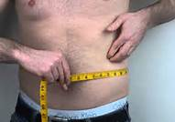

Measuring Waist Circumference
Notes:
Vascular Risk Assessment: Measuring Waist Circumference
Assess and treat CVD risk factors including obesity-related comorbidities. Risk assessment for CVD and diabetes in a person who is overweight, or obese, includes history, physical examination and CV Risk assessment calculation which includes clinical and laboratory assessments such as BP, fasting blood glucose, and fasting lipid panel (expert opinion).
A waist circumference measurement is recommended for individuals with Body Mass Index (BMI) 25 to <35 kg/m2 to provide additional information on risk. It is not necessary to measure waist circumference in patients with BMI >35 because the waist circumference will likely be elevated and it will add no additional risk information. The Panel recommends, by expert opinion, using the current cut points as indicative of increased cardiometabolic risk:
Women: greater than 88 cm (greater than 35 inches)
Men: greater than 102 cm (greater than 40 inches)
Because obesity is associated with increased risk of hypertension, dyslipidemia, diabetes, and a host of other comorbidities, the clinician should assess for associated conditions. The Panel recommends by expert opinion that intensive management of CVD risk factors (hypertension, dyslipidemia, prediabetes or diabetes) or other obesity-related medical conditions (eg, sleep apnea) be instituted if they are found, regardless of weight loss efforts.

Slide 40
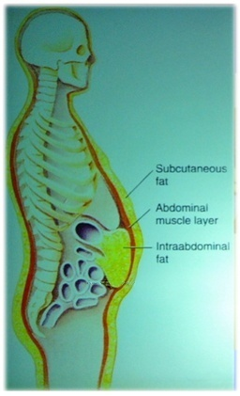
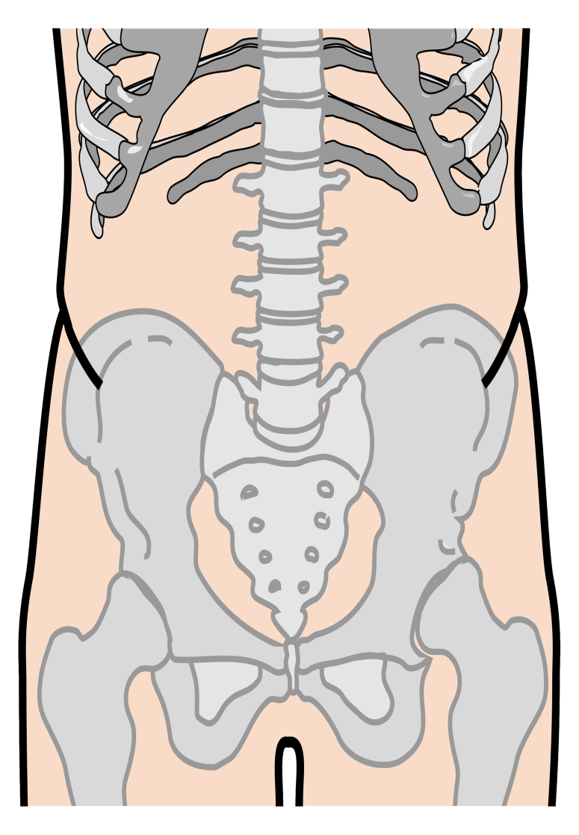

VRR – How to Assess Waist Circumference
Last rib margin
Mid distance
Men:
< 102 cm
Women:
< 88 cm
Iliac crest
Courtesy J.P. Després 2006
Notes:
Vascular Risk Reduction – How to Assess Waist Circumference
Measuring-tape position for waist (abdominal) circumference in adults: To measure waist circumference, locate the upper hip bone and the top of the right iliac crest. Place a measuring tape in a horizontal plane around the abdomen just above the iliac crest (mid distance between the last rib margin and the iliac crest). Before reading the tape measure, ensure that the tape is snug, but does not compress the skin, and is parallel to the floor. The measurement is made at the end of a normal expiration.
Jensen MD, Ryan DH, Apovian CM, et al. 2013 AHA/ACC/TOS Guideline for the Management of Overweight and Obesity in Adults: A Report of the American College of Cardiology/American Heart Association Task Force on Practice Guidelines and The Obesity Society. J Am Coll Cardiol 2013 Nov 7. DOI: 10.1016/j.jacc.2013.11.004

Slide 41
Waist Circumference:
An important vital sign:
Men Women
Canada & US < 102 cm < 88 cm
Europid < 94 cm < 80 cm
South Asian/Chinese < 90 cm < 80 cm
Japanese < 85 cm < 90 cm
Video on waist measurement at www.heartandstroke.ca
http://www.heartandstroke.com/site/c.ikIQLcMWJtE/b.3484281/k.515D/Healthy_living__Assess_your_weight.htm
Notes:
Waist Circumference:
It is recommended that all adult patients be screened for overweight and obesity. We measure body mass index (BMI) at the periodic health examination. Measure waist circumference in those with BMI between 25 and 35 kg/m2 . Waist circumference measurement is unnecessary in patients with BMI ≥35 kg/m2.
●BMI classifications are based upon risk of cardiometabolic disease. The classification is used for identifying adults at increased risk for morbidity and mortality due to obesity. However, the relationship between percent body fat and BMI is different among different ethnic groups. In Caucasian, Hispanic, and Black individuals, overweight is defined as a BMI of 25 to 29.9 kg/m2 and obesity as a BMI of ≥30 kg/m2. For Asians, overweight is a BMI between 23 and 24.9 kg/m2 and obesity a BMI >25 kg/m2.
●Waist circumference is a measurement of abdominal obesity and provides risk information that is not accounted for by BMI. Patients with abdominal obesity (also called central adiposity, visceral, android, or male-type obesity) are at increased risk for heart disease, diabetes, hypertension, dyslipidemia, and nonalcoholic fatty liver disease. A waist circumference of 102 cm (≥40 in ) for men and 88 cm (≥35 in ) for women is considered elevated and indicative of increased cardiometabolic risk. In Asian females a waist circumference 80 cm (≥31 in ) and in Asian males a value 90 cm (≥35 in ) are considered abnormal.
●In individuals with BMI ≥25 kg/m2 or a waist circumference greater than 88 cm (women) or 102 cm (men), we suggest further evaluation to assess overall risk status.
Assessment of an individual's overall risk status includes determining the degree of overweight (BMI) and the presence of abdominal obesity (waist circumference), cardiometabolic risk factors, obstructive sleep apnea, symptomatic osteoarthritis, and other comorbidities. The evaluation includes a history, physical examination, and measurement of fasting glucose (or glycated hemoglobin [A1C]), thyroid stimulating hormone (TSH), liver enzymes, and fasting lipids . Subsequent intervention, if necessary, is based upon overall risk assessment. The coexistence of several diseases, including established coronary heart disease (CHD), other atherosclerotic disease, type 2 diabetes mellitus, and sleep apnea places patients in a very high-risk category for subsequent mortality.
Lau DC, Obesity Canada Clinical Practice Guidelines Steering Committee and Expert Panel. Synopsis of the 2006 Canadian clinical practice guidelines on the management and prevention of obesity in adults and children. CMAJ 2007; 176:1103.

Slide 42
Vascular Risk Assessment
Blood pressure
Alcohol use
Diabetes
Fruits and vegetables
Activity
Tobacco use
B
A
D
F
A
T
Waist Height Obesity ?
Labs?
Notes:
Vascular Risk Assessment
Review:
What should be assessed on every adult? WHO BAD FAT
Who requires additional vascular risk assessment? See this… DO THAT Cardiovascular Risk Assessment
Men age 40 and over
Women age 50 over, or who are postmenopausal
All patients with any of the following conditions regardless of age:
Current cigarette smoking
Diabetes
Arterial hypertension
Family history of premature CVD
Family history of hyperlipidemia
Erectile dysfunction
Chronic kidney disease*
Inflammatory disease†
HIV infection
Chronic obstructive pulmonary disease
Clinical evidence of atherosclerosis or abdominal aneurysm
Clinical manifestation of hyperlipidemia
Obesity (body mass index >27)

Slide 43
Identifying Vascular Risk
Key Messages:
Assess all adult patients for vascular risk
Complete a cardiovascular risk assessment on all appropriate individuals.
Utilize recommended techniques and resources when completing assessments.
Notes:
VRR: Key Messages
Summary slide – Highlight the key messages discussed in this presentation.

Slide 44
How can you implement Vascular Risk Assessment into your daily practice?
Everyone at every patient visit?
Identify who is HIGH RISK?
Those requiring additional assessment?
Notes:
How can you implement Vascular Risk Assessment into your daily practice?
Participants divide into groups, perhaps according to work area, and brain storm of practical ways to implement vascular risk assessment into practice. Who can do what job? What tools will you use? What tools will you need? Where will VR assessment be recorded?
Some other suggestions would be a ‘see, do, reflect’ type of exercise. This could be implemented with cases in which you present how the steps involved would be used. Work through a case in groups (use different cases) and then present back to the larger group for reflection on what they did and how they could do it differently.

Slide 45
Questions?

Slide 46

A Special Thanks to:
The Calgary & Lethbridge Vascular Risk Reduction
Programs and the CvHS SCN - VRR RxEACH Project,
for their support and collaboration.

Slide 47
References:
Canadian Cardiovascular Society:
http://www.ccs.ca/index.php/en/
C-CHANGE Clinical Resource Centre:
http://www.c-changecrc.ca/
Harmonization of guidelines for the prevention and treatment of cardiovascular disease: the C-CHANGE Initiative – www.cmaj.ca (November 18, 2014)
Hypertension Canada (CHEP recommendations): http://hypertension.ca
Vascular Risk Reduction Resource:
http://www.albertahealthservices.ca/10585.asp

