Slide 1



Vascular Risk Reduction:
Addressing Vascular Risk
Notes:
Vascular Risk Reduction: Addressing Vascular Risk
To maximize the benefits of preventive therapy, lipid and hypertension guidelines increasingly recommend that high-risk individuals be targeted for treatment. An individual's risk of developing vascular disease depends on many risk factors, such as age, sex, blood pressure, blood lipid levels, body weight, physical fitness, smoking habits and familial predisposition. Multivariable statistical models have therefore been developed to better estimate the global risk of future coronary events and stroke.
Despite the continuing improvements in treating vascular disease among Canadians, coronary artery disease and stroke remain among the most common causes of premature mortality and disability in adults. Accordingly, the treatment of manageable risk factors, such as hypertension and dyslipidemia, to prevent or delay the development of vascular disease remains an essential component of medical therapy and public health policy.
The clinical benefits of risk factor modification to prevent cardiovascular events have been clearly demonstrated in randomized clinical trials. Nonetheless, these benefits may be associated with important treatment complications, minor side effects and the substantial, direct health care costs of lifelong therapy. To maximize the net benefits of preventive therapy, evolving treatment guidelines increasingly recommend that health care professionals target high-risk individuals for therapy. In this way, the potential risks of therapy are offset by a substantial reduction in the risk of cardiovascular disease. Targeting high-risk individuals also maximizes the cost-effectiveness of treatment.
Padwal R, Straus SE, McAlister FA. Evidence based management of hypertension. Cardiovascular risk factors and their effects on the decision to treat hypertension: Evidence based review. BMJ. 2001;322:977–80.

Slide 2
Vascular Risk Reduction (VRR)
Welcome!
Presentation & Activities
Focus: Managing known risk factors for vascular disease.
Engage, collaborate and have fun!
Notes:
VRR: Welcome and Introduction
The focus of this presentation is on implementing evidence based management of known vascular risk factors into practice.
Cardiovascular disease (CVD) is common in the general population, affecting the majority of adults past the age of 60 years. In 2012, CVD was estimated to result in 17.3 million deaths worldwide on an annual basis . CVD includes four major areas:
●Coronary heart disease (CHD), manifested by myocardial infarction (MI), angina pectoris, heart failure, and coronary death
●Cerebrovascular disease, manifested by stroke and transient ischemic attack
●Peripheral artery disease, manifested by intermittent claudication
●Aortic atherosclerosis and thoracic or abdominal aortic aneurysm
AULaslett LJ, Alagona P Jr, Clark BA 3rd, Drozda JP Jr, Saldivar F, Wilson SR, Poe C, Hart M. The worldwide environment of cardiovascular disease: prevalence, diagnosis, therapy, and policy issues: a report from the American College of Cardiology. SOJ Am Coll Cardiol. 2012;60(25 Suppl):S1.

Slide 3
Vascular Risk Reduction
Objectives:
Discuss the impact of vascular disease in Canada.
Identify non-modifiable, modifiable and manageable vascular risk factors.
Describe appropriate management of known vascular risk factors .
Notes:
Vascular Risk Reduction: Objectives:
Review learning objectives

Slide 4
Impact of Vascular Disease
Vascular Risk Round Up:
Volunteer reads Question card.
The person with the correct Answer card must wave it and read the answer aloud.
If correct, it will be his/her turn to read out the question
on the Question card.
If not correct, everyone must agree on the correct answer, then ask the person with the correct Answer card to read out his/her question.
Play continues until all questions have been read, along with their correct answers.
Notes:
Impact of Vascular Disease:
Group Game: (see instructions). A number of participants should have both a question card and an answer card (A maximum of 15 participants should be dispersed throughout the room). Dispense these cards at the beginning of the session.

Slide 5





Addressing Vascular Risk Factors
Notes:
Vascular Risk Assessment: Addressing Vascular Risk Factors
Assessment of an individual's overall risk status includes determining the degree of overweight (Body Mass Index – (BMI)) and the presence of abdominal obesity (waist circumference), cardiovascular risk factors and other comorbidities. The coexistence of several diseases, including established coronary heart disease (CHD), cerebrovascular disease (previous stroke or TIA) other atherosclerotic disease (peripheral vascular disease, vascular dementia, chronic kidney disease) and type 2 diabetes mellitus places patients in a high-risk category for subsequent mortality.

Slide 6


Vascular Disease & Risk Factors
Most vascular disease(s) can be prevented or managed by addressing the risk factors
Why are risk factors such a big deal??
  Over 90% of Canadians have one or more risk factors
  Almost every person you come across can have increased risk for vascular disease
Notes:
Vascular Disease & Risk Factors:
The causes of vascular disease are known and preventable, therefore identification, control and management are key.
Activity: Group Game – Have everyone stand up and stay standing if their answer is ‘Yes’ to each of the following questions:
Do you get 3 out of 4 food groups at every meal (vegetable and fruit, grain products, milk and alternatives, meat and alternatives)
Are you a non-smoker
Did you get 7-8 hours of uninterrupted sleep last night
Do you get 30 mins of physical activity most days
You do NOT use the salt shaker at the dinner table
Do you use healthy interventions, such as tai chi or yoga to cope with stress

Slide 7
Non-Modifiable Risk Factors
Age
Gender
Family History/Genetics
Ethnicity
Previous Event (Heart Attack, Stroke, etc)
Notes:
Non-Modifiable Risk Factors:
These are things your patient cannot change, but it is important to have an awareness of how these fit into the overall risk
Even though these risk factors may exist, there are a number of actions which can be taken to positively affect overall health and decrease overall risk.
IN GENERAL
Age: Older age = more risk
Gender: Males generally have more risk, until female reach age 55 (post menopausal) Then equal risk
Family History/Genetics: Risk increased if first degree relative have event (male > 55yo, female >65 yo)
Ethnicity: Higher risk for some African or Asian, Native American or Spanish descent.
Previous Event: Higher risk of another event

Slide 8

What are some risk factors we can modify?
Notes:
What are some risk factors we can modify?
Activity: Discussion – Question & Answer
Ask group the above question.

Slide 9
Modifiable Risk Factors
May also be called “Healthy Lifestyle Behaviors”
Tobacco Use
Physical Inactivity
Poor Diet
Obesity or Overweight
Excess Alcohol
Unmanaged Stress
Lack of Sleep
Notes:
Modifiable Risk Factors:
Certain unhealthy lifestyle behaviours can increase an individual’s risk of vascular disease. These behaviours can be addressed and modified, or ‘changed’, to reduce vascular risk. Identify and discuss these risk factors which are known to have a significant impact. Ask participants if they can think of any others risk factors which can be modified?
An in depth description of recommended healthy lifestyle behaviours is addressed in the slide set “Vascular Risk Reduction: Healthy Lifestyle Behaviours”. Please refer to this presentation for additional information.

Slide 10

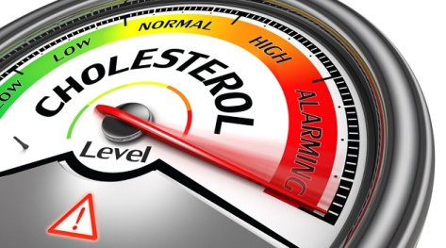
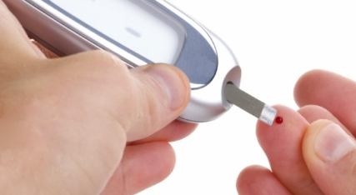
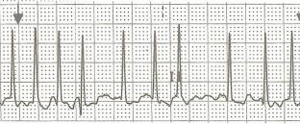
“Manageable” Risk Factors
Hypertension (High Blood Pressure)
Dyslipidemia (High Cholesterol)
“Metabolic Syndrome”
Diabetes
Cardiac Disease: Atrial Fibrillation
Notes:
Manageable Risk Factors
These risk factors may not necessarily be able to be ‘changed’ but they can be “managed”. Steps can be taken to improve the overall health and quality of life when these risk factors are present. This presentation will focus on the clinical management of the risk factors identified on this slide.

Slide 11
Hypertension (HTN)
#1 risk for Stroke and major risk for Heart Disease
  #1 risk of death and disability
Manage HTN, by addressing modifiable risk factors (healthy lifestyle behaviours)
Antihypertensive therapy should be strongly considered if blood pressure is not within target
Notes:
Hypertension:
Over time, high blood pressure can damage blood vessel walls, causing scarring that promotes the build-up of fatty plaque. This build-up can narrow and eventually block arteries. It also strains the heart and eventually weakens it. Very high blood pressure can cause blood vessels in the brain to burst resulting in a stroke.
95% of Canadians will develop HTN if they live a normal lifespan
91% with CHF have HTN
84% who have a stroke have HTN
70% who have had an MI have HTN
• Antihypertensive therapy should be strongly considered if systolic blood pressure readings average 140 mm Hg or higher in the presence of macrovascular target organ damage.
• For patients with nondiabetic chronic kidney disease, target blood pressure is < 130/80 mm Hg.
• Persons with diabetes mellitus should be treated to attain systolic blood pressures of less than 130 mm Hg and diastolic blood pressures of less than 80 mm Hg. (These target blood pressure levels are the same as the blood pressure treatment thresholds.)
• Antihypertensive therapy should be strongly considered if diastolic blood pressure readings average 90 mm Hg or higher in the presence of macrovascular target organ damage or other independent cardiovascular risk factors.
Dasgupta K, Quinn RR, Zarnke KB, et al. The 2014 Canadian Hypertension Education Program Recommendations for Blood Pressure Measurement, Diagnosis, Assessment of Risk, Prevention, and Treatment of Hypertension. Can J Cardiol 2014;30:485-501.

Slide 12

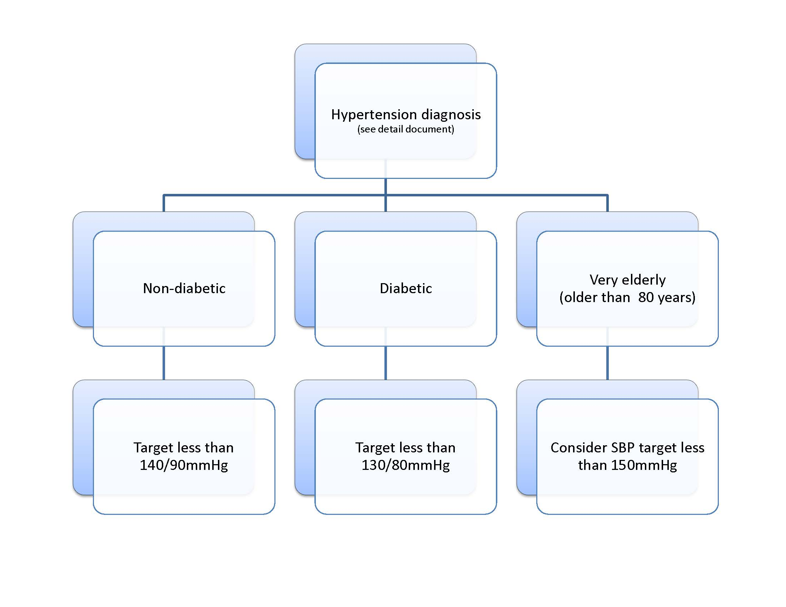
Hypertension Targets
Notes:
Hypertension Targets
Anderson TJ, Gregoire J, Hegele RA, Couture P, Mancini GB, McPherson R, Francis GA, Poirier P, Lau DC, Grover S, Genest J, Jr., Carpentier AC, Dufour R, Gupta M, Ward R, Leiter LA, Lonn E, Ng DS, Pearson GJ, Yates GM, Stone JA, Ur E: 2012 update of the Canadian Cardiovascular Society guidelines for the diagnosis and treatment of dyslipidemia for the prevention of cardiovascular disease in the adult. Can J Cardiol 2013;29:151-167.
Dasgupta K, Quinn RR, Zarnke KB, et al. The 2014 Canadian Hypertension Education Program Recommendations for Blood Pressure Measurement, Diagnosis, Assessment of Risk, Prevention, and Treatment of Hypertension. Can J Cardiol 2014;30:485-501.

Slide 13
Exogenous Factors That Can
Elevate Blood Pressure
Prescription Drugs:
  NSAIDS, including Cox II inhibitors
  Corticosteroids and anabolic steroids
  Oral contraceptives and other hormonal therapy
  Vasoconstricting/sympathominetic decongestants
  Calcineurin inhibitors (cyclosporins, tacrolimus)
  Erythropoietin and analogues
  MAOI’s – Monoamine Oxidase Inhibitors (Marplan, Nardil, Parnate)
  Midodrine
Notes:
Exogenous Factors That Can Elevate Blood Pressure
Strategies to improve patient adherence
Assist your patient to adhere by:
Tailoring pill-taking to fit patients’ daily habits
Simplifying medication regimens to once-daily dosing
Replacing multiple pill antihypertensive combinations with single pill combinations
Utilizing unit-of-use packaging (of several medications to be taken together)
Adherence to an antihypertensive prescription can be improved by a multidisciplinary team approach
Assist your patient in getting more involved in their treatment by:
Encouraging greater patient responsibility/autonomy in monitoring their blood pressure and adjusting their prescriptions
Educating patients and patients’ families about their disease/treatment regimens
Improve your management in the office and beyond by:
Assessing adherence to pharmacological and non-pharmacological therapy at every visit
Encouraging adherence with therapy by out of office contact (either by phone or mail), particularly over the first three months of therapy
Coordinating with work-site healthcare givers to improve monitoring of adherence with pharmacological and lifestyle modification prescriptions
Utilizing electronic medication compliance aids
Dasgupta K, Quinn RR, Zarnke KB, et al. The 2014 Canadian Hypertension Education Program Recommendations for Blood Pressure Measurement, Diagnosis, Assessment of Risk, Prevention, and Treatment of Hypertension. Can J Cardiol 2014;30:485-501.

Slide 14
Exogenous Factors That Can
Elevate Blood Pressure
Others
  Licorice Root
  Stimulants including cocaine
  Sodium
  Excessive Alcohol
  Sleep Apnea
Notes:
Exogenous Factors That Can Elevate Blood Pressure (cont.)

Slide 15

Recommended Health Behaviours in Adults with Hypertension:
Intervention |  | Target
Reduce foods with added sodium |  | → 2000 mg /day
Weight loss |  | BMI <25 kg/m²
Alcohol restriction |  | < 2 drinks/day
Physical activity |  | 30-60 minutes 4-7 days/week
Dietary patterns |  | DASH diet
Smoking cessation |  | Smoke free environment
Waist circumference |  | Men <102 cm Women <88 cm
Notes:
15
Recommended Health Behaviours in Adults with Hypertension
2014 CHEP Recommendations
Dasgupta K, Quinn RR, Zarnke KB, et al. The 2014 Canadian Hypertension Education Program Recommendations for Blood Pressure Measurement, Diagnosis, Assessment of Risk, Prevention, and Treatment of Hypertension. Can J Cardiol 2014;30:485-501.

Slide 16
Impact of Health Behaviours on
Blood Pressure
Intervention | Systolic BP (mmHg) | Diastolic BP (mmHg)
Diet and weight control | -6.0 | -4.8
Reduced salt/sodium intake | - 5.4 | - 2.8
Reduced alcohol intake (heavy drinkers) | -3.4 | -3.4
DASH diet | -11.4 | -5.5
Physical activity | -3.1 | -1.8
Relaxation therapies | -3.7 | -3.5
Multiple interventions | -5.5 | -4.5
Clinical Guideline : Methods, evidence and recommendations National Institute for Health and Clinical Excellence (NICE) May 2011
Notes:
Impact of Health Behaviours on Blood Pressure
2014 CHEP Recommendations
Weight Reduction
Height, weight, and waist circumference should be measured and body mass index calculated for all adults.
Maintenance of a healthy body weight (body mass index 18.5 to 24.9 kg/m² and waist circumference less than 102 cm for men and less than 88 cm for women) is recommended for non-hypertensive individuals to prevent hypertension and for hypertensive patients to reduce blood pressure. All overweight hypertensive individuals should be advised to lose weight.
Weight loss strategies should employ a multidisciplinary approach that includes dietary education, increased physical activity and behavioral intervention.
Salt Intake
To decrease blood pressure, consider reducing sodium intake towards 2,000 mg (5g of salt or 87mmol of sodium) per day.
*Old recommendations had a significantly lower affect on BP (decreased systolic BP by -3.4 and Diastolic BP by -2.2)
Potassium, Calcium and Magnesium Intake
Supplementation of potassium, calcium and magnesium is not recommended for the prevention or treatment of hypertension.
Alcohol Consumption
To reduce blood pressure, alcohol consumption should be in accordance with Canadian low-risk drinking guidelines in both normotensive and hypertensive individuals. Healthy adults should limit alcohol consumption to two drinks or less per day, and consumption should not exceed 14 standard drinks per week for men and nine standard drinks per week for women. (Note: one standard drink is considered 13.6 g or 17.2 ml of ethanol, or approximately 44 mL [1.5 oz] of 80 proof [40%] spirits, 355 mL [12 oz] of 5% beer or 148 mL [5 oz] of 12% wine.)
Dietary Recommendations
It is recommended that hypertensive patients and normotensive individuals at increased risk of developing hypertension consume a diet that emphasizes fruits, vegetables and low-fat dairy products, dietary and soluble fiber, whole grains and protein from plant sources and that is reduced in saturated fat and cholesterol (Dietary Approaches to Stop Hypertension [DASH] diet).
Physical Exercise
For nonhypertensive individuals (to reduce the possibility of becoming hypertensive) or for hypertensive patients (to reduce their blood pressure), prescribe the accumulation of 30 to 60 minutes of moderate intensity dynamic exercise (such as walking, jogging, cycling or swimming) four to seven days per week in addition to the routine activities of daily living. Higher intensities of exercise are no more effective. For non-hypertensive or stage 1 hypertensive individuals, the use of resistance or weight training exercise (such as free weight lifting, fixed-weight lifting, or handgrip exercise) does not adversely influence BP.
Stress management
In hypertensive patients in whom stress may be contributing to blood pressure elevation, stress management should be considered as an intervention (Grade D). Individualized cognitive behavioural interventions are more likely to be effective when relaxation techniques are used.
Healthcare Provider Educational Resources available from CHEP
Sodium Key Messages (PDF)
Excess Dietary Sodium - Impact on Hypertension and Health Outcomes (PPT)
Excess Dietary Sodium - Additional Slides (PPT)
Sodium Quiz - slide deck (PPT)
Sodium Quiz - Paper (PDF)
Patient Resources available from CHEP
Healthy Eating for Healthy Blood Pressure (PDF)
Salt and Sodium - Get the facts (PDF)
Dasgupta K, Quinn RR, Zarnke KB, et al. The 2014 Canadian Hypertension Education Program Recommendations for Blood Pressure Measurement, Diagnosis, Assessment of Risk, Prevention, and Treatment of Hypertension. Can J Cardiol 2014;30:485-501.

Slide 17
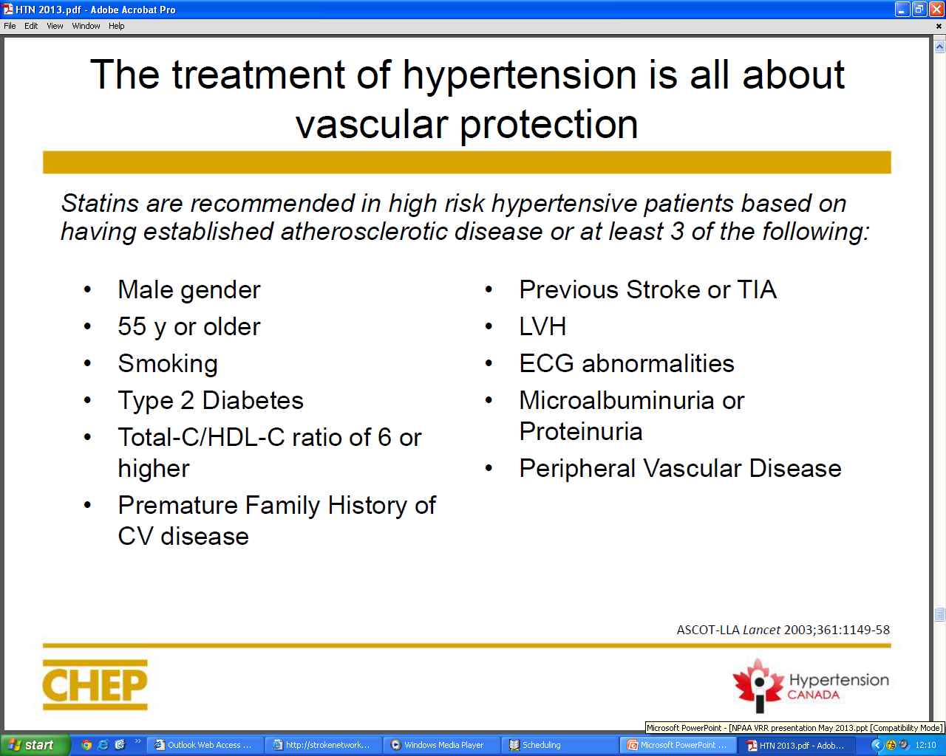
Notes:
The Treatment of Hypertension is all about Vascular Protection
Statins are recommended in high risk hypertensive patients. These are patients with hypertension plus three of the following risk factors:
male left ventricular hypertrophy (LVH)
age greater than 55 years family history of premature CVD
smoking electrocardiogram (ECG) abnormalities
total cholesterol/HDL-C ratio greater than 6 micoalbuminuria
Type 2 Diabetes Previous stroke or TIA
Anderson TJ, Gregoire J, Hegele RA, Couture P, Mancini GB, McPherson R, Francis GA, Poirier P, Lau DC, Grover S, Genest J, Jr., Carpentier AC, Dufour R, Gupta M, Ward R, Leiter LA, Lonn E, Ng DS, Pearson GJ, Yates GM, Stone JA, Ur E: 2012 update of the Canadian Cardiovascular Society guidelines for the diagnosis and treatment of dyslipidemia for the prevention of cardiovascular disease in the adult. Can J Cardiol 2013;29:151-167.
Dasgupta K, Quinn RR, Zarnke KB, et al. The 2014 Canadian Hypertension Education Program Recommendations for Blood Pressure Measurement, Diagnosis, Assessment of Risk, Prevention, and Treatment of Hypertension. Can J Cardiol 2014;30:485-501.

Slide 18
Medication Recommendations
Low doses of multiple drugs may be more effective and better tolerated than higher doses of fewer drugs.
A combination of two first line drugs may also be considered as initial treatment if SBP 20 mmHg above target or is DBP is 10 mmHg above target.
Notes:
Medication Recommendations
2014 CHEP Recommendations
Indications for drug therapy for adults with hypertensions without compelling indications for specific agents
Antihypertensive therapy should be prescribed for average diastolic blood pressures of 100 mmHg or higher, or average systolic blood pressures of 160 mmHg or higher in patients without macrovascular target organ damage or other cardiovascular risk factors.
Antihypertensive therapy should be strongly considered if diastolic blood pressure readings average 90 mmHg or higher in the presence of macrovascular target organ damage or other independent cardiovascular risk factors.
Antihypertensive therapy should be strongly considered if systolic blood pressure readings average 140 mmHg or higher in the presence of macrovascular target organ damage (Grade C for 140 mmHg to 160 mmHg; Grade A for higher than 160 mmHg).
Antihypertensive therapy should be considered in all patients meeting the above indications regardless of age. Caution should be exercised in elderly patients who are frail.
Choice of therapy for adults with hypertensions without compelling indications for specific agents:
Recommendations for Individuals with Diastolic and/or Systolic Hypertension
Initial therapy should be monotherapy with a thiazide/thiazide-like diuretic; a beta-blocker (in patients younger than 60 years of age); an ACE inhibitor (in nonblack patients); a long-acting CCB or an ARB. If there are adverse effects, another drug from this group should be substituted. Hypokalemia should be avoided in patients treated with thiazide/thiazide-like diuretic monotherapy.
Additional antihypertensive drugs should be used if target blood pressure levels are not achieved with standard-dose monotherapy. Add-on drugs should be chosen from first- line choices. Useful choices include a thiazide/thiazide-like diuretic or CCB with either an ACE inhibitor, ARB or beta-blocker (Grade B for the combination of thiazide/thiazide-like diuretic and a dihydropyridine CCB; Grade C for the combination of dihydropyridine CCB and ACE inhibitor; and Grade D for all other combinations). Caution should be exercised in combining a nondihydropyridine CCB and a beta-blocker.
*The combination of an ACE inhibitor and ARB is not recommended .
Combination therapy using two first-line agents may also be considered as initial treatment of hypertension if systolic blood pressure is 20 mmHg above target or if diastolic blood pressure is 10 mmHg above target. However, caution should be exercised in patients in whom a substantial fall in blood pressure from initial combination therapy is more likely to occur or in whom it would be more poorly tolerated (e.g. elderly patients).
If blood pressure is still not controlled with a combination of 2 or more first line agents, or there are adverse effects, other antihypertensive drugs may be added.
Possible reasons for poor response to therapy should be considered.
Alpha-blockers are not recommended as first-line agents for uncomplicated hypertension; beta-blockers are not recommended as first-line therapy for uncomplicated hypertension in patients 60 years of age or older; and ACE inhibitors are not recommended as first-line therapy for uncomplicated hypertension in black patients. However, these agents may be used in patients with certain comorbid conditions or in combination therapy.
Recommendations for individuals with isolated systolic hypertension
In the very elderly (age 80 years and older), who do not have diabetes or target organ damage, the SBP threshold for initiating drug therapy is >160 mm Hg and the BP target is <150 mmHg.
Initial therapy should be monotherapy with a thiazide/thiazide-like diuretic; a long-acting dihydropyridine CCB or an ARB. If there are adverse effects, another drug from this group should be substituted. Hypokalemia should be avoided in patients treated with thiazide/thiazide-like diuretic monotherapy.
Additional antihypertensive drugs should be used if target blood pressure levels are not achieved with standard-dose monotherapy. Add-on drugs should be chosen from first-line options.
If blood pressure is still not controlled with a combination of two or more first-line agents, or there are adverse effects, other classes of drugs (such as alpha-blockers, ACE inhibitors, centrally acting agents or nondihydropyridine CCBs) may be added or substituted.
Possible reasons for poor response to therapy should be considered.
Alpha-blockers are not recommended as first-line agents for uncomplicated isolated systolic hypertension; beta-blockers are not recommended as first-line therapy for isolated systolic hypertension in patients 60 years of age or older. However, both agents may be used in patients with certain comorbid conditions or in combination therapy.
Global vascular protection for adults with hypertensions without compelling indications for specific agents
Statin therapy is recommended in hypertensive patients with 3 or more cardiovascular risk factors (Grade A in patients older than 40 years) or with established atherosclerotic disease (Grade A regardless of age).
Consideration should be given to the addition of low-dose acetylsalicylic acid (ASA) therapy in hypertensive patients >50 years. Caution should be exercised if blood pressure is not controlled.
Goal for therapy for adults with hypertensions without compelling indications for specific agents
The systolic blood pressure treatment goal is a pressure level of less than 140 mmHg. The diastolic blood pressure treatment goal is a pressure level of less than 90 mmHg.
Dasgupta K, Quinn RR, Zarnke KB, et al. The 2014 Canadian Hypertension Education Program Recommendations for Blood Pressure Measurement, Diagnosis, Assessment of Risk, Prevention, and Treatment of Hypertension. Can J Cardiol 2014;30:485-501.

Slide 19
Treatment of Systolic-Diastolic Hypertension without Other Compelling Indications
TARGET <140/90 mmHg
Lifestyle modification
A combination of 2 first line drugs may be considered as initial therapy if the blood pressure is >20 mmHg systolic or >10 mmHg diastolic above target
Initial therapy
Thiazide
diuretic
ACEI
ARB
Long-acting
CCB
Beta-
blocker*
CONSIDER
Nonadherence
Secondary HTN
Interfering drugs or lifestyle
White coat effect
Dual Combination
Triple or Quadruple Therapy
*Not indicated as first line therapy over 60 y
Notes:
19
Treatment of Systolic-Diastolic Hypertension without Other Compelling Indications (without Co-morbidities):
Considerations Regarding the Choice of First-Line Therapy
Use caution in initiating therapy with 2 drugs in whom adverse events are more likely (e.g. frail elderly, those with postural hypotension or who are dehydrated).
ACE inhibitors, renin inhibitors and ARBs are contraindicated in pregnancy and caution is required in prescribing to women of child bearing potential.
Beta blockers are not recommended as first line therapy for patients age 60 and over without another compelling indication.
Diuretic-induced hypokalemia should be avoided through the use of potassium sparing agents if required.
The use of dual therapy with an ACE inhibitor and an ARB should only be considered in selected and closely monitored people with advanced heart failure or proteinuric nephropathy.
ACE-inhibitors are not recommended (as monotherapy)
for black patients without another compelling indication.
Considerations Regarding Drug Combination:
When combining drugs, use first-line therapies.
Two drug combinations of beta blockers, ACE inhibitors and angiotensin receptor blockers have not been proven to have additive hypotensive effects. Therefore these potential two drug combinations should not be used unless there is a compelling (non blood pressure lowering) indication
Combinations of an ACEI with an ARB do not reduce cardiovascular events more than the ACEI alone and have more adverse effects therefore are not generally recommended
Caution should be exercised in combining a non dihydropyridine CCB and a beta blocker to reduce the risk of bradycardia or heart block.
Monitor serum creatinine and potassium when combining K sparing diuretics (such as aldosterone antagonists), ACE inhibitors and/or angiotensin receptor blockers.
If a diuretic is not used as first or second line therapy, triple therapy should include a diuretic, when not contraindicated.
If blood pressure is still not controlled, or there are adverse effects, other classes of antihypertensive drugs may be combined (such as alpha blockers or centrally acting agents).
Dasgupta K, Quinn RR, Zarnke KB, et al. The 2014 Canadian Hypertension Education Program Recommendations for Blood Pressure Measurement, Diagnosis, Assessment of Risk, Prevention, and Treatment of Hypertension. Can J Cardiol 2014;30:485-501.

Slide 20
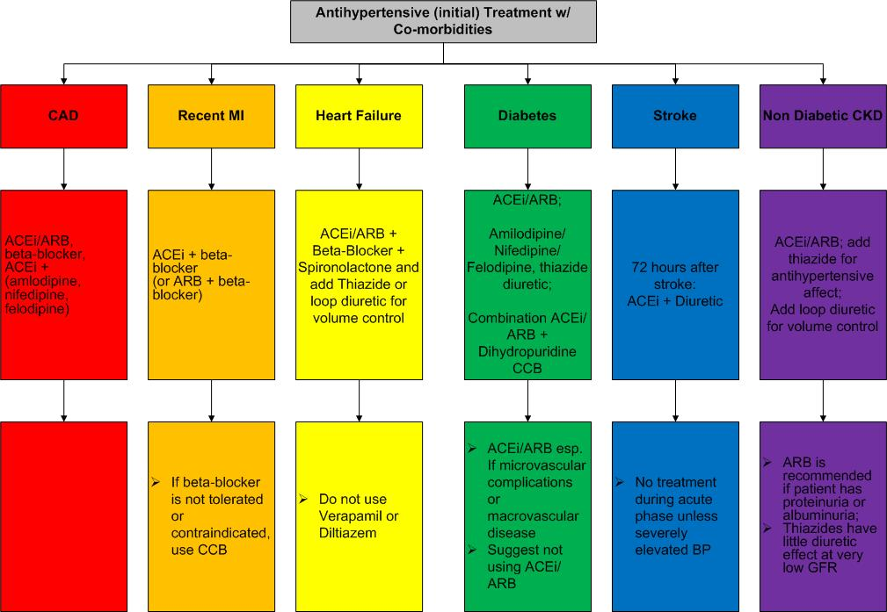
HTN Treatment with
Co-morbidities
Notes:
Hypertension Treatment with Co-morbidities
2014 CHEP Recommendations
TREATMENT OF HYPERTENSION IN ASSOCIATION WITH ISCHEMIC HEART DISEASE
A- Recommendations for Hypertensive Patients with Coronary Artery Disease
An ACE inhibitor is recommended for patients with hypertension and documented coronary artery disease (Grade A).
For patients with stable angina, beta-blockers are preferred as initial therapy (Grade B). CCBs may also be used (Grade B).
Short-acting nifedipine should not be used (Grade D).
For patients with coronary artery disease, but without coexisting systolic heart failure, the combination of an ACE inhibitor and ARB is not recommended (Grade B).
In high-risk patients, when combination therapy is being used, choices should be individualized. The combination of an ACE inhibitor and a dihydropyridine CCB is preferable to an ACE inhibitor and a thiazide/thiazide-like diuretic in selected patients (Grade A).
When lowering SBP to target levels in patients with established CAD (especially if isolated systolic hypertension is present), be cautious when the diastolic blood pressure is ≤60 mmHg because of concerns that myocardial ischemia may be exacerbated (Grade D).
B- Recommendations for Patients with Hypertension Who Have Had a Recent ST-elevation Myocardial Infarction or Non-ST Segment Elevation Myocardial Infarction
Initial therapy should include both a beta-blocker and an ACE inhibitor (Grade A). An ARB can be used if the patient is intolerant of an ACE inhibitor (Grade A in patients with left ventricular systolic dysfunction).
CCBs may be used in postmyocardial infarction patients when beta-blockers are contraindicated or not effective. Nondihydropyridine CCBs should not be used when there is heart failure, as evidenced by pulmonary congestion on examination or radiography (Grade D).
TREATMENT OF HYPERTENSION IN ASSOCIATION WITH HEART FAILURE
In patients with systolic dysfunction (EF < 40%), ACE inhibitors (Grade A) and β-blockers (Grade A) are recommended for initial therapy. Aldosterone antagonists (mineral corticoid receptor antagonists) may be added for patients with a recent cardiovascular hospitalization, acute myocardial infarction, elevated BNP or NT-proBNP level, or NYHA Class II to IV symptoms (Grade A). Careful monitoring for hyperkalemia is recommended when adding an aldosterone antagonist to ACE inhibitor or ARB.Other diuretics are recommended as additional therapy if needed (Grade B for thiazide/thiazide-like diuretics for BP control, Grade D for loop diuretics for volume control). Beyond considerations of blood pressure control, doses of ACE inhibitors or ARBs should be titrated to those found to be effective in trials unless adverse effects become manifest (Grade B).
An ARB is recommended if ACE inhibitors are not tolerated (Grade A).
A combination of hydralazine and isosorbide dinitrate is recommended if ACE inhibitors and ARBs are contraindicated or not tolerated (Grade B).
For hypertensive patients whose blood pressure is not controlled, an ARB may be added to an ACE inhibitor and other antihypertensive drug treatment (Grade A). Careful monitoring should be used if combining an ACE inhibitor and an ARB due to potential adverse effects such as hypotension, hyperkalemia and worsening renal function (Grade C). Additional therapies may also include dihydropyridine CCBs (Grade C).
TREATMENT OF HYPERTENSION IN ASSOCIATION WITH STROKE
Blood Pressure Management in Acute Stroke (Onset to 72 Hours)
For patients with ischemic stroke not eligible for thrombolytic therapy, treatment of hypertension in the setting of acute ischemic stroke or TIA should not be routinely undertaken [Grade D]. Extreme blood pressure elevation (e.g. systolic > 220 mmHg or diastolic > 120 mmHg) may be treated to reduce the blood pressure by approximately 15 percent [Grade D], and not more that 25%, over the first 24h with gradual reduction thereafter [Grade D]. Avoid excessive lowering of blood pressure as this may exacerbate existing ischemia or may induce ischemia, particularly in the setting of intracranial arterial occlusion or extra cranial carotid or vertebral artery occlusion [Grade D]. Pharmacological agents and routes of administration should be chosen to avoid precipitous falls in blood pressure (Grade D).
For patients with ischemic stroke eligible for thrombolytic therapy, very high blood pressure (>185/110mmHg) should be treated concurrently in patients receiving thrombolytic therapy for acute ischemic stroke to reduce the risk of secondary intracranial hemorrhage. [Grade B]
Blood Pressure Management After Acute Stroke
Strong consideration should be given to the initiation of antihypertensive therapy after the acute phase of a stroke or transient ischemic attack (Grade A).
Following the acute phase of a stroke, blood pressure lowering treatment is recommended to a target of consistently lower than 140/90 mmHg (Grade C).
Treatment with an ACE inhibitor/diuretic combination is preferred (Grade B).
For patients with stroke, the combination of an ACE inhibitor and ARB is not recommended (Grade B).
TREATMENT OF HYPERTENSION IN ASSOCIATION WITH LEFT VENTRICULAR HYPERTROPHY
Hypertensive patients with left ventricular hypertrophy should be treated with antihypertensive therapy to lower the rate of subsequent cardiovascular events (Grade C).
The choice of initial therapy can be influenced by the presence of left ventricular hypertrophy (Grade D). Initial therapy can be drug treatment using ACE inhibitors, ARBs, long-acting CCBs or thiazide/thiazide-like diuretics. Direct arterial vasodilators such as hydralazine or minoxidil should not be used.
TREATMENT OF HYPERTENSION IN ASSOCIATION WITH NONDIABETIC CHRONIC KIDNEY DISEASE
For patients with non-diabetic chronic kidney disease, target blood pressure is < 140/90 mmHg (Grade B).
For patients with hypertension and proteinuric chronic kidney disease (urinary protein > 500 mg/24hr or albumin to creatinine ratio [ACR] > 30 mg/mmol), initial therapy should be an ACE inhibitor (Grade A) or an ARB if there is intolerance to ACE inhibitors (Grade B).
Thiazide/thiazide-like diuretics are recommended as additive antihypertensive therapy (Grade D). For patients with chronic kidney disease and volume overload, loop diuretics are an alternative (Grade D).
In most cases, combination therapy with other antihypertensive agents may be needed to reach target blood pressures (Grade D).
The combination of an ACE inhibitor and ARB is not recommended for patients with non-proteinuric chronic kidney disease (Grade B).
TREATMENT OF HYPERTENSION IN ASSOCIATION WITH RENOVASCULAR DISEASE
Renovascular hypertension should be treated in the same manner as hypertension without compelling indications, except for caution in the use of ACE inhibitors or ARBs due to the risk of acute renal failure in bilateral disease or unilateral disease with a solitary kidney (Grade D).
Close follow-up and early intervention (angioplasty and stenting or surgery) should be considered for patients with uncontrolled hypertension despite therapy with three or more drugs, deteriorating kidney function, bilateral atherosclerotic renal artery lesions (or tight atherosclerotic stenosis in a single kidney) or recurrent episodes of flash pulmonary edema (Grade D).
TREATMENT OF HYPERTENSION IN ASSOCIATION WITH DIABETES MELLITUS
Persons with diabetes mellitus should be treated to attain systolic blood pressures of less than 130 mmHg (Grade C) and diastolic blood pressures of less than 80 mmHg (Grade A). (These target blood pressure levels are the same as the blood pressure treatment thresholds.) Combination therapy using two first-line agents may also be considered as initial treatment of hypertension (Grade B) if systolic blood pressure is 20 mmHg above target or if diastolic blood pressure is 10 mmHg above target. However, caution should be exercised in patients in whom a substantial fall in blood pressure is more likely or poorly tolerated (e.g. elderly patients and patients with autonomic neuropathy).
For persons with cardiovascular or kidney disease, including microalbuminuria or with cardiovascular risk factors in addition to diabetes and hypertension, an ACE inhibitor or an ARB is recommended as initial therapy (Grade A).
For persons with diabetes and hypertension not included in the above recommendation, appropriate choices include (in alphabetical order): ACE inhibitors (Grade A), angiotensin receptor blockers (Grade B), dihydropyridine CCBs (Grade A) and thiazide/thiazide-like diuretics (Grade A).
If target blood pressures are not achieved with standard-dose monotherapy, additional antihypertensive therapy should be used. For persons in whom combination therapy with an ACE inhibitor is being considered, a dihydropyridine CCB is preferable to hydrochlorothiazide (Grade A).
Dasgupta K, Quinn RR, Zarnke KB, et al. The 2014 Canadian Hypertension Education Program Recommendations for Blood Pressure Measurement, Diagnosis, Assessment of Risk, Prevention, and Treatment of Hypertension. Can J Cardiol 2014;30:485-501.

Slide 21
Vascular Protection for
Hypertensive Patients: ASA
Low Dose ASA in patients ≥ 50 years
Caution should be exercised if BP is not controlled.
Notes:
21
Vascular Protection for Hypertensive Patients
2014 CHEP Recommendations
Global vascular protection for adults with hypertensions (without compelling indications for specific agents) recommends consideration should be given to the addition of low-dose acetylsalicylic acid (ASA) therapy in hypertensive patients >50 years. Caution should be exercised if blood pressure is not controlled.
Hansson L, Zanchetti A, Carruthers SG, et al. Effects of intensive blood-pressure lowering and low-dose aspirin in patients with hypertension: principal results of the Hypertension Optimal Treatment (HOT) randomised trial. Lancet 1998; 351: 1755-1762.

Slide 22
*** Reminder ***
ACE and ARB combinations are not recommended except for HTN with heart failure refractory to an ACE alone.
Notes:
The use of the combination of ACE inhibitor with an ARB should only be considered in selected and closely monitored people with advanced heart failure or proteinuric nephropathy

Slide 23
How do I monitor and follow up?
Recommend regular home BP monitoring and keeping a log
Ask about potential symptoms (dizziness)
Encourage lifestyle modification at every visit
Additional blood tests may include serum creatinine, potassium, HbA1C in patients with diabetes
Notes:
How do I monitor and follow –up?
To optimally reduce cardiovascular risk reduce the blood pressure to specified targets.
This usually requires two or more drugs and lifestyle changes
The systolic target is more difficult to achieve however controlling systolic blood pressure is as important if not more important than controlling diastolic blood pressure
Patients with blood pressure above target are recommended to be followed at least every 2nd month
Follow-up visits are used to increase the intensity of lifestyle and drug therapy, monitor the response to therapy and assess adherence
Important messages from past recommendations
Patients with diabetes are at high cardiovascular risk
Most patients with diabetes have hypertension
Treatment of hypertension in patients with diabetes reduces total mortality, myocardial infarction, stroke, retinopathy and progressive renal failure rates.
Treating hypertension in patients with diabetes reduces death and disability and reduces health care system costs
In diabetes, TARGET <130 systolic and <80 mmHg diastolic
If a patient has both diabetes and CKD, TARGET <130 systolic and <80 mmHg diastolic
The use of the combination of ACE inhibitor with an ARB should only be considered in selected and closely monitored people with advanced heart failure or proteinuric nephropathy

Slide 24
Dyslipidemia
High cholesterol can contribute to atherosclerosis
Treatment targets are based on the level of risk
- Known Vascular Disease or High cardiovascular risk (FRS > 20%)
Lifestyle modification + Statin therapy
For those not already treated and FRS 10-19%, Statin therapy will reduce risk
Notes:
Dyslipidemia:
High cholesterol can lead to a buildup of plaque in the artery walls, narrowing your arteries, and causing a condition called atherosclerosis. Dyslipidemia can increase risk of vascular diseases including heart disease, stroke, PVD, vascular dementia, CKD.
Treatment targets are based on the level of an individual’s risk. For example, an individual with known Vascular Disease or a High cardiovascular risk score (Framingham risk score (FRS) > 20%) should be treated with lifestyle modification and Statin therapy.
For those not already treated, and have a FRS 10-19% ( Intermediate Risk), Statin therapy will reduce relative risk.

Slide 25
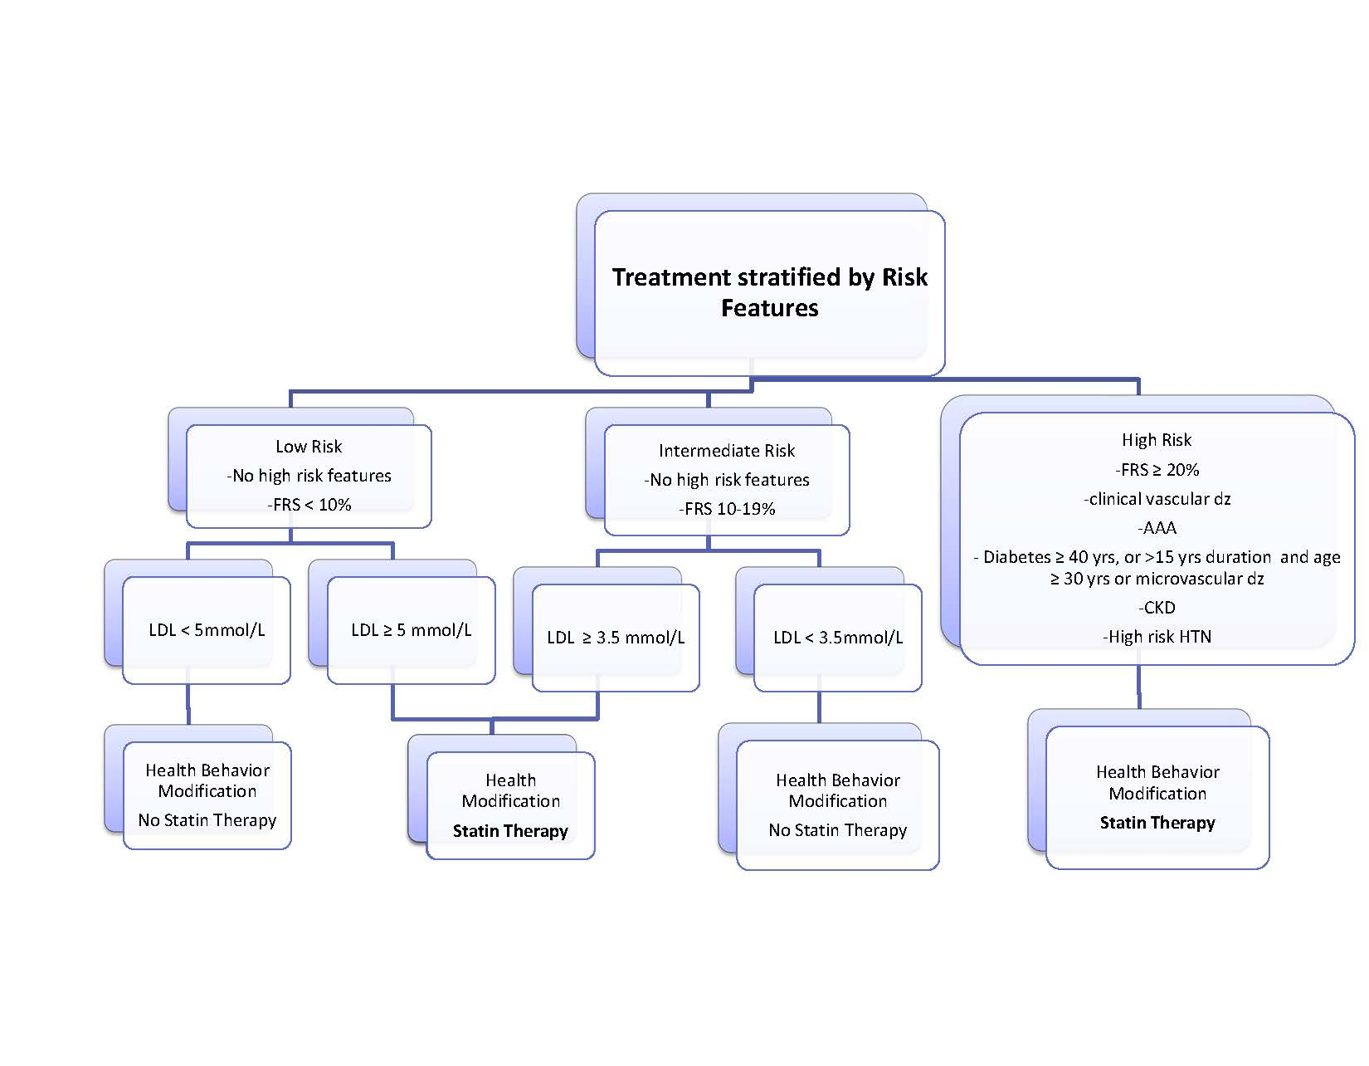
Dyslipidemia
Treatment Recommendations
Notes:
Dyslipidemia: Treatment Recommendations
2013 Canadian Cardiovascular Society Dyslipidemia Guidelines
Treatment is based on risk. Everyone can benefit from health behaviour modification
Mod-High risk should consider Statin Therapy
Anderson TJ, Gregoire J, Hegele RA, Couture P, Mancini GB, McPherson R, Francis GA, Poirier P, Lau DC, Grover S, Genest J, Jr., Carpentier AC, Dufour R, Gupta M, Ward R, Leiter LA, Lonn E, Ng DS, Pearson GJ, Yates GM, Stone JA, Ur E: 2012 update of the Canadian Cardiovascular Society guidelines for the diagnosis and treatment of dyslipidemia for the prevention of cardiovascular disease in the adult. Can J Cardiol 2013;29:151-167.
Take home message *Anyone with vascular disease or high FRS should be on a Statin*

Slide 26
Statins: “Myth Busting” for Patients
My cholesterol is normal, why do I need a statin?
Does changing my diet work as well as taking a statin?
What kind of side effects do statins have?
Is it true that statins cause serious muscle problems?
Is it true that statins can damage the liver?
Do I have to take a statin for the rest of my life?
Are natural health products a good option to statins?
If taking a statin, Do I have to take coenzyme Q10?
When is the best time of day to take a statin?
Is Lipitor more harmful compared to other statins?
Notes:
Statins: “Myth Busting” for Patients
I’ve never been told I have high cholesterol, why do I need a statin?
Sometimes people who have a blocked artery or have a health event like a stroke or heart attack may be started on a statin. This is because the cholesterol target is much lower once you’ve had one of these events, even though your cholesterol may be normal. The goal is to lower your risk of another event.
Does changing my diet work as well as taking a statin?
A heart healthy diet is very important and a great way to prevent a heart attack and stroke.
However, it’s very hard to lower your cholesterol without taking a statin. Changing your diet will reduce your cholesterol by only 10 per cent to 15 per cent —statins can lower cholesterol by more than 50 per cent. (Lipitor decreases LDL 35-60%, Pravastatin decreases LDL 25-35%, Crestor decreases LDL 40-65%, Simvastatin decreases LDL 35-50%)
As well, statins affect your body in other ways. Besides lowering cholesterol, statins protect the plaque in your blood vessels from breaking open and causing a heart attack or stroke.
What kind of side effects do statins have?
Most side effects are mild (such as stomach upset) and go away over time. Less than five out of every 100 people who take a statin have side effects.
Is it true that statins cause serious muscle problems?
A rare side effect of statins is aching muscles. It usually affects large muscles (such as the arms or legs) on both sides of the body. Less than five out of every 100 people who take a statin have this side effect.
It can usually be managed by lowering the dose or changing to another brand of statin. It doesn’t cause any long-term muscle damage. Rarely, muscle pain may be a sign of a serious muscle problem (about one out of every 2500 people).
Is it true that statins can damage the liver?
Statins can cause a mild form of liver inflammation that usually doesn’t cause symptoms. It affects up to three out of every 100 people who take a statin. This mild side effect doesn’t cause permanent liver damage.
Blood tests to check your liver will be done before you start the statin, and then about three months after. The inflammation is usually managed by lowering the dose or changing to another brand of statin. It’s rare that statins will cause a serious liver problem. In fact, it’s so low— one out of every 1 or 2 million people—that doing a blood test to check the liver every year is no longer recommended.
Do I have to take a statin for the rest of my life?
Yes, in most cases. High cholesterol and heart disease can’t be cured. Statins work by protecting against heart attacks and strokes over many years. If you’re on a statin and your cholesterol is normal, it’s usually because of the drug. If you stop it, your cholesterol will go up. This is just like medicine for diabetes and high blood pressure.
Are natural health products a good option to taking statins?
Some natural health products may lower cholesterol, but don’t help prevent heart attacks and strokes. Some products, such as soluble fibre and omega-3 fatty acids, will lower cholesterol by a small amount. Red yeast rice also lowers cholesterol because it has a small amount of statin (lovastatin) in it.
Because red yeast rice already has a statin in it and can also interact with other medicine, talk to your healthcare provider before taking a product with red yeast rice.
Does everyone taking a statin have to take coenzyme Q10?
No. It was thought that coenzyme Q10 may help prevent muscle aches in people who take a statin.
However, most studies show that coenzyme Q10 doesn’t have any benefit. Ask your healthcare professional before starting to take coenzyme Q10. It’s expensive and usually not needed.
When is the best time of day to take a statin?
Both atorvastatin (Lipitor ® ) and rosuvastatin (Crestor ® ) can be taken anytime during the day. For example, a healthcare provider may ask you to take your statin in the morning with your other heart medicine. Other statins (such as simvastatin/Zocor ® ) should be taken at bedtime or with the evening meal.
Is atorvastatin (Lipitor ® ) more harmful compared to other statins?
No. Atorvastatin (Lipitor ® ) is just as safe as other statins.

Slide 27
Statins:“Myth Busting” for HCPs
Should statins be used in elderly patients?
If CK is elevated, should the statin be stopped?
If myalgias without CK elevation, should statin be stopped?
If not at LDL-C target with a statin, is adding a fibrate OK?
Does high-dose statin therapy increase risk of myopathy?
Do statins cause diabetes?
Do statins cause cognitive impairment?
Do statins cause cancer?
Does the dose of statin matter in primary prevention?
Notes:
Statins:“Myth Busting” for Healthcare Professionals
Should statins be used in elderly patients?
Yes. Most elderly patients are at high risk for cardiovascular disease (CVD) due to their age alone, and would benefit more from statin therapy than younger patients. For example, the
PROSPER study was done in elderly patients between 70 and 82 years old. (1) In this study,
pravastatin 40 mg daily, compared to placebo, decreased coronary heart disease (CHD) death or non-fatal myocardial infarction (MI) by 2.1 per cent (relative risk reduction of 15 per cent, number needed to treat of 48) over three years.
Elderly patients are at a slightly higher risk for adverse effects (such as myalgias), but should still be treated. In the PROSPER study, the incidence of serious adverse events was similar between groups with no cases of rhabdomyolysis in either group. In general, if you believe your patient has a life expectancy of at least three to five years, and is at high risk for CVD, then a statin could be considered.
If a patient’s CK is elevated, should the statin be stopped?
Not always. First, rule out other causes such as exercise, trauma or infection. A recent
Canadian Cardiovascular Society (CCS) working group consensus statement recommends that if the CK is elevated (in the absence of other causes) but is less than or equal to five times the upper normal limit (UNL), the statin can be continued. (2)
The CK should be repeated in six to 12 weeks or if the patient develops symptoms. If the patient has symptoms, hold the statin until other causes are ruled out. Once the CK is equal to or less than the UNL and the patient has no symptoms, the statin can be restarted (if the case was mild), switched or the dose lowered.
If a patient has myalgias without CK elevation, should the statin be stopped?
This is debatable. If the pain is tolerable, you can take a watch-and-wait approach. The symptoms may resolve on their own, as there are other reasons for muscles aches. In this case, if the statin is held and the muscle aches improve (which is often the case) the patient may feel that the statin caused the muscle pain. If the pain isn’t tolerable, the CCS consensus statement suggests holding the statin and restarting, switching or lowering the dose once the patient’s pain is gone. (2)
If a patient has a documented statin-related myopathy, can they be changed to another statin?
Most patients with true statin-related myopathy (with the exception of rhabdomyolysis) will tolerate another statin. Therefore, it’s suggested to switch statins, start at a low dose, and titrate slowly. For patients with multiple statin intolerances, there is even evidence to support intermittent dosing strategies (every-other-day or once-weekly dosing) with rosuvastatin (Crestor® ). Whenever possible, patients should be encouraged to try several types of statins before switching to an alternate lipid-lowering agent. There are many studies that support the benefit of statins at reducing cardiovascular events and little to no benefit with other lipid-lowering therapies. A patient who has rhabdomyolysis should never take a statin again.
If a patient is not at their LDL-C target with a statin, is adding a fibrate a good adjunct therapy?
In most cases no, due to lack of benefit and risk of harm. Avoid the statin-fibrate combination whenever possible. The combination of statin-fibrate (specifically gemfibrozil) has been shown to cause an almost six-fold increase in the risk of rhabdomyolysis. (3) Thus, the combination of gemfibrozil with a statin is contraindicated.
The ACCORD-Lipid trial, which investigated simvastatin plus fenofibrate or placebo in patients with type 2 diabetes mellitus, did not show any difference in the incidence of myopathy between groups, including rhabdomyolysis. However, there was no difference in major fatal or non-fatal CV events between groups. Though the serum triglycerides were lower in the fibrate group, there was no difference in serum low-density lipoprotein cholesterol (LDL-C) level. This combination should only be used in patients in whom the triglycerides are at a level where pancreatitis is a concern. Even then, the evidence for fibrates decreasing the risk of triglyceride-induced pancreatitis is very weak.
Does high-dose statin therapy, as compared to low dose, increase the risk of myopathy?
There is a general consensus that high-dose statin therapy, compared to low-dose, carries a higher risk of myopathy. However, there is limited evidence to support this statement. Case reports show that higher circulating serum levels of statins secondary to drug interactions may lead to myopathies (including rhabdomyolysis). Large clinical trials that compared high-dose to moderate or low-dose statin therapy have not consistently shown a higher risk of myopathy with high-dose therapy. (4–6) The one exception is simvastatin.
The SEARCH study, which compared 80 mg to 20 mg of simvastatin daily, showed 53 cases of definite myopathy with 80 mg (0.9 per cent) compared to two with 20 mg (0.03 per cent) with no additional reduction in major CV events. (7) Therefore, simvastatin 80 mg daily is no longer recommended unless a patient has been taking it chronically with no muscle problems.
Do statins cause diabetes?
Recent meta-analyses have shown that statins are associated with a small incremental increase in the risk of incident diabetes with a number needed to harm of about 255 for statin versus placebo and 125 for high-dose versus moderate-dose statin over four years, which are much higher than the number needed to treat to prevent one CV event. (8, 9) There was also a positive association for patients with pre-existing risk factors for diabetes, such as high fasting blood glucose and body mass index. The higher number of risk factors corresponded to a higher risk of diabetes. Overall, the benefit of statins at reducing CV events far exceeds the small risk of diabetes.
Do statins cause cognitive impairment?
Five systematic reviews report on the cognitive impact of statins. (10–14) The highest level evidence (a systematic review of randomized controlled trials (RCTs)) with over 25,000 patients showed no increase in dementia or cognitive impairment in patients without cognitive impairment. Lower level evidence shows no impact or a reduction in dementia or cognitive impairment (likely due to a healthy user effect rather than real benefit). For those with cognitive impairment or dementia, results from up to 18 RCTs show no indication that statins worsen cognition or dementia. Although some patients may have an idiosyncratic reaction of “fuzzy” thinking, there is no reliable data to support statins impact cognition.
Do statins cause cancer?
The evidence is mixed—some evidence supports a reduction in risk while other studies show a higher risk. However, the best available evidence doesn’t support an increase in the risk of cancer with statin therapy. A recent meta-analysis of RCTs, which included over 100,000 patients, showed that statins have a neutral effect on the incidence of cancer compared to control. (15) This is further supported by another meta-analysis of over 70,000 patients without CVD that didn’t find an increased risk of cancer with statins. (16)
Does the dose of statin matter in primary prevention?
It depends. In appropriately selected patients (based on the patient’s risk for CVD, as well as their values and preferences), statin therapy should be initiated and titrated to the targets specified in the CCS guidelines for the treatment of dyslipidemia. (17) In most cases, this is either an LDL-C less than or equal to 2 mmol/L or a 50 per cent reduction of LDL-C from baseline.
A good approach is to start with the lowest available statin dose and titrate every 6 to 8 weeks until the LDL-C target is reached. The starting dose of a statin gives the greatest relative reduction in LDL-C (20% to 40%). Doubling the dose usually only gives another 6 per cent to 7 per cent reduction in LDL-C. Therefore, a patient may be able to reach their LDL-C target with either a low or high dose of statin.
1. Shepherd J, Blauw GJ, Murphy MB, et al. Pravastatin in elderly individuals at risk of vascular disease (PROSPER): a randomised controlled trial. Lancet 2002;360:1623-30.
2. Mancini GBJ, Baker S, Bergeron J, et al. Diagnosis, prevention, and management of statin adverse effects and intolerance: proceedings of a Canadian Working Group Consensus Conference. Can J Cardiol 2011;27:635-62.
3. Graham DJ, Staffa JA, Shatin D, et al. Incidence of hospitalized rhabdomyolysis in patients treated with lipid-lowering drugs. JAMA 2004;292:2585-90.
4. Cannon CP, Braunwald E, McCabe CH, et al. Intensive versus moderate lipid lowering with statins after acute coronary syndromes. N Engl J Med 2004;350:1495-504.
5. LaRosa JC, Grundy SM, Waters DD, et al. Intensive lipid lowering with atorvastatin in patients with stable coronary disease. N Engl J Med 2005;352:1425-35.
6. Pedersen TR, Faergeman O, Kastelein JJP, et al. High-dose atorvastatin vs usual-dose simvastatin for secondary prevention after myocardial infarction: the IDEAL study: a randomized controlled trial. JAMA 2005;294:2437-45.
7. Study of the Effectiveness of Additional Reductions in Cholesterol and Homocysteine (SEARCH) Collaborative Group. Intensive lowering of LDL cholesterol with 80 mg versus 20 mg simvastatin daily in 12 064 survivors of myocardial infarction: a double-blind randomised trial. Lancet 2010;376:1658-69.
8. Sattar N, Preiss D, Murray HM, et al. Statins and risk of incident diabetes: a collaborative meta-analysis of randomised statin trials. Lancet 2010;375:735-42.
9. Preiss D, Seshasai SRK, Welsh P, et al. Risk of incident diabetes with intensive-dose compared with moderate-dose statin therapy. JAMA 2011;305:2556-64.
10. Richardson K, Schoen M, French B, et al. Statins and cognitive function: a systematic review. Ann Intern Med 2013;159:688-97.
11. McGuinness B, Craig D, Bullock R, Passmore P. Statins for the prevention of dementia. Cochrane Database Syst Rev 2009;2:CD003160.
12. McGuinness B, O’Hare J, Craig D, Bullock R, Malouf R, Passmore P. Statins for the treatment of dementia. Cochrane Database Syst Rev 2010;8:CD007514.
13. Macedo AF, Taylor FC, Casas JP, Adler A, Prieto-Merino D, Ebrahim S. Unintended effects of statins from observational studies in the general population: systematic review and meta-analysis. BMC Med 2014;12:51.
14. Swiger KJ, Manalac RJ, Blumenthal RS, Blaha MJ, Martin SS. Statins and cognition: a systematic review and meta-analysis of short- and long-term cognitive effects. Mayo Clin Proc 2013;88:1213-21.
15. Naci H, Brugts J, Ades T. Comparative tolerability and harms of individual statins: A study-level network meta-analysis of 246 955 participants from 135 randomized, controlled trials. Circ Cardiovasc Qual Outcomes 2013;6:390-99.
16. Brugts JJ, Yetgin T, Hoeks SE, et al. The benefits of statins in people without established cardiovascular disease but with cardiovascular risk factors: meta-analysis of randomised controlled trials. BMJ 2009;338:b2376.
17. Anderson TJ, Gregoire J, Hegele RA, et al. 2012 update of the Canadian Cardiovascular Society guidelines for the diagnosis and treatment of dyslipidemia for the prevention of cardiovascular disease in the adult. Can J Cardiol 2013;29:151-67.

Slide 28
Metabolic Syndrome (aka Syndrome X)
May be diagnosed if ≥ 3 of the following conditions:
  Fasting Glucose >5.6 mmol/L
  Blood Pressure >130/85 mmHg
  Triglycerides >1.7 mmol/L
  HDL <1.0 mmol/L in men
  <1.3 mmol/L in women
  Abdominal Obesity (Caucasians)
Waist Circumference >102 cm in men
>88 cm in women
Notes:
Metabolic Syndrome:
May be diagnosed if 3 or more of the following conditions are present:
Fasting Glucose greater than 5.6 mmol/L
Blood Pressure greater than 130/85 mmHg
Triglycerides greater than 1.7 mmol/L
HDL less than 1.0 mmol/L in men or less than 1.3 mmol/L in women
Abdominal Obesity (Waist Circumference greater than 102 cm in men or greater than 88 cm in women). These values are for Caucasians, lower values are recommended for South Asians.
This collection of conditions places individuals at higher risk of developing Type 2 Diabetes and vascular diseases (heart disease, stroke / TIA, vascular dementia, CKD, PVD).
It approximately doubles risk of artery disease and results in an approximately 5 fold increased risk of Diabetes.
*1 in 4 Canadians has Metabolic Syndrome (also referred to as Insulin Resistance or Syndrome X)
IT IS IMPORTANT TO NOTE: ALL THESE NUMBERS ARE WITHIN NORMAL RANGE, JUST HIGH NORMAL!!!!
Even modest improvements in eating habits and physical activity have been shown to improve the conditions associated with metabolic syndrome. The literature shows lifestyle change can decrease your risk by 80%.
Goldenberg R, Punthakee Z: Definition, classification and diagnosis of diabetes, prediabetes and metabolic syndrome: Canadian Diabetes Association Clinical Practice Guidelines Expert Committee. Can J Diabetes 2013;37 Suppl 1:S8-S11.

Slide 29
Metabolic Syndrome – Cont’d
The good news... even modest improvements can improve health and reduce poor health outcomes
Research has shown:
↓ body weight 5-7% and ↑ physical activity to 150 mins/wk could reduce the risk of developing Type 2 DM in obese patients
Management includes targeting modifiable risk factors (diet, activity, weight) and monitoring blood glucose, cholesterol and blood pressure regularly
Notes:
Metabolic syndrome
Even modest improvements can improve health and reduce poor health outcomes.
A decrease in body weight of 5-7% and an increase in physical activity to 150 mins/wk could reduce the risk of developing Type 2 DM in obese patients. Management includes targeting modifiable risk factors (diet, activity, weight) and monitoring blood glucose, cholesterol and blood pressure regularly.
Dworatzek PD, Arcudi K, Gougeon R, Husein N, Sievenpiper JL, Williams SL: Nutrition Therapy: Canadian Diabetes Association Clinical Practice Guidelines Expert Committee. Canadian Journal of Diabetes 2013;37:S45-S55.
*** It is important to note that lean individuals can also have this syndrome

Slide 30
Diabetes - Assessing Plasma Glucose
Test Result | FPG (mmol/l) | OGTT (mmol/l) | HbA1C (%)
Normal | FPG ≤ 6 | OGTT < 7.8 | HbA1c < 6
Impaired | 6.1 ≤ FPG < 7 | 7.8 ≤ OGTT < 11.1 | 6 ≤ HbA1c ≤ 6.4
Diabetes | FPG ≥ 7 | OGTT ≥ 11.1 | HbA1c ≥ 6.5
*If one of these measurements was indicating diabetes without any hyperglycemia symptoms, the test should be repeated on another day to confirm the diagnosis
Notes:
Diabetes - Assessing Plasma Glucose:
Lab tests & results used to diagnose diabetes
FPG – Fasting Plasma Glucose (measures glucose after having not eaten for 8 hours)
OGTT – Oral Glucose Tolerance Test (measurement taken after 2 hours of taking a glucose solution
HbA1C – Glycated Hemoglobin A1C (measures how much glucose is attached to hemoglobin in RBCs) – estimates average blood sugar level last ~3 months
Screening for diabetes using FPG and/or A1C should be performed every 3 years in individuals > 40 years of age or at high risk using a risk calculator. More frequent and/or earlier testing with either FPG and/or A1C or 2hPG in a 75 g OGTT should be considered in those at very high risk using a risk calculator or in people with additional risk factors for diabetes. These risk factors include:
First-degree relative with type 2 diabetes;
Member of high-risk population (e.g. Aboriginal, African, Asian; Hispanic or South Asian descent;
History of prediabetes (IGT, IFG, or A1C 6.0%-6.4%);
History of gestational diabetes mellitus;
History of delivery of a macrosomic infant;
Presence of vascular risk factors (low HDL <1.0 mmol/L in males, < 1.3 mmol/L in females, high triglycerides > 1.7 mmol/L, hypertension, overweight/obesity);
Presence of associated diseases (polycystic ovary syndrome, acanthosis nigricans, obstructive sleep apnoea, psychiatric disorders, HIV infection);
Use of drugs associated with diabetes (glucocorticoids, atypical antipsychotics, HAART)
Testing with 2hPG in a 75 g OGTT should be undertaken in individuals with FPG 6.1 - 6.9 mmol/L and/or A1C 6.0% - 6.4% in order to identify individuals with IGT or diabetes
Testing with 2hPG in a 75 g OGTT may be undertaken in individuals with FPG 5.6 - 6.0 mmol/L and/or A1C 5.5% - 5.9% and ≥ 1 risk factor(s) in order to identify individuals with IGT or diabetes.
Ekoe JM, Punthakee Z, Ransom T, Prebtani APH, Goldenberg R: Screening for Type 1 and Type 2 Diabetes; 2013, p S12-S15.
Goldenberg R, Punthakee Z: Definition, classification and diagnosis of diabetes, prediabetes and metabolic syndrome: Canadian Diabetes Association Clinical Practice Guidelines Expert Committee. Can J Diabetes 2013;37 Suppl 1:S8-S11.
Tobe SW, Stone JA, Walker KM, et al. Canadian cardiovascular harmonized national guidelines endeavour (C-CHANGE): 2014 update. CMAJ 2014;186(17):E1299-1305.

Slide 31
Glycemic Control Targets
Glycemic control targets should be individualized based on the following:
  • Age
  • Diabetes duration
  • Life expectancy
  • Risk of severe hypoglycemia
  • Presence or absence of cardiovascular disease
A target of HbA1c ≤ 7% is recommend in
most patients with diabetes
Notes:
Glycemic Control Targets:
Therapy in most individuals with type 1 or type 2 diabetes should be targeted to achieve an A1C ≤7.0% in order to reduce the risk of microvascular and, if implemented early in
the course of disease, macrovascular complications.
An A1C≤ 6.5% may be targeted in some patients with type 2 diabetes to further lower the risk of nephropathy and retinopathy, but this must be balanced against the risk of hypoglycemia and increased mortality in patients who are at significantly elevated risk of cardiovascular disease.
Less stringent A1C targets (7.1%-8.5% in most cases) may be appropriate in patients with type 1 or type 2 diabetes with any of the following:
a. Limited life expectancy
b. High level of functional dependency
c. Extensive coronary artery disease at high risk of ischemic events
d. Multiple comorbidities
e. History of recurrent severe hypoglycemia
f. Hypoglycemia unawareness
g. Longstanding diabetes for whom it is difficult to achieve an A1C ≤ 7.0% despite effective doses of multiple antihyperglycemic agents, including intensified basal-bolus insulin therapy.
Stone JA, Fitchett D, Grover S, Lewanczuk R, Lin P: Vascular Protection in People with Diabetes: Canadian Diabetes Association Clinical Practice Guidelines Expert Committee. Canadian Journal of Diabetes 2013;37:S100- S104.
Imran SA, Rabasa-Lhoret R, Ross S: Targets for Glycemic Control: Canadian Diabetes Association Clinical Practice Guidelines Expert Committee. Canadian Journal of Diabetes 2013;37:S31-S34.
Tobe SW, Stone JA, Walker KM, et al. Canadian cardiovascular harmonized national guidelines endeavour (C-CHANGE): 2014 update. CMAJ 2014;186(17):E1299-1305.

Slide 32
Diabetes Management
Optimal glucose control is very important in diabetes treatment. Diabetes can be treated by:
    Lifestyle Adjustments
    Oral Antihyperglycemic medications
    Insulin
Type 2 diabetes treatment should start with lifestyle adjustment; if lifestyle adjustment fails to achieve the target blood glucose after 2-3 months, antihyperglycemic medication should be started
Notes:
All individuals with diabetes (type 1 or type 2) should follow a comprehensive, multifaceted approach to reduce cardiovascular risk in the majority of adult patients, including: Achievement and maintenance of healthy body weight; Healthy diet; Regular physical activity; Smoking cessation; Optimal glycemic control (usually A1C ≤ 7%); Optimal blood pressure control (<130/80 mm Hg); Additional vascular protective medications.
An intensive lifestyle intervention program combining dietary modification and increased physical activity may be used to achieve weight loss and improvements in glycemic control and cardiovascular risk factors.
Dworatzek PD, Arcudi K, Gougeon R, Husein N, Sievenpiper JL, Williams SL: Nutrition Therapy: Canadian Diabetes Association Clinical Practice Guidelines Expert Committee. Canadian Journal of Diabetes 2013;37:S45-S55.
Tobe SW, Stone JA, Walker KM, et al. Canadian cardiovascular harmonized national guidelines endeavour (C-CHANGE): 2014 update. CMAJ 2014;186(17):E1299-1305.

Slide 33

Diabetes – Medical Management
Diabetes treatment should be individualized based on the properties of the antihyperglycemic medications, e.g. efficacy, contraindications, side effects and risk of hypoglycemia
For more information on specific pharmacotherapy recommendations, go to the Canadian Diabetes Association 2013 Clinical Practice Guidelines at:
http://guidelines.diabetes.ca/
Notes:
Diabetes Medical Management
Diabetes treatment should be individualized based on the properties of the antihyperglycemic medications, e.g. efficacy, contraindications, side effects and risk of hypoglycemia
2014 C-CHANGE Recommendations:
Beta blockers should be prescribed when indicated for systolic heart failure, as they provide similar benefits in people with diabetes compared with people without diabetes
Statin therapy should be used to reduce cardiovascular risk in adults with type 1 or type 2 diabetes with any of the following features:
a. Clinical macrovascular disease;
b. Age ≥40 years;
c. Age <40 years and 1 of the following: diabetes duration >15 years and age >30 years, microvascular complications
ACE inhibitor or ARB, at doses that have demonstrated vascular protection, should be used to reduce cardiovascular risk in adults with type 1 or type 2 diabetes with any of the following:
a. Clinical macrovascular disease,
b. Age > 55 years, c. Age < 55 years and microvascular complications.[6;59-61]
For persons with diabetes and hypertension not included in the above recommendation, appropriate choices include (in alphabetical order): ACE inhibitors, angiotensin receptor
blockers, dihydropyridine CCBs and thiazide/thiazide-like diuretics. If target blood pressures are not achieved with standard-dose monotherapy, additional antihypertensive therapy should be used. For people in whom combination therapy with an ACE inhibitor is being considered, a dihydropyridine CCB is preferable to hydrochlorothiazide.
Tobe SW, Stone JA, Walker KM, et al. Canadian cardiovascular harmonized national guidelines endeavour (C-CHANGE): 2014 update. CMAJ 2014;186(17):E1299-1305.
Stone JA, Fitchett D, Grover S, Lewanczuk R, Lin P: Vascular Protection in People with Diabetes: Canadian Diabetes Association Clinical Practice Guidelines Expert Committee. Canadian Journal of Diabetes 2013;37:S100- S104.

Slide 34

Atrial Fibrillation
Irregular rhythm / contraction of the atrium muscles
Why is it important to treat?
  Formation of blood clots Stroke / TIA
  Worsening of other cardiac conditions (i.e. heart failure)
When is it important to treat?
  Decision tools (CHADS2 or CHA2DS2-VASc)
  CCS Algorithm
Notes:
Atrial Fibrillation (AF)
Depending on the baseline knowledge of participants, initial discussions may focus on answering the following questions:
What is atrial fibrillation? What are the symptoms of atrial fibrillation? Why is it important to treat atrial fibrillation?
Atrial fibrillation (AF or afib) occurs if rapid, disorganized electrical signals cause the heart's atria to fibrillate, or contract very fast and irregularly. In AF, blood pools in the atria and doesn’t get pumped completely into the heart's ventricles. As a result, the upper and lower chambers of the heart don't work together as they should.
Atrial fibrillation is the most common abnormal heart rhythm. It may cause no symptoms, but is often associated with palpitations, fatigue, fainting, chest pain, or shortness of breath (congestive heart failure). AF may occur in episodes lasting from minutes to days (paroxysmal AF) or may be permanent in nature. AF can result in a reduction of cardiac output or formation of blood clots in the heart. The risk of stroke is increased fivefold in individuals with AF.
In the 2010 and 2012 Canadian Cardiovascular Society (CCS) guidelines, it was recommended that the Congestive Heart Failure, Hypertension, Age, Diabetes, Stroke/Transient Ischemic Attack (CHADS2) schema be used to estimate stroke risk, because of its simplicity, familiarity, and extensive validation. However, in the 2012 guidelines, elements of the Congestive Heart Failure, Hypertension, Age (≥ 75 years), Diabetes, Stroke/Transient Ischemic Attack, Vascular Disease, Age (65-74 years), Sex (Female) (CHA2DS2-VASc) schema were incorporated in an algorithm for the selection of antithrombotic therapy, particularly for patients with a CHADS2 score of 0.
Additional information regarding calculation of the CHADS2 and CHA2DS2-VASc scores is available on the CCS website (www.ccs.ca ) along with a mobile application resource.
For 2014, the CCS continues to recommend that the CHADS₂ schema be used to estimate stroke risk, complemented by the inclusion of some, but not all, of the CHA₂DS₂-VASc criteria. The CCS is recommending an updated simple “CCS algorithm”.
Ciervo CA, Granger CB, Schaller FA; Granger; Schaller (September 2012). "Stroke prevention in patients with atrial fibrillation: disease burden and unmet medical needs". J Am Osteopath Assoc (Review) 112 (9 (Suppl 2)): eS2–8. PMID 23014814.
Lindsay P, Bayley M, McDonald A, Graham ID, Warner G, Phillips S: Toward a more effective approach to stroke: Canadian Best Practice Recommendations for Stroke Care. Can Med Assoc J 2008;178:1418-1425.
Atul Verma, MD, John A. Cairns, MD, L. Brent Mitchell, MD, Laurent Macle, MD, Ian G. Stiell, MD, David Gladstone, MD, Michael Sean McMurtry, MD, Stuart Connolly, MD, Jafna L. Cox, MD, Paul Dorian, MD, Noah Ivers, MD, Kori Leblanc, PharmD, Stanley Nattel, MD, Jeff S. Healey, MD. 2014 Focused Update of the Canadian Cardiovascular Society Guidelines for the Management of Atrial Fibrillation. Canadian Journal of Cardiology; 30(10): 1114-1130.

Slide 35
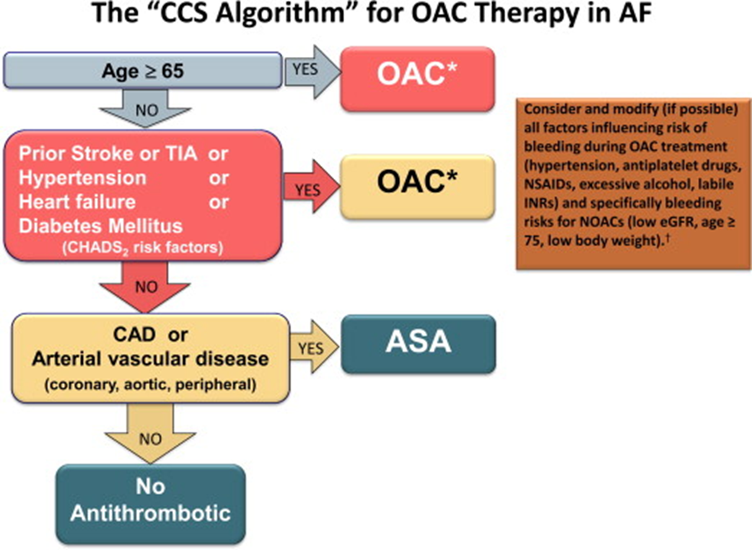
Atrial Fibrillation: Treatment
Canadian Journal of Cardiology
2014 30, 1114-1130DOI: (10.1016/j.cjca.2014.08.001)
Notes:
Atrial Fibrillation: Treatment
The 2014 CCS Recommendations recommend use of this simple algorithm to select appropriate antithrombotic therapy. Based on clinical significance of age ≥ 65 years as a risk factor, the clinician should use OAC for most patients who are aged ≥ 65 years or have a CHADS2 score ≥ 1. Acetylsalicylic acid (ASA) should be used for patients aged < 65 years with CHADS2 score = 0 who have vascular disease. No antithrombotic therapy should be given for patients aged < 65 years with CHADS2 score = 0 and no vascular disease. The CCS does not consider female sex or vascular disease alone as sufficient reasons to prescribe OAC therapy, in contrast to the European Society of Cardiology guideline to use OACs for anyone with a CHA2DS2-VASc score ≥ 1. The CCS does, however, recommend OAC therapy for patients ≥ 65 years old in agreement with the European Society of Cardiology guidelines, but different from the American Heart Association guidelines which suggests a choice of no antithrombotic, ASA, or OAC therapy in these patients. The simplified “CCS algorithm” differs from the 2012 algorithm in only 1 respect: women with vascular disease no longer qualify for OAC therapy unless they are age ≥ 65 or have an additional CHADS2 risk factor.
* The CCS suggests that a NOAC be used in preference to warfarin for non-valvular AF.
† Might require lower dosing. ASA, acetylsalicylic acid; CAD, coronary artery disease
(CCS, Canadian Cardiovascular Society; CHADS2, Congestive Heart Failure, Hypertension, Age, Diabetes, Stroke/Transient Ischemic Attack; eGFR, estimated glomerular filtration rate; INR, international normalized ratio; NOAC, novel oral anticoagulant; NSAID, nonsteroidal anti-inflammatory drug; TIA, transient ischemic attack.)
2014 CCS Recommendations:
We recommend that when OAC therapy is indicated for patients with nonvalvular AF, most patients should receive dabigatran, rivaroxaban, apixaban, or edoxaban (when approved) in preference to warfarin (Strong Recommendation, High-Quality Evidence).
Practical tip. Nonvalvular AF refers to AF in the absence of rheumatic mitral stenosis, a mechanical or bioprosthetic heart valve, or mitral valve repair.
A major challenge for clinicians in following this recommendation is that the current reimbursement systems in Canada are not aligned with it.
We recommend that when OAC is indicated, warfarin be used rather than a NOAC for patients with a mechanical prosthetic valve, rheumatic mitral stenosis or eGFR of 15-30 mL/min/1.73 m2 (Strong Recommendation, Moderate-Quality Evidence).
Practical tip. Patients should generally receive the higher of the 2 doses of the NOACs evaluated in the RCTs unless there is a specific reason to use the lower dose (eg, advanced age, renal failure, small body weight).
Practical tip. Among patients aged ≥ 75 years who receive dabigatran, the dose should be 110 mg twice per day, because of better balance between risks of stroke and major bleeding.
We recommend that patients whose risk of stroke warrants OAC therapy, but who refuse any OAC, should receive ASA 81 mg/d with clopidogrel 75 mg/d (Strong Recommendation, High-Quality Evidence).
Atul Verma, MD, John A. Cairns, MD, L. Brent Mitchell, MD, Laurent Macle, MD, Ian G. Stiell, MD, David Gladstone, MD, Michael Sean McMurtry, MD, Stuart Connolly, MD, Jafna L. Cox, MD, Paul Dorian, MD, Noah Ivers, MD, Kori Leblanc, PharmD, Stanley Nattel, MD, Jeff S. Healey, MD. 2014 Focused Update of the Canadian Cardiovascular Society Guidelines for the Management of Atrial Fibrillation. Canadian Journal of Cardiology; 30(10): 1114-1130.
Secondary Prevention of Stroke
For the secondary prevention of stroke, patients with atrial fibrillation who have had a stroke/TIA should be treated with Oral Anticoagulation therapy.
Tobe SW, Stone JA, Walker KM, et al. Canadian cardiovascular harmonized national guidelines endeavour (C-CHANGE): 2014 update. CMAJ 2014;186(17):E1299-1305.

Slide 36
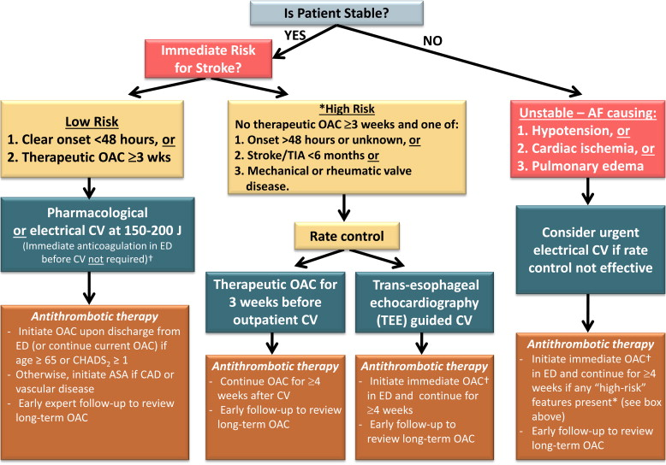
Atrial Fibrillation: Treatment (in the ED)
Canadian Journal of Cardiology
2014 30, 1114-1130DOI: (10.1016/j.cjca.2014.08.001)
Notes:
Atrial Fibrillation: Treatment in the ED
2014 CCS Recommendations: Decision algorithm for management of oral anticoagulation (OAC) therapy for patients who present to the emergency department (ED) with recent-onset atrial fibrillation (AF) requiring rate control or cardioversion (CV) in the ED.
† Immediate OAC = a dose of OAC should be given just before cardioversion; either a novel direct oral anticoagulant (NOAC) or a dose of heparin or low molecular weight heparin with bridging to warfarin if a NOAC is contraindicated.
(ASA, acetylsalicylic acid; CAD, coronary artery disease; CHADS2, Congestive Heart Failure, Hypertension, Age, Diabetes, Stroke/Transient Ischemic Attack; TIA, transient ischemic attack.)
For patients with no high-risk factors for stroke (recent stroke or TIA within 6 months; rheumatic heart disease; mechanical valve) and clear AF onset within 48 hours or therapeutic OAC therapy for ≥ 3 weeks, the CCS recommends that they may undergo cardioversion in the ED without immediate initiation of anticoagulation. After attempted or successful cardioversion, antithrombotic therapy should be initiated as per the CCS algorithm.
Stroke prevention for patients with symptomatic, recent-onset AF/AFL is the most common arrhythmia in the Emergency Department (ED). There are 2 competing strategies for ED management; rate-control and rhythm control treatment. The rate control approach consists of ventricular rate control, OAC, and delayed cardioversion after 4 weeks if indicated. With the rhythm control approach, attempts are made to cardiovert patients to sinus rhythm in the ED, either pharmacologically or electrically. The rhythm control approach is widely used in Canadian EDs and details of care are provided in the 2010 CCS AF guidelines.
Atul Verma, MD, John A. Cairns, MD, L. Brent Mitchell, MD, Laurent Macle, MD, Ian G. Stiell, MD, David Gladstone, MD, Michael Sean McMurtry, MD, Stuart Connolly, MD, Jafna L. Cox, MD, Paul Dorian, MD, Noah Ivers, MD, Kori Leblanc, PharmD, Stanley Nattel, MD, Jeff S. Healey, MD. 2014 Focused Update of the Canadian Cardiovascular Society Guidelines for the Management of Atrial Fibrillation. Canadian Journal of Cardiology; 30(10): 1114-1130.

Slide 37
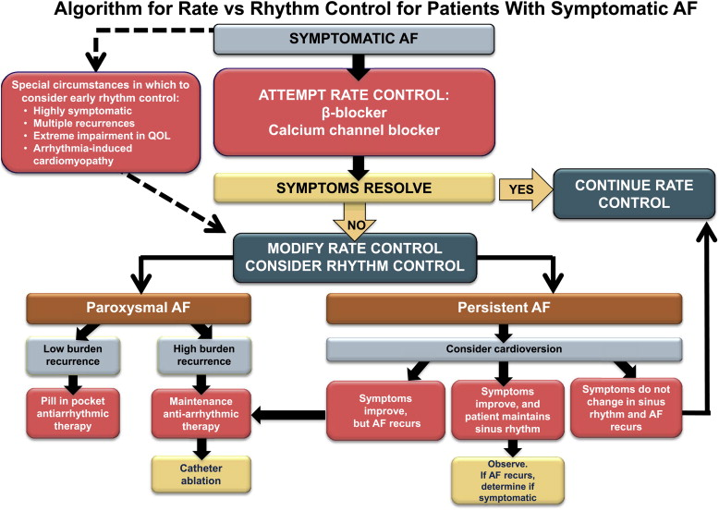
Atrial Fibrillation: Treatment
Canadian Journal of Cardiology
2014 30, 1114-1130DOI: (10.1016/j.cjca.2014.08.001)
Notes:
Atrial Fibrillation: Treatment
Approach to rate and/or rhythm control of atrial fibrillation (AF) in patients presenting with symptomatic AF. (QOL, quality of life.)
The main goal of AF treatment is to relieve symptoms, improve functional capacity and quality of life, and where possible, improve left ventricular function. Trial results suggest that this can be accomplished by either rate control or rhythm control, without systematic benefit of either strategy in terms of mortality or morbidity. Thus, the choice of rate vs rhythm control must be individualized for each patient. Furthermore, the preferred treatment strategy might change over time if the patient's symptoms change or if one strategy has not proven effective.
Atul Verma, MD, John A. Cairns, MD, L. Brent Mitchell, MD, Laurent Macle, MD, Ian G. Stiell, MD, David Gladstone, MD, Michael Sean McMurtry, MD, Stuart Connolly, MD, Jafna L. Cox, MD, Paul Dorian, MD, Noah Ivers, MD, Kori Leblanc, PharmD, Stanley Nattel, MD, Jeff S. Healey, MD. 2014 Focused Update of the Canadian Cardiovascular Society Guidelines for the Management of Atrial Fibrillation. Canadian Journal of Cardiology; 30(10): 1114-1130.

Slide 38
Atrial Fibrillation: Treatment
Anti-coagulants
  NOACs (novel oral anticoagulant)
    include Dabigatran (Pradex), Rivaroxaban (Xarelto) & Apixaban (Eliquis)
  Warfarin (Coumadin)
Rhythm and Rate control
  Beta-blockers, CCB’s (Digoxin), Amiodarone
*Individuals with atrial fibrillation have a risk of stroke that is 3 to 5 times greater than those without AF.
Notes:
Atrial Fibrillation: Treatment
Treatment of atrial fibrillation focuses on rhythm and rate control as well as anti-coagulation therapy. Many novel, or new, oral anti-coagulants were developed to overcome the major limitations associated with warfarin and other vitamin K antagonists.The NOACs apixaban, dabigatran, edoxaban, and rivaroxaban have been evaluated in large, blinded, RCTs involving > 70,000 patients. Each of the NOACs was found to be noninferior to warfarin for the outcome of all stroke or systemic embolism. None of them caused more major bleeding and all were superior for the outcome of intracranial hemorrhage. Based on these observations coupled with greater convenience for patients and physicians, the CCS Guidelines Committee continues to recommend NOACs over warfarin for nonvalvular AF.
2014 CCS Recommendations:
We recommend that when oral anti-coagulant (OAC) therapy is indicated for patients with nonvalvular AF, most patients should receive dabigatran, rivaroxaban, apixaban, or edoxaban (when approved) in preference to warfarin (Strong Recommendation, High-Quality Evidence).
Practical tip. Nonvalvular AF refers to AF in the absence of rheumatic mitral stenosis, a mechanical or bioprosthetic heart valve, or mitral valve repair.
A major challenge for clinicians in following this recommendation is that the current reimbursement systems in Canada are not aligned with it.
We recommend that when OAC is indicated, warfarin be used rather than a NOAC for patients with a mechanical prosthetic valve, rheumatic mitral stenosis or eGFR of 15-30 mL/min/1.73 m2 (Strong Recommendation, Moderate-Quality Evidence).
Practical tip. Patients should generally receive the higher of the 2 doses of the NOACs evaluated in the RCTs unless there is a specific reason to use the lower dose (eg, advanced age, renal failure, small body weight).
Practical tip. Among patients aged ≥ 75 years who receive dabigatran, the dose should be 110 mg twice per day, because of better balance between risks of stroke and major bleeding.
We recommend that patients whose risk of stroke warrants OAC therapy, but who refuse any OAC, should receive ASA 81 mg/d with clopidogrel 75 mg/d (Strong Recommendation, High-Quality Evidence).
The main goal of AF treatment is to relieve symptoms, improve functional capacity and quality of life, and where possible, improve left ventricular function. Trial results suggest that this can be accomplished by either rate control or rhythm control, without systematic benefit of either strategy in terms of mortality or morbidity. Thus, the choice of rate vs rhythm control must be individualized for each patient. Antiarrhythmic may interfere with other concomitant medications so it is important to speak with the physician or Pharmacist about possible drug (or non-drug) interactions.
Atul Verma, MD, John A. Cairns, MD, L. Brent Mitchell, MD, Laurent Macle, MD, Ian G. Stiell, MD, David Gladstone, MD, Michael Sean McMurtry, MD, Stuart Connolly, MD, Jafna L. Cox, MD, Paul Dorian, MD, Noah Ivers, MD, Kori Leblanc, PharmD, Stanley Nattel, MD, Jeff S. Healey, MD. 2014 Focused Update of the Canadian Cardiovascular Society Guidelines for the Management of Atrial Fibrillation. Canadian Journal of Cardiology; 30(10): 1114-1130.

Slide 39
Addressing Vascular Risk
Key Messages:
Support Healthy Lifestyle Behaviours to reduce vascular risk
Strongly consider antihypertensive therapy if blood pressure is not within target
Base dyslipidemia treatment on level of vascular risk
  Those with High Cardiovascular Risk or known Vascular Disease should be treated with statin therapy
Optimal glucose control is important in diabetes treatment.
Treat atrial fibrillation when indicated
Notes:
VRR: Key Messages
Summary slide – Highlight the key messages discussed in this presentation.

Slide 40
Questions?

Slide 41

A Special Thanks to:
The Calgary & Lethbridge Vascular Risk Reduction
Programs and the CvHS SCN - VRR RxEACH Project,
for their support and collaboration.

Slide 42
References:
Canadian Cardiovascular Society:
http://www.ccs.ca/index.php/en/
C-CHANGE Clinical Resource Centre:
http://www.c-changecrc.ca/
Harmonization of guidelines for the prevention and treatment of cardiovascular disease: the C-CHANGE Initiative – www.cmaj.ca (November 18, 2014)
Heart and Stroke Foundation of Canada: http://heartandstroke.com

Slide 43
References:
Hypertension Canada (CHEP recommendations): http://hypertension.ca
Vascular Risk Reduction Resource:
http://www.albertahealthservices.ca/10585.asp

