Slide 1
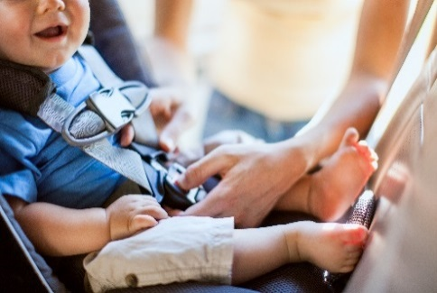
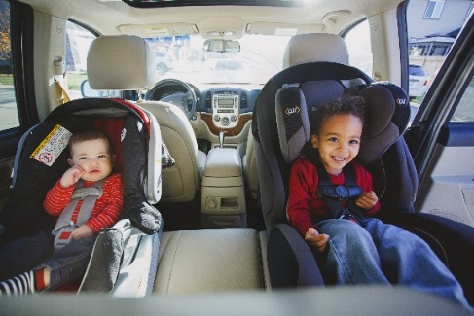
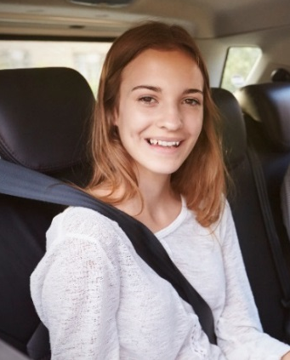
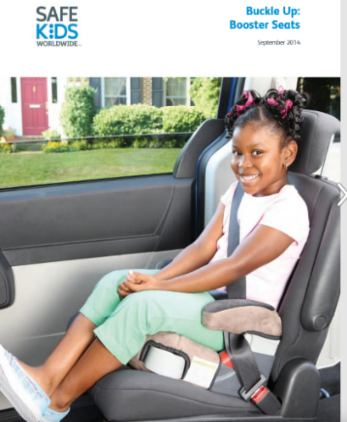
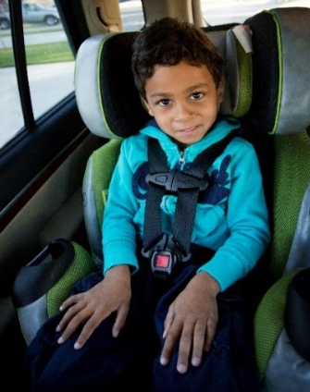
Child Passenger Safety
From Infants to Teens
Notes:
There are four stages of child passenger safety: rear-facing car seat, forward-facing car seats, booster seats and seat belts.
This presentation includes information on all stages as well as the legal requirements for child passengers.
Each stage has different requirements for safe use.
Resources are available for each stage to assist parents/caregivers to check their child’s car seat, booster seat or seat belt for correct use.

Slide 2
Presentation Outline
Child Passenger Safety
Why use car seats and booster seats?
Alberta law
Common safety errors
Car seat stages and types of car seats
Tips for buying car seats and booster seats
Where to get more information
Notes:
Suggestions for using this presentation:
See the presenter’s notes for each slide for details. Many slides have animation (show one line at a time); click to progress
Connect to the internet so the videos/links work. If connected and you play Slide 7 video, skip Slides 8-12
Customize the presentation for suit your audience. Examples: Prenatal teaching, use slides 1-26 (rear-facing car seats), finish with slides 40-41; For parents and/or staff at a daycare, use entire presentation.

Slide 3
Learning Objectives
Child Passenger Safety
To provide participants information on:
  The safest ways to travel with children in vehicles
  How to choose which car seat or booster seat to purchase
  Car seat laws in Alberta

Slide 4
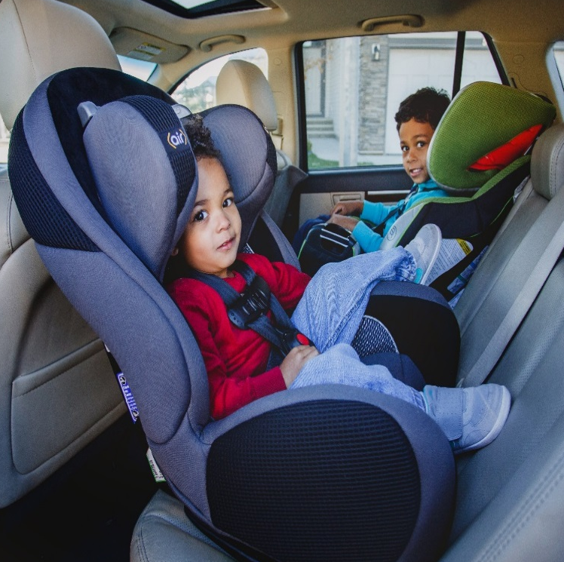
Why buckle kids up?
Child Passenger Safety
Car crashes are the leading cause of child deaths and injuries in Canada
Car seats can reduce deaths by as much as 71% (Canadian Paediatric Society, 2008)
Unrestrained children are 7 times more likely to have traumatic brain injury (concussions) compared with children in appropriate restraints (Centre for Disease Control, 2008)
Correct use of car seats and booster seats save lives
Notes:
Using a car seat properly will reduce the likelihood of a child being injured or killed in a crash by as much as 71%.
When children use car seats and booster seats, they are well protected and less likely to be severely injured.

Slide 5
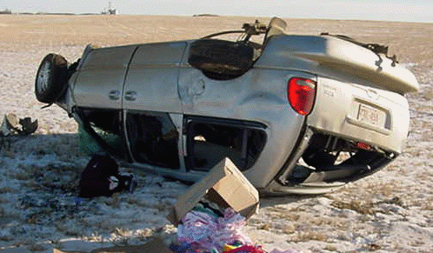
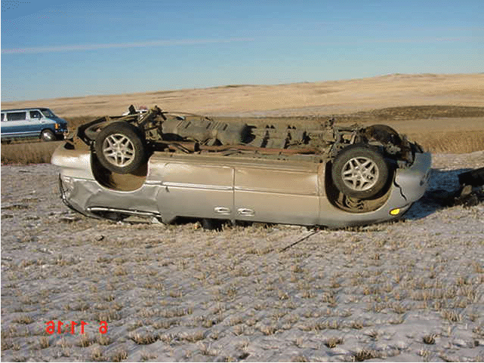
Car Seats Save Lives
Child Passenger Safety
As severe as the damage to the vehicle was (rollover, driver’s side roof crushed, rear wheel torn off, all windows broken), the mom and both children were shaken but not injured at all. Both children were correctly buckled up in car seats. Both car seat were securely installed. The mother had checked the seats to make sure everything was done up right.
Notes:
These crash photos show the same vehicle in both pictures. What do you think happened? Where did the crash take place (rural or urban setting). What type of damage is visible?
The crash was a single vehicle rollover collision where the driver lost control on a rural gravel road just a few kilometers from home.

Slide 6
Alberta Law
Child Passenger Safety
Drivers and passengers must use a seat belt or car seat
Drivers are responsible for passengers under 16 years old
Car seats are needed for children under 6 who weigh less than 18 kg (40 lbs.)
Seat belt or car seat must be used correctly
Notes:
Alberta law sets these requirements:
All drivers and passengers must use an appropriate occupant restraint. Seat belts are designed for adults, but are safely used by older children and youth over 145 cm (4 feet 9 inches) tall.
If a passenger is under 16 years of age, it is the driver’s responsibility to make sure that the passenger is buckled up correctly. If the child is under 6 years of age, and weighs less than 18 kg (40 lbs.):
An appropriate car seat has to be used;
The car seat has to be correctly installed into the vehicle according to the manufactures instructions, and
The child has to be properly secured in the seat.
All three conditions must be met.
The fine per offence is $162 (from Alberta Specified Penalty Listing, August 2021), obtained from http://www.qp.alberta.ca/570.cfm.
Alberta is the only province in Canada that does not have booster seat legislation (as of August 18, 2021).

Slide 7
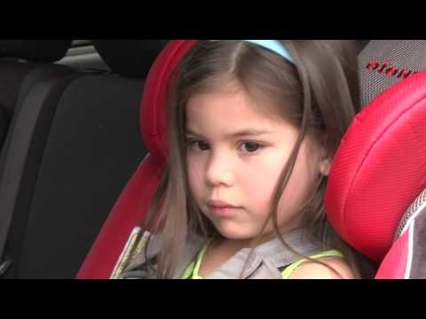
Child Passenger Safety
AHS Car Seat Recommendations (2017) from the AHS YouTube Channel
Notes:
Click the picture to open the AHS Channel on YouTube and start the video. To play the video, there must be an internet connection. The video length 3:15. Viewing tip: In YouTube, check that the view is set to Theatre mode.
If the video doesn’t work, use slides 8 to 12 instead.

Slide 8

AHS Car Seat, Booster Seat and Seat Belt Recommendations for Children Under the Age of 13
Child Passenger Safety
AHS Recommendations for Car Seat, Booster Seat and Seat Belt Use for Children
Key Messages
Always refer to the car seat user manual for the maximum weight and height limits of the child’s particular car seat, and to the vehicle manual for installation instructions
A child is safest in their car seat and booster seat until the maximum weight or height limits of their seat according to the manufacturer
Children under the age of 13 are safest in the back seat
Notes:
Only use these slides (8- 12) if the video (slide 7) doesn’t play in your location.

Slide 9
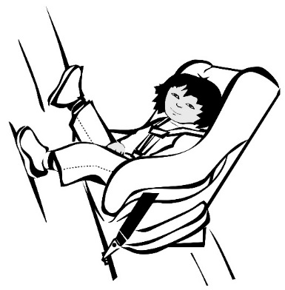
AHS Car Seat, Booster Seat and Seat Belt Recommendations for Children Under the Age of 13
Child Passenger Safety
Rear-facing Car Seats
A rear-facing seat provides the best protection for a child’s head, neck and spine in a sudden stop or crash
A child is safest in a rear-facing car seat until they are at least 2 years old or reach the maximum weight or height limit for the rear-facing seat (as stated by the manufacturer)
Rear-facing car seats with higher weight and height limits will keep a child in the safer, rear-facing position beyond age 2
Notes:
Only use these slides (8- 12) if the video (slide 7) doesn’t play in your location.

Slide 10
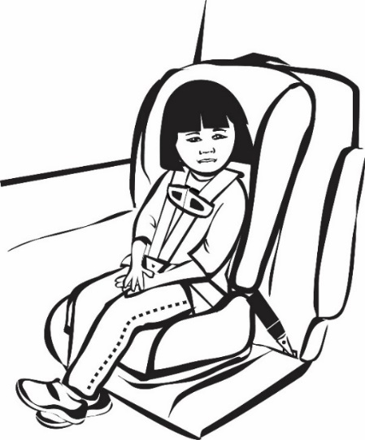
AHS Car Seat, Booster Seat and Seat Belt Recommendations for Children Under the Age of 13
Child Passenger Safety
Forward-facing Car Seats
A child who is at least 2 years old or has reached the maximum weight or height limit of the rear-facing seat (as stated by the manufacturer) should ride in a forward-facing car seat
A child should stay in the forward-facing car seat until they reach the maximum weight or height limit of the seat (as stated by the manufacturer)
Notes:
Only use these slides (8- 12) if the video (slide 7) doesn’t play in your location.

Slide 11
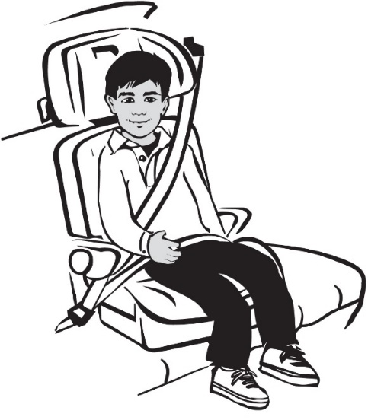
AHS Car Seat, Booster Seat and Seat Belt Recommendations for Children Under the Age of 13
Child Passenger Safety
Booster Seats
Once a child has reached the maximum weight or height limit of their forward-facing car seat (as stated by the manufacturer), they should move into a booster seat
A child is safest in a booster seat until they reach the maximum weight or height limit of the seat (as stated by the manufacturer)
Notes:
Only use these slides (8- 12) if the video (slide 7) doesn’t play in your location.

Slide 12
AHS Car Seat, Booster Seat and Seat Belt Recommendations for Children Under the Age of 13
Child Passenger Safety
Seat Belts
A child is ready to ride in the vehicle without a booster seat when the vehicle seat belt fits properly. This is typically when a child is between 8 and 12 years of age. Children can safely use a seat belt when:
  They are at least 145cm (4 feet 9 inches) tall
  Their knees bend comfortably at the edge of the seat when sitting all the way back
  The lap belt stays low and snug across the hip bones
  The shoulder belt crosses the chest and stays between your child’s neck and shoulder
  They can sit like this for the whole trip without slouching
Until a child can meet all 5 steps, continue using a booster seat for every ride
Notes:
Only use these slides (8- 12) if the video (slide 7) doesn’t play in your location.

Slide 13
Common Safety Errors
Child Passenger Safety
Car seat moves around, does not stay tight
Shoulder straps loose or twisted
Top tether strap not used for a forward-facing car seat
Notes:
These are common safety errors that could result in a child getting hurt, perhaps seriously, in a crash.
To keep your child safe: the seat belt or Universal Anchorage System (UAS) needs to be tight, and the harness straps needs to be snug. For forward-facing car seats, the top tether strap must be used with the seat belt or UAS.

Slide 14

Tips for Buying a Car Seat or Booster Seat
Child Passenger Safety
Fits your child
Fits your vehicle
Fits your budget
What you should know before buying a car seat or booster seat (video)
Source: Parachute Canada YouTube Channel
Notes:
There are many car seat and booster seat options. Keep three things in mind: Your child’s weight and height, how the car seat or booster seat fits in your vehicle, and your budget.
Less expensive seats meet the same safety standards as higher priced seats.
Click the link to start the video, then ‘skip ad.’ Video length 2:56.
If the video fails to load on YouTube, return to presentation and continue to next slide.

Slide 15
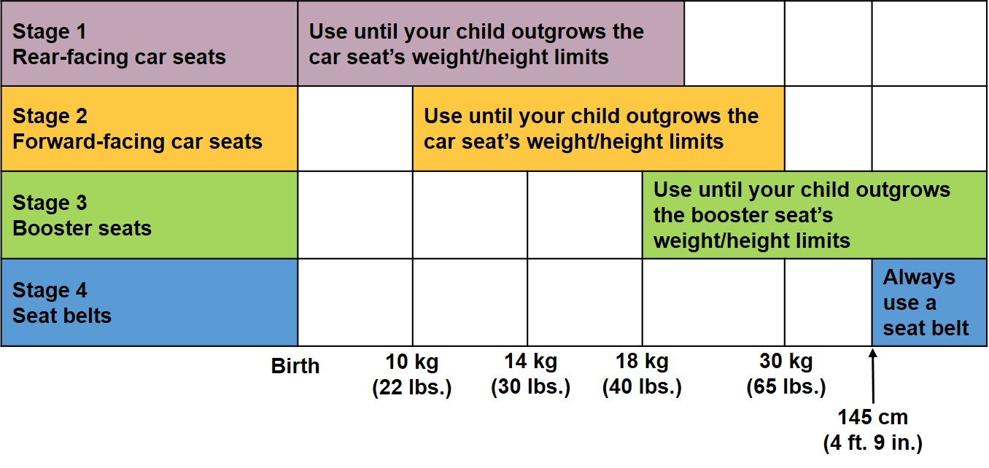
Child Passenger Safety
Transport Canada – Car Time Stages
Keep your child in each stage as long as possible
Source: Choosing a child car seat or booster seat from Transport Canada
Notes:
Transport Canada identifies four Car Time Stages: rear-facing seats, forward-facing seats, booster seats and seat belts.
They recommended keeping babies and young children in each stage as long as possible, until they outgrow the weight and height limits for that seat.
Stage 1: rear-facing provides the best protection for a child’s head, neck and back in a crash or sudden stop.
Many seats are available that combine more than one stage.
A car seat that can be both rear-facing and then turned forward-facing will have higher rear-facing weight/height limits so a child can be kept rear-facing, and safer, longer.
Stage 4: seat belts, has a height, not a weight, as the starting point.
Adapted from: http://www.tc.gc.ca/en/services/road/child-car-seat-safety/buying-child-car-seat-booster-seat.html

Slide 16
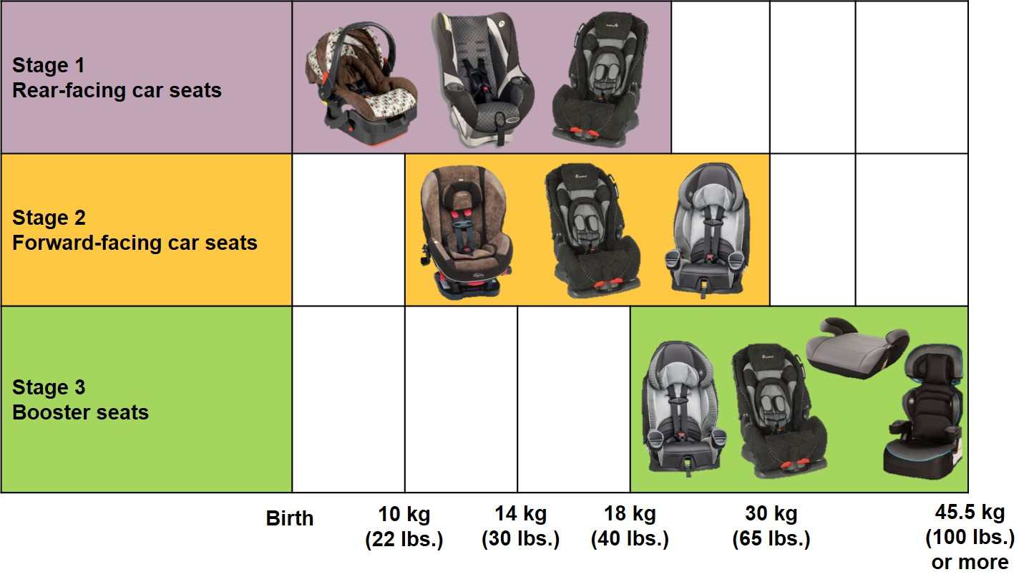
Child Passenger Safety
Car Seat Options by Stage
Notes:
There are many options when looking for a car seat. Each seat comes with specific instructions on how to use it.
All car seats and booster seats sold in Canada must meet the Canada Motor Vehicle Safety Standard (CMVSS). Seats purchased in the United States or other countries do not meet CMVSS standards and cannot be used.
Seats purchased at second-hand stores or garage sales are often missing parts, instructions or may have been involved in a crash and are not recommended.
The best seat for you and your child is one that fits in your vehicle, and that you can and will use correctly every time.
Check the car seat manufacturer’s instructions for directions on replacing a car seat after a crash.
Call the manufacturer or check their website to replace missing instructions. The phone number for the manufacturer is on the seat. For help, call Transport Canada at 1-800-333-0371.

Slide 17
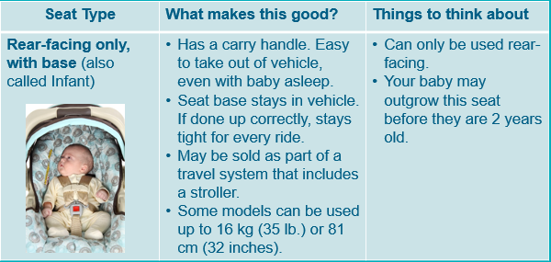
Buying a Car Seat or Booster Seat – Example
Child Passenger Safety
Notes:
When purchasing a car seat, review the tips on the MyHealth.Alberta.ca website: Tips for buying. A link will also appear later in the presentation. This slide has an example about purchasing a rear-facing only car seat.
https://myhealth.alberta.ca/Alberta/Pages/tips-for-buying-a-child-safety-seat-or-booster-seat.aspx

Slide 18
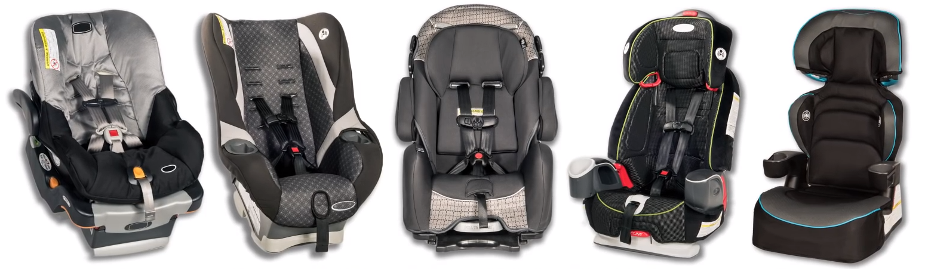
Child Passenger Safety
Examples of Car Seats and Boosters
Less expensive seats meet same safety standards as higher priced seats
Many car seats combine stages - can be used for longer
Rear-facing only
Rear-facing/
forward-facing
Rear-facing/
forward-facing/ booster
Forward-facing/ booster
High back booster
Notes:
There are a wide variety of car seat choices. Each seat type has both advantages and challenges.
Less expensive seats meet the same safety standards as higher priced seats.
Many car seats combine stages and may be used for a longer time.
A forward-facing car seat is always combined with one or more of the other stages (rear-facing, booster or both).

Slide 19

Tips for Buying a Car Seat or Booster Seat
Child Passenger Safety
Look for a label on each car seat and booster seat to see the weight and height limits
Resource for comparing seat types
Source: MyHealth.Alberta.ca
Notes:
Tips for Buying resource is available on MyHealth.Alberta.ca. Use the MHA Print Manager to print.

Slide 20
Stage 1: Rear-facing Car Seats
Child Passenger Safety
Set up your rear-facing seat
Install your rear-facing seat with UAS
Install your rear-facing seat with the seat belt
Source: Child Safety Link (IWK Health Centre, Nova Scotia) on YouTube.
20
Notes:
There are 3 video clips for Stage 1, Rear-facing. To play the videos, there must be an internet connection.
Click the first link: ‘Set up your rear-facing seat.’ The Child Safety Link YouTube channel opens. Click skip ad. Video length 1:41
Click ‘Install your rear-facing seat with UAS’ (or it will start automatically). Video length 3:10
‘Install you rear-facing seat with the seat belt’ should start automatically. Video length 3:12. Note: Stop this video at 1:24 to avoid repetition.
If the video fails to load on YouTube, return to this slide and click a link to open the next video. If next video fails to play, return to the presentation and continue to next slide.

Slide 21
Key Points, Rear-facing
Child Passenger Safety
Keep your child rear-facing for as long as possible
Use a car seat with higher rear-facing limits
Secure seat with the UAS or the seat belt
Make sure the harness is snug
Notes:
The rear‐facing position is the safest for babies and toddlers.
Keep your child rear‐facing as long as possible. Check the weight and height limits of the seat.
Some car seats are designed for rear‐facing use up to 18 kg (40 lbs.), some to 16kg (35 lbs.), and some as high as 22.7 kg (50 lbs.).
When your baby is too big for the rear‐facing only (or infant) car seat, choose a bigger seat where they can stay rear‐facing.
It is okay if your child’s legs touch the back of the vehicle seat.
Secure a rear‐facing car seat with either the UAS (Universal Anchorage System) or the seat belt.
Read and follow the car seat user’s manual and the vehicle owners manual.

Slide 22
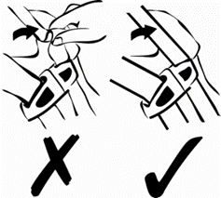
Pinch Test
Child Passenger Safety
If you can pinch the strap, it’s too loose
Follow the car seat’s instructions to tighten
Notes:
There should be no slack in the shoulder straps. If the strap can be pinched, it’s too loose.
Follow the instructions for how to tighten the harness straps.
Adjust the straps so they’re snug for every ride.

Slide 23
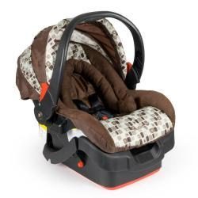
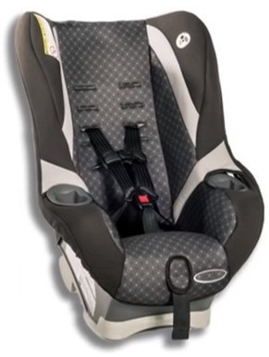
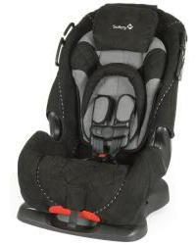
Examples of Rear-facing Car Seats
Child Passenger Safety
Rear-facing only
(infant)
Rear-facing/
forward-facing
(convertible)
Rear-facing/
forward-facing/booster
(3-in-1 and 4-in-1)
Car seats that combine rear-facing with another stage often have higher rear-facing weight and height limits.
Notes:
Your child may outgrow the weight/height limits of a ‘rear-facing only car seat,’ and you may need to buy another car seat with higher rear-facing weight/height limits (a ‘convertible’ or ‘3-in-1,’ for example) to keep your child rear-facing longer.

Slide 24
Rear-facing Only Car Seat
Child Passenger Safety
May have lower rear-facing weight or height limits – check labels
Has a carry handle, is easy to take out of the vehicle
Car seat base stays in vehicle
Many people find this convenient in first 6+ months of their baby’s life
Rear-facing only
(infant)
Notes:
A rear-facing only car seat:
May have lower rear-facing weight or height limits – check the labels. Has a carry handle and is easy to take out of the vehicle.
Car seat base stays in vehicle. If done up correctly, stays tight for every ride.
May be sold as part of a travel system that includes a stroller.​ Many people find this convenient in the first 6+ months of their baby’s life.
A baby may outgrow this seat before they are 2 years old.

Slide 25
Other Rear-facing Car Seats
Child Passenger Safety
Follow rear-facing instructions
Usually have higher rear-facing weight and height limits
Larger than rear-facing only seat
Not easy to move in and out of vehicle
Rear-facing/
forward-facing
(convertible)
Rear-facing/
forward-facing/ booster
(3-in-1 & 4-in-1)
Notes:
A rear-facing/forward-facing seat - this is also called a convertible car seat or an infant/child car seat. It can be used as a rear-facing seat and then changed to a forward-facing seat.
A rear-facing/forward-facing/booster seat - this is also called a 3-in-1 (or 4-in-1) car seat or a ‘birth to booster’ seat. It combines all three types of seat: 3-in-1 includes rear-facing, forward-facing, and high back booster seats; 4-in-1 includes rear-facing, forward-facing, high back booster and backless booster seats.

Slide 26
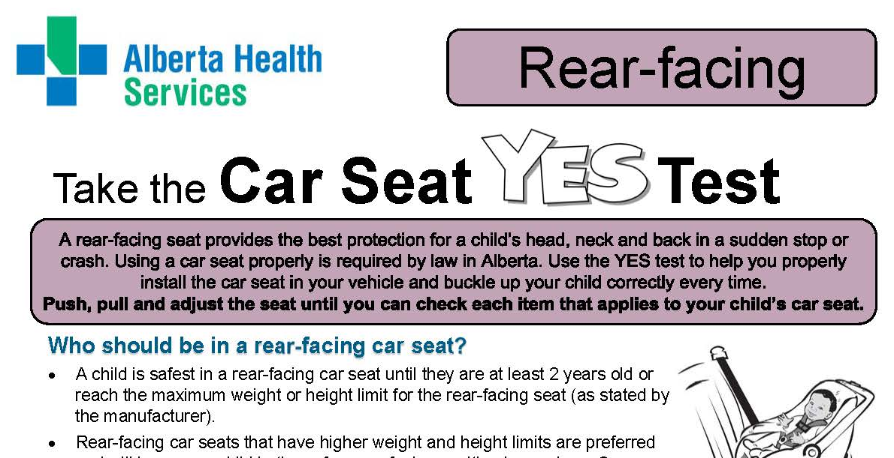
Child Passenger Safety
Car Seat Guidelines in Alberta
Notes:
The Rear-facing Car Seat YES Test is a checklist to help you know you’re using your child’s rear-facing car seat correctly.
Your child is safest when you can check YES to each item that applies to your child’s car seat in your vehicle.
Click the link (or click on the YES Test). Let people know to go to www.MyHealth.Alberta.ca and search for ‘Car seat guidelines in Alberta’ to find the YES Tests and other resources.

Slide 27
Stage 2: Forward-facing Car Seats
Child Passenger Safety
Set up your forward-facing seat
Install your forward-facing seat with UAS
Install your forward-facing seat with the seat belt
Source: Child Safety Link (IWK Health Centre, Nova Scotia) on YouTube.
Notes:
There are 3 videos for Stage 2, Forward-facing. To play the videos, there must be an internet connection.
Click the first link: Set up your forward-facing seat. Skip ad if necessary, video length 1:36.
At the end click, Install your forward-facing seat with UAS. Video length: 3:13.
Next click, Install your forward-facing seat with the seat belt. Video length: 2:58. Note: at 1:44, the content in this video starts to repeat the UAS video content. You may choose to stop the seat belt video at 1:44 to avoid repetition.
If any video fails to load on YouTube, use the ‘Back’ arrow to return to this slide and continue to next slide.

Slide 28

Key Points: Forward-facing
Child Passenger Safety
Use once child is at least 2 years old or is over the limits for a rear-facing car seat
Secure the seat with the UAS or seat belt
Always use the top tether strap
Adjust the harness and keep it snug
Notes:
Once a child is at least 2 years old or has reached the weight or height limit of the larger rear-facing seat, they can move to a forward-facing seat.
When changing from rear-facing to forward-facing, read and follow the instructions for forward-facing use.
Pay attention to: the height of the harness straps (at or above the child’s shoulders); where to put the seat belt or UAS belt for forward-facing use; and how to use the top tether strap (required for forward-facing use). Use the pinch test to make sure the harness is snug
Use a forward-facing car seat as long as possible. Most forward-facing car seats can be used up to 30 kg (65 lbs.)

Slide 29

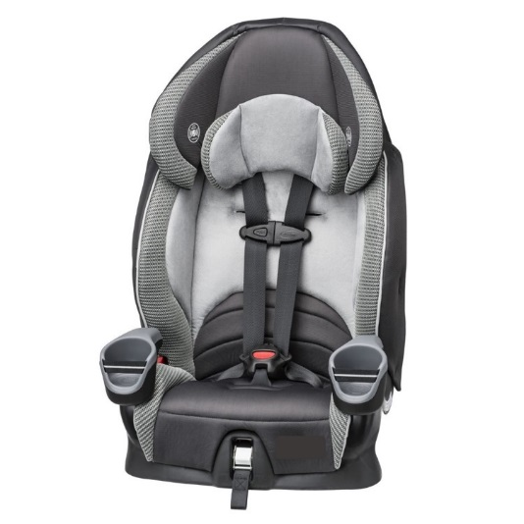
Examples of Forward-facing Car Seats
Child Passenger Safety
Rear-facing/
forward-facing
(convertible)
Rear-facing/
forward-facing/ booster
(3-in-1 & 4-in-1)
Forward-facing/ booster
(harnessed booster)
Notes:
Forward-facing seats come in a variety of styles. Forward-facing seats are always combined with another seat type.
Any of the seats shown can be used as a forward-facing seat. Follow the manufacturer’s instructions for forward-facing use.
Each seat will give the maximum weight and height for use in the forward-facing mode.

Slide 30
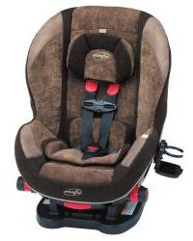
Rear-facing/Forward-facing Car Seats
Child Passenger Safety
Follow the instructions for forward-facing use
Use the top tether
Some models can be used forward-facing with the 5-point harness up to 30 kg (65 lb.) or 132 cm (52 inches)
Rear-facing/
forward-facing
(convertible)
Rear-facing/
forward-facing/ booster
(3-in-1 & 4-in-1)

Slide 31
Forward-facing/Booster Seats
Child Passenger Safety
Combines forward-facing car seat and booster seat
Cannot be used rear-facing
Some models can be used with the 5-point harness up to 30 kg (65 lb.) or 127 cm (50 inches)
Forward-facing/ booster
(harnessed booster)

Slide 32
Child Passenger Safety
Car Seat Guidelines in Alberta
Notes:
The Forward-facing Car Seat YES Test is a checklist to help you know you’re using your child’s forward-facing car seat correctly.
A child is safest when you can check YES to each item that applies to the child’s car seat in your vehicle.
Click the link (or click on the YES Test). Let people know to go to www.MyHealth.Alberta.ca and search for ‘Car seat guidelines in Alberta’ to find the YES Tests and other resources.

Slide 33
Stage 3: Booster Seats
Child Passenger Safety
A guide to installing a booster seat
Source: Parachute Canada on YouTube
Notes:
To play the video, there must be an internet connection. Click the link to start the video. The video length is 4:21, stop at 4:07 to avoid information about the Safe & Sure workshops. Those workshops have never been offered in Alberta.
AHS recommends using a forward-facing car seat for as long as possible before moving to a booster seat. The video says to use a booster seat once a child weighs 18 kg (40 lbs.).
If the video fails to load on YouTube, return to this slide and continue to next slide.
Note: Although the video’s information doesn’t match the AHS recommendations exactly, it was the best video available at the time this presentation was written.

Slide 34
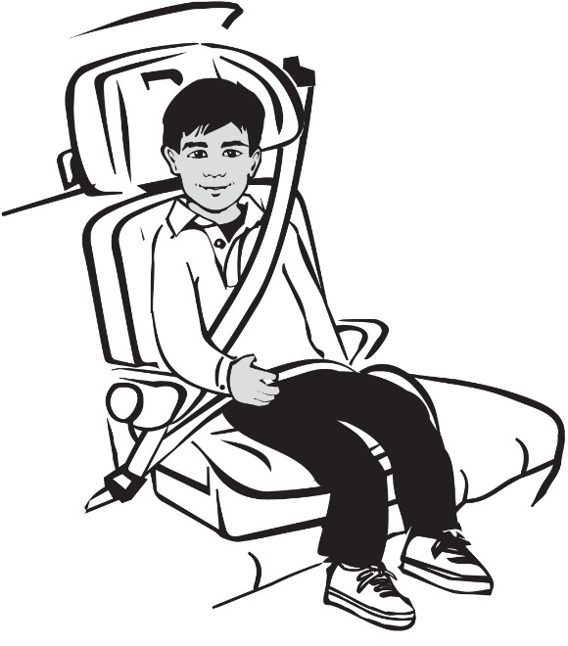
Key Points: Booster Seats
Child Passenger Safety
Use a booster seat after a forward-facing car seat
Always use a lap-shoulder seat belt with a booster seat
Make sure the seat belt fits correctly
Use a booster seat until your child is 145 cm (4 feet 9 inches) tall or reaches the booster seat’s limits
Notes:
Many forward-facing car seats can be used until a child weighs 30 kg (65 lbs.). A forward-facing car seat with a harness keeps a child safer than a booster seat, so use a forward-facing car seat with a harness as long as possible.
Once they’re in a booster seat, encourage your child to be independent and buckle themselves, but check that the seat belt is properly positioned. The shoulder belt should cross the centre of your child's chest and the lap belt should be across their hips.

Slide 35
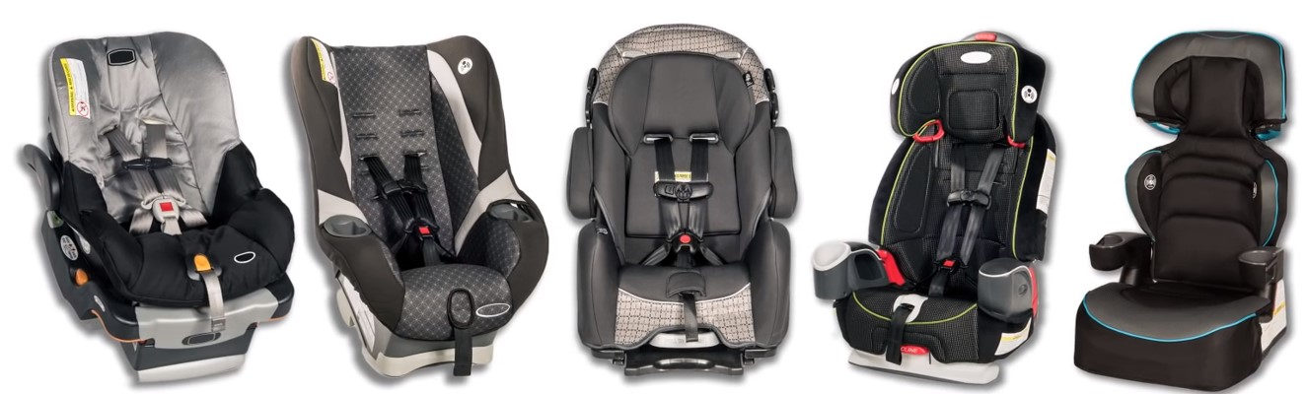
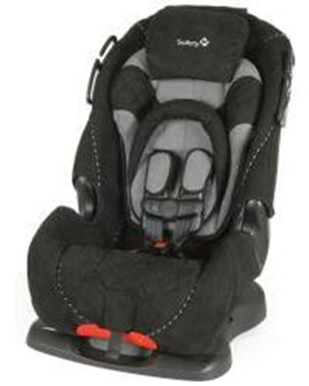
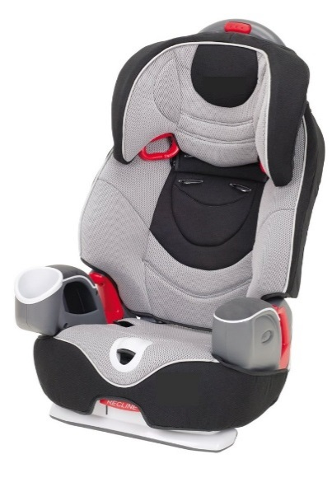
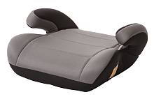
Examples of Booster Seats
Child Passenger Safety
Rear-facing/
forward-facing/ booster
(3-in-1 & 4-in-1) as booster seat
Forward-facing/ booster
(with harness removed)
High back booster
Backless booster
Notes:
Booster seats:
Can only be used with lap-shoulder seat belts and can only be used by children over 18 kg (40 lb.).
When choosing a booster, see if a head restraint (head rest) is on the seat where the booster seat will be placed:
If there’s no head restraint, a high back or adjustable booster may be a better choice than a backless booster.
If a head restraint is present, a backless booster may be used.

Slide 36
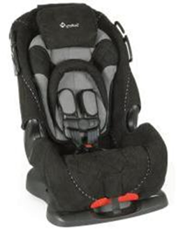
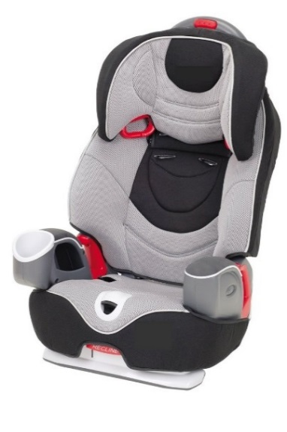
Booster Seats with Backs
Child Passenger Safety
Offer head/neck protection
Good for vehicle seats without head rests
Some models can be adjusted as your child grows
Rear-facing/
forward-facing/ booster
(3-in-1 & 4-in-1) as booster seat
Forward-facing/ booster
(with harness removed)
High back booster
Notes:
Forward-facing/ booster (with harness removed), high back booster and adjustable booster seats:
Offer head/neck protection, good for vehicle seats without head rests. Some models can be adjusted as your child grows.
Some models can be used up to 50 kg (110 lb.) or 145 cm (57 inches).

Slide 37
Backless Booster Seats
Child Passenger Safety
Cost less than high-back boosters
Good for vehicle seats with head rests
Some models can be used up to 45 kg (100 lbs.) or 145 cm (57 inches)
Backless booster
Notes:
Backless booster seat
If a head restraint is present, a backless booster may be used. If there is no head restraint, a high back or adjustable booster may be a better choice than a backless booster.

Slide 38
Child Passenger Safety
Car Seat Guidelines in Alberta
Notes:
The Booster Seat YES Test is a checklist to help you know if you’re using your child’s booster seat correctly.
A child is safest when you can check YES to each item that applies to your child’s booster seat in your vehicle.
A lap-shoulder belt MUST be used with any booster seat. Problems may exist with older vehicles that only have lap belts in the back seat.
Click the link (or click on the YES Test). Let people know to go to www.MyHealth.Alberta.ca and search for ‘Car seat guidelines in Alberta’ to find the YES Tests and other resources.

Slide 39
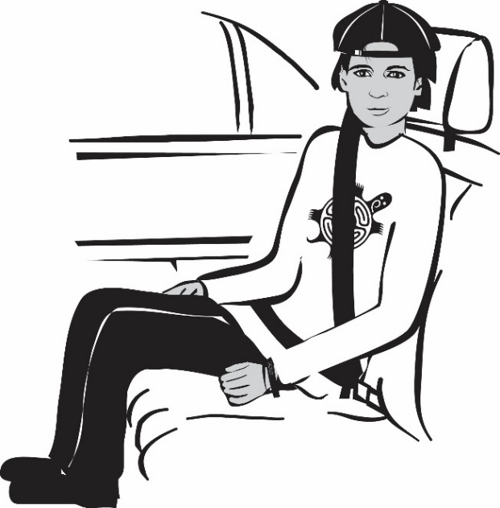
Moving to a Seat Belt
5 Step Test: Check all 5 boxes
Child Passenger Safety
Child is at least 145 cm
(4 feet 9 inches) tall
Knees bend comfortably at
edge of seat
Lap belt stays low and snug
on hips
Shoulder belt crosses middle of chest
They can sit like this for the whole trip
Notes:
Once a child is 145 cm (4 feet 9 inches) tall, it’s important to check that the seat belt will fit your child before they move out of a booster seat.
A child is safest in a booster seat until you can check ALL 5 of the boxes on this slide. These check points are included in the Booster Seat YES Test.

Slide 40



For more information
Child Passenger Safety
Contact the car seat manufacturer or your vehicle manufacturer
Call Health Link at 811
Visit:
  Car Seat Guidelines in Alberta, MyHealth.Alberta.ca
  Motor Vehicle Safety, Transport Canada
Notes:
Car seat manufacturers and vehicle manufacturers will provide help for their products. Call their toll-free numbers. Most car seat manufacturers provide the instructions for each of their car seats on their website, plus videos showing how to use the seat correctly.
Look in your vehicle owners manual to learn about the seat belts in your vehicle, or where a tether anchorage bolt is located. If you can’t find what you need, call the manufacturer. If you need help locating the manufacturer, call Transport Canada at 1-800-333-0371.
Additional Information
On the Transport Canada link, click on ‘child car seat safety’.

Slide 41


Questions?
Provincial Injury Prevention Program
injury.prevention@ahs.ca
41
Notes:
If parents have questions that you’re not able to answer, review the “For more information” slide.
Transport Canada and/or the car seat manufacturers may be the best contact to find answers specific to a particular model of car seat or booster seat.
If there are questions or concerns with the presentation, please email the Provincial Injury Prevention Program at injury.prevention@ahs.ca.

