Slide 1
Good News: Falls are Preventable!
Good News: Falls are Preventable!
Brought to you by AHS Provincial Injury Prevention Program and Seniors Health, with support from IPC Finding Balance resources.
4 Key Ways to Prevent Falls:
Challenge Your Balance^{1,2}
Build Strength^{1,2}
Active Living³
Healthy Eating⁴
Notes:
Welcome Everyone. The AHS Provincial Injury Prevention Program has created a presentation which we are pleased to be able to share with you today. My name is _________________ and I work with (name of your organization) as a ______________________. The theme of this presentation is Good News: Falls are Preventable!
Today we will explore 4 key ways to support falls prevention: Challenging your balance, Building strength, Active living, & Healthy eating.
*Optional Activity: All exercises referenced in this presentation are taken from the three exercise resource series available through request at injury.prevention@ahs.ca as indicated in the Presenter’s Guide.
Either demonstrate, adapt or exempt the activities as needed for individuals standing/sitting and various abilities, and or consult with the appropriate health care provider i.e. Physical Therapist, Kinesiologist, exercise specialist.
Throughout this presentation we will incorporate some physical activity, and you are encouraged to participate in all of the movements if you feel comfortable and able to do so. Let’s start off with a bit of stretch and warm up.
Shoulder Rolls (“Adult and Older Adult Pre-Exercise Stretching Routine” resource, *pg. 4)
Bear Hug (“Adult and Older Adult Pre-Exercise Stretching Routine” resource, *pg. 7)
Calf Stretch ( “Adult and Older Adult Pre-Exercise Stretching Routine” resource, *pg. 9)
Marching on the spot (Not covered in the resources.) This is basic walking in place and can be done sitting or standing – it’s good for weight transfer, sets the mood and gets heartrate up
Slide References:
1. Injury Prevention Centre. (2018). Finding Balance Alberta. Could a fall change your lifestyle? (brochure).
Edmonton, Alberta. Retrieved from https://findingbalancealberta.ca/wp-content/uploads/FB-Brochure-April2019-DIGITAL.pdf
2. Injury Prevention Centre. (2018). Finding Balance Alberta. Challenge Your Balance & Build Strength (brochure). Edmonton, Alberta. Retrieved from https://findingbalancealberta.ca/wp-content/uploads/FB-Active-Strength-Handout-2018.pdf
3. Alberta Health Services (2019). Preventing falls: Injury prevention and safety, information for health professionals. Retrieved from https://www.albertahealthservices.ca/injprev/Page15787.aspx
4. Scott, Vicky. (2017). Fall Prevention Programming: Designing, Implementing and Evaluating Fall Prevention Programs for Older Adults. Retrieved from http://canadianfallprevention.ca/.
Copyright information for users of this resource:
© 2019, Alberta Health Services, Population Public and Indigenous Health/Provincial Injury Prevention Program.
This work is licensed under a Creative Commons Attribution-Non-commercial-Share Alike 4.0 International license. You are free to copy, distribute and adapt the work for non-commercial purposes, as long as you attribute the work to Alberta Health Services and abide by the other licence terms. If you alter, transform, or build upon this work, you may distribute the resulting work only under the same, similar, or compatible licence. The licence does not apply to AHS trademarks, logos or content for which Alberta Health Services is not the copyright owner. To view a copy of this licence, see https://creativecommons.org/licenses/by-nc-sa/4.0/.
This material is intended for general information only and is provided on an "as is", "where is" basis. Although reasonable efforts were made to confirm the accuracy of the information, Alberta Health Services does not make any representation or warranty, express, implied or statutory, as to the accuracy, reliability, completeness, applicability or fitness for a particular purpose of such information. This material is not a substitute for the advice of a qualified health professional. Alberta Health Services expressly disclaims all liability for the use of these materials, and for any claims, actions, demands or suits arising from such use.

Slide 2
Did You Know?
“Falls are the leading cause of injury among older adults.”⁵
4 Key Ways to Prevent Falls:
Challenge Your Balance^{1,2}
Build Strength^{1,2}
Active Living³
Healthy Eating⁴
Notes:
We have bad news and good news.
The bad news is Seniors are at an increased risk of falls, and falls are the leading cause of injuries among seniors.
The “good news is that actions can be taken to prevent falls”¹ and reduce the risk of injuries.¹
Let’s explore further what these are and what this means to you.
Slide References:
5. Finding Balance Alberta. (2019). Am I at risk for a fall. Retrieved from https://findingbalancealberta.ca/am-i-at-risk-for-a-fall/
1. Injury Prevention Centre. (2018). Finding Balance Alberta. Could a fall change your lifestyle? (brochure).
Edmonton, Alberta. Retrieved from https://findingbalancealberta.ca/wp-content/uploads/FB-Brochure-April2019-DIGITAL.pdf

Slide 3
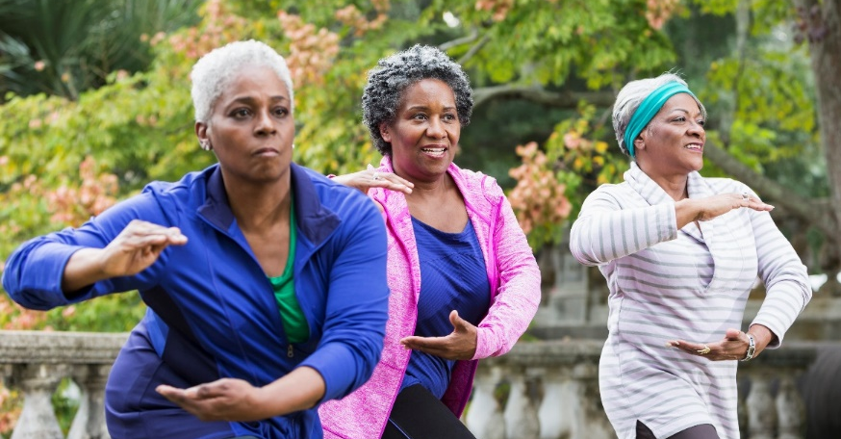
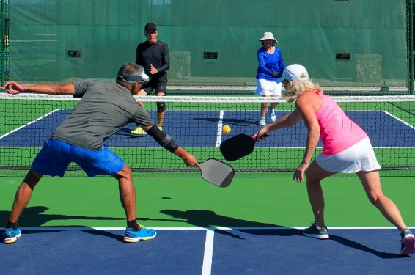
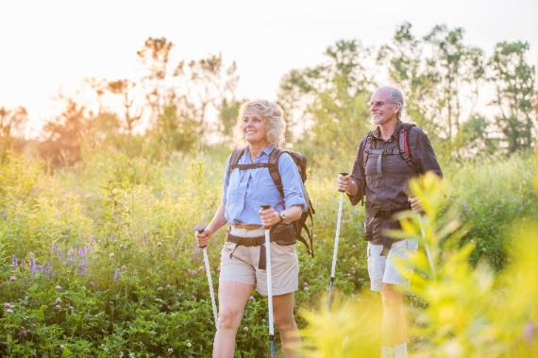
Physical activity helps to maintain independence and prevent falls.
Challenging Your Balance is Key to Preventing Falls
4 Key Ways to Prevent Falls:
Challenge Your Balance^{1,2}
Build Strength^{1,2}
Active Living³
Healthy Eating⁴
Notes:
At the beginning of the presentation I mentioned there were four ways to prevent falls.
The first way to prevent a fall is by regularly challenging your balance.
Read slide.
“Falls are caused by a loss of balance or an inability to recover balance.”⁴
You will see on the slide we have three different pictures representing different physical activities. These pictures include Tai Chi, pickle ball and urban poling, also known as Nordic walking.
Ask the audience:
What do these three of these physical activities have in common?
They all challenge balance in one form or another. Each activity challenges our center of mass by changing the base of support through various movement and motions. For example, Nordic walking on a nature path with uneven surfaces and changes in grade will challenge our base of support. Tai Chi with its continuous slow movements involving shifts in body weight, and pickle ball includes stepping, reaching, lunging and so forth, both challenge our base of support.
These may or may not be activities of choice for each of you but there are many other activities and exercises which you can do daily that will challenge your balance and support falls prevention.
What are some other activities you can think of that challenge your base of support?
(e.g. gardening, golf, yoga, horseshoes, lawn bowling, playing various ball games with grandkids, etc.)
Slide Reference:
4.) Scott, Vicky. (2017). Fall Prevention Programming: Designing, Implementing and Evaluating Fall Prevention Programs for Older Adults. Raleigh, North Carolina: Lulu Publishing

Slide 4
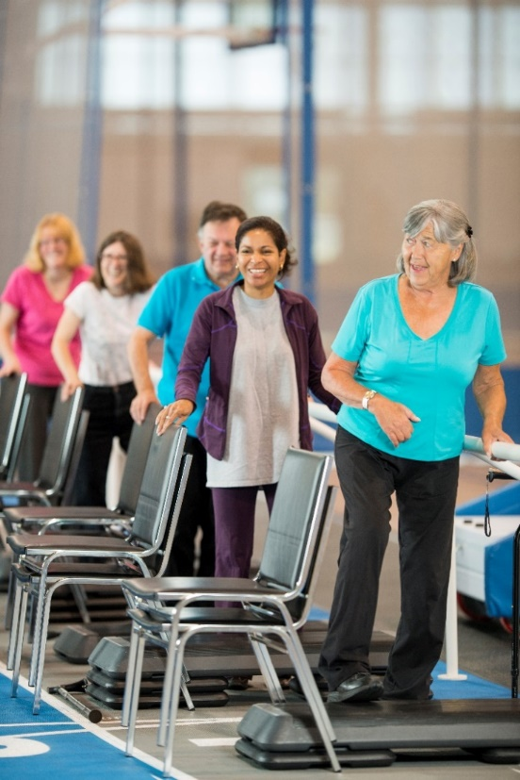
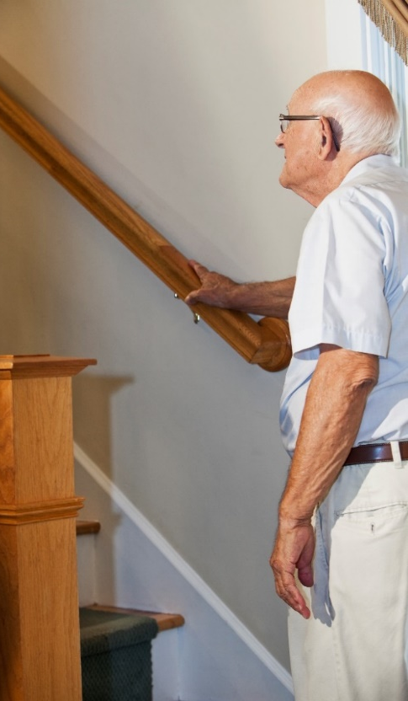
Struggling with your balance?
Practice movements like:
reaching while standing¹
toe and heel raises¹
stepping in different directions¹
half squats¹
using the stairs
Challenging Your Balance is Key to Preventing Falls
4 Key Ways to Prevent Falls:
Challenge Your Balance^{1,2}
Build Strength^{1,2}
Active Living³
Healthy Eating⁴
Notes:
Read slide.
Optional Activity: *(Either demonstrate, adapt or exempt the activities as needed for individuals standing/sitting and various abilities, and or consult with the appropriate health care provider i.e. P.T., Kinesiologist, exercise specialist)
Let’s do a couple of exercises now that will demonstrate how to challenge your balance by changing your base of support within an exercise. Guide the participants through one or more activities on the slide or try either of the following exercises:
Heel –Toe Rock (“Adult and Older Adult Exercise Routine Using Theraband” resource, *pg. 9) *Band not required for this exercise.
Ball Rolls – Alphabet (“Adult and Older Adult Exercise Routine Using an Inflatable Ball” resource, *pg. 7) *This exercise can be done with or without a ball. If you are using balls with the group, introduce the ball here (*pg. 2)
Around the Clock Balance Exercise: (Not listed in the resources) Imagine you are standing in the middle of a clock with your feet together; put your right foot at the 12 o'clock position, bring your foot back to center, then 1 o'clock, 2 o'clock etc.; at 6 o'clock, switch to left leg. Have participants to count out loud as they do these movements too to practice multi tasking and add some fun!
Slide References:
1. Injury Prevention Centre. (2018). Finding Balance Alberta. Could a fall change your lifestyle? (brochure). (quote above taken from this brochure) Edmonton, Alberta. Retrieved from https://findingbalancealberta.ca/wp-content/uploads/FB-Brochure-April2019-DIGITAL.pdf

Slide 5
“Muscle weakness is the most important risk factor which increases the risk of a
fall by 4-5 times.”⁶
Did You Know?
4 Key Ways to Prevent Falls:
Challenge Your Balance^{1,2}
Build Strength^{1,2}
Active Living³
Healthy Eating⁴
Notes:
Read slide.
“Normal age-related changes, result in a reduction in muscle mass of about 30 percent between the ages of 50 and 70 years, with a greater rate of loss in subsequent years.
Weakness in the lower limbs was found to be a risk factor for fall-related hip fractures.
Good news: Physical activity can reduce the impact of muscle loss associated with the natural aging process and increase mobility, physical function, bone density and balance” ⁴
Slide References:
4. Scott, Vicky. (2017). Fall Prevention Programming: Designing, Implementing and Evaluating Fall Prevention Programs for Older Adults. Retrieved from http://canadianfallprevention.ca/
6. Public Health Agency of Canada. (2014) Seniors’ falls in Canada: second report. https://www.canada.ca/en/public-health/services/health-promotion/aging-seniors/publications/publications-general-public/seniors-falls-canada-second-report.html. Accessed April 2019 (page 27)

Slide 6
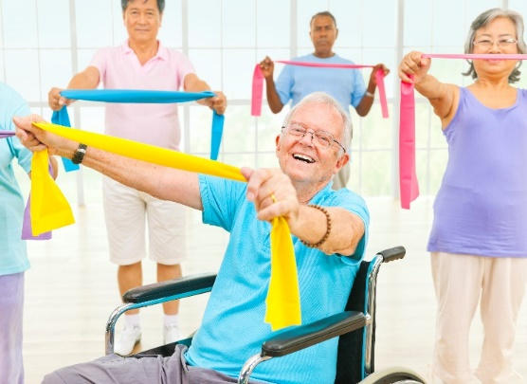
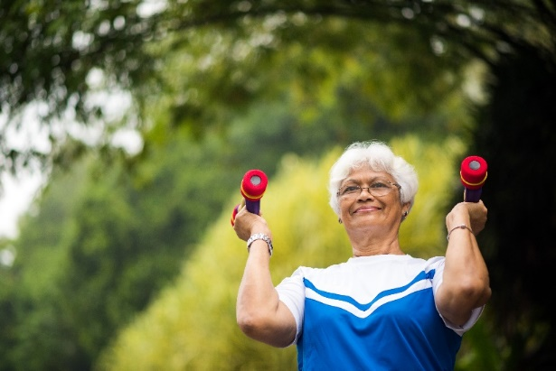
Increase upper body strength by using resistance bands and weights.
Building Strength is Key to Preventing Falls
4 Key Ways to Prevent Falls:
Challenge Your Balance^{1,2}
Build Strength^{1,2}
Active Living³
Healthy Eating⁴
Notes:
To recap, the first way to prevent a fall is by challenging your balance.
The second way to prevent a fall (and not necessarily in this order) is by building strength. They are both of equal importance.
You will see on this slide there are two pictures of seniors incorporating exercise bands and weights into their exercises.
Ask the audience:
Have any of you ever tried exercise bands or weights?
Optional Activities:
*(Either demonstrate, adapt or exempt the activities as needed for individuals standing/sitting and various abilities, and or consult with the appropriate health care provider i.e. P.T., Kinesiologist, exercise specialist)
*Refer to Adult and Older Adult Exercise Routine Using Theraband resource (*pg. 2) to share information about exercise bands. Demonstrate the stretch yourself and let people touch it to get a feel for the stretch and resistance of it)
If you have access to exercise bands and/or inflatable balls for the group to use, lead the group through some of the exercises listed in the resources, for example:
Sword Drawn/Lawn Mower (Adult and Older Adult Exercise Routine Using Theraband resource, *pg. 3)
Punches (“Adult and Older Adult Exercise Routine Using Theraband” resource, *pg. 4)
Frontal Raise (*“Adult and Older Adult Exercise Routine Using Theraband” resource, *pg. 5)
Ball Press (*“Adult and Older Adult Exercise Routine Using an Inflatable Ball” resource, *pg. 8 )

Slide 7
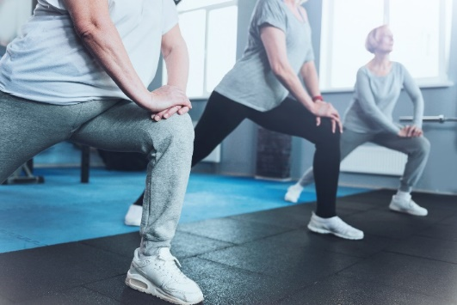
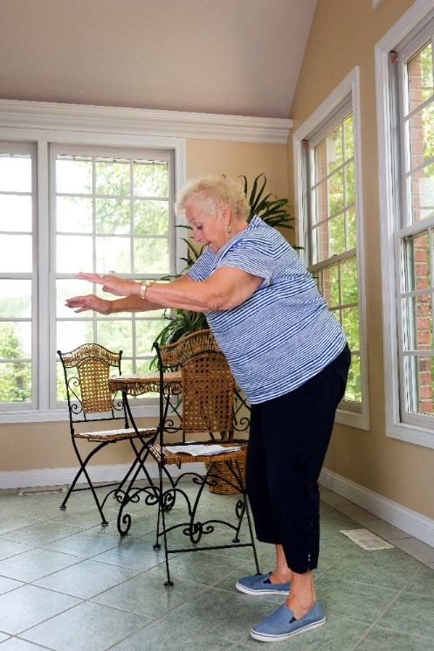
To build lower body strength include body weight exercises such as:
sit-to-stand chair squats²
lunges
side leg-lifts²
Building Strength is Key to Preventing Falls
4 Key Ways to Prevent Falls:
Challenge Your Balance^{1,2}
Build Strength^{1,2}
Active Living³
Healthy Eating⁴
Notes:
Read slide.
Explain what people are doing for exercise in the pictures in case of visual impairment in audience.
Ask the audience:
What activities do you do or know of that challenge strength? (e.g. dancing, yoga, bicycling, weight training, Tai Chi, hiking, etc.)
Optional Activity:
*(Either demonstrate, adapt or exempt the activities as needed for individuals standing/sitting and various abilities, and or consult with the appropriate health care provider i.e. P.T., Kinesiologist, exercise specialist)
Let’s try a couple strength building exercises together. For these exercises we will use an inflatable ball. (refer to“Adult and Older Exercise Routine Using an Inflatable Ball” resource, *pg. 2 to share more information about inflatable balls.)
Seated Ball Squeeze (“Adult and Older Exercise Routine Using an Inflatable Ball” resource *pg. 4)
Seated Ball Kick (“Adult and Older Exercise Routine Using an Inflatable Ball” resource *pg. 5)
Slide References:
2. Injury Prevention Centre. (2018). Finding Balance Alberta. Challenge Your Balance & Build Strength. Edmonton, Alberta. Retrieved from
https://findingbalancealberta.ca/wp-content/uploads/FB-Active-Strength-Handout-2018.pdf

Slide 8
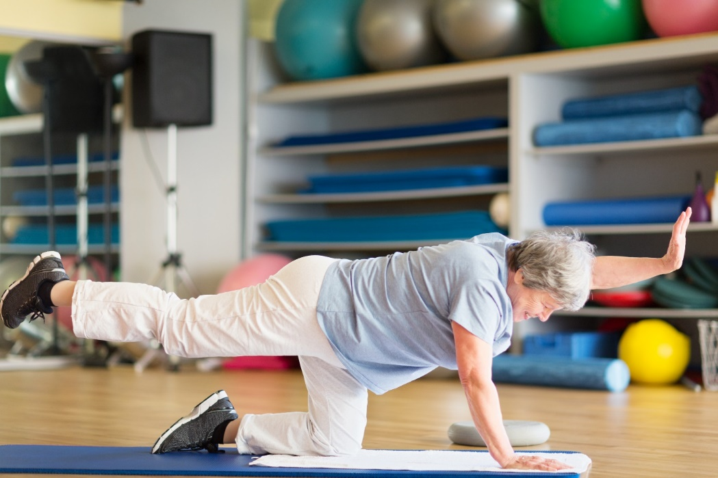
“Include strength and balance activities on most days of the week.”¹
Building Strength is Key to Preventing Falls
4 Key Ways to Prevent Falls:
Challenge Your Balance^{1,2}
Build Strength^{1,2}
Active Living³
Healthy Eating⁴
Notes:
Read slide.
Individual and group exercise programs ideally should focus on:
“training for balance, gait, muscle strength, flexibility, endurance or coordination.
Programs that contain two or more of these have shown to reduce the rate and risk of falling” ⁴.
We can see in this exercise picture that this individual is using her own body weight in challenging core strength, muscle strength, coordination, flexibility and balance.
Slide References:
1. Injury Prevention Centre. (2018). Finding Balance Alberta. Could a fall change your lifestyle? (brochure). Edmonton, Alberta. Retrieved from https://findingbalancealberta.ca/wp-content/uploads/FB-Brochure-April2019-DIGITAL.pdf
4. Scott, Vicky. (2017). Fall Prevention Programming: Designing, Implementing and Evaluating Fall Prevention Programs for Older Adults. Retrieved from http://canadianfallprevention.ca/.

Slide 9
“People with strong legs and
good balance are less likely to fall.”¹
Did You Know?
4 Key Ways to Prevent Falls:
Challenge Your Balance^{1,2}
Build Strength^{1,2}
Active Living³
Healthy Eating⁴
Notes:
Read slide.
Remember from the previous Did you Know slide – muscle weakness was found to be the most important risk factor increasing the risk of a fall by four to five times.
“Exercise is an effective intervention to reduce the risk and rate of falls and an important way for seniors to compensate for age-related changes.” ⁴
Optional Activities: *(Either demonstrate, adapt or exempt the activities as needed for individuals standing/sitting and various abilities, and or consult with the appropriate health care provider i.e. P.T., Kinesiologist, exercise specialist)
If audience is able to stand suggest trying a couple more exercises together
Balance on one foot – hold for 10-30 seconds, and then the other foot, lightly hold onto chair as needed for additional support.
Partial Squat With Band (Adult and Older Adult Exercise Routine Using Theraband, *pg. 8)
Slide References:
Injury Prevention Centre. (2018). Finding Balance Alberta. Could a fall change your lifestyle? (brochure). Edmonton, Alberta. Retrieved from https://findingbalancealberta.ca/wp-content/uploads/FB-Brochure-April2019-DIGITAL.pdf
4. Scott, Vicky. (2017). Fall Prevention Programming: Designing, Implementing and Evaluating Fall Prevention Programs for Older Adults. Retrieved from http://canadianfallprevention.ca/.

Slide 10
Wanting to do more physical activity?
Two 10-minute movement breaks per day will help you reach the recommended 150 minutes per week.
Active Living is Key to Preventing Falls
4 Key Ways to Prevent Falls:
Challenge Your Balance^{1,2}
Build Strength^{1,2}
Active Living³
Healthy Eating⁴
Notes:
To recap: The first way we discussed to prevent a fall was to challenge your balance. The second way was to build strength. The third way is to prevent a fall is through active living.
The Canadian Physical Activity Guidelines for Older Adults (65 years and older) suggest that older adults should:
Accumulate at least 150 minutes of moderate to vigorous intensity aerobic physical activity per week in bouts of 10 minutes or more. For example you might consider taking two 10-15 minute walk breaks throughout the day to total 150 minutes per week.
Add muscle and bone strengthening activities using major muscle groups, at least 2 times per week.
Challenge balance and build strength in both the upper and lower limbs.
Incorporate strength training using weights and or resistance all year long⁷.
Slide Reference:
7. Canadian Society for Exercise Physiology. (n.d.). Canadian Physical Activity Guidelines: For older adults – 65 years & older. Retrieved from http://www.csep.ca/CMFiles/Guidelines/CSEP_PAGuidelines_older-adults_en.pdf

Slide 11
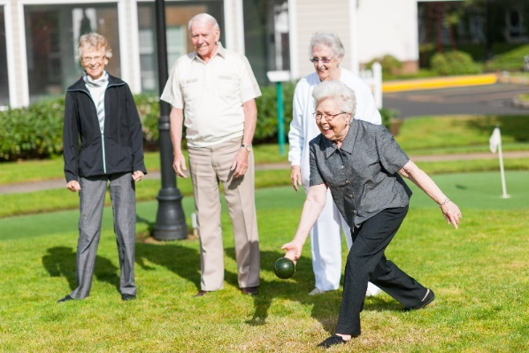
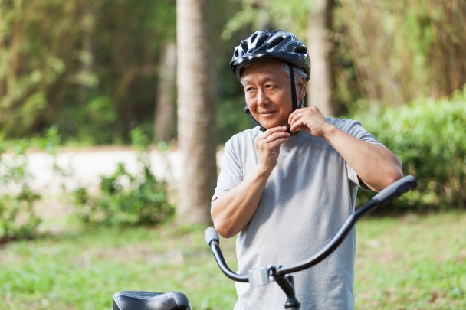
Even without an injury, a fall can lead to a fear of falling.
This fear might stop you from doing things you enjoy and increases your risk of having another fall.
The key is to keep active!
Active Living is Key to Preventing Falls
4 Key Ways to Prevent Falls:
Challenge Your Balance^{1,2}
Build Strength^{1,2}
Active Living³
Healthy Eating⁴
Notes:
Read slide.
Fear of falling is an important risk factor for future falls, either as an emotional response to a previous fall and worry over falling again, or as an anticipatory fear of falling for the first time. Up to 40% of those with a fear of falling decreased their physical activity, leading to muscle weakness and poor balance, social isolation and depression – further increasing their risk of falling⁴.
Lack of physical activity is associated with reduced mobility, a decline in physical function, reduced bone density, weak muscles and poor balance⁴.
The key is to keep active.
Slide Reference:
4. Scott, Vicky. (2017). Fall Prevention Programming: Designing, Implementing and Evaluating Fall Prevention Programs for Older Adults. Retrieved from http://canadianfallprevention.ca

Slide 12
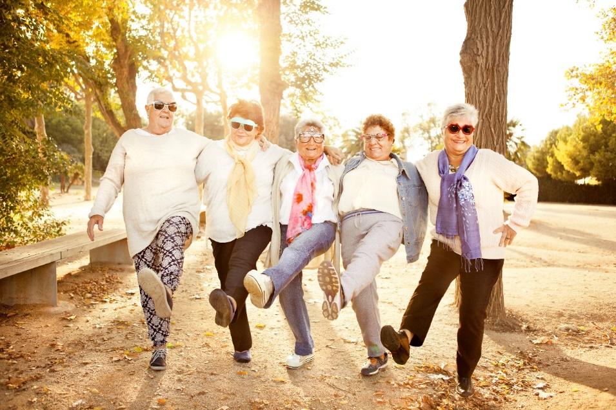
Do activities you enjoy!
Physical activity improves mood, sense of well-being and social connection.
Active Living is Key to Preventing Falls
4 Key Ways to Prevent Falls:
Challenge Your Balance^{1,2}
Build Strength^{1,2}
Active Living³
Healthy Eating⁴
Notes:
Read slide.
Ask: What kinds of physical activities do you enjoy and what is it about that activity that is so enjoyable?

Slide 13
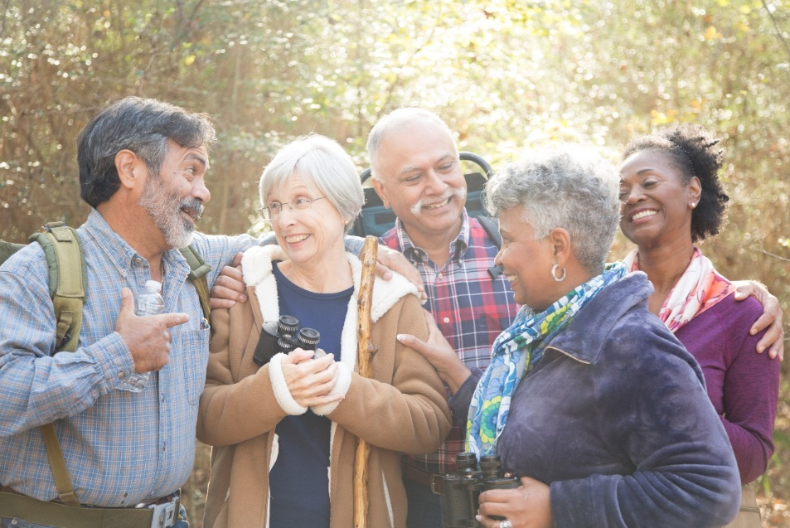
Spend time outdoors.
Being active in nature increases energy levels and improves your mood.
Active Living is Key to Preventing Falls
4 Key Ways to Prevent Falls:
Challenge Your Balance^{1,2}
Build Strength^{1,2}
Active Living³
Healthy Eating⁴
Notes:
Read slide. Describe bird watching picture.
Ask: How many of you enjoy being in nature and or outside? What is it about the outdoors that make you feel good?
Encourage conversation with the group – ask additional questions as needed, share your ideas.

Slide 14
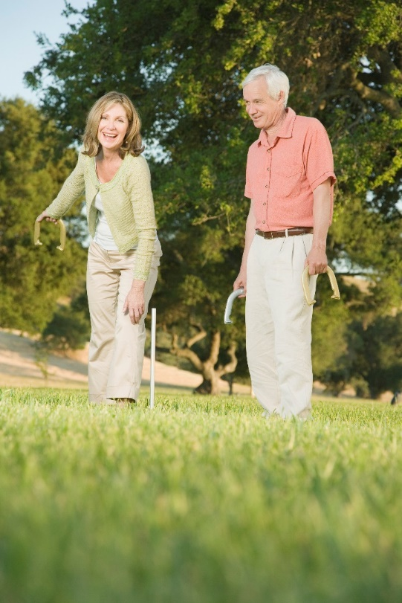
Visit your local seniors’ centre or recreation centre to learn about programs and services that support active living.
Active Living is Key to Preventing Falls
4 Key Ways to Prevent Falls:
Challenge Your Balance^{1,2}
Build Strength^{1,2}
Active Living³
Healthy Eating⁴
Notes:
Read slide.
Talk about some of your local programs and resources to support seniors in the 4 ways to prevent falls.
You could list specific activities that you know of in your community or ask the participants what organized activities they partake in.
This is also an opportunity to ask a guest speaker to share about activities in the community.

Slide 15
While the risk of falling increases with age, falls should not be accepted as a normal part of aging.
Did You Know?
4 Key Ways to Prevent Falls:
Challenge Your Balance^{1,2}
Build Strength^{1,2}
Active Living³
Healthy Eating⁴
Notes:
Read slide.
“Falls are a very complex problem and have been identified as the costliest source of injury among all ages, with falls among those aged 65 years and older contributing to over 30% of total injury related costs in Canada.” ⁴ There are numerous risk factors that have been identified which contribute to falls including mobility, advanced age, gender, chronic conditions, disabilities and acute illnesses as well as history of falls, fear of falling, medication, lack of exercise, footwear, clothing, lack of sleep, social and economic factors, environmental risk factors, where we live, poor nutrition or hydration, etc.⁴
We know “falls are a significant problem and we also know falls are a preventable problem.” ⁴ There is no one magic answer but we do know everyone has a role in falls prevention.
Slide Reference:
4. Scott, Vicky. (2017). Fall Prevention Programming: Designing, Implementing and Evaluating Fall Prevention Programs for Older Adults. Retrieved from http://canadianfallprevention.ca

Slide 16
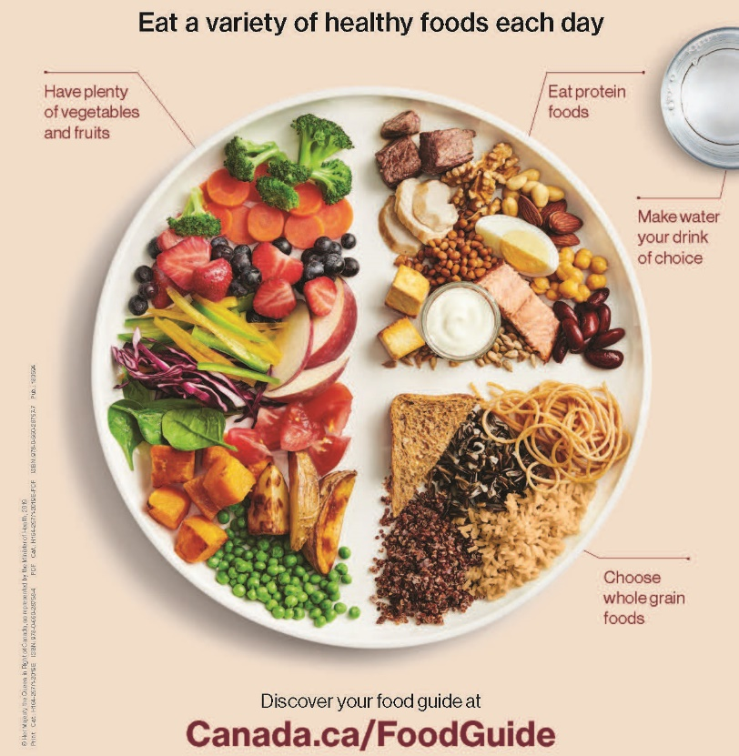
Eat three well-balanced meals and drink enough fluids everyday.
Healthy Eating is Key to Preventing Falls
4 Key Ways to Prevent Falls:
Challenge Your Balance^{1,2}
Build Strength^{1,2}
Active Living³
Healthy Eating⁴
Notes:
To recap: We have covered three ways to prevent falls: challenging your balance, building strength, active living and the fourth way is by healthy eating.
Read slide.
As an option, hand out copies of the new Canada’s Food Guide. www.healthcanada.gc.ca/foodguide
Healthy foods
A healthy diet for seniors, 65 years and older, should include a variety of foods based on the Canada’s Food Guide with emphasis on Protein Foods.
Nutrition in seniors is a topic of growing interest because good nutritional status is associated with successful aging, lower susceptibility to disease, prevention of pressure injuries, improved wound healing, better cognitive and physical performance, and improved quality of life.
Nutrients of concerns for the senior population include vitamin A, vitamin B12, vitamin D, calcium, iron, and zinc. An inadequate dietary intake of energy foods and micronutrients, such as folate, calcium, zinc and vitamin D has been reported in community-dwelling people older than 60 years of age.
Seniors at nutrition risk should have a comprehensive nutrition assessment completed by a Registered Dietitian
Fluids
Fluid/beverage intake is defined as the amount and type of fluid consumed orally. Examples include water, milk, fortified plant beverages, tea, coffee, juice, and soups, to name a few
• Fluid intake should be sufficient to satisfy thirst and produce adequate urine output.
For adults, a general recommendation is to drink 9-12 cups (2.25 – 3L) fluid from all sources each day.
Reference:
10. Alberta Health Services – Nutrition Services. Choose Healthy Drinks; Healthy Bones. Retrieved from:
https://www.albertahealthservices.ca/nutrition/Page11115.aspx. August 12, 2019
Additional information can be found at:
https://food-guide.canada.ca/en/
https://www.albertahealthservices.ca/assets/info/nutrition/if-nfs-ng-seniors-health-overview.pdf
https://www.albertahealthservices.ca/assets/info/nutrition/if-nfs-ng-vitamins-and-minerals.pdf
https://www.albertahealthservices.ca/assets/info/nutrition/if-nfs-choose-healthy-drinks.pdf

Slide 17
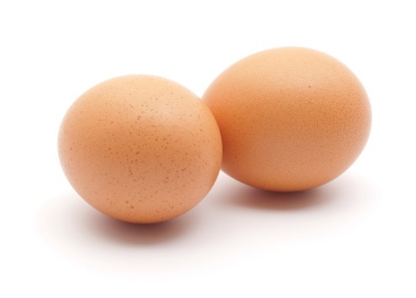
Eat high protein and calcium rich foods at every meal.
Healthy Eating is Key to Preventing Falls
4 Key Ways to Prevent Falls:
Challenge Your Balance^{1,2}
Build Strength^{1,2}
Active Living³
Healthy Eating⁴
Notes:
Read slide
Seniors are at a higher risk for conditions such as sarcopenia (muscle loss) and osteoporosis, which can contribute to an increase in falls and fractures, disabilities, loss of independence, and death.
Protein
• Reasons for suboptimal protein intake in seniors includes poor dentition, swallowing difficulties,
decreased cognition, limited income, decreased mobility, isolation, and self-restriction of animal protein,
cholesterol and fat.
Seniors may need more protein to stimulate muscle protein synthesis, maintain muscle mass and even greater benefit may be seen with higher intakes.
Newer consensus for seniors recommends a minimum of 1.0-1.2 g protein/kg body weight per day, even though the recommended daily allowance (RDA) for protein for seniors is 0.8 g/kg body weight per day (based on the minimum dietary protein required to avoid deficiency and maintain growth).
Using Canada’s Food Guide, seniors should eat Protein Foods at every meal, and at snacks
Examples of protein foods include: cheese, cottage cheese, eggs, milk, fortified soy beverage, meat, poultry, fish, yogurt, nuts, and soybeans.
Calcium
Calcium is part of the structural component of teeth and bones
It is needed for functioning and maintenance of muscle contractions, nerve activity, hormone and enzyme secretions and blood clotting, and to prevent/treat osteoporosis
Risk factor for osteoporosis include older age, sex (female), low body weight, a history of falls and fracture, and medications
Food sources of calcium include milk products (milk, yogurt, cheese), fortified plant based beverages, soybeans, fortified tofu, canned salmon with bones , white beans, navy beans, and cooked bok choy
Calcium requirements as follows (from food and supplements combined):
Adults 51-70 years: 1000-1200mg per day
Adults over 70 years: 1200 mg per day
Adults over 50 years at risk or diagnosed with osteoporosis : 1200 mg per day
Slide Reference:
10. Alberta Health Services – Nutrition Services. Choose Healthy Drinks; Healthy Bones. Retrieved from:
https://www.albertahealthservices.ca/nutrition/Page11115.aspx. August 12, 2019
Additional Information can be found at:
https://www.albertahealthservices.ca/assets/info/nutrition/if-nfs-ng-seniors-health-overview.pdf
https://www.albertahealthservices.ca/assets/info/nutrition/if-nfs-ng-vitamins-and-minerals.pdf

Slide 18
for active living and healthy eating, but it can be hard to know where to start.
Talk to your physician or your health care provider for more information.
It’s never too late…
4 Key Ways to Prevent Falls:
Challenge Your Balance^{1,2}
Build Strength^{1,2}
Active Living³
Healthy Eating⁴
Notes:
Today we have explored four ways to prevent falls:
Challenging Your Balance
Building strength
Active Living
Health Eating
Read slide.
We hope you have learned some new information and ideas today to support you in active living and falls prevention.
If you have any questions or thoughts we would like to hear from you. Thank You!

Slide 19
THANK YOU!
Questions or Comments
For more information:
Email injury.prevention@ahs.ca
www.albertahealthservices.ca/injuryprevention
4 Key Ways to Prevent Falls:
Challenge Your Balance^{1,2}
Build Strength^{1,2}
Active Living³
Healthy Eating⁴
Notes:
*For presenter: If you have any comments, questions or feedback on the materials or resources in this presentation please email injury.prevention@ahs.ca.

Slide 20
References
1. Injury Prevention Centre. (2018). Finding Balance Alberta. Could a fall change your lifestyle? (brochure). Edmonton, Alberta. Retrieved from https://findingbalancealberta.ca/wp-content/uploads/FB-Brochure- April2019-DIGITAL.pdf.
2. Injury Prevention Centre. (2018). Finding Balance Alberta. Challenge Your Balance & Build Strength. Edmonton, Alberta. Retrieved from https://findingbalancealberta.ca/wp-content/uploads/FB-Active-Strength-Handout-2018.pdf.
3. Alberta Health Services (2019). Preventing falls: Injury prevention and safety, information for health professionals. Retrieved from https://www.albertahealthservices.ca/injprev/Page15787.aspx
4. Scott, Vicky. (2017). Fall Prevention Programming: Designing, Implementing and Evaluating Fall Prevention Programs for Older Adults. Retrieved from http://canadianfallprevention.ca
5. Finding Balance Alberta. (2019). Am I at risk for a fall. Retrieved from https://findingbalancealberta.ca/am-i-at-risk-for-a-fall/
6. Public Health Agency of Canada. (2014). Seniors’ falls in Canada: second report. Retrieved from https://www.canada.ca/en/public-health/services/health-promotion/aging- seniors/publications/publications-general-public/seniors-falls-canada-second-report.html.

Slide 21
References
7. Canadian Society for Exercise Physiology. (n.d.). Canadian Physical Activity Guidelines for Older Adults – 65 years & older. Retrieved from http://www.csep.ca/CMFiles/Guidelines/CSEP_PAGuidelines_older- adults_en.pdf.
8. Government of Canada - Health Canada. 2019. Canada’s Food Guide. Retrieved from
https://food- guide.canada.ca/en/ August 12, 2019
9. Alberta Health Services – Nutrition Services. Seniors Health Overview; Calcium and Vitamin D for the Prevention and Treatment of Osteoporosis; Vitamins and Minerals. Retrieved from
https://www.albertahealthservices.ca/info/Page8247.aspx. August 12, 2019
10. Alberta Health Services – Nutrition Services. Choose Healthy Drinks; Healthy Bones. Retrieved from:
https://www.albertahealthservices.ca/nutrition/Page11115.aspx. August 12, 2019

Slide 22
Image References
Slide 1
istock.com/Squaredpixels
Slide 3
istock.com/kali9
istock.com/BHPix
istock.com/FatCamera
Slide 4
istock.com/FatCamera
istock.com/kali9
Slide 6
istock.com/Rawpixel
istock.com/stockstudioX
Slide 7
Istock.com/yacobchuk
istock.com/FatCamera
istock.com/wanderluster
Slide 8
istock.com/SilviaJansen
Slide 10
istock.com/SilviaJansen
Slide 11
istock.com/FatCamera
istock.com/kali9
Slide 12
Istock.com/Orbon Alija
Slide 13
istock.com/fstop123
Slide 14
istock.com/FangXiaNuo
Slide 16
r. Health Canada, 2019. Canada’s Food Guide. Retrieved from https://food-guide.canada.ca/en/
Slide 17
s. Istock.com/carmelbalcells
t. Istoc.com/ermingut
Slide 18
istock.com/itsskin
Slide 19
istock/Dean Mitchell

Slide 23
© 2019, Alberta Health Services, Population Public and Indigenous Health/Provincial Injury Prevention Program.
This work is licensed under a Creative Commons Attribution-Non-commercial-Share Alike 4.0 International license. You are free to copy, distribute and adapt the work for non-commercial purposes, as long as you attribute the work to Alberta Health Services and abide by the other licence terms. If you alter, transform, or build upon this work, you may distribute the resulting work only under the same, similar, or compatible licence. The licence does not apply to AHS trademarks, logos or content for which Alberta Health Services is not the copyright owner. To view a copy of this licence, see https://creativecommons.org/licenses/by-nc-sa/4.0/.
This material is intended for general information only and is provided on an "as is", "where is" basis. Although reasonable efforts were made to confirm the accuracy of the information, Alberta Health Services does not make any representation or warranty, express, implied or statutory, as to the accuracy, reliability, completeness, applicability or fitness for a particular purpose of such information. This material is not a substitute for the advice of a qualified health professional. Alberta Health Services expressly disclaims all liability for the use of these materials, and for any claims, actions, demands or suits arising from such use.

