Slide 1



Concurrent Capable Program Review
Developed by Practice Supports Team
amh.practicesupports@recoveryalberta.ca

Slide 2
Welcome!
Concurrent Capable Program Review
Thanks for taking the time to gather and reflect on our team’s program and practice.
Notes:
Say: Good morning/afternoon and welcome! Thanks for taking the time to gather and reflect on our team’s program and practice.
Recovery Alberta is committed to improving services and support for mental health, substance use and gambling or behavioural addiction concerns, as well as concurrent disorders.
Do: Introductions -20 minutes
To warm up the atmosphere and ensure all participants feel connected, start the session by introducing yourself and then going around the room. Have each participant introduce themselves, their role and what their hopes are for the review session. Or, if everyone knows each other, develop a meaningful icebreaker.

Slide 3

Concurrent Capable Program Review

Slide 4
Background
Concurrent Capable Program Review
In 2009, Alberta Health Services announced a province-wide system of addiction and mental health services that would respond to the unique needs of three groups of people:
those with mental illness or mental disorders
those with substance use and/or gambling concerns (behavioural addiction)
those with both.
In 2024, Recovery Alberta formed, and Practice Supports team supports healthcare providers with tools and resources to integrate addiction and mental health services. The Standard Approach to Concurrent Capable Practice Framework was developed to help individuals, their families, and healthcare providers understand what to expect from Addiction and Mental Health Services through standards and key indicators.
Notes:
Do: Read slide
Say: Recovery Alberta has provided tools and resources to integrate addiction and mental health services.
The Concurrent Capable Program Review is one of these resources that is part of the Standard Approach to Concurrent Capable Practice Framework.

Slide 5
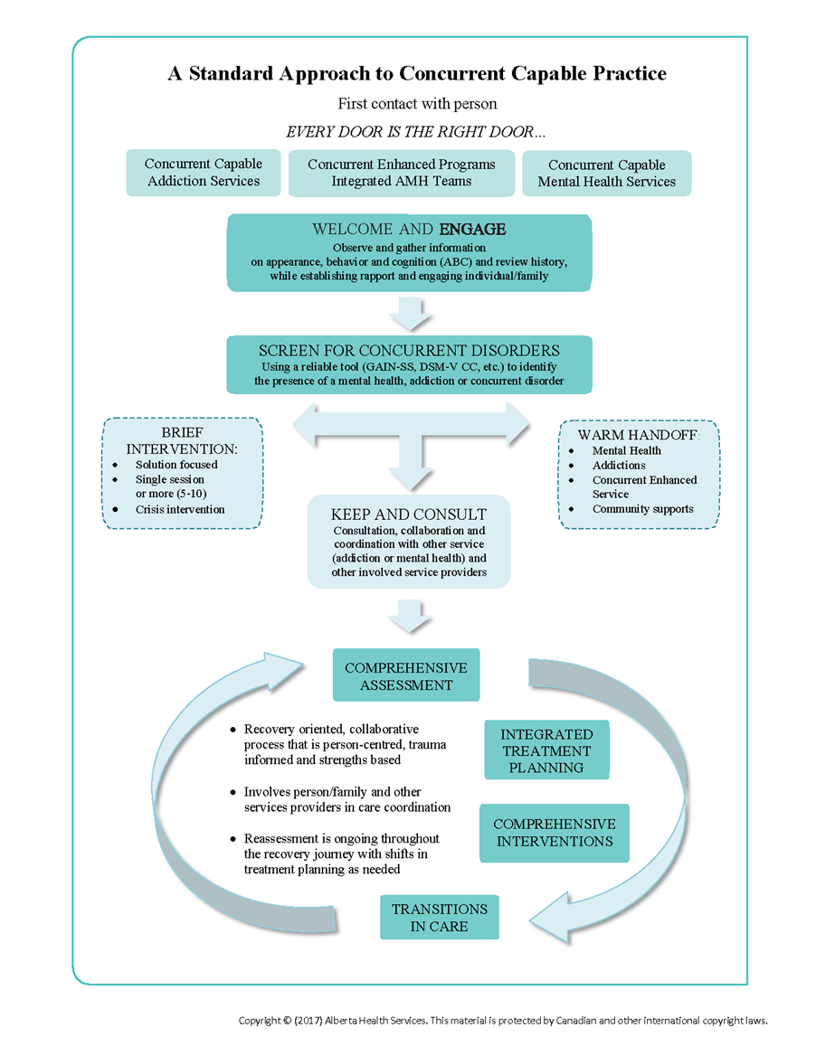
Concurrent Capable Program Review
Notes:
Say: This algorithm was developed to illustrate Recovery Alberta’s Standard Approach to Concurrent Capable Practice Framework, which was developed from best practices for concurrent capable care. Here are the six essential guidelines in the framework:
Welcome and Engage
Screening for Concurrent Disorders
Comprehensive Assessment
Integrated Treatment Planning
Comprehensive Interventions
Transitions in Care

Slide 6
The goal:
Concurrent Capable Program Review
Creating welcoming, trauma-informed, recovery-oriented, and concurrent capable services for individuals and families experiencing mental health and substance use disorder or behavioural addiction.
Notes:
Say: The reason we are here today is to assess our clinic’s concurrent capability and whether we create welcoming, trauma-informed, recovery-oriented and concurrent capable services for individuals and families experiencing mental health and substance use disorder or behavioural addiction.

Slide 7
Definitions
Concurrent Capable Program Review
Concurrent Capability means providing welcoming, trauma-informed, recovery-oriented care within our healthcare services for people experiencing concurrent or co-occurring disorders.
Concurrent Disorders describe a situation where a person is experiencing a mental health and substance use disorder or behavioural addiction at the same time.
Notes:
Do: Read the slide
Say: This review will help assess if our services are concurrent capable.

Slide 8
Two Activities for the CCPR
Concurrent Capable Program Review
Review Session (3 hours): where the group meets to score each section, which can include robust discussion. The entire content can be completed in a half day or 2-3 hours.
Recommendations Session (1 hour): where the group regathers to hear a summary of the review scores and suggested recommendations. This session includes time for team input and brainstorming on quality improvement initiatives that are proposed and planned and takes about one hour.
Notes:
(Optional Slide-as a facilitator you can choose to remove this slide from the presentation) Say: Thank you to (name of scribe) for being our scribe to capture our discussion today and thank you for participating in this review today.

Slide 9
Roles and Responsibilities for CCPR
Concurrent Capable Program Review
Facilitator
Prepares materials for a virtual or in-person session
Allows conversation to happen when reaching a consensus on each item to score
Guides participants through review sections and discussion
Scribe
Uses scorebook to record scores for each item and capture discussions
Participants
Participates in scoring, reading sections and collaborative conversations
Notes:
(Optional Slide-as a facilitator you can choose to remove this slide from the presentation) Say: Thank you to (name of scribe) for being our scribe to capture our discussion today and thank you for participating in this review today.

Slide 10
Process of Review
Concurrent Capable Program Review
Choose a scribe to record each section’s scores and notes​
Read each item out loud​
Have a discussion with your group to reach a consensus on the average score for each section
Scribe records scores and summarizes discussion notes​
Progress through each section(s)
Wrap-Up and Next Steps
Notes:
Say: We will allow 10 - 15 min to score and collaborate on each section. I will be asking for a volunteer to read each section out loud. I will also ask that each of you tell us your score for each statement after they are read out loud. This will allow us to collaborate and discuss each section together to help us reach a consensus on a score for each section. (see the scribe scorebook for more information on how to score each section of the review).
Do:
Read the slide
Get each volunteer to read out each section.
Once read, ask each participant what score they gave and why.
Keep the conversation open and collaborative, remembering all scores are opportunities – low scores open up quality improvement initiatives, and high scores show team/program strengths to celebrate.
Direct the scribe as needed by indicating what score the group has reached for each item and suggesting noting key discussion themes

Slide 11
Agenda
Concurrent Capable Program Review
Introductions – 20 mins
Set the Stage– 20 mins
Section by Section scoring – 90-120 mins
Summary and Wrap-Up – 15 mins
Notes:
Say: Today’s review session will take approximately 3 hours and will include our introductions, overview of the session, section-by-section scoring, session summary and wrap-up.
Do: While you are outlining the agenda, and setting the stage for the session:
Distribute handouts
Show PowerPoint slides
Answer questions
Explain Likert scale
(Content for setting the stage is slides 1-11)

Slide 12
The Likert Scale
Concurrent Capable Program Review
1 Not at All
2 Slightly
3 Somewhat
4 Mostly
5 Completely
Five-point scale
Allows each participant to indicate how much they agree or disagree with each statement
Can indicate their positive to negative strength of agreement or feeling regarding the statement.
Notes:
Do: Explain the Likert scale and read slide
Say: The Likert scale is used to score the 8 principles that are listed in the review section.
Here are some key points:
It is a five-point scale
It allows each participant to indicate how much they agree or disagree with each statement
It provides five possible answers so each person can indicate their strength of agreement regarding the statement.

Slide 13
Review Sections
Concurrent Capable Program Review
Welcoming and Engaging
Standardized Screening
Comprehensive Assessment
Integrated Recovery Planning
Comprehensive Interventions
Transitions in Care
Program Collaboration and Partnership
Concurrent Capable Competency Development
Notes:
Say: There are several elements of integrated program design that you can review in the Recovery Alberta’s Standard Approach to Concurrent Capable Care Framework which will be used for this review and include:
Welcoming and Engaging
Standardized Screening
Comprehensive Assessment
Integrated Recovery Planning
Comprehensive Interventions
Transitions in Care
Program Collaboration and Partnership
Concurrent Capable Competency Development
Facilitator note: Please ensure you’ve reviewed the Standard Approach to Concurrent Capable Care Framework before you facilitate

Slide 14
Welcoming and Engaging
Concurrent Capable Program Review
Written and online information about accessing services welcomes individuals and families with concurrent disorders into service and offers hope for recovery.
Access to services is prompt and offered in a coordinated manner. People are supported through delays they may experience while getting to their preferred services.
The program environment (i.e., signage to find the program, reception area, waiting room, hallways, meeting spaces, pictures/posters, brochures, flyers, etc.) creates a welcoming atmosphere that supports engagement and recovery for individuals and families with substance use, gambling, and mental health conditions.
People and their family members receive welcoming access to service regardless of their stage of change regarding their mental health, substance use and/or gambling concerns.
Notes:
Say: I’d like to invite ___ to read the following two slides
Do: Volunteer reads slide
Facilitation Tips:
Guide the group through each section, item by item.
Ensure each person says or indicates their score.
Steer the discussion toward reaching a consensus on the score for each item.
Keep the conversation open and collaborative, remembering all scores are opportunities – low scores open up quality improvement initiatives, and high scores show team/program strengths to celebrate.
Remember that this is not the time to troubleshoot and try to solve issues that may arise from conversations. Redirect problem-solving by reminding participants that the scoring will be evaluated, and recommendations will be made at the next step.
Support the group to reach an agreed-upon score for each statement. This is a must. A way to bridge score gaps is to enquire about an individual's score, for example, “Ryan, tell us about your score of 1…” or “Susan, I am curious why you scored 4…” Giving space and time for honest conversations allows team members to hear what pieces each other thinks is important.
Direct the scribe as needed by indicating what score the group has reached for each item and suggest that they note key discussion themes.

Slide 15
Welcoming and Engaging
Concurrent Capable Program Review
Access to educational information about recovery and building resilience, substance use and/or gambling and mental health conditions is available.
Healthcare providers introduce themselves, explain their role, consent for treatment, the limits of confidentiality, how to include family and other support persons in the recovery planning process and the process of filing a complaint if there are concerns about how a person is treated while accessing services or the kind of services they received.
Healthcare providers actively listen to people seeking services, answer their questions, and collaboratively explore which resources will work best for them, considering their stage of change, cultural beliefs, and lifestyle.
Notes:
Do: volunteer reads slide
Ask for each participant’s score and why

Slide 16
Standardized Screening and
Brief Intervention
Concurrent Capable Program Review
In a welcoming and respectful manner, standardized screening tools are used to screen everyone seeking services for concurrent substance use, gambling, mental health conditions (including trauma), medical conditions, and areas with increased health or well-being risks. This information is used to inform recovery planning.
People seeking services feel engaged in the screening process, understand the purpose of the questions, and how their answers help connect them to the most appropriate service(s).
Notes:
Say: I’d like to invite ___ to read the following slide
Do: volunteer reads slide
Ask for each participant’s score and why

Slide 17
Comprehensive Assessment
Concurrent Capable Program Review
Initial assessments gather and document information about each concurrent substance use, gambling and/or mental health condition, active or stable.
Assessment is an ongoing process in which information is gathered and reviewed regularly to understand people’s evolving concerns and goals.
Assessments focus on people’s current strengths, skills, supports and periods of well-being to provide a positive, recovery-focused approach to recovery planning.
Notes:
Say: I’d like to invite ___ to read the following two slides
Do: volunteer reads slide

Slide 18
Comprehensive Assessment
Concurrent Capable Program Review
Assessments regularly gather and document information about the stage of change (i.e., precontemplation, contemplation, preparation, action, maintenance, return to use) people are in regarding each condition for which they receive services.
With consent, healthcare information may be shared with the care team and/or family members to support people’s recovery.
Notes:
Do: volunteer reads slide
Ask for each participant’s score and why

Slide 19
Integrated Treatment & Recovery Planning
Concurrent Capable Program Review
People’s hopeful goals, personal needs, recent successes, and strengths are included in their recovery plan.
For each concern, a stage of change is identified, stage-matched interventions are explored, and achievable steps to help the person feel and be successful are agreed to.
Person-centred plans focus on building skills and support. When required, the plan is modified and positive feedback for small steps of progress in the recovery journey is used.
People are active participants in care. They know their rights and responsibilities, and their preferences and goals in their recovery journey are respected. Family members may be included.
Notes:
Do: volunteer reads slide
Ask for each participant’s score and why

Slide 20
Integrated Treatment & Recovery Planning
Concurrent Capable Program Review
When exploring potential resources to support recovery, the risks and benefits of each alternative are explained.
Recovery plans include biopsychosocial and spiritual goals to ensure people feel empowered to meet their basic needs and address substance use and/or gambling and/or mental health concerns.
When possible, a copy of the recovery plan is provided to people and/or family members and others in the care team.
Notes:
Say: I’d like to invite ___ to read the following two slides
Do: volunteer reads slide

Slide 21
Comprehensive Interventions
Concurrent Capable Program Review
Education and resources about mental health, substance use, gambling, concurrent disorders, recovery and building resilience are available and accessible (i.e., placement for pick up, various languages based on community demographics).
People feel involved in implementing their recovery plan. They learn skills, practice good self-care, and have the necessary information about connecting with mutual support groups and community resources to improve their quality of life and maintain well-being.
Stage-matched group or individual sessions provide psychoeducation to empower choice and decision-making.
Notes:
Say: I’d like to invite ___ to read the following two slides
Do: volunteer reads slide

Slide 22
Comprehensive Interventions
Concurrent Capable Program Review
Family members understand how to access community support and resources that promote their well-being and recovery.
Healthcare providers provide strengths-based, recovery-oriented, trauma-informed services for people who continue to use substances, do not take medication as prescribed, or are not following other aspects of their recovery plans. Negative consequences or punishment are not used.
The program responds positively when individuals ask for help when they are having difficulty maintaining their recovery or beginning to experience increased symptoms of mental health conditions.
Notes:
Do: volunteer reads slide
Ask for each participant’s score and why

Slide 23
Transitions in Care
Concurrent Capable Program Review
Transition plans, procedures, practices, and forms identify specific stage-matched recommendations for each issue the person seeks treatment for.
For each transition in care, people are included in warm handoff communication between the sending and receiving healthcare providers, whether in person or by phone.
A multidisciplinary team of healthcare providers works collaboratively to coordinate care, provide care and help people make transitions to ensure suitable supports are in place to help them achieve their recovery goals at all stages.
With consent, information regarding care and progress may be shared with other care team members.
Notes:
Say: I’d like to invite ___ to read the following two slides
Do: volunteer reads slide

Slide 24
Transitions in Care
Concurrent Capable Program Review
People often have multiple priorities, so services are coordinated to match their goals for recovery.
Healthcare providers help people navigate the health and social services support systems to ensure they become connected with community services they need (i.e., housing, food security, showers, finance, legal, education, dental, optometry). A written list of community resources and contact information is provided.
People, family members and the larger care team know how to re-engage with services when needed.
The program invites people and family members to provide feedback on their service experience to foster continued program development and improvement.
Notes:
Say: I’d like to invite ___ to read the following two slides
Do: volunteer reads slide. Ask for each participant’s score and why

Slide 25
Program Collaboration & Partnership
Concurrent Capable Program Review
The program is connected to and collaborates with local partner agencies offering community-based health and social services.
Addiction or mental health staff promptly consult a collaborative program partner when requested.
Healthcare providers participate in scheduled addiction and mental health services interagency care coordination meetings to address the complex needs of people and their families.
Notes:
Say: I’d like to invite ___ to read the following slide
Do: volunteer reads slide
Ask for each participant’s score and why

Slide 26
Concurrent Capable Competency Development
Concurrent Capable Program Review
Specific recovery-oriented concurrent disorder competencies for all staff are included in position descriptions.
The program has and implements its written scope of practice for concurrent disorder competency for all healthcare providers based on their position within the program and professional designation, if any. This may be done through local procedures, supervision, group and individual learning activities) for all staff working in and leading the program.
Administrative and clinical supervisors use their knowledge and skills to help staff become more welcoming, recovery-oriented, and concurrent capable.
Notes:
Say: I’d like to invite ___ to read the following slide
Do: volunteer reads slide
Ask for each participant’s score and why

Slide 27
Next Steps
Concurrent Capable Program Review
Team Priorities
Quick Wins
Notes:
Say: Thank you to ___ for being our scribe. Let’s highlight some of the quick wins that we identified our program is doing right, based on our discussion. Now let’s highlight some of the areas that will be prioritized, based on our discussion.
Say: Thank you all for your time today! The next steps are (name of the scribe) and I will take the information collected, collate the scores, and summarize your comments. We will then meet again in a month to discuss the summary of scores and recommendations to enhance concurrent capability for our program.
Retain the scorebook for the recommendations session.
Do:
Thank participants for their engaged input into scoring and discussion
Ask the group to provide reflections on what could be ‘Quick Wins’ and ‘Team Priorities’ based on the insights shared during conversations through the review session

Slide 28
Preparing for the Recommendations
Session
Insert Presenter Name | Date

Slide 29
Recommendations Session
Concurrent Capable Program Review
Meet again with your participants in one month
Review how each section scored and summary of comments
Present the recommendations list
Brainstorm quality improvement actions
Notes:
Do: For your recommendation session, you will meet again as a group and review each section’s average score from the review session. The facilitator will tell the group about the emerging themes, concerns, and comments that were captured by the scribe during the review section and share a list of recommendations. Take note that for each section, there may have been high scores and low scores (please consult the scorebook for more detailed information on scoring):
Low scores (1-3) indicate areas where small changes may help improve people’s experiences of your program’s services. The follow-up recommendations session will address most of these areas and suggest actions, small steps, and changes to improve the team’s concurrent capability.
High scores (4-5) represent your team and program’s strengths. Take a moment to celebrate what the team is already doing well.
The facilitator will share the recommendations list with the group for discussion.

Slide 30
Recommendations Session Agenda
Concurrent Capable Review Program
Welcome to participants
  Handout summary of scores and recommendations
Review each section's recommendations
Highlight team strengths and team opportunities
Follow-up meeting in 3-6 months to review planned improvements
Notes:
Say: Welcome to our recommendation session! Today, we will discuss the scores from the review session and see a list of recommendations for each section. We will also have the opportunity to brainstorm some quality improvements as a group.
Do:
Welcome to participants.
Handout the completed scoresheet and recommendations list to each person (optional).
Review each section's recommendations with the group.
Highlight team strengths and team opportunities.
Allow time for brainstorming quality improvement opportunities for low-score items or sections.
Consider striking a small working group to follow up on the recommendations.
Plan for a follow-up meeting in 3-6 months to review planned improvements

Slide 31
Thank you
Want to collaborate or have questions?
Amh.practicesupports@recoveryalberta.ca

