Slide 1

Before you begin…
Slide Show view
For the best experience for your audience, use slide show view which will play animations. Accompanying script and notes are available to print out in the ‘Presenter’s Guide’.
Wifi
A wifi or internet connection is required to play the videos within this presentation.
Enable Content
The videos in this slide deck link to an external site. To ensure they will work for you while presenting, click Enable Content in the banner you see across the top.

Slide 2

Clearing the Air
What parents need to know about vaping
Notes:
Introductions: Name, Role and Topic

Slide 3
Topics
Introductory information
Why this matters?
Why young people vape?
Signs your child may be vaping
What can parents do?
Notes:
Let’s run through the topics we will be covering today.
Introductory information
Why this matters?
Why young people vape?
Signs your child may be vaping
What can parents do?
This presentation was provided to us by Primary Care Alberta or PCA. If there are questions we can’t answer through today’s discussion, we can take those back to PCA and communicate responses to you via email.

Slide 4

What is vaping?
The use of electronic cigarettes (e-cigarettes) or similar devices that heat a liquid into an aerosol (not just “harmless vapour”) to be inhaled.
Notes:
Vaping is the act of inhaling and exhaling an aerosol, often containing nicotine and other chemicals (not just water vapour), produced by an electronic device like an e-cigarette.
VIDEO: Vaping, like many subcultures, has developed its own set of slang terms. This quick video shows some common vaping slang and their meanings.
Click image on slide to play video.
Source: https://www.youtube.com/watch?v=NOj2NC3YPAY

Slide 5
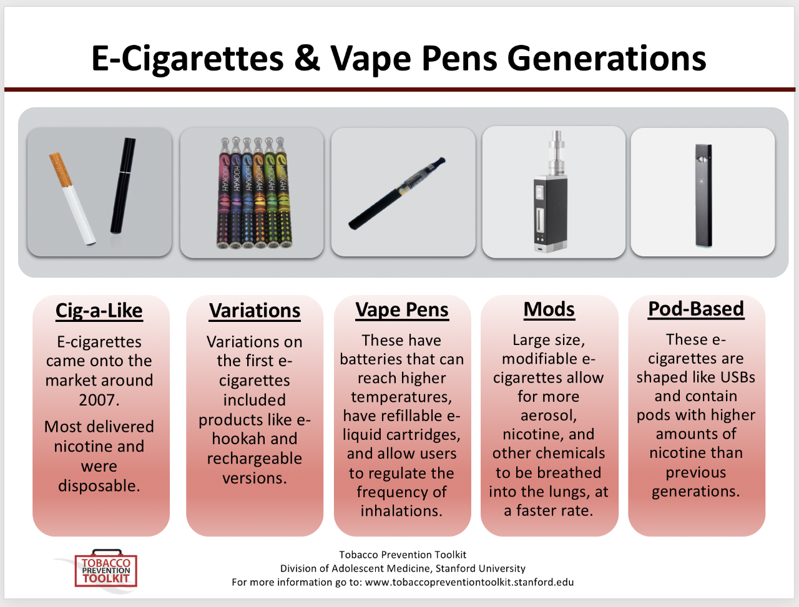
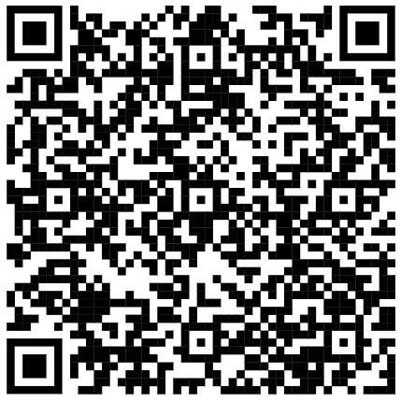
What are
“vapes”?
Notes:
Many of you may already be familiar with e-cigarettes or “vapes” so this is a quick overview.
You can see here how vapes have changed over the years, beginning on the left with those made to look as much like cigarettes as possible. This was followed by modifications and optimizations to produce products over time that maximized the amount of nicotine absorbed by the consumer. Focus was also placed on design and technologies to promote trends and increase use.
Vaping products do not contain tobacco or burning or produce smoke. Vaping devices work by heating e-juice to produce an aerosol that’s inhaled and absorbed into the bloodstream.
Most e-cigarettes contain nicotine, flavourings and sometimes THC.
Source: https://med.stanford.edu/tobaccopreventiontoolkit/curriculum-decision-maker/by-module/E-Cigs.html
If you’d like to read more information to understand the devices, how they work, and what they contain, you can use the QR Code to access Health Canada’s page on vaping devices. This link is also listed in your handout.
Source: https://www.canada.ca/en/health-canada/services/smoking-tobacco/vaping.html

Slide 6
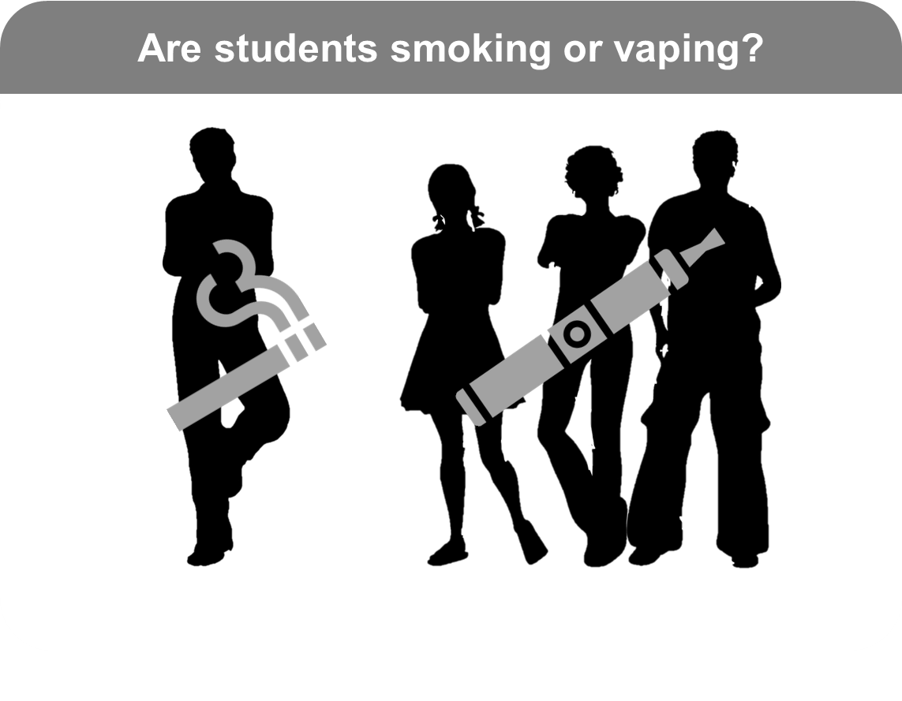
Why this matters?
Grades 7-12
Source: Canadian Student Alcohol and Drugs Survey, 2023-24
Notes:
Presenters: Use the notes below to describe the stats in this image. Make it relatable by discussing what you are seeing/experiencing at your school.
In Alberta, for each student who says they are currently smoking (4.3% of students in Grades 7-12 have smoked a cigarette in the past 30-days), there are over 3 times the number of students who say they are currently vaping (15.6% have vaped in the past 30-days).
Source: https://health-infobase.canada.ca/substance-use/csads/

Slide 7
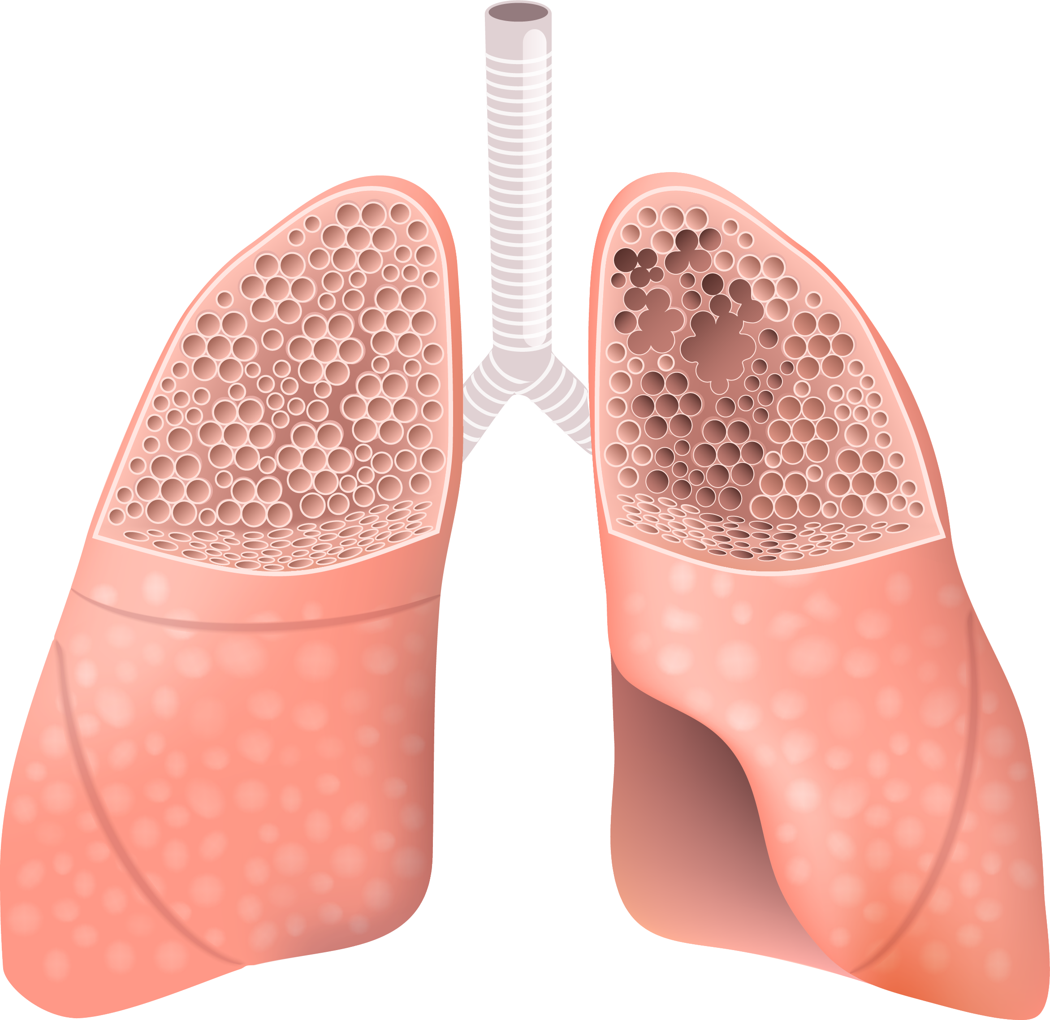
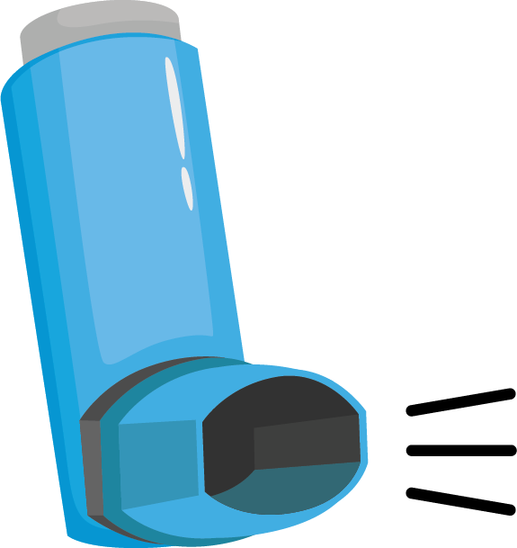

Why this matters?
Vaping is linked to several health issues/risks:
Asthma
E-cigarette vapour inflames the airways producing phlegm
Lung Disease
Emphysema, bacterial infections, pneumonia
Injury
Physical injury from defective batteries catching fire or exploding
Notes:
Known health issues linked to vaping include:
Asthma
Emphysema, lung infections and pneumonia
Defective batteries have caused fires or explosions leading to injury
Source: https://behindthehaze.ca/vaping-risks

Slide 8
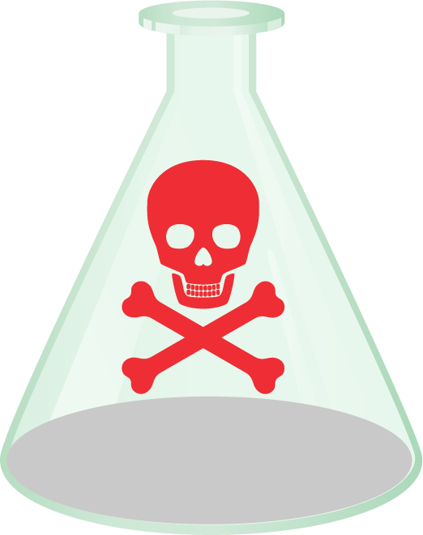

Why this matters?
Most vaping products contain nicotine
Nicotine harms the development of the adolescent brain
Early vaping can lead to addiction
Notes:
Most vaping products contain nicotine which is known to have adverse health effects.
For adolescents especially, nicotine harms brain development which continues up to age 25.
Nicotine is highly addictive, and youth are particularly vulnerable to this, sometimes showing signs of addiction before they start regular or daily use.
Source: https://www.cdc.gov/tobacco/e-cigarettes/health-effects.html

Slide 9

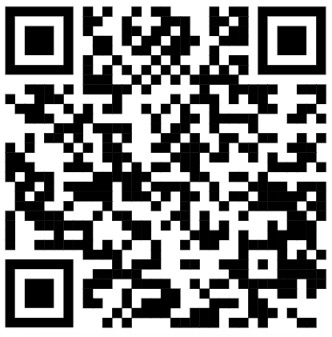
Why this matters
Notes:
Click on the picture on the slide to play the video.
This video provides an overview of nicotine and addiction resulting from vaping. The video is used in schools to inform teens about nicotine and how it works, ultimately leading to addiction. We will now watch the video together. The aim is to gain a basic understanding, similar to what our students will learn. More information like this, geared towards students is available on BehindtheHaze.ca, a website created to help teens understand vaping. The QR code for BehindtheHaze is on the screen but also listed in your handout.
Source: https://www.youtube.com/watch?v=XDYPaEiDUJ0

Slide 10
Risky behaviour among teens
Lower risk perception
Less intuitive reasoning
More emotion-based reasoning
Limited knowledge
Notes:
While risk-taking is considered normal and developmentally appropriate behavior for youth, we know there is an important difference between healthy and unhealthy risk-taking.
Research shows that adolescents’ decision-making around risks differs from adults in a number of ways:
Lower risk perception: They underestimate risks and may even perceive more potential benefits from their actions. In fact, in a 2021-22 survey of Canadian students, less than half (48%) of students report perceiving a “great risk” of harm from using e-cigarettes with nicotine on a regular basis. 6% of them report perceiving no risk of harm.
Less intuitive reasoning: They lack the education and experience to decide based on their intuition, whereas adults can engage in this type of “gist-based” reasoning. This often leads to students make decisions in a different way, as shown in the next point.
More emotion-based reasoning: They don’t just weigh the risks they think about the social consequences of their decisions. This highlights the need for health education that targets social competencies to equip students with resilience and responsible decision-making skills.
Limited knowledge: They may have a limited understanding of the possible consequences of their actions. Facilitating students in gaining reliable and accurate information on vaping is an important piece of prevention and can be done using some of the ready-to-use classroom resources found in the CANVAS package of resources.
Source: https://www.canada.ca/en/health-canada/services/canadian-student-tobacco-alcohol-drugs-survey/2021-2022-detailed-tables.html
Source: National Academies of Sciences, Engineering, and Medicine; Health and Medicine Division; Division of Behavioral and Social Sciences and Education; Board on Children, Youth, and Families; Committee on Applying Lessons of Optimal Adolescent Health to Improve Behavioral Outcomes for Youth; Kahn NF, Graham R, editors. Promoting Positive Adolescent Health Behaviors and Outcomes: Thriving in the 21st Century. Washington (DC): National Academies Press (US); 2019 Dec 12. 3, The Current Landscape of Adolescent Risk Behavior. Available from: https://www.ncbi.nlm.nih.gov/books/NBK554988/

Slide 11
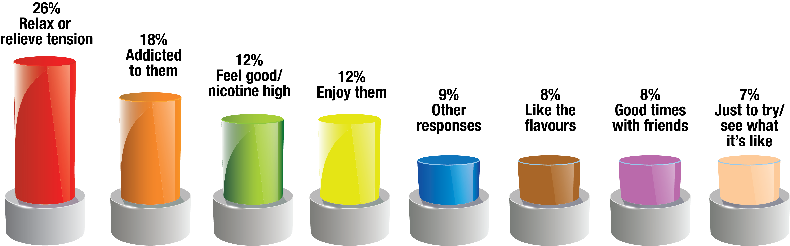
Why students say they vape?
Source: Canadian Student Tobacco, Alcohol and Drugs Survey, 2023-24
Notes:
The top reason that over a quarter of Alberta students reported as the reason they vape, is to relieve tension or stress, and the second highest reason reported, is because they feel hooked on them. Other reasons reported include feeling good or even high when vaping, or generally just enjoying them. 8% of students surveyed even reported it is because they like the flavours.
Within the blue bar in the chart, 9% of students gave a range of other responses including reasons such as peer pressure and using them instead of smoking cigarettes or to quit cigarettes.
Presenters: An optional interactive question on “Were you surprised by these results? What was surprising?” can be asked here to spark discussion.
Source: https://www.canada.ca/en/health-canada/services/canadian-student-tobacco-alcohol-drugs-survey/2021-2022-detailed-tables.html

Slide 12

Signs your teen might be vaping
Unusual smells on clothes or breath (fruity, minty)
Becomes more thirsty
Changes in sleep patterns or mood (irritable, anxious)
Frequent bathroom breaks
Secretive behaviour (protective of phones/pockets, excuses to leave)
Having frequent nosebleeds

Slide 13





What can parents do?
Know the
facts
School
policies
Vape-free
homes
Classroom
curriculum
Conversations
Notes:
Know the facts: Get credible information from reliable sources such as those in your handout. Avoid scare tactics or exaggerating the negatives. Acknowledging both the benefit and harm of substance use can help you to have a more balanced perspective when talking with children and teens. If there is something you don't know, find the answer together.
Vape-free homes: A vape-free home can ensure your child is not exposed to secondhand aerosol from vapes while setting a good example for youth.
School policies: Do your best to become familiar with your child’s school vaping policies, including the consequences for policy violations by students.
Classroom curriculum: Talk to teachers or school administrators about any vaping prevention curriculum in the classroom. It is a good idea to be familiar with what your children and teens will learn and continue those conversations at home.
Conversations: It's never too early or too late to start these conversations. Many small conversations over time are better than one big one. Discussing vaping regularly is a good idea as it will help your child avoid misinformation and learn your family values and expectations.
Sources:
https://www.cdc.gov/tobacco/e-cigarettes/protecting-youth.html
https://www.notanexperiment.ca/parents/
https://www.albertahealthservices.ca/dsa/Page18000.aspx

Slide 14






Talking to your child about vaping
Choose your moments
Listen more than talk
Be honest
Be open, patient and understanding
Be clear about values and expectations
Keep checking-in
Notes:
Choose your moments – look for natural opportunities to start the conversation. For example, you might ask them what they think about something you see together such as vape ads, a vape store, or someone vaping.
Be open, patient and understanding – Try to prepare yourself for what you might hear. Do your best to be non-judgemental and avoid criticism.
Be honest – Share your knowledge as you understand it. If there is something you don’t know, learn with your child together. It is ok not to be the expert. Your guidance to reliable sources of information is just as valuable. Read about it together or suggest chatting with your healthcare provider about it.
Listen more than talking – the goal is to have a conversation rather than to provide all the information you have. Ask open-ended questions.
Keep checking-in– Over time, children and teens mature, pressures change, they experience new things. This makes it important to keep the conversation going.
Be clear about your values and expectations - It is important that they know your values and what is expected of them. If the conversation steers towards questions about your experiences, the TalkTips resource in your handout will lead you to useful information on sharing your experiences surrounding substance use.
Sources:
https://www.cdc.gov/tobacco/e-cigarettes/protecting-youth.html
https://www.notanexperiment.ca/parents/
https://www.albertahealthservices.ca/dsa/Page18000.aspx

Slide 15
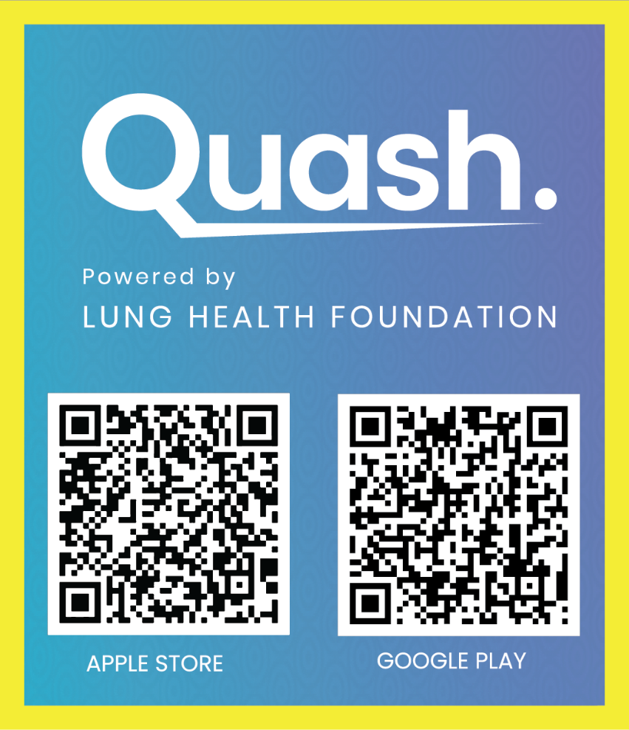


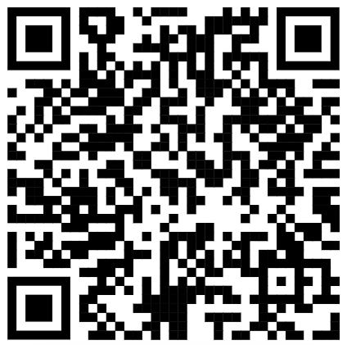
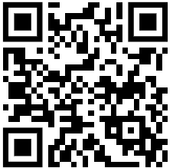
Support if your child is vaping
Conversation tools for parents
Smartphone App
www.notanexperiment.ca
Web-based
Notes:
The Lung Health Foundation have created some resources as a part of the Quash program. It is suitable for any educator who has the opportunity to talk to a young person about quitting vaping. The conversation is said to take under 3 minutes, with the toolkit providing guidance on how to approach the conversation.
The NotAnExperiment website has easy-to-access resources for students to learn the facts and prepare them to stop vaping. This resource is especially useful if they don’t appear to be ready to quit just yet.
The Quash app is a comprehensive tool that helps teens plan their journey to stop vaping. It prepares them in case they get off-track, and helps them celebrate successes on their journey.
All these resources are listed in your handout, or you can use the QR Code on the slide.

Slide 16

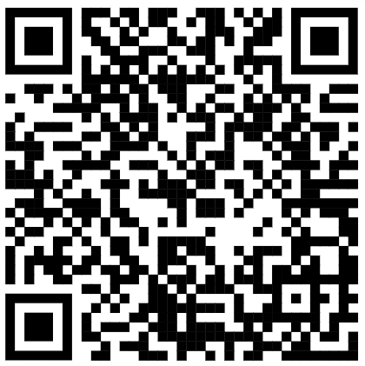


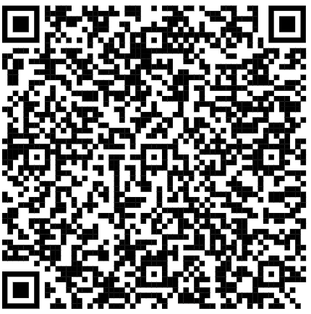
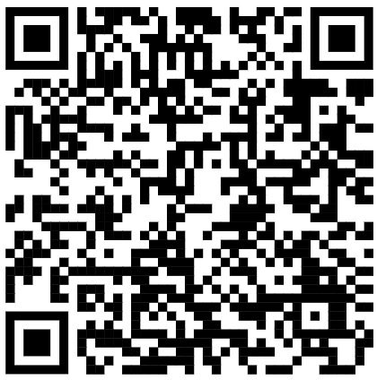

https://www.notanexperiment.ca/parents
Talking with your teen about vaping: A tip sheet for parents - Canada.ca
https://www.ahs.ca/talktips
Notes:
The links on this slide are specifically for parents.
Not An Experiment is a website with a ‘parent portal’ that contains information that is specifically of interest to parents, about vaping.
Health Canada also have a useful tip sheet for talking to teens about vaping
The TalkTips handbook also has information when talking about substances with youth. Page 12 of the guide provides information on helping teenagers resist peer pressure.

Slide 17

Useful links in this presentation are found in the ‘Useful Links (Parents)’ handout.
Notes:
Any final questions or thoughts?
Suggest emailing or printing off the Useful Links (Parents) handout and providing directly to parents.

