Slide 1

Before you begin…
Slide Show view
For the best experience for your audience, use slide show view which will play animations. Accompanying script and notes are available to print out in the ‘Presenter’s Guide’.
Wifi
A wifi or internet connection is required to play the videos within this presentation.
Enable Content
The videos in this slide deck link to an external site. To ensure they will work for you while presenting, click Enable Content in the banner you see across the top.

Slide 2

Clearing the Air
Let’s Talk Vapes
Notes:
Speaker Introduction
Introduce topic – We’re going to talk about e-cigarettes (vapes) today.

Slide 3
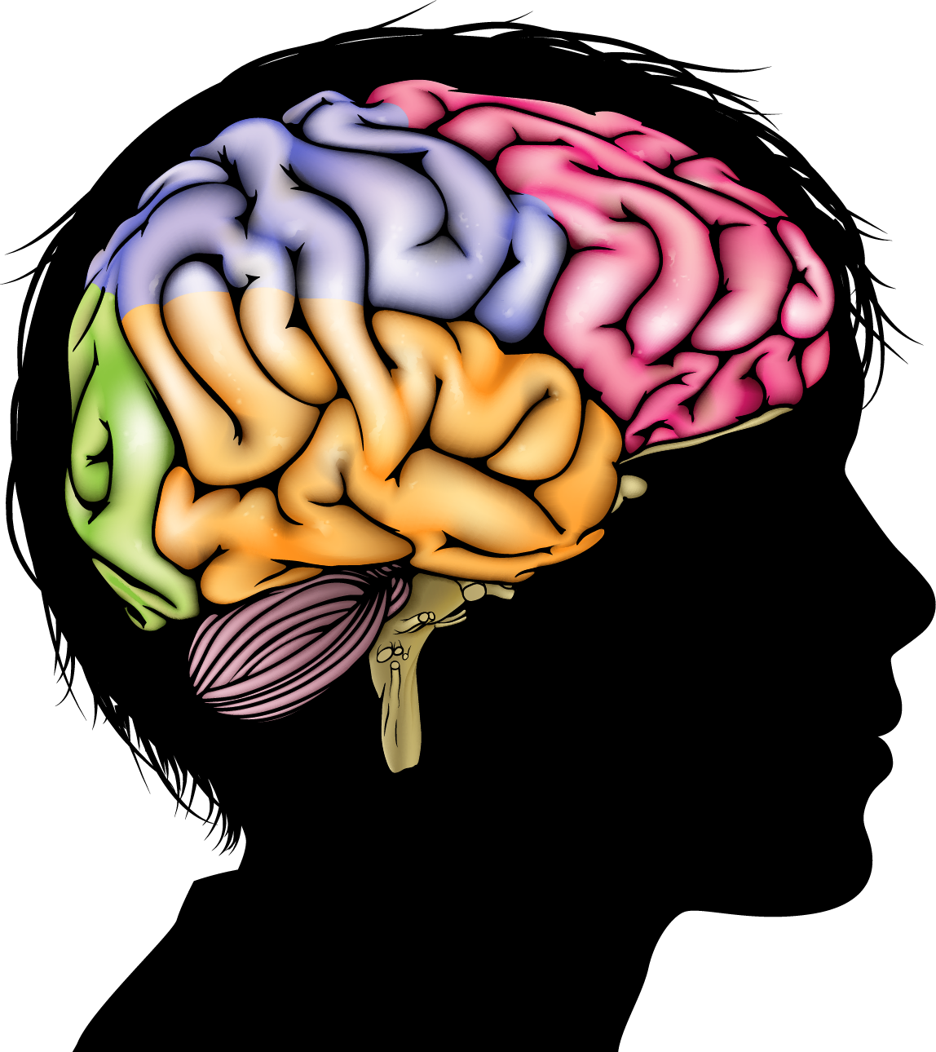
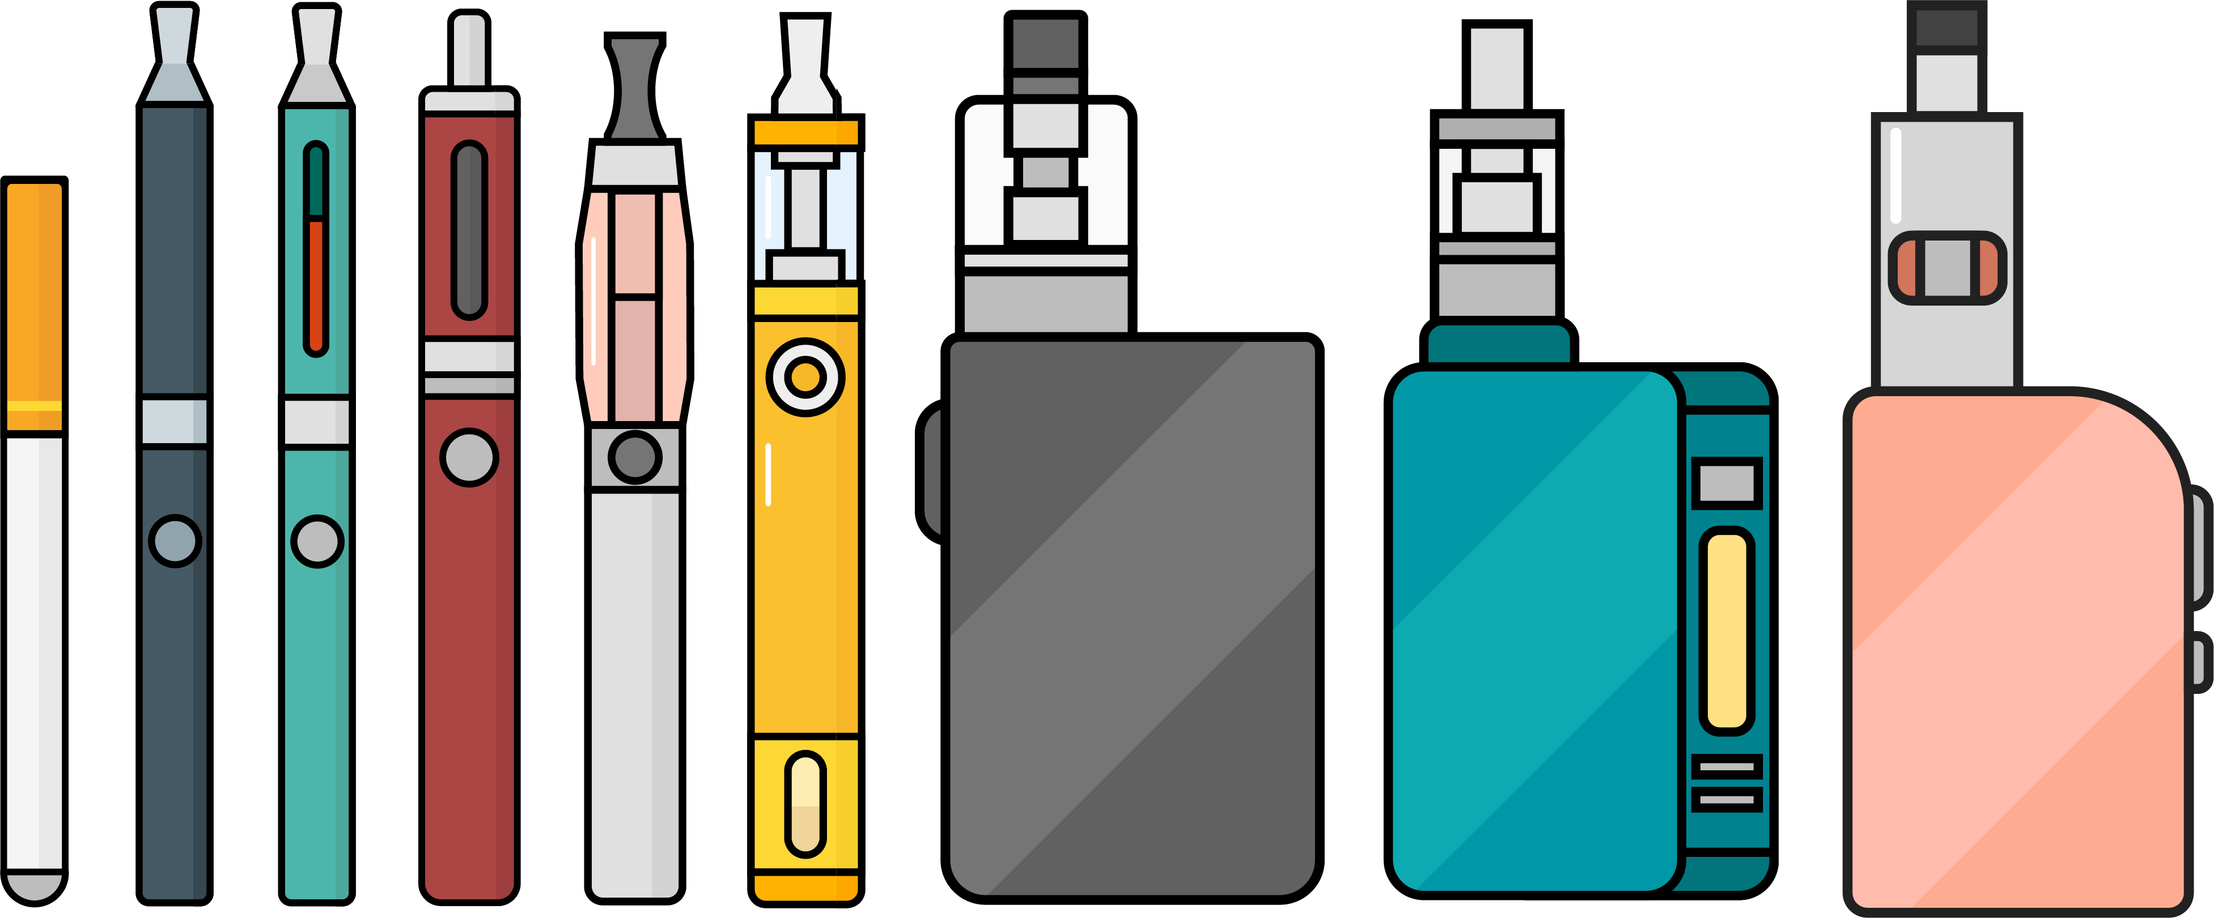

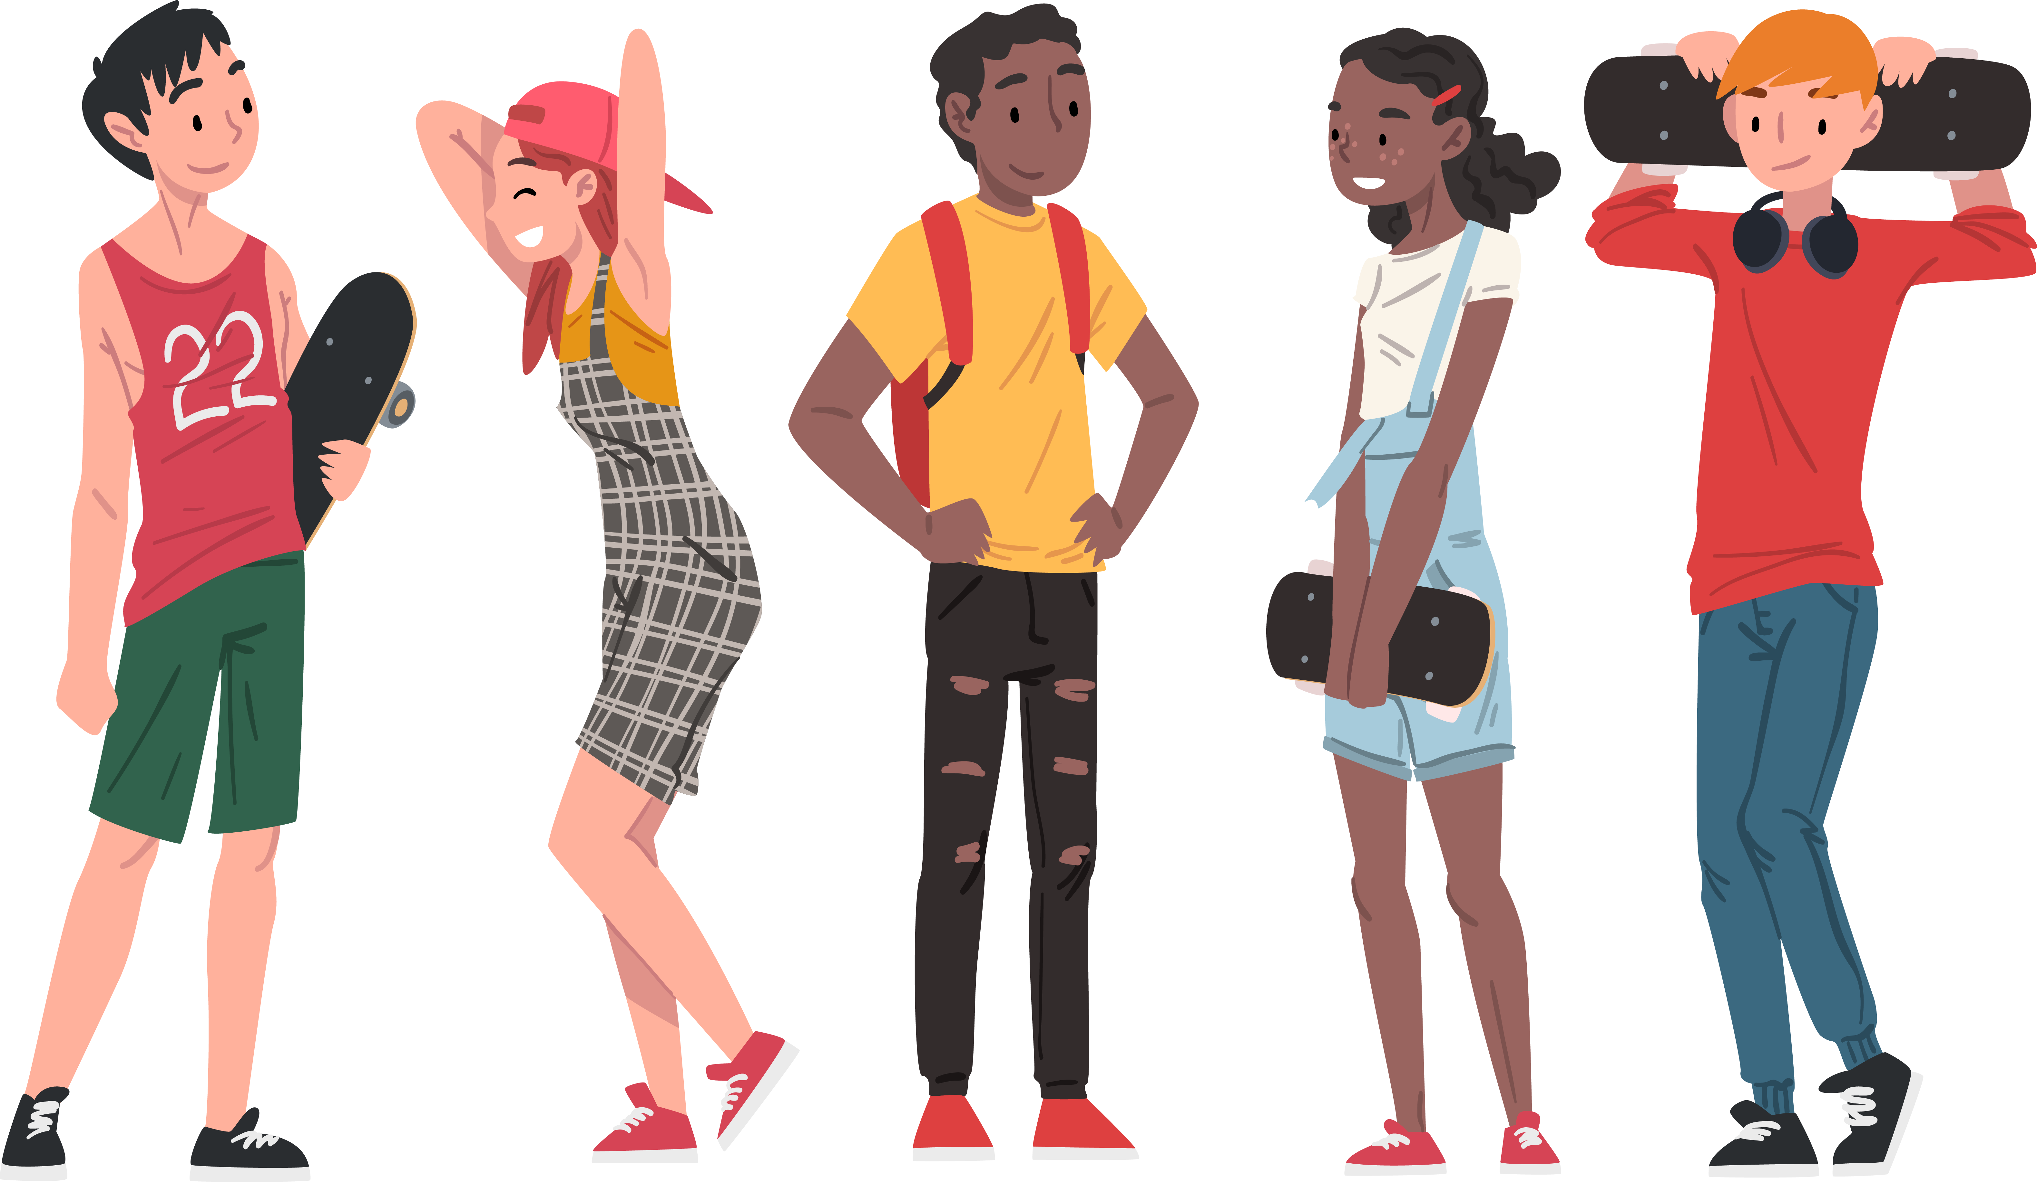
Topics
Vapes – What are they?
Vaping and Your Health
Why do some people use Nicotine Products?
Find Out More
Notes:
Let’s take a look at today’s topics:
We’ll start by defining what vapes are.
Then, we’ll examine their effects on health.
After that, we’ll discuss reasons why some young people choose to use nicotine products.
Lastly, we’ll explore where you can find more support and information.

Slide 4
Vapes – What are they?
Notes:
Let’s start with a basic question: What is an e-cigarette (or vape)?
An e-cigarette is a device that heats a liquid and turns it into an aerosol, which the user breathes in.
This is important to know because it tells us what people are actually inhaling. Even though it’s called “vaping,” users are not breathing in vapour—they’re breathing in aerosol.
As you can see on the slide, e-cigarettes come in a variety of shapes and sizes. You’ve probably heard them called by different names—like vapes (already discussed), vape pens, e-hookahs, tank systems, or mods.
Have you heard of any other names?

Slide 5




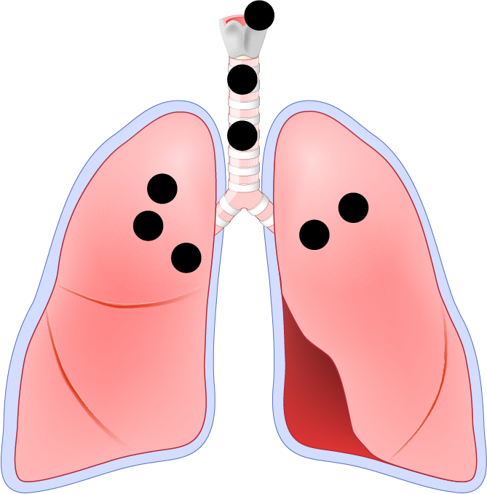

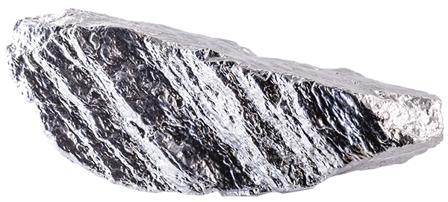
E-cigarettes Make Aerosol, Not Vapour
The e-cigarette aerosol that users breathe from the device and
exhale can contain harmful and potentially harmful substances:
Volatile
organic
compounds
Cancer-causing
chemicals
Flavouring such as Diacetyl, a chemical linked to a
serious lung
disease
Heavy metals
such as
nickel, tin, and lead
Nicotine
Ultrafine
particles
Notes:
We’ve already talked about how users breathe in aerosol when they vape. Let’s take a look at the variety of substances found in aerosol.
Nicotine – which we’ll explore more shortly
Heavy metals – like nickel, tin, and lead.
Toxic chemicals – including formaldehyde.
Does anyone know what formaldehyde is commonly used for?
Formaldehyde is used in science labs to preserve dead animals and in funeral homes to preserve bodies.

Slide 6
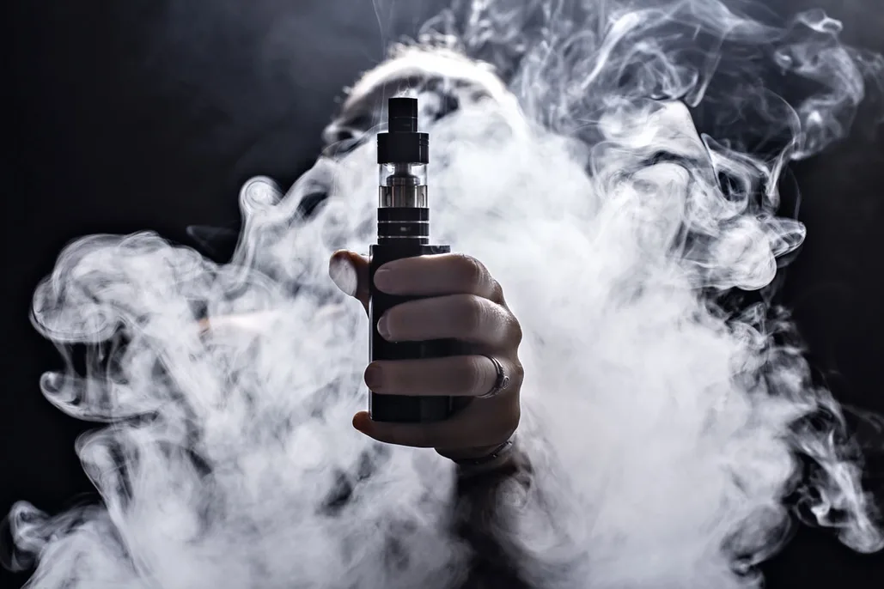

Clearing the Air
Most e-cigarettes contain nicotine.
Notes:
What are your thoughts about this statement?
For some of you, this may be new information.
Most e-cigarettes do contain nicotine.
So how do you know if an e-cigarette has nicotine in it?
Vapes sold in Canada have specific labelling regulations.
There must be a nicotine concentration statement displaying how much nicotine is in the product.
Additionally, every vaping product that contains nicotine must display a health warning.
Source: Health Canada, Vaping Products Labelling and Packaging Regulations

Slide 7

Clearing the Air
Nicotine harms brain development.
Notes:
Any thoughts about this?
Your brain's still under construction!
It keeps growing and changing until you're about 25. That means during your teen years, it's super sensitive and a lot easier to mess with.
Using nicotine (like vaping or using nicotine pouches) can impact how you focus, learn, remember things, and control your impulses. Plus, teens get hooked on nicotine much faster than adults.
Bottom line: your brain’s got a lot going on!

Slide 8

Teen Vaping and Nicotine
Notes:
Click on the slide to play the video.
After playing the video, ask students questions to generate conversation.
Example Questions:
What did you learn?
Did anything jump out at you?
What did you take away from this video?
The video also discussed stress. We’ll talk a bit more about this shortly.
Source: Health Canada : Teen vaping and nicotine (video) - Canada.ca

Slide 9

Second-hand exposure
Notes:
When someone vapes near you, you’re breathing in the chemicals they exhale. This is called second-hand exposure.
Something to think about… Just being near someone who’s vaping can be risky. Even if you don’t vape, being around others who do can still affect you.

Slide 10
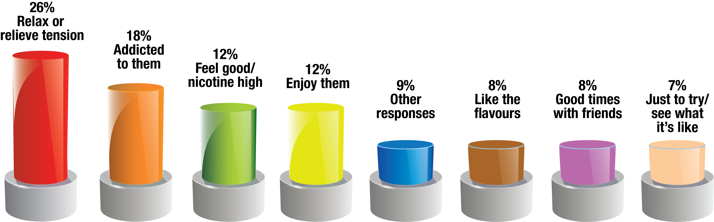
Youth E-Cigarette Survey
Source: Canadian Student Tobacco, Alcohol and Drugs Survey, 2021-22
Notes:
According to this survey, the top reason students in Alberta say they use e-cigarettes is to deal with stress and tension and the second the highest reason is because students feel hooked on them. Others use e-cigarettes to feel good or have a high, because their friends use them, or because they’re curious.

Slide 11

Notes:
Seeing that stress is the number one reason people use vapes, let’s talk about other ways to deal with stress.
Brainstorm ways to deal with stress- use a SmartBoard to record students’ answers or have students work in pairs or small groups.
Examples: exercise, play a sport, read a book, listen to music, call a friend/parent, have a bath/shower, get outdoors, walk the dog, draw/paint, play a musical instrument, deep breathing, baking/cooking, crafts, etc
Having multiple coping strategies can help you feel confident about handling your stress.
References:
1. https://www.thetruth.com/the-facts/fact-vaping-nicotine-and-stress
2.Kutlu MG, Gould TJ. Nicotine modulation of fear memories and anxiety: Implications for learning and anxiety disorders. Biochemical Published Online First: 2015/08/02.
3.Lechner WV, Janssen T, Kahler CW, et al. Bi-directional associations of electronic and combustible cigarette use onset patterns with depressive symptoms in adolescents. Preventive Medicine 2017;96:73-78.

Slide 12
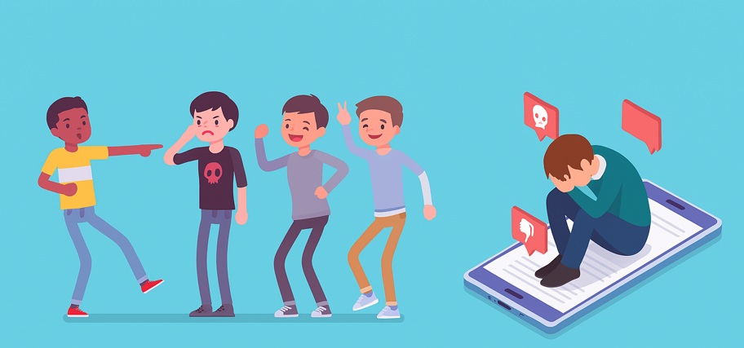
Dealing with Pressure
Notes:
Feeling pressure from friends or people around you can make it tough to know what to say or how to act in the moment.
Understanding where that pressure is coming from and how someone might be trying to influence you, makes it easier to recognize it and respond confidently.
Saying “no” to something you’re not comfortable with, like vaping or nicotine pouches, isn’t always simple. It can feel awkward, or even risky if you’re worried about what others might think.
The more you prepare for social situations, the more confident you’ll be. Practicing your response ahead of time might feel weird—but it works. It helps you stay in control instead of being caught off guard.
Source:
www.notanexperiment.ca/resisting-pressure-to-vape/ent

Slide 13
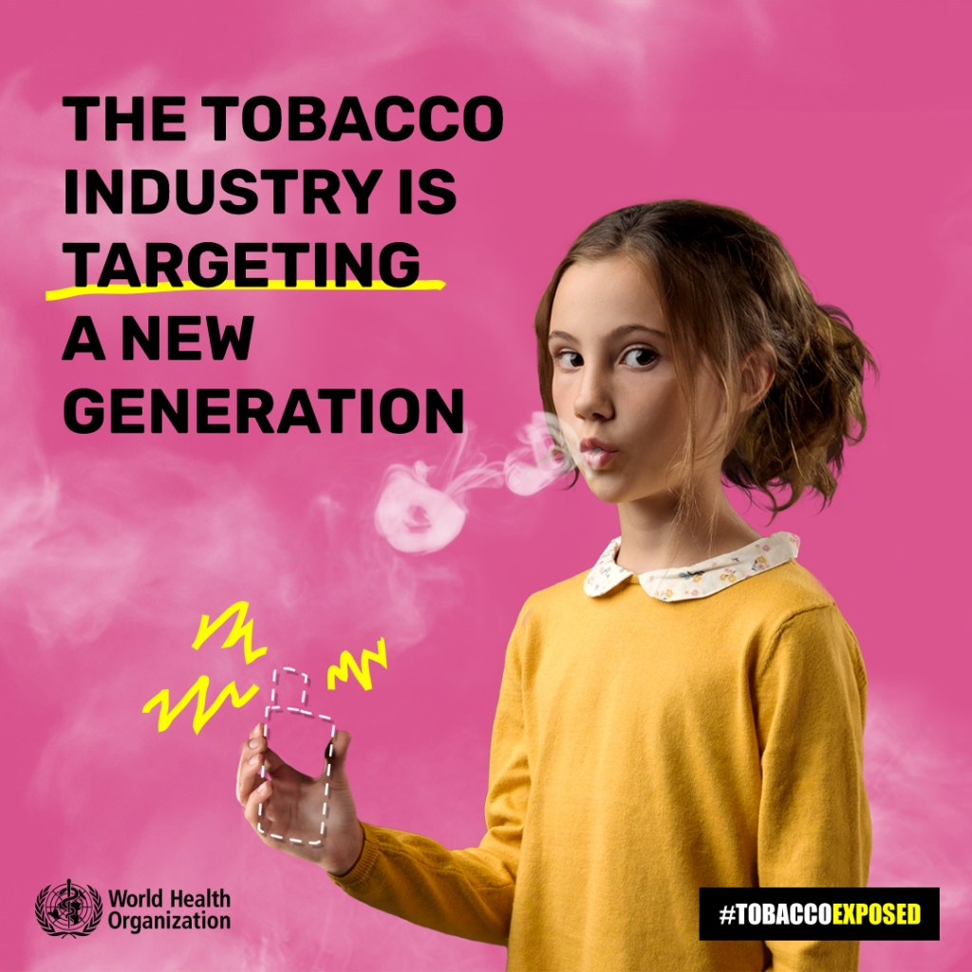

Spotting Marketing Tactics
Big Vape = Big Tobacco
Notes:
The tobacco industry spends millions of dollars trying to get people—especially young people—hooked on their products.
Brainstorm - What marketing tactics do you think these companies use? – (large group or small groups)
Here’s what’s really happening:
Tobacco companies are all over social media. Why? Because that’s where teens are. They want to catch your attention, boost their sales, and stay trendy.
Instead of saying “nicotine” or “tobacco,” they use softer words like “vaping” or “vapour.” Sounds like mist, right? But that “mist” as we’ve already discussed contains harmful chemicals and nicotine.
Their ads are colorful and eye-catching on purpose. They know how to grab your attention and influence how you feel about their products.
A lot of these companies pay influencers to promote products like e-cigarettes or nicotine pouches. They want you to see their content, like it, share it, and maybe even try it.
The truth is: these companies are using smart strategies in hopes of manipulating you.
Source:
https://med.stanford.edu/tobaccopreventiontoolkit/you-and-me-together-vape-free-curriculum/hs-lesson-4-dont-be-played-how-tobacco-marketing-targets-youth.html

Slide 14
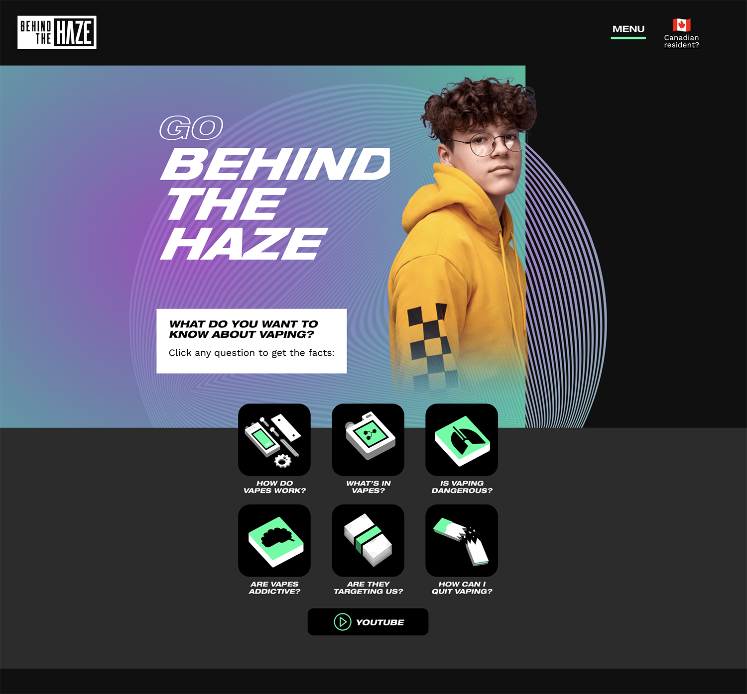
Looking to Learn More
Behind the Haze
Notes:
If you want to learn more about e-cigarettes, you can check out Behind the Haze.
https://behindthehaze.com

Slide 15



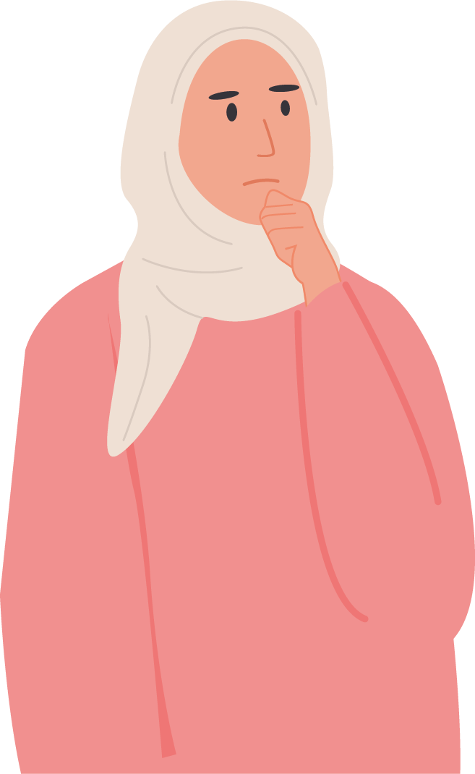
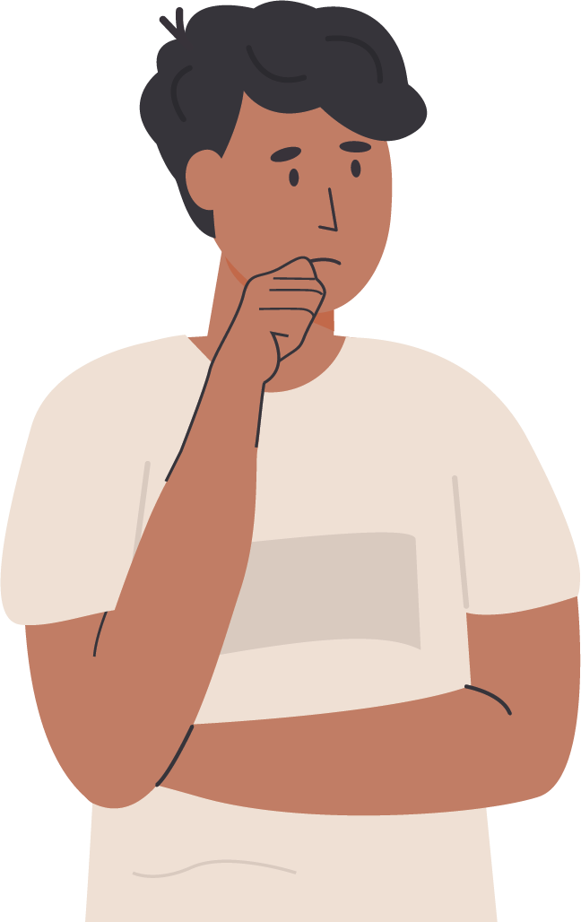
What’s Your Takeaway
?
Notes:
We’ve covered a lot today…. Think about your own takeaway and what you learned today.
If you’d like to talk about it more, please come and see myself, school counsellor, wellness coach, etc. (Customize the individuals available in your school to fit this last statement.)

Slide 16

PrimaryCareAlberta.ca
Notes:
Any final questions or thoughts?

