Slide 1

Before you begin…
Slide Show view
For the best experience for your audience, use slide show view which will play animations. Accompanying script and notes are available to print out in the ‘Presenter’s Guide’.
Wifi
A wifi or internet connection is required to play the videos within this presentation.
Enable Content
The videos in this slide deck link to an external site. To ensure they will work for you while presenting, click Enable Content in the banner you see across the top.

Slide 2

Clearing the Air
What educators need to know about vaping
Notes:
Introductions: Name, Role and Topic

Slide 3
Topics
Introductory information
Why this matters?
Why students vape?
Signs your student may be vaping
What can teachers do?
Notes:
Let’s run through the topics we will be covering today.
Introductory information
Why this matters?
Why young people vape?
Signs your child may be vaping
What can parents do?
This presentation was provided to us by Primary Care Alberta or PCA. If there are questions we can’t answer through today’s discussion, we can take those back to PCA and communicate responses to you via email.

Slide 4

What is vaping?
The use of electronic cigarettes (e-cigarettes) or similar devices that heat a liquid into an aerosol (not just “harmless vapour”) to be inhaled.
Notes:
Vaping is the act of inhaling and exhaling an aerosol, often containing nicotine and other chemicals (not just water vapour), produced by an electronic device like an e-cigarette.

Slide 5
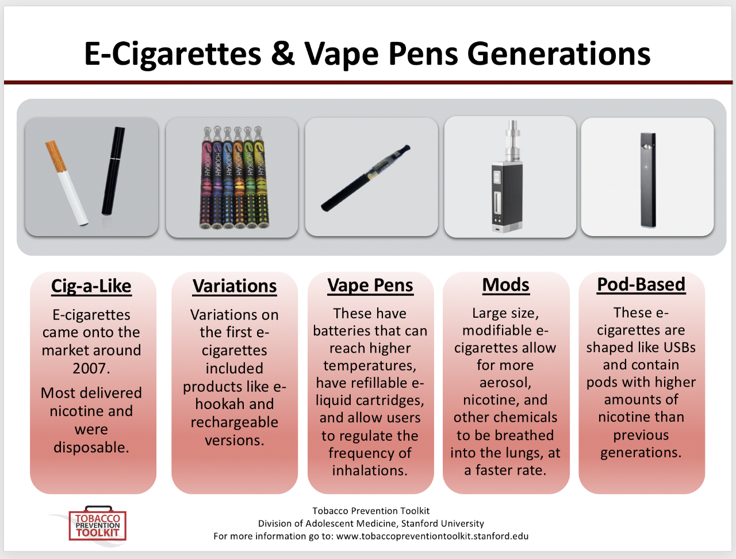
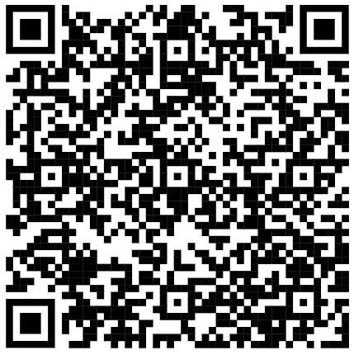
What are
“vapes”?
Notes:
Many of you may already be familiar with e-cigarettes or “vapes” so this is a quick overview.
You can see here how vapes have changed over the years, beginning on the left with those made to look as much like cigarettes as possible. This was followed by modifications and optimizations to produce products over time that maximized the amount of nicotine absorbed by the consumer. Focus was also placed on design and technologies to promote trends and increase use.
Source: https://med.stanford.edu/tobaccopreventiontoolkit/curriculum-decision-maker/by-module/E-Cigs.html

Slide 6

What are
“vapes”?
Notes:
Click on slide to play the video.
Despite the design changes over time, the underlying mechanics of vaping remain the same. This video describes how vapes work.
Source: https://www.youtube.com/watch?v=vbNrlsR-pnI
If you’d like to read more information to understand the devices, how they work, and what they contain, you can use the QR Code to access Health Canada’s page on vaping devices. This link is also listed in your handout.
Source: https://www.canada.ca/en/health-canada/services/smoking-tobacco/vaping.html

Slide 7
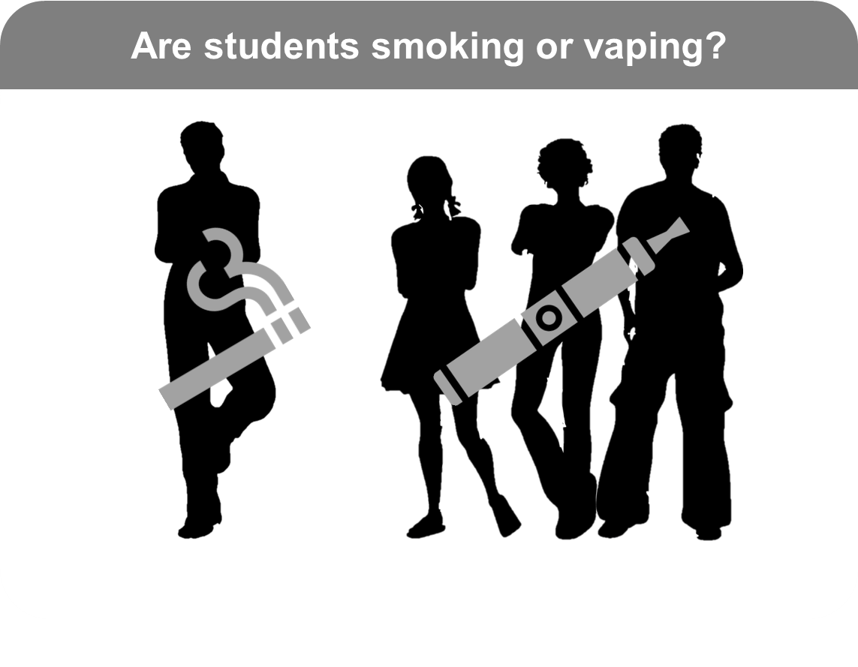
Why this matters?
Grades 7-12
Source: Canadian Student Alcohol and Drugs Survey, 2023-24
Notes:
Presenters: Use the notes below to describe the stats in this image. Make it relatable by discussing what you are seeing/experiencing at your school.
In Alberta, for each student who says they are currently smoking (4.3% of students in Grades 7-12 have smoked a cigarette in the past 30-days), there are over 3 times the number of students who say they are currently vaping (15.6% have vaped in the past 30-days).
Source: https://health-infobase.canada.ca/substance-use/csads/

Slide 8
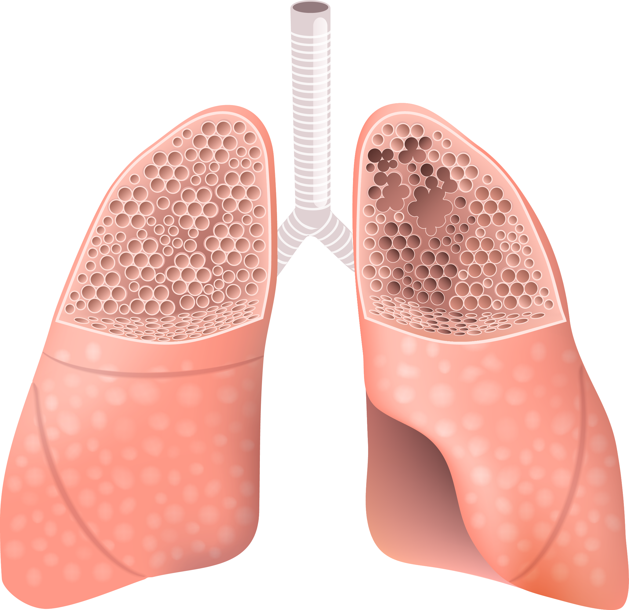
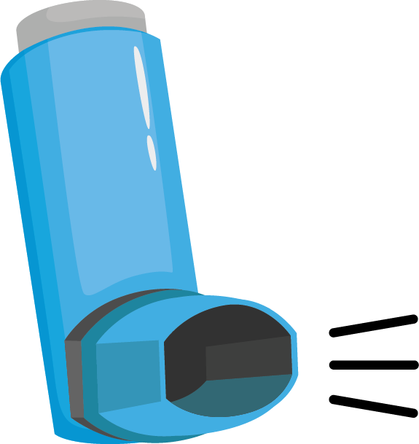

Why this matters?
Vaping is linked to several health issues/risks:
Asthma
E-cigarette vapour inflames the airways producing phlegm
Lung Disease
Emphysema, bacterial infections, pneumonia
Injury
Physical injury from defective batteries catching fire or exploding
Notes:
Known health issues linked to vaping include:
Asthma
Emphysema, lung infections and pneumonia
Defective batteries have caused fires or explosions leading to injury
Source: https://behindthehaze.ca/vaping-risks

Slide 9


Why this matters?
Most vaping products contain nicotine
Nicotine harms the development of the adolescent brain
Early vaping can lead to addiction
Notes:
Most vaping products contain nicotine which is known to have adverse health effects.
For adolescents especially, nicotine harms brain development which continues up to age 25.
Nicotine is highly addictive, and youth are particularly vulnerable to this, sometimes showing signs of addiction before they start regular or daily use.
Source: https://www.cdc.gov/tobacco/e-cigarettes/health-effects.html

Slide 10

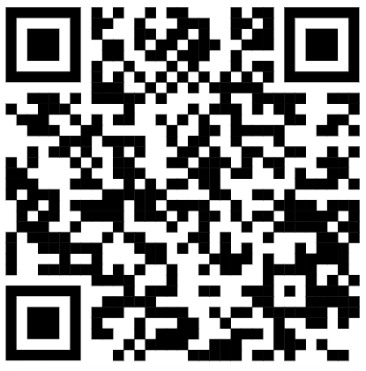
Why this matters
Notes:
Click on the slide to play the video.
This video provides an overview of nicotine and addiction resulting from vaping. The video can also be used in classrooms or assemblies to inform students about nicotine, how it works, and how it ultimately leads to addiction. We will now watch the video together. More information like this, geared towards students is available on BehindtheHaze.ca, a website created to help teens understand vaping. The QR code for BehindtheHaze is on the screen but also listed in your handout.
Source: https://www.youtube.com/watch?v=XDYPaEiDUJ0

Slide 11
Risky behaviour among teens
Lower risk perception
Less intuitive reasoning
More emotion-based reasoning
Limited knowledge
Notes:
While risk-taking is considered normal and developmentally appropriate behavior for youth, we know there is an important difference between healthy and unhealthy risk-taking.
Research shows that adolescents’ decision-making around risks differs from adults in a number of ways:
Lower risk perception: They underestimate risks and may even perceive more potential benefits from their actions. In fact, in a 2023-24 survey of Alberta students, 17% of students report perceiving a low risk of harm from using e-cigarettes with nicotine on a regular basis. 40% of them report perceiving low risk of harm from using e-cigarettes without nicotine regularly.
Less intuitive reasoning: They lack the education and experience to decide based on their intuition, whereas adults can engage in this type of “gist-based” reasoning. This often leads to students make decisions in a different way, as shown in the next point.
More emotion-based reasoning: They don’t just weigh the risks they think about the social consequences of their decisions. This highlights the need for health education that targets social competencies to equip students with resilience and responsible decision-making skills.
Limited knowledge: They may have a limited understanding of the possible consequences of their actions. Facilitating students in gaining reliable and accurate information on vaping is an important piece of prevention and can be done using some of the ready-to-use classroom resources found in the CANVAS package of resources.
Source: https://health-infobase.canada.ca/substance-use/csads/
Source: National Academies of Sciences, Engineering, and Medicine; Health and Medicine Division; Division of Behavioral and Social Sciences and Education; Board on Children, Youth, and Families; Committee on Applying Lessons of Optimal Adolescent Health to Improve Behavioral Outcomes for Youth; Kahn NF, Graham R, editors. Promoting Positive Adolescent Health Behaviors and Outcomes: Thriving in the 21st Century. Washington (DC): National Academies Press (US); 2019 Dec 12. 3, The Current Landscape of Adolescent Risk Behavior. Available from: https://www.ncbi.nlm.nih.gov/books/NBK554988/

Slide 12
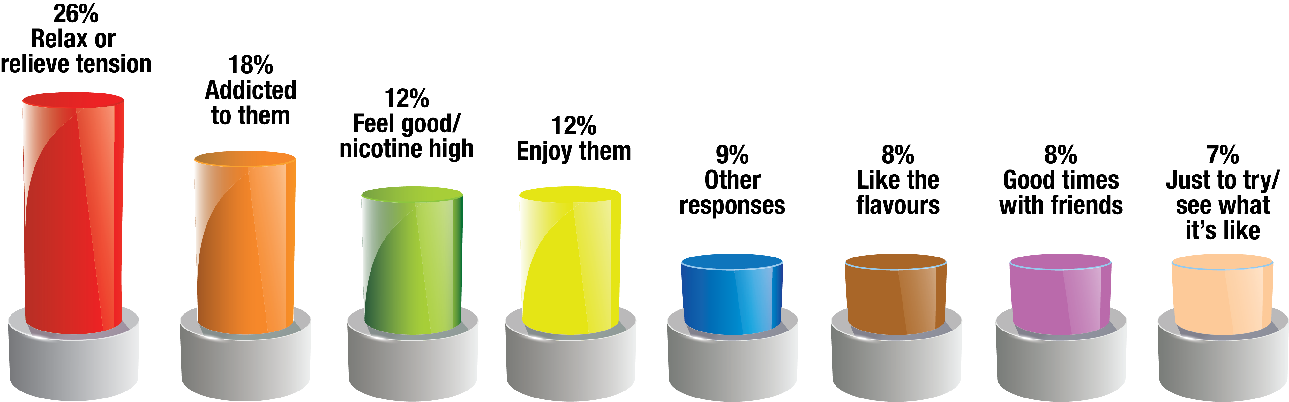
Why students say they vape?
Source: Canadian Student Tobacco, Alcohol and Drugs Survey, 2021-22
Notes:
The top reason that over a quarter of Alberta students reported as the reason they vape, is to relieve tension or stress, and the second highest reason reported, is because they feel hooked on them. Other reasons reported include feeling good or even high when vaping, or generally just enjoying them. 8% of students surveyed even reported it is because they like the flavours.
Within the blue bar in the chart, 9% of students gave a range of other responses including reasons such as peer pressure and using them instead of smoking cigarettes or to quit cigarettes.
Presenters: An optional interactive question on “Were you surprised by these results? What was surprising?” can be asked here to spark discussion.
Source: https://www.canada.ca/en/health-canada/services/canadian-student-tobacco-alcohol-drugs-survey/2021-2022-detailed-tables.html

Slide 13

Signs your student might be vaping
Unusual smells on clothes or breath (fruity, minty)
Excessive thirst
Evidence of trouble sleeping (constantly tired)
Changes in mood (irritable, anxious)
Frequent bathroom breaks
Secretive behaviour (protective of phones/pockets, excuses to leave)
Frequent nosebleeds
Persistent mouth sores

Slide 14





What can teachers do?
Know the
facts
School
policies
Classroom
strategies
Integrate
curriculum
Restorative
practices
Notes:
Know the facts: Get credible information from reliable sources such as those in your handout. Avoid scare tactics or exaggerating the negatives. If there is something you don't know, find the answer together – you do not have to be an expert. The goal is to help students get accurate information from reliable sources.
School policies: Review your school’s vaping policy and be consistent with supporting enforcement. Advocate for prevention programs and activities in your school.
Classroom strategies: Promote belonging and connection in class through open and non-judgmental discussions. Use collaborative classroom agreements on respect and safety to set boundaries and expectations. Teaching stress management and problem-solving skills can build protective factors within each student.
Integrate curriculum: Incorporate prevention into classroom learning opportunities (health, science, advisory). Curriculum resources are available through the CANVAS package of resources. There are options with different preparation time required to fit your schedule.
Restorative practices: Supportive responses have been shown to be more effective than punitive approaches. As much as possible when responding to suspected use, approach students privately, not in front of peers. When communicating with parents, share observations and offer to share some resources for parents if parents are open to it. If time is limited, referring to a school counsellor or admin for supportive follow-up actions may work better. With vaping, there are a number of ways to implement a restorative practice approach.
Sources:
https://www.cdc.gov/tobacco/e-cigarettes/protecting-youth.html
https://www.notanexperiment.ca/parents/
https://www.albertahealthservices.ca/dsa/Page18000.aspx

Slide 15
More on restorative practices
1st Violation
Confiscation
School notifies caregivers
2nd Violation
Confiscation
Meeting with student (re: policy and education program)
3rd Violation
Meeting with student (re: policy)
Confiscation
Meeting with student (re: policy and resources)
Student notifies caregivers during meeting
Student notifies caregivers
Alternative to Suspension Program
Provide general info with resources for cessation
Possible referral to cessation service
Stigma
Support
Notes:
Restorative practices are a set of strategies for building healthy relationships while responding effectively to unacceptable school behaviour. In a nutshell, it’s about incorporating responses that support rather than stigmatize in policy enforcement approaches.
With vaping, this might involve a tiered or progressive approach that starts with one response action and incrementally includes additional actions for future infractions.
For example: [Click for chart to appear]
i) A first infraction may involve confiscation of vaping paraphernalia, notifying caregivers and having a meeting with the student to discuss school policy.
ii) The second may involve confiscation of vaping paraphernalia, having a meeting with the student during which they communicate the violation to their caregiver themselves, and provision of information on vaping and available cessation supports.
iii) The third may involve the above as well as mandatory completion of an ‘alternative to suspension program’. Alternative to suspension programs provide an educational opportunity in lieu of a suspension. They aim to address the root cause (in this case the addiction) and deter future use or violations. Students may also be referred to a community cessation service, if available and appropriate. In Alberta, there is currently no provincial program for alternatives to suspensions for vaping. However, locally, resources found in the Teachers’ Vaping Toolkit within the CANVAS resource package, such as the recommended self-led modules, can be used to create a consistent response plan that serves as an alternative to suspension.
Source: https://www.alberta.ca/restorative-practices
Source: https://legacy.teachers.ab.ca/SiteCollectionDocuments/ATA/Publications/School-Leaders/PD-233a%20Alternatives%20to%20Suspension.pdf
Source: https://www.publichealthlawcenter.org/sites/default/files/resources/Commercial-Tobacco-Free-K-12-School-Model-Policy-2019.pdf

Slide 16
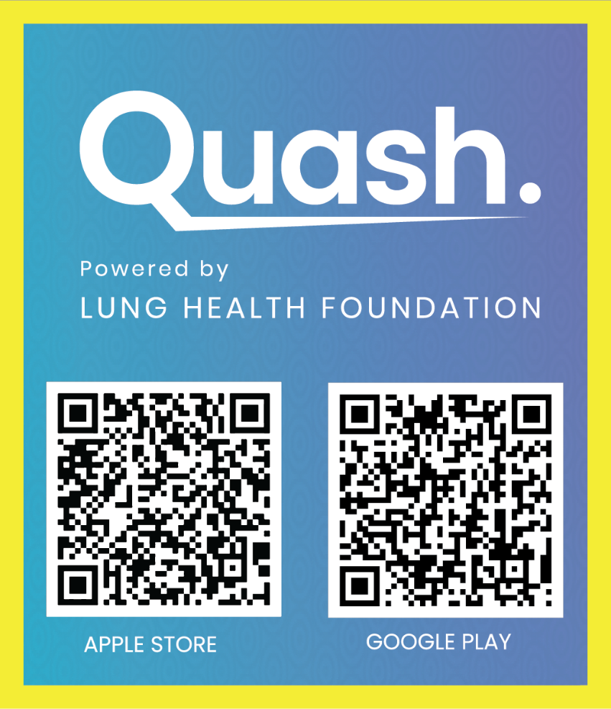


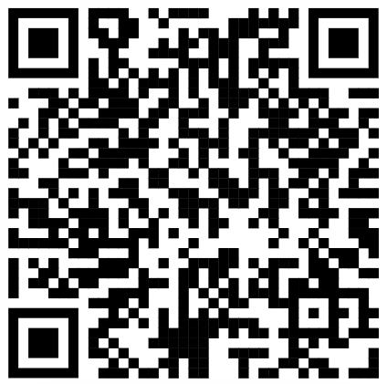
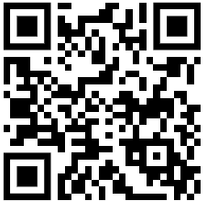
Support if a student is vaping
Conversation tools for parents
Smartphone App
www.notanexperiment.ca
Web-based
Notes:
The Lung Health Foundation have created some resources as a part of the Quash program. It is suitable for any educator who has the opportunity to talk to a young person about quitting vaping. The conversation is said to take under 3 minutes, with the toolkit providing guidance on how to approach the conversation.
The NotAnExperiment website has easy-to-access resources for students to learn the facts and prepare them to stop vaping. This resource is especially useful if they don’t appear to be ready to quit just yet.
The Quash app is a comprehensive tool that helps teens plan their journey to stop vaping. It prepares them in case they get off-track, and helps them celebrate successes on their journey.
All these resources are listed in your handout, or you can use the QR Code on the slide.

Slide 17

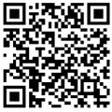
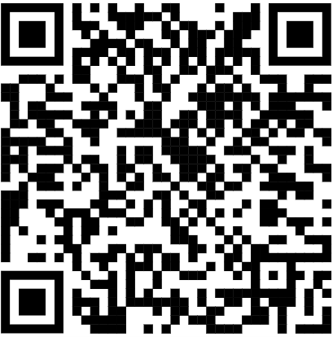
Teachers’ Vaping Toolkits
Healthier Together Schools
Notes:
The links on this slide are specifically for teachers.
The toolkits are grades-based and contain age-appropriate resources to support teachers in classrooms. These resources can also be tailored for use as alternatives to suspension programs in schools.
Healthier Together Schools contains a host of general information for schools taking action on vaping such as grants available, or information on reaching a health promotion facilitator in your area.

Slide 18

Useful links in this presentation are found in the ‘Useful Links (Educators)’ handout.
Notes:
Any final questions or thoughts?

