Slide 1

Food Safety Fails
PUB-0009-201806
CC BY-NC-SA 4.0
Notes:
This presentation holds a Creative Commons License: Attribution-NonCommercial-ShareAlike 4.0 International. Please see the next slide for more information.

Slide 2

©2018 Alberta Health Services, Knowledge Management.
This work is licensed under a Creative Commons Attribution-Non-commercial-Share Alike 4.0 International license. You are free to copy, distribute and adapt the work for non-commercial purposes, as long as you attribute the work to Alberta Health services and abide by the other licence terms. If you alter, transform, or build upon this work, you may distribute the resulting work only under the same, similar, or compatible licence. The licence does not apply to content for which the Alberta Health Services is not the copyright owner. To view a copy of this licence, see https://creativecommons.org/licenses/by-nc-sa/4.0/
This material is intended for general information only and is provided on an “as is”, “where is” basis. Although reasonable efforts were made to confirm the accuracy of the information, Alberta Health Services does not make any representation or warranty, express, implied or statutory, as to the accuracy, reliability, completeness, applicability or fitness for a particular purpose of such information. This material is not a substitute for the advice of a qualified health professional. Alberta Health Services expressly disclaims all liability for the use of these materials, and for any claims, actions, demands or suits arising from such use.
Notes:
Copyright and Disclaimer information

Slide 3
Food Safety Fails
What is the food safety concern(s) in the picture?
Why is it a risk to the public?
How could the concern be fixed?
Notes:
Next are some slides showing food safety violations. All pictures are from food facilities in Alberta.
ACTIVITY:
1. What is the food safety concern(s) in the picture?
2. Why is it a risk to the public?
3. How could the concern be fixed?

Slide 4
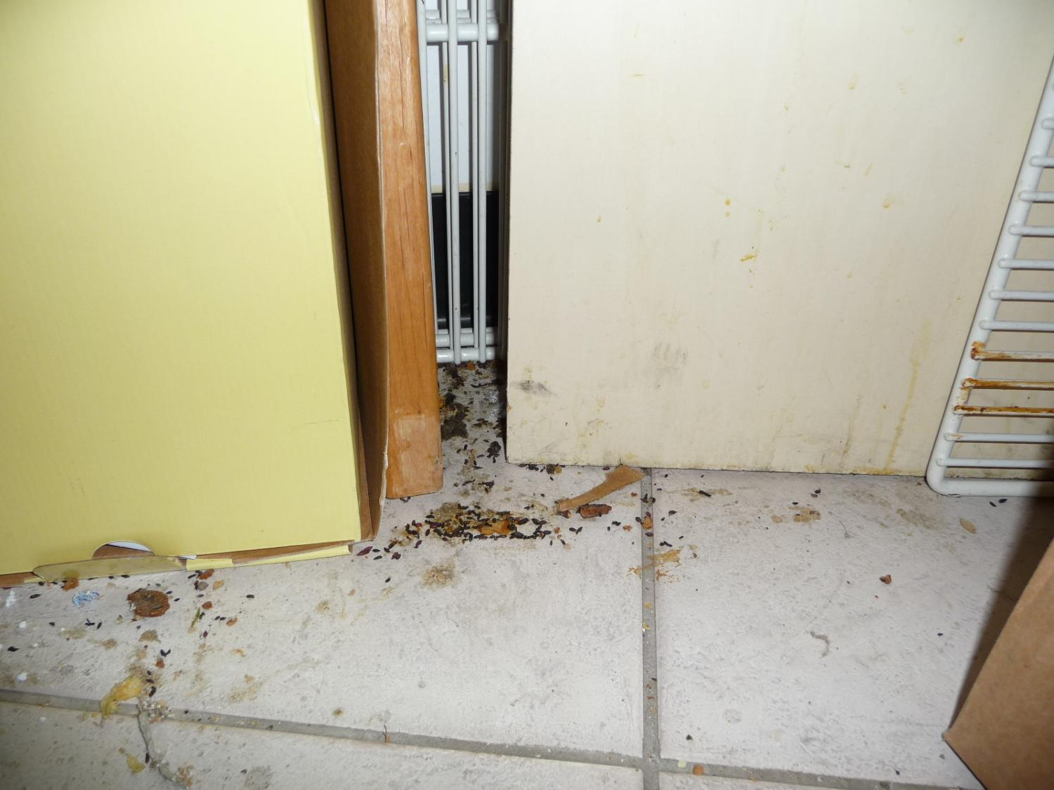
Notes:
ACTIVITY:
What is the food safety concern(s) in the picture?
mouse droppings
2. Why is it a risk to the public?
Mice and their droppings carry pathogens (disease-causing microbes/germs) which can then contaminate the food.
3. How could you fix the concern?
Droppings must be sprayed with a sanitizer solution like a mild bleach solution (100ppm bleach – ½ teaspoon of bleach in 1 liter of water) and wiped up using paper towel and gloves. Area should then be sanitized again
All areas must be cleaned and sanitized.
Any contaminated food must be discarded.
You must hire a pest control operator to deal with an infestation.
In severe cases, the food facility would be closed.
© AHS EPH

Slide 5
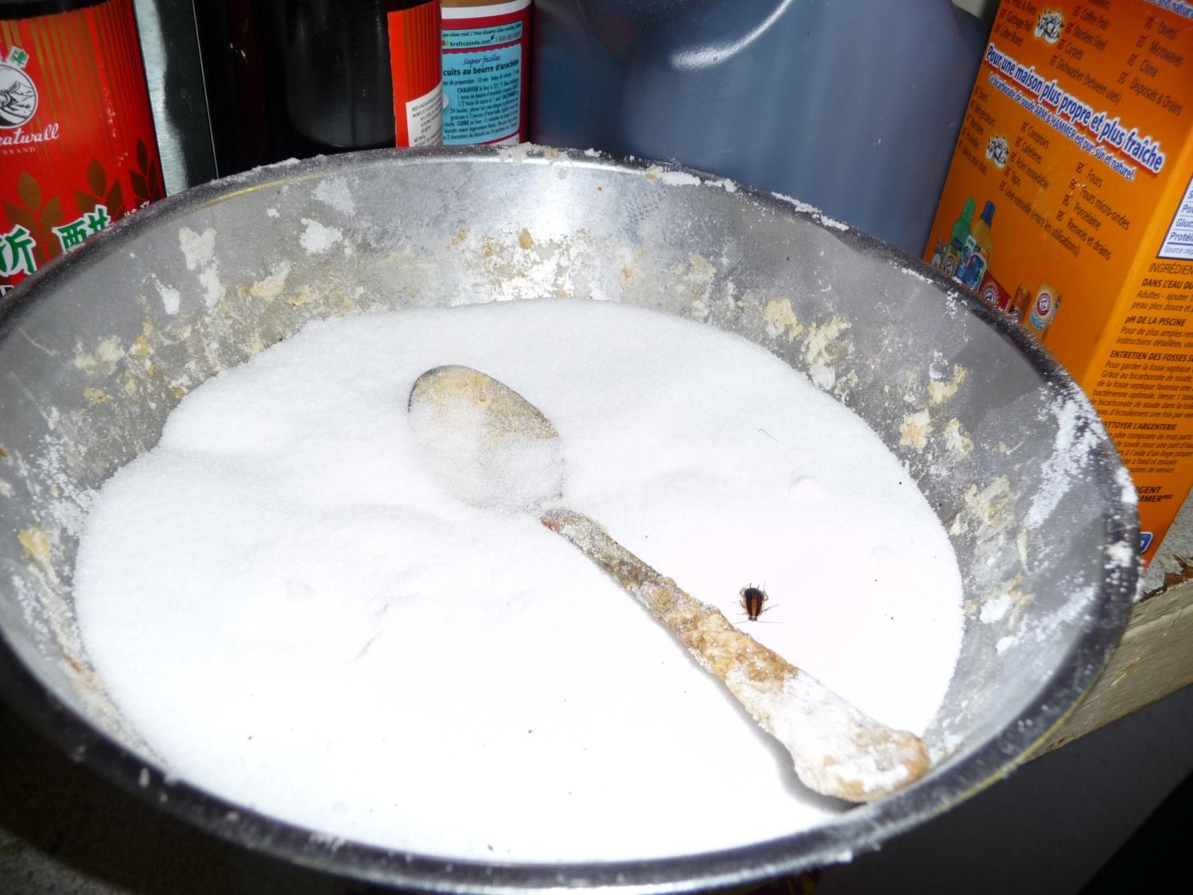
Notes:
What is the food safety concern(s) in the picture?
There is a cockroach in the sugar bowl.
The bowl and spoon are dirty.
2. Why is it a risk to the public?
Cockroaches can carry pathogens such as Salmonella.
Contaminated containers and utensils can contaminate food.
3. How could the concern be fixed?
Sugar must be discarded.
Bowl and spoon must be washed.
A system for washing food containers, equipment and utensils must be established.
Pest control operator must be called immediately to remedy the cockroach infestation (often closure is needed to eliminate the infestation).
All food contact surfaces must be cleaned and sanitized.
Any contaminated food must be discarded.
© AHS EPH

Slide 6
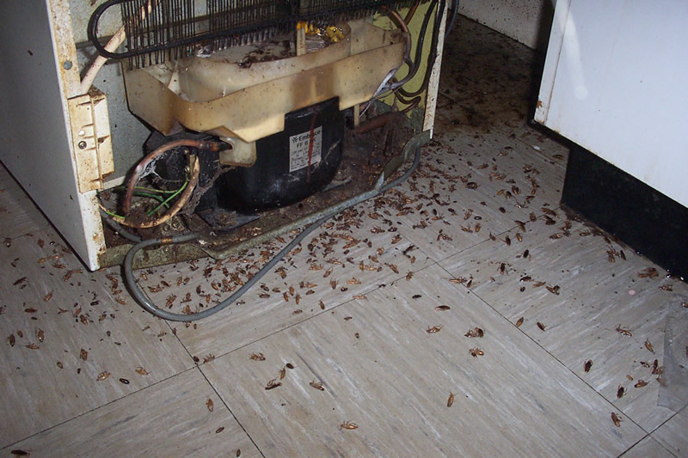
Notes:
Follow up from previous slide: this picture shows a huge infestation of cockroaches.
© AHS EPH

Slide 7
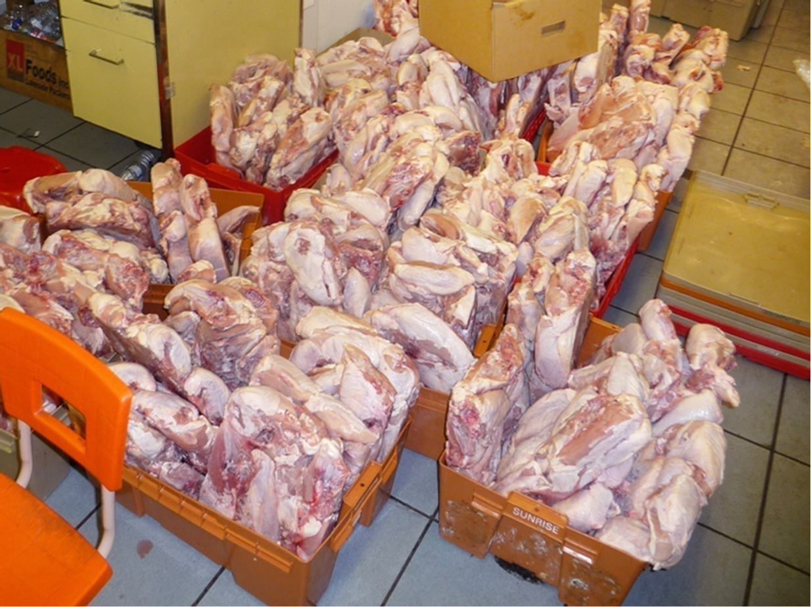
Notes:
What is the food safety concern(s) in the picture?
There are large amounts of perishable foods (chicken) left at room temperature uncovered and exposed to contamination.
2. Why is it a risk to the public?
Bacteria will grow to large numbers.
Chicken is easily contaminated.
3. How could the concern be fixed?
Place chicken in food safety containers and cover.
Move chicken to fridge or freezer.
Discard the food if necessary.
- © AHS EPH

Slide 8
Notes:
Follow-up from previous slide: ~ $100,000 worth of product discarded.
Photo: © AHS EPH

Slide 9
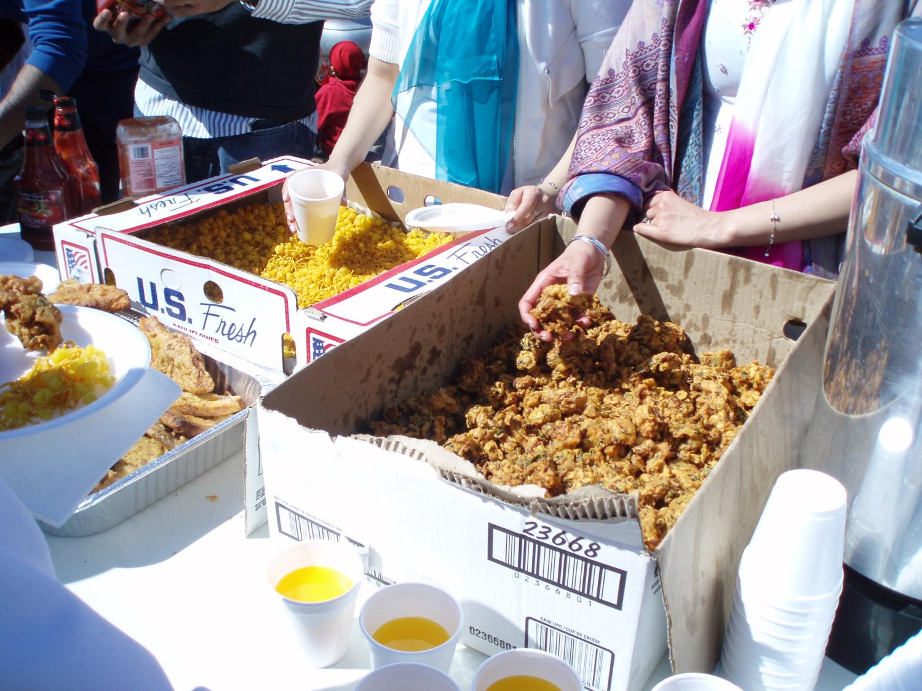
Notes:
Context: this was an outdoor, summer festival with hundreds of attendees.
What is the food safety concern(s) in the picture?
Food is being held in the Danger Zone (4°C – 60°C).
Food is being held in old cardboard boxes.
Food is uncovered.
Food is being served using bare hands and a cup without a handle.
Food handlers are wearing jewelry.
Food handlers are wearing loose clothing.
2. Why is it a risk to the public?
Bacteria will grow quickly in the food.
Food could be contaminated from the old cardboard boxes.
Food could be easily contaminated by flies and people.
Food could easily be contaminated by the food handlers hands.
Food could be easily contaminated by the jewelry.
Food could be easily contaminated by loose clothing.
3. How could the concern be fixed/ what could you change in the future?
Discard the food. In the future, ensure food is kept in food grade equipment/containers with proper heat control. Chafing dishes would be a good option.
Cover the food.
Use gloves and utensils with handles while serving food.
Remove jewelry.
Remove loose clothing (scarves, etc.).
© AHS EPH

Slide 10
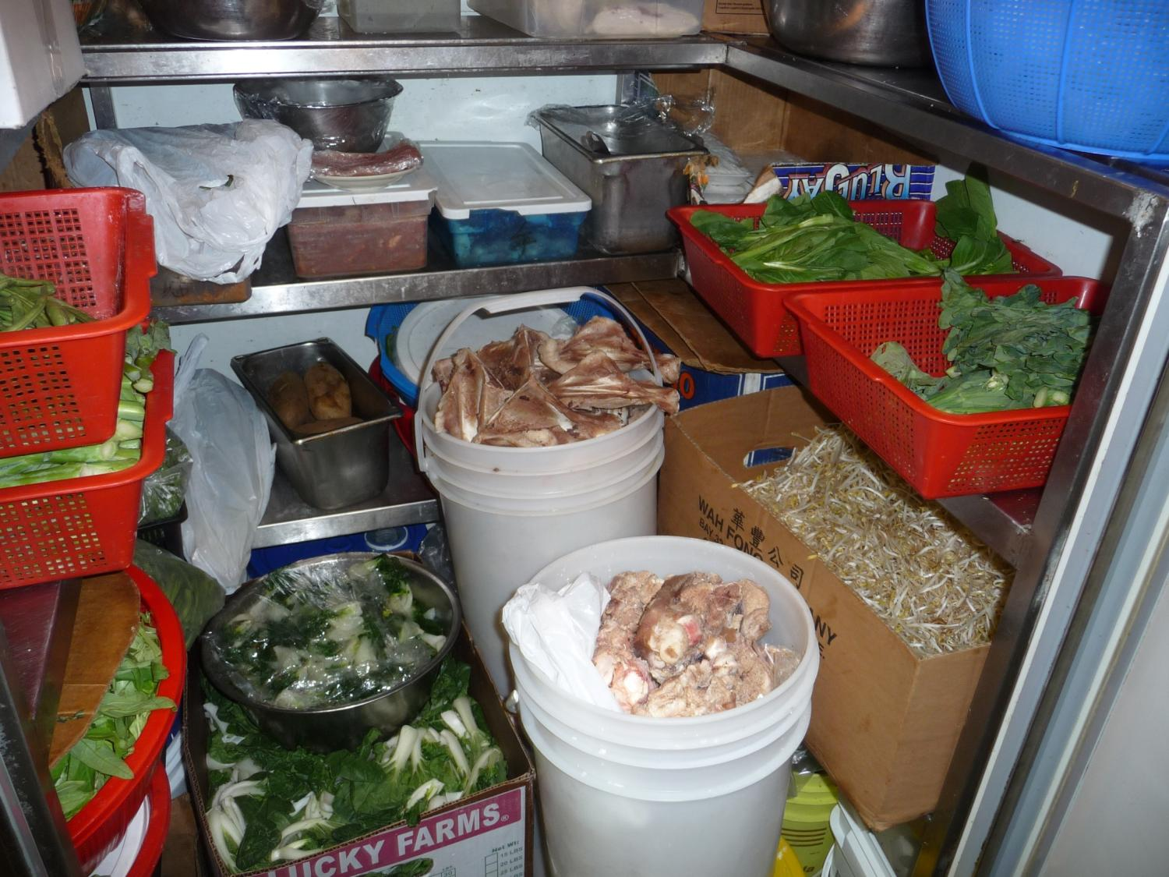
Notes:
10
What is the food safety concern(s) in the picture?
Food is uncovered.
Food is being stacked on top of one another.
Food isn’t labelled.
Food stored in non food-grade containers such as the red plastic containers.
Fridge is too full.
2. Why is it a risk to the public?
Food may be contaminated.
Food may be too warm because the fridge is too full and doesn’t allow proper air circulation.
3. How could the concern be fixed/ what could you change in the future?
Discard any contaminated food.
Replace non food grade containers.
Label containers.
Cover foods.
Move some food to other fridge or freezer or change food delivery schedule, amounts ordered, etc.
© AHS EPH

