Slide 1
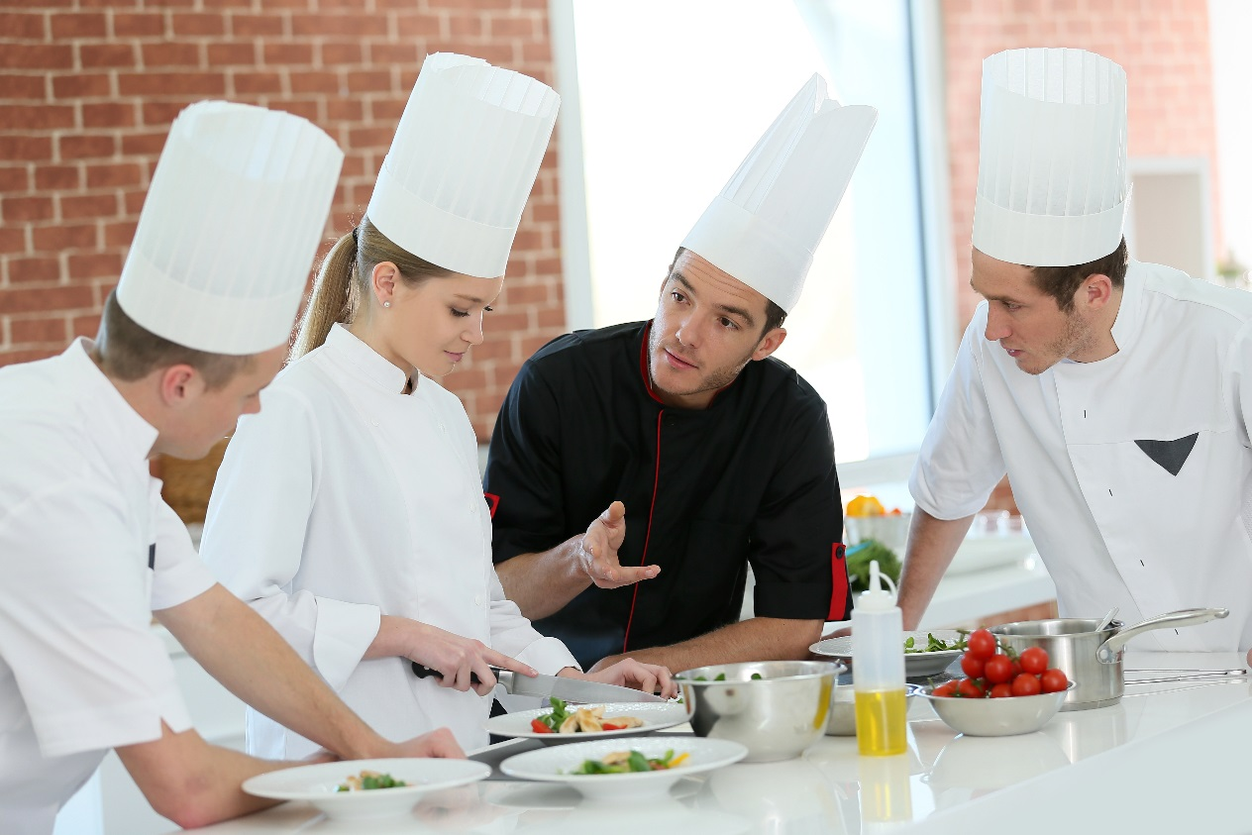
Food Safety Facts: Risk Game
PUB-0010-201709
CC BY-NC-SA 4.0
Notes:
This Risk game is designed as a review of the information found in the main Alberta Food Safety Facts presentation.
How to Play!
Go to the slide with the Risk Board (Slide 3)
Start slide show from current slide
Click on a square with a number (this is the number of points the team will get for answering the question). This will open the question
Read the question
Choose team to answer
Go back to the Risk Board by using the forward arrow on the slide
The team that gets the most points wins
This presentation holds a Creative Commons License: Attribution-NonCommercial-ShareAlike 4.0 International. Please view the link (CC BY-NC-SA 4.0) in the slide for more information.

Slide 2
How to Play
Form teams of 4-5.
You must wait to be called on to answer a question.
You can get input from others on your team.
Keep track of your team’s points.
Notes:
How to Play!
Go to the slide with the Risk Board (Slide 3).
Start slide show from current slide.
Click on a square with a number (this is the number of points the team will get for answering the question). This will open the question.
Read the question.
Choose team to answer.
Go back to the Risk Board by using the forward arrow on the slide.
The team that gets the most points wins.

Slide 3
Put it away
Here comes the FBI
Didn’t do it
Sam and Ella
X games
100
100
100
100
100
200
200
200
200
200
300
300
300
300
300
400
400
400
400
400
Notes:
How to Play!
Start slide show from current slide.
Click on a square with a number (this is the number of points the team will get for answering the question). This will open the question.
Read the question.
Choose team to answer. Answer are in the notes sections of each slide.
Go back to the Risk Board by using the forward arrow on the slide.
The team that gets the most points wins.

Slide 4
Put it Away 100
  What temperature should a fridge be?
Notes:
Answer: 4°C or colder

Slide 5
Put it Away 200
How long can potentially hazardous food be left in the Danger Zone?
Notes:
Answer: no more than 2 hours

Slide 6
Put it Away 300
What is the cooking temperature for most foods?
Notes:
Answer: 74°C for at least 15 seconds

Slide 7
Put it Away 400
If inspecting your walk-in cooler, what are three things you would check?
Notes:
Answer:
temperature
cross contamination issues
foods covered
foods off the floor
first in/first out stock rotation
best-before/expiry dates
cleanliness

Slide 8
Here Comes the FBI 100
Name three potentially hazardous foods?
Notes:
Answer:
meat
eggs
poultry
dairy
fish
shellfish
cream-filled pastries
gravies
stews
soup
cooked vegetables and grains

Slide 9
Here Comes the FBI 200
Where does Staphylococcus aureus come from?
Notes:
Answer: people – coughs and sneezes and cuts and boils

Slide 10
Here Comes the FBI 300
What are three sources of pathogens?
Notes:
Answer:
people (fecal-oral route)
raw food (raw meat, fresh produce)
pests
environment such as kitchen, garbage, etc.

Slide 11
Here Comes the FBI 400
What are three common symptoms of foodborne illness?
Notes:
Answer:
stomach cramps
diarrhea
vomiting
nausea
fever
headache
body ache

Slide 12
Didn’t do it 100
How can you be sure that a food is safely cooked?
Notes:
Answer: use a thermometer and make sure the thickest part of the food has reached 74°C.

Slide 13
Didn’t do it 200
What minimum temperature should the food in a hot buffet/steam table be?
Notes:
Answer: 60°C or hotter

Slide 14
Didn’t do it 300
What are the danger zone temperatures?
Notes:
Answer: 4°C to 60°C

Slide 15
Didn’t do it 400
What are 4 ways to cool food more quickly?
Notes:
Answer:
fridge
ice-water bath
ice paddle/ ice wand
keep uncovered
stir
break into smaller volumes
use shallow metal pans

Slide 16
Sam and Ella 100
What bacteria is commonly associated with poultry?
Notes:
Answer: Salmonella (or Campylobacter)

Slide 17
Sam and Ella 300
What is the dirtiest thing in most people’s homes?
Notes:
Answer: the kitchen sponge

Slide 18
Sam and Ella 400
What is the best way to stop the spread of foodborne illness?
Notes:
Answer: wash your hands

Slide 19
X Games 100
What is cross contamination?
Notes:
Answer: the transfer of pathogens to food.

Slide 20
X Games 200
How should raw chicken be placed in your fridge?
Notes:
Answer: covered and on the bottom shelf away from other food.

Slide 21
X Games 300
When washing dishes by hand, what are the steps?
Notes:
Answer:
pre-scrape and pre-soak
wash with warm soapy water
rinse with clean water
sanitize with chemicals or heat
air dry

Slide 22
X Games 400
What is an example of a chemical sanitizer and how to do make it up properly?
Notes:
Answer: ½ teaspoon of bleach in one liter of water.

Slide 23
Sam and Ella 200
What is a pathogen?
Notes:
Answer: a disease causing microbe.

